Slide 1
Collection in Action

Slide 2
Agenda
Collection Introduction
Collection Hierarchy
List
Set
Map
Sorting in Collection
Generics
Auto-Boxing

Slide 3
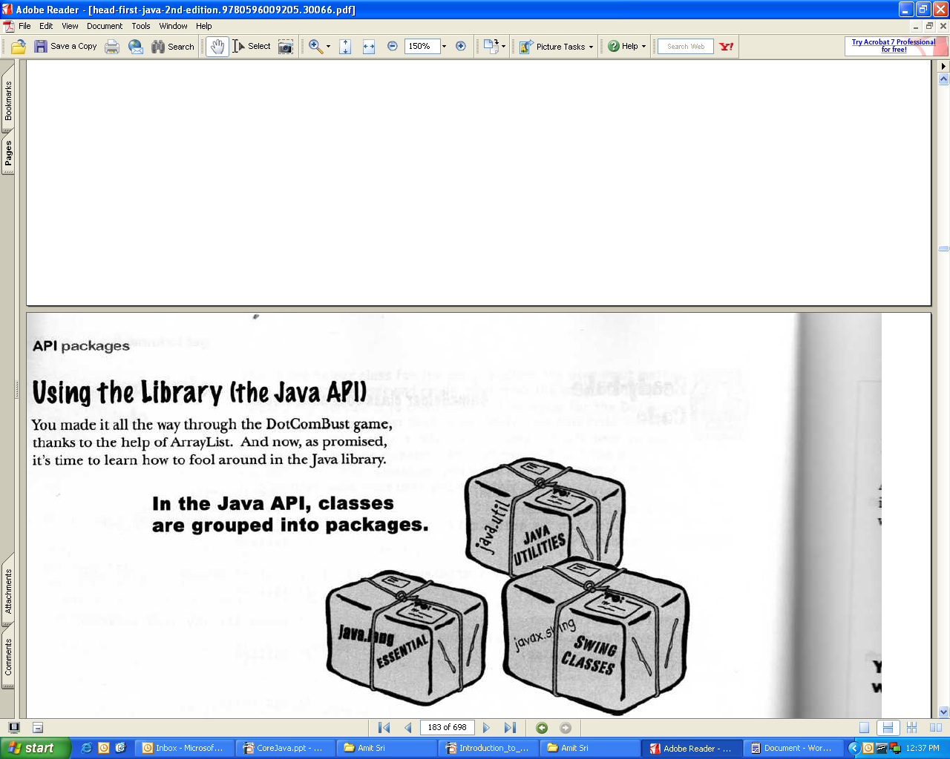

I want to make the playlist of songs and, also want check no duplicate song in the playlist and then sort the list.
For this i want to write lot of code, if i am a “C or C++” programmer.
Thank God! I am using java and java provides us java.util package, which provides inbuilt data-structure like ArrayList, LinkedList, TreeSet, HashMap, Collections etc.
So programmer not worried to write long and boring codes for data-structure.

Slide 4
Java Collection Framework
So What Do You Do with a Collection?
  There are a few basic operations you'll normally use with the collections.
  Add Objects to the collection.
  Remove Object from the collection.
  Find out if an object in the collection.
  Reterive an object from the collection.
  Iterate through the collection.
Note: Collection is a collection of objects.
The Collection framework in java, which took shape with the release of JDK1.2 and was expanded in JDK1.4.

Slide 5
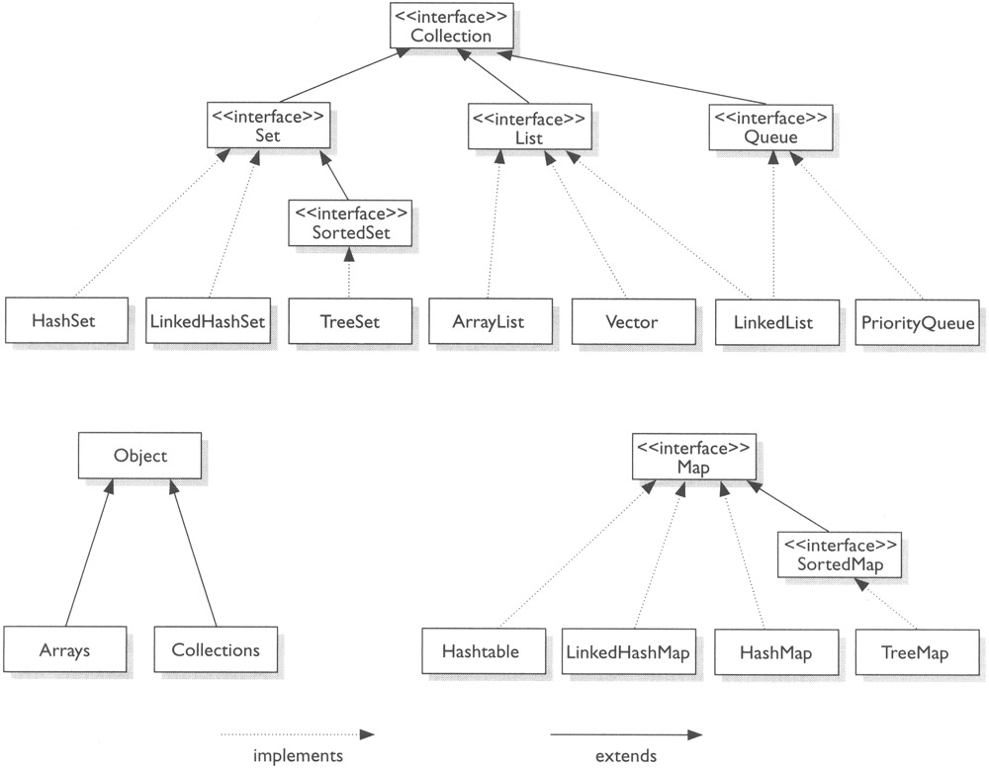

Slide 6
Collections comes in four flavours
1) List- List of Things, It cares about index.
2) Set – Unique Things
3) Map- Things with a Unique Id.
4) Queue- Things arranged by the order in which they are to be processed. (Java 5 / JDK 1.5 onwards)

Slide 7
List
List Interface – It cares about the index.
1. ArrayList
2. Vector
3. LinkedList

Slide 8
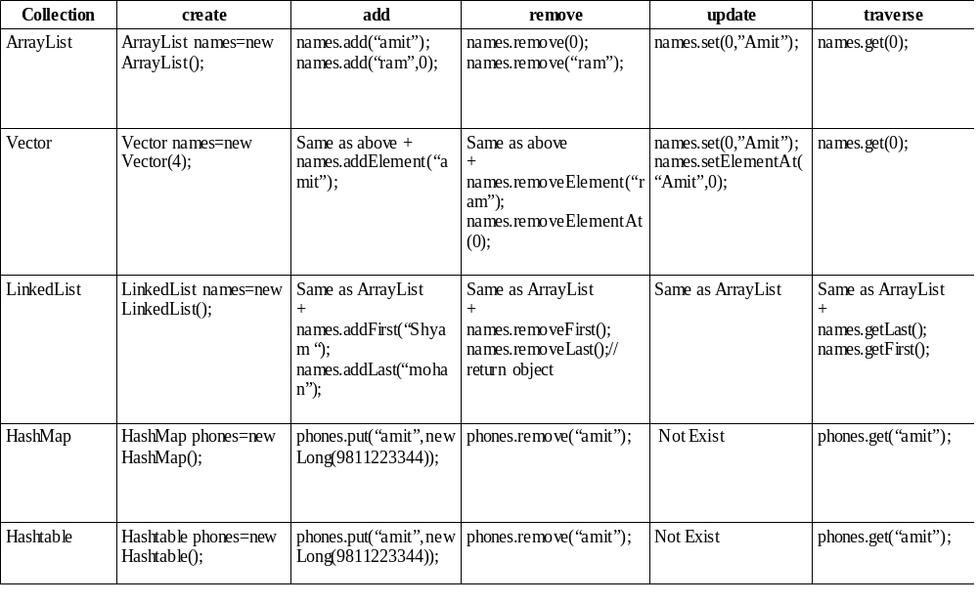
KICK START

Slide 9
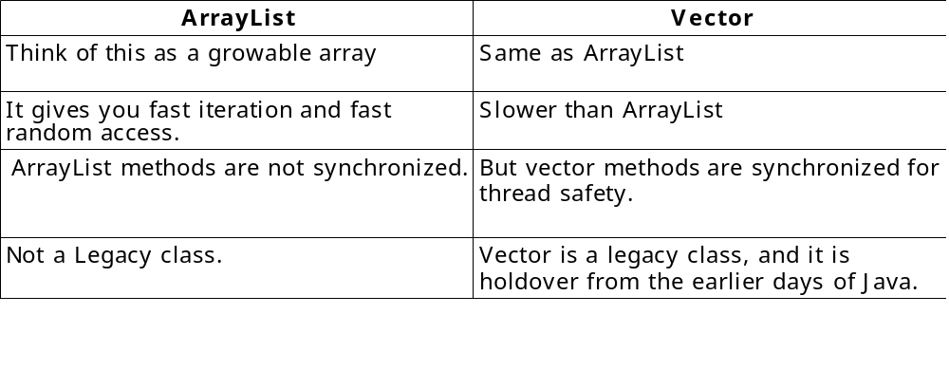
List
Birthday party
Today is my birthday and i want to invite my friends for the party.
now i have to prepare a list of my friends.
So i just use an array of string and put it all the names in array. Now i want to add a new friend name so i have to make a logic to add a new name in array , and i have to check my array has empty space, because we know array is of fixed size.
Now i want to search a particular friend in that array, so i also have to make a logic for search.
For this purpose we have ArrayList and Vector. It provides predefine functions to perform CRUD (Create,Read,Update,Delete) operartions.

Slide 10
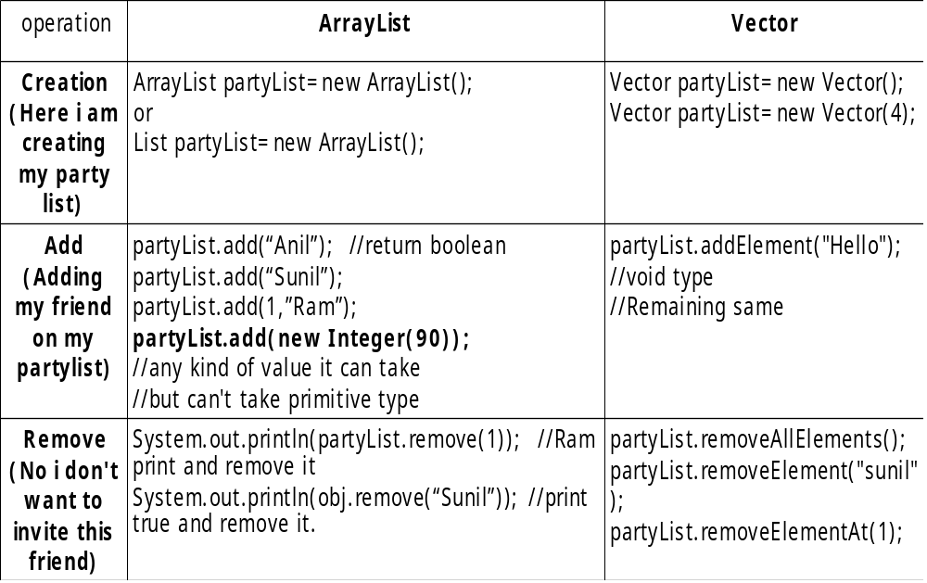
List
ArrayList and Vector Operations

Slide 11
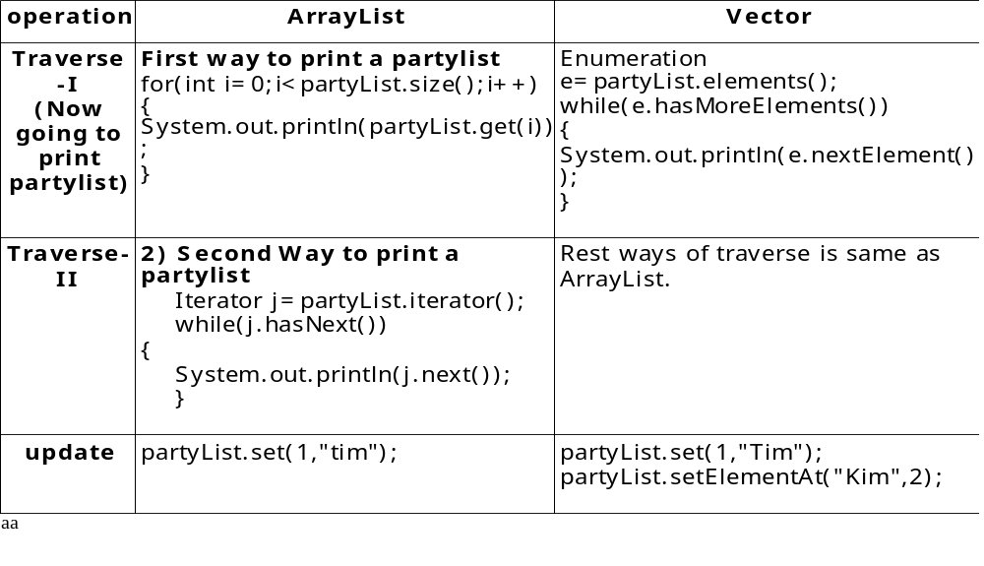
List
ArrayList and Vector Operations continued....

Slide 12
List
ArrayList on job
Suppose I want to store 10 records of my customer in the ArrayList.
Create a Java Bean Name Customer , following are the properties.
  Customerid
  name
  address
  city
  zip
  email
  phone
  mobile
  gender
After adding 10 records, print the records.

Slide 13
List
LinkedList
Same like an ArrayList except that the elements are doubly
linked to one another.
Keep in mind , your LinkedList is slower than ArrayList when you
traverse it. But it is good choice when you required fast insertion and
deletion.
Example:
LinkedList l=new LinkedList();
l.add("Amit");
l.addFirst("Amit Srivastava");
l.addLast("Ram");
System.out.println("Linked List Elements are "+l);
System.out.println("Return Object "+l.remove(2));
System.out.println("Return Boolean "+l.remove("Amit"));
System.out.println("Return First Object "+l.removeFirst());
System.out.println("Return Last Object "+l.removeLast());

Slide 14
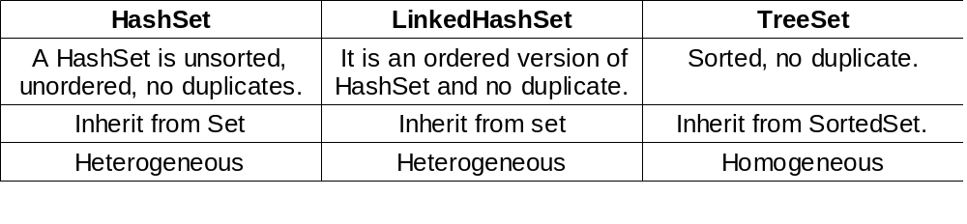
Set
No Duplicate Customer Records Allowed.
Suppose i want to make a list of my customers , but i don't want a duplicate
record of my customer.
What i need to do ?
Answer is Set
Set- It cares about uniqueness. The equals() method determines whether
two objects are identical
There are three sets.

Slide 15
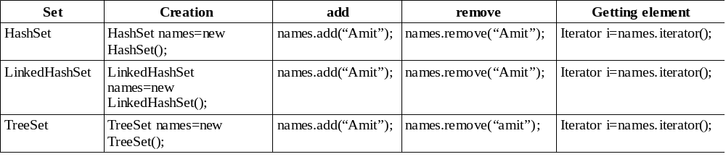
Set
Set Operations

Slide 16
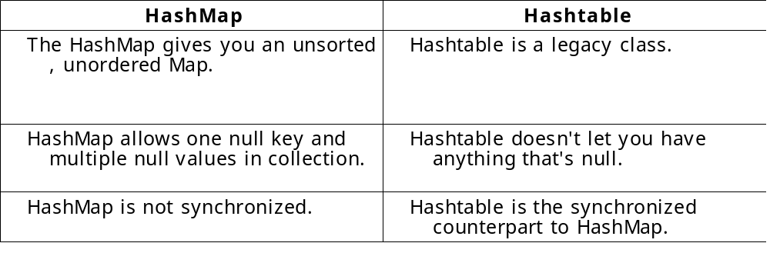
Map
Who's phone number is this ?
Suppose i want to store 100 phone numbers so i use “ArrayList or Vector” for this.
Now i want to reterive the phone number of Amit , so for the “ArrayList or Vector” i have to remember the index number of Amit phone number.
So instead of remembering the index number of each phone number we can give a unique key to each index , and that unique key is name of a phone person.
A Map cares about unique identifiers. You may a Unique key(the ID) to a specific value, where both the key and the value are, of course objects.
So to use key(Name of a person) and value (phone number) we use “HashMap or Hashtable”.

Slide 17
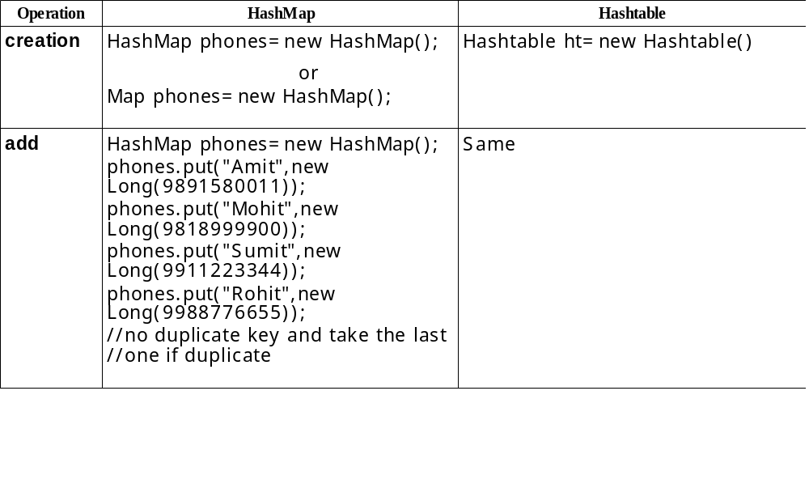
Map
Map Operations

Slide 18
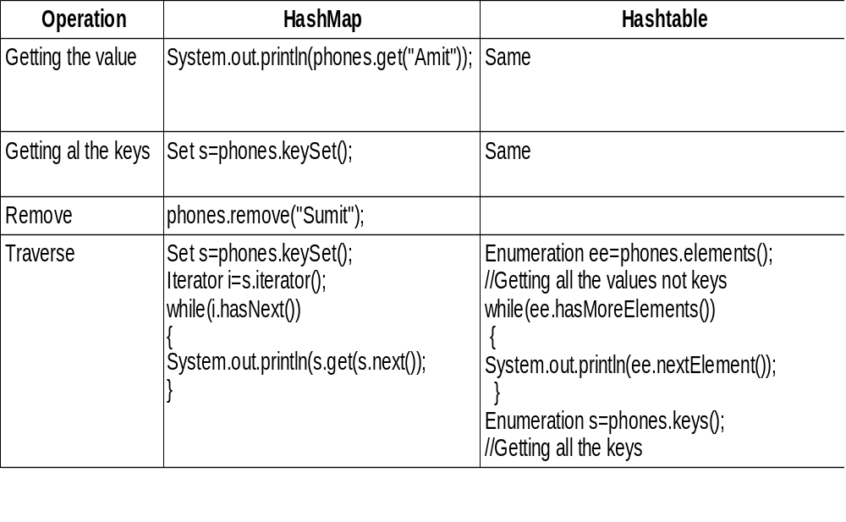
Map

Slide 19
Map
Hashtable example
Hashtable ht=new Hashtable();
ht.put("A","AAA");
ht.put("B","BBB");
Enumeration values=ht.elements();
Enumeration keys=ht.keys();
System.out.println("Printing Values ");
while(values.hasMoreElements())
{
System.out.println(values.nextElement());
}
System.out.println("Printing Keys ");
while(keys.hasMoreElements())
{
System.out.println(keys.nextElement());
}
System.out.println("Printing Keys , Values ");
keys=ht.keys();
while(keys.hasMoreElements())
{
String temp=(String)keys.nextElement();
System.out.println("Key is "+temp +" Value is "+ht.get(temp));
}

Slide 20
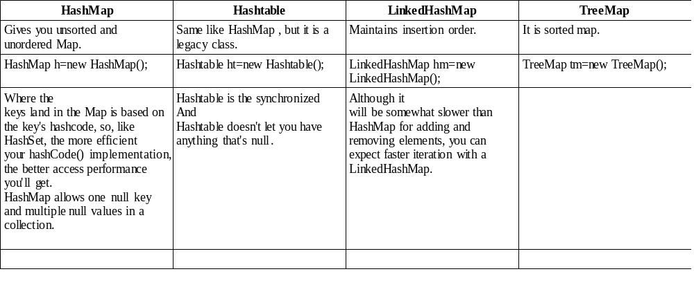
Map
A Map cares about unique identifiers. You map a unique key (the ID)
to a specific value, where both the key and the value are, of course,
objects.

Slide 21
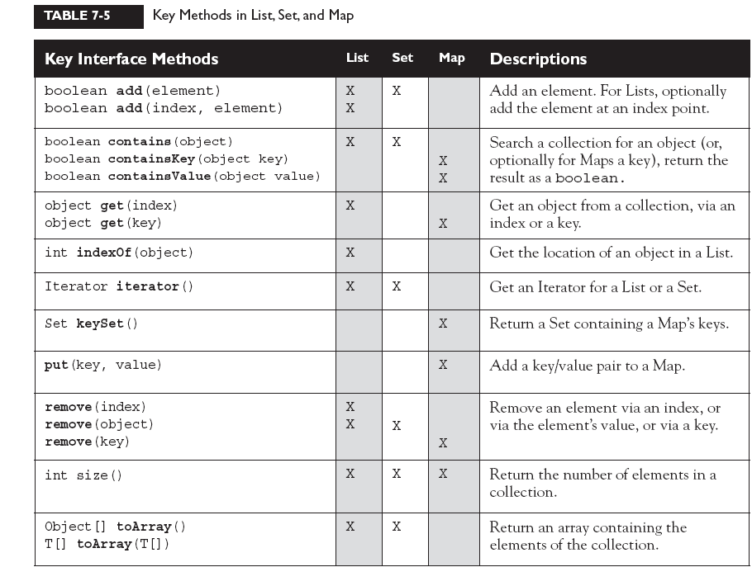

Slide 22
Map
HashMap on job
Exercise:
WAP to create four beans
  CustomerDetail Bean
  CustAddress Bean
  Order bean
  ProductDetail bean.
Put “Customer bean” objects and “CustAddress” bean objects in two different HashMaps
and
put “Order Bean” and “ProductDetail bean” objects in another two different HashMaps ,
and then put four hashmap objects into one hashmap and give keys customer ,product,order and address.
Take input from the user if user ask for the customer so print CustomerDetail bean data by using last hashmap u made.
If user ask for Product, so print ProductDetail bean data.

Slide 23
QUESTION ???
I have a list of names in ArrayList, now i want to sort the names list
ascending order.
Answer is :)
ArrayList names=new ArrayList();
names.add(“Ram”);
names.add(“Amit”);
names.add(“Anil”);
names.add(“Sunil”);
Collections.sort(names);
System.out.println(“After Sorting the list elements are “+names);

Slide 24
SORTING
QUESTION ? ? ?
Now fine after sorting a list of names, i have a list of customers object , and i
want to sort list of customers by customer names?
Answer is :)
For Sorting user-defined objects , Collections.sort() fails, it cannot sort
user-defined objects, so sorting user-defined objects , we required
Comparable
or
Comparator interface.

Slide 25
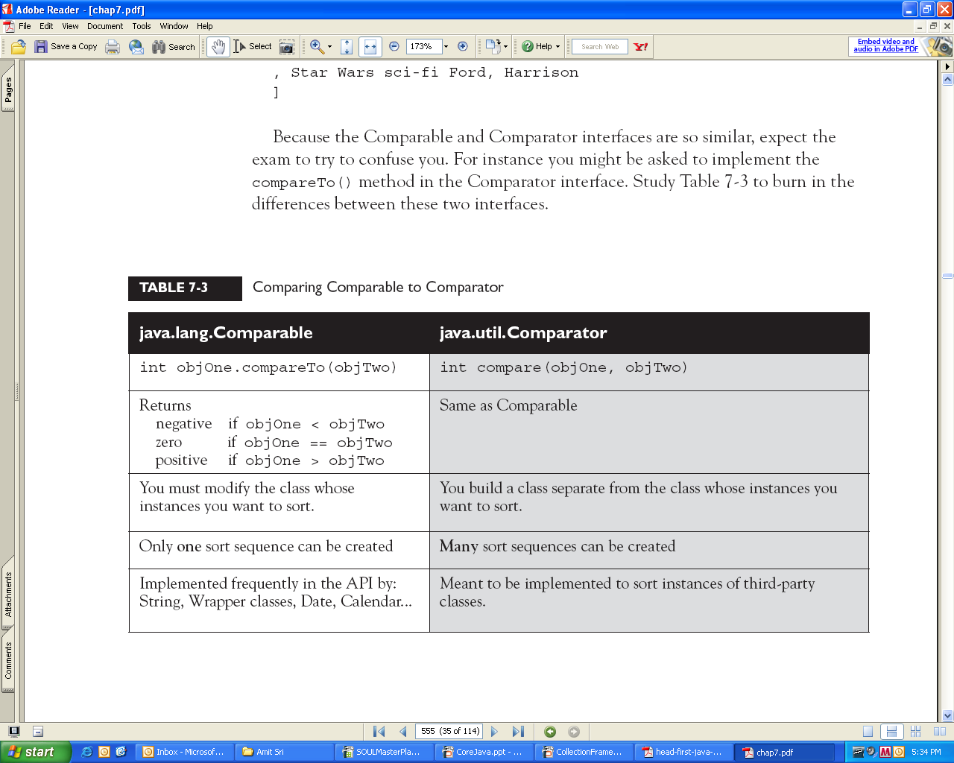
Comparable Vs Comparator

Slide 26
java.lang.Comparable Example
import java.util.*;
class Customer implements java.lang.Comparable //or java.lang.Comparable<Customer>
{
private int custid;
private String name;
private int sal;
Customer()
{
custid=1001;
name="Amit";
sal=99090;
}
Customer(int custid,String name,int sal)
{
this.custid=custid;
this.name=name;
this.sal=sal;
}
public int compareTo(Object o)
{
Customer e=(Customer)o;
return this.name.compareToIgnoreCase(e.name);
}
public String toString()
{
return "Customer id is "+custid+ " Name is "+name+" Salary is "+sal;
}
}
public class Sorting1
{
public static void main(String[] args)
{
Customer obj1=new Customer();
Customer obj2=new Customer(1002,"Ram",4444);
Customer obj3=new Customer(1003,"Anil",6666);
Customer obj4=new Customer(1004,"Sunil",7777);
ArrayList l=new ArrayList();
l.add(obj1);
l.add(obj2);
l.add(obj3);
l.add(obj4);
Collections.sort(l); //The Comparable Interface is used by Collections.sort() and Arrays.sort()
System.out.println(l);
}
}

Slide 27
import java.util.*;
class SortByName implements java.util.Comparator<Customer>
{
public int compare(Customer first,Customer second)
{
return first.name.compareToIgnoreCase(second.name);
}
}
class Customer
{
int custid;
String name;
int sal;
Customer()
{
custid=1001;
name="Amit";
sal=9090;
}
Customer(int custid,String name,int sal)
{
this.custid=custid;
this.name=name;
this.sal=sal;
}
public int compareTo(Object o)
{
Customer e=(Customer)o;
return this.name.compareToIgnoreCase(e.name);
}
public String toString()
{
return "Customer id is "+custid+ " Name is "+name+" Salary is "+sal;
}
}
public class Sorting2
{
public static void main(String[] args)
{
Customer obj1=new Customer();
Customerobj2
=newCustomer(1002,"Ram",4444);
Customer obj3=
new Customer(1003,"Anil",6666);
Customer obj4=
new Customer(1004,"Sunil",7777);
ArrayList l=new ArrayList();
l.add(obj1);
l.add(obj2);
l.add(obj3);
l.add(obj4);
Collections.sort(l,new SortByName());
System.out.println(l);
}
}

Slide 28
Queue- Things arranged by the order in which they are to be processed.
Priority Queue- The purpose of a PriorityQueue is to create a "priority-in, priority out"
queue as opposed to a typical FIFO queue. A PriorityQueue's elements are ordered
either by natural ordering (in which case the elements that are sorted first will be
accessed first) or according to a Comparator. In either case, the elements' ordering
represents their relative priority.
Priority Queue orders its elements using a user-defined priority.
In addition, a PriorityQueue can be ordered using a Comparator, which lets you define any ordering you want. Queues have
a few methods not found in other collection interfaces: peek(), poll(), and offer().
offer() method to add elements to the PriorityQueue
poll() method, which returns the highest priority entry in Proirity-Queue AND removes the entry from the queue.
peek() returns the highest priority element in the queue without removing it, and poll() returns the highest priority
element, AND removes it from the queue.

Slide 29
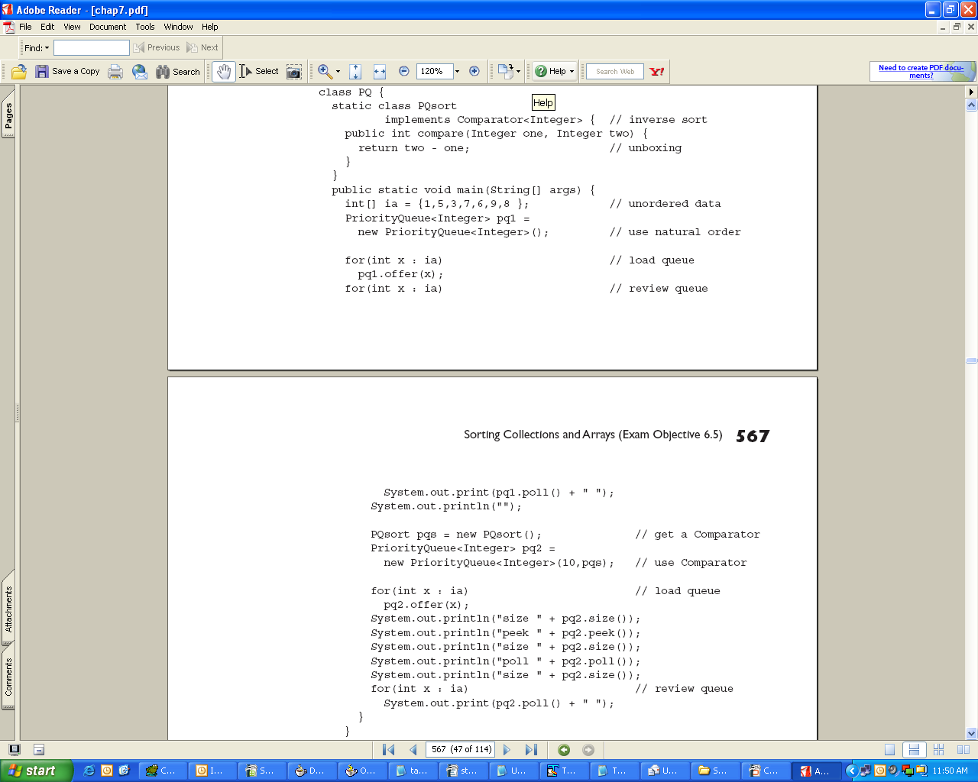

Slide 30
Arrays class
and
Collections class

Slide 31
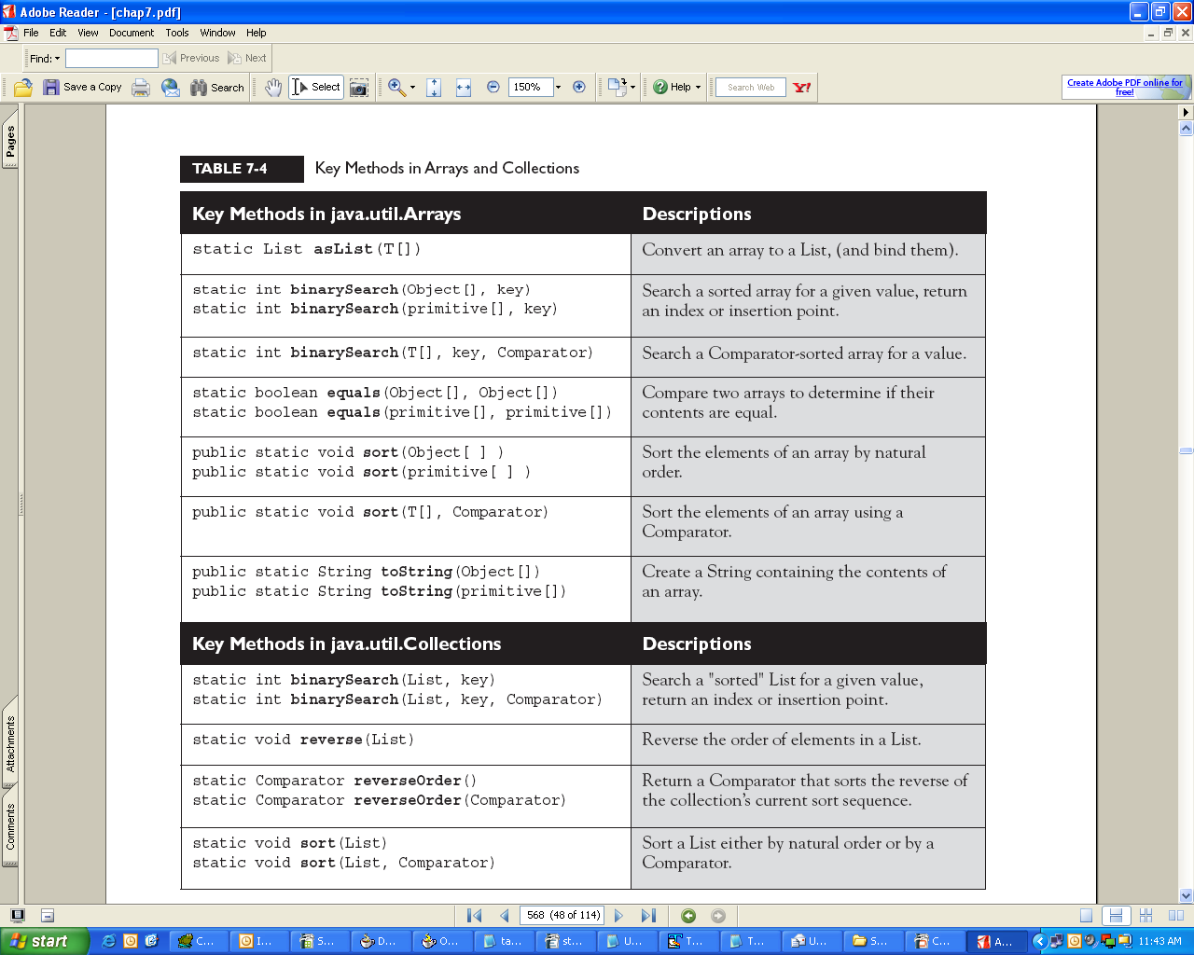

Slide 32
Generics

Slide 33
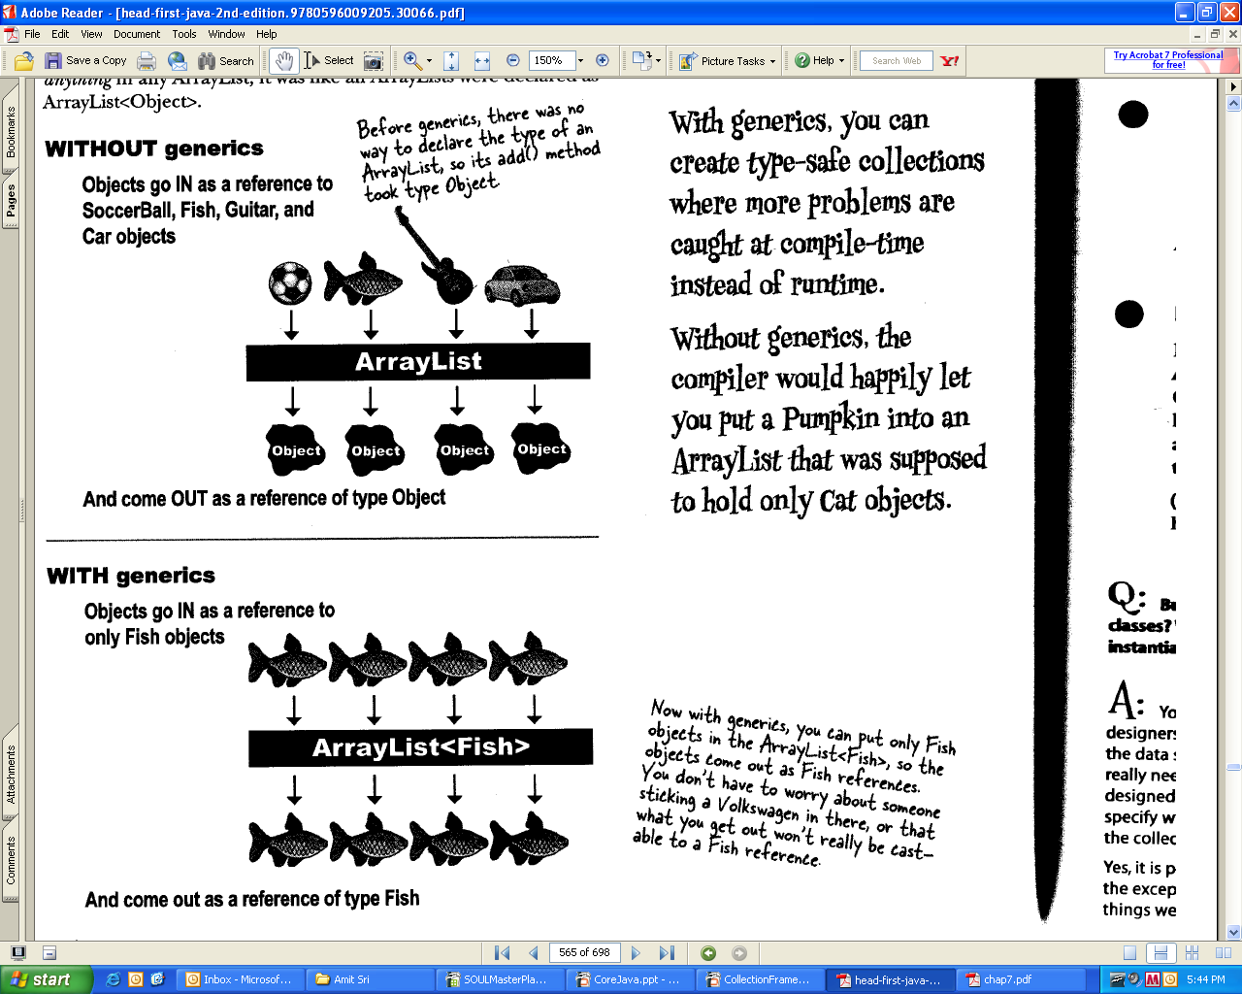
Generics means more type safety.

Slide 34
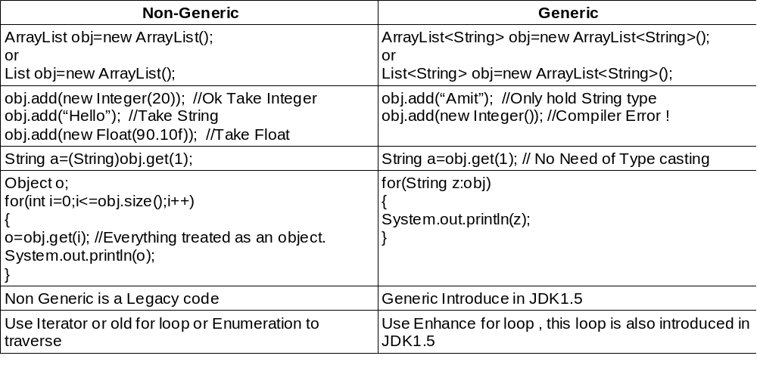
Generics

Slide 35
Mixing Generic and Non-Generic
Polymorphism in Generic
Generic Methods
Generic Class

Slide 36
MIXING GENERIC AND NON-GENERIC COLLECTIONS
package mypackage;
import java.util.ArrayList;
import java.util.List;
public class C
{
static void show(List l)
{
l.add("XYZ"); //No Error treated as Legacy type not generic
l.add(new Float(90.89));
l.add(new Integer(10));
System.out.println("List Value is "+l);
}
public static void main(String args[])
{
ArrayList<Integer> l=new ArrayList<Integer>();
l.add(90);
l.add(100);
show(l);
//l.add("Hello"); //Error
}
}

Slide 37
Polymorphism and Generics
You've already seen that polymorphism applies to the "base" type of the collection:
List<Integer> myList = new ArrayList<Integer>();
List<Object> myList = new ArrayList<JButton>(); // NO!
List<Number> numbers = new ArrayList<Integer>(); // NO!
// remember that Integer is a subtype of Number
But these are fine:
List<JButton> myList = new ArrayList<JButton>(); // yes
List<Object> myList = new ArrayList<Object>(); // yes
List<Integer> myList = new ArrayList<Integer>(); // yes
So far so good. Just keep the generic type of the reference and the generic type of the object to
which it refers identical.
Object[] myArray = new JButton[3]; // yes
but not this:
List<Object> list = new ArrayList<JButton>(); // NO!
List<?> obj=new ArrayList<?>();
List<?> obj=new ArrayList<? extends String>();
List<?> obj=new ArrayList<? super String()>();
NOTE: The same extends keyword use for the class and interface in wild card.

Slide 38
Auto-Boxing in Generics
Auto-boxing is introduced in JDK1.5, Auto-boxing has two terms
1) Boxing – Converting Primitive type into reference type.
2) Un-Boxing- Converting reference type into primitive type.
Example:
ArrayList<Integer> l=new ArrayList<Integer>();
l.add(10); //Boxing
l.add(new Integer(10)); //Legacy way
int i=l.get(i); //UnBoxing

Slide 39
Thank You !

