Slide 1
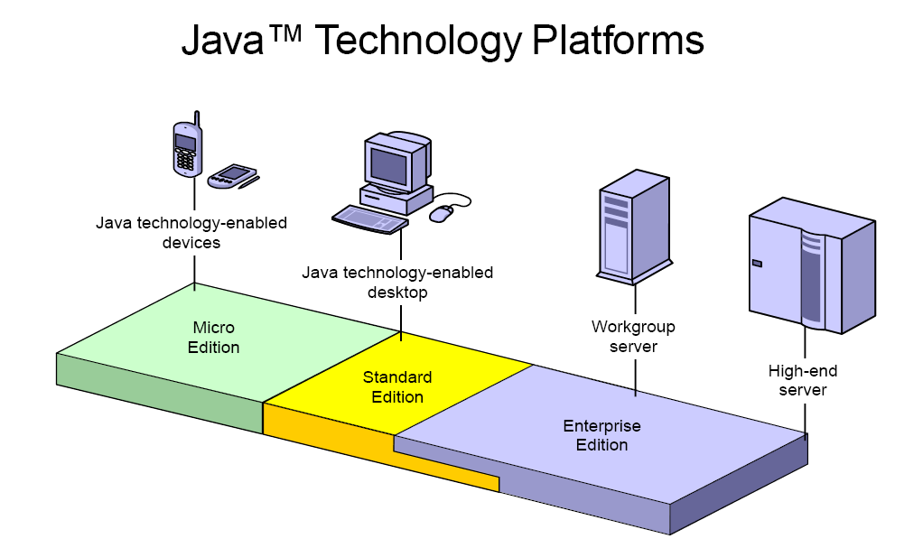

Slide 2
WHAT IS J2EE or JEE ?

Slide 3
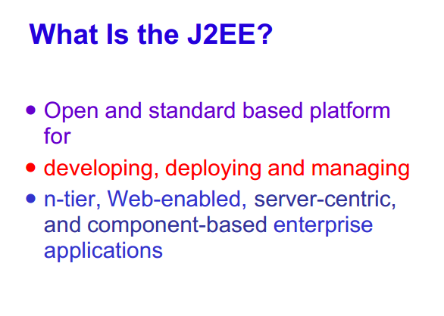

Slide 4
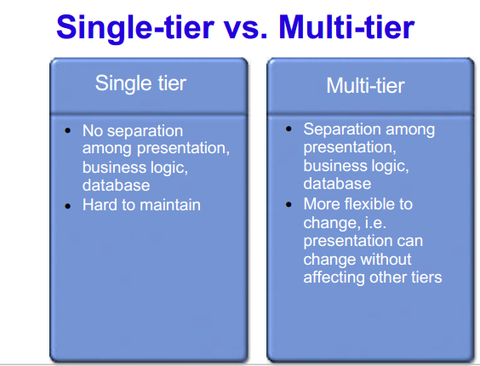

Slide 5
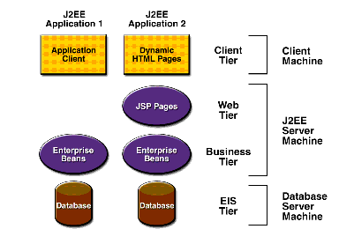
J2EE
The J2EE platform uses a distributed multi tiered application model for enterprise applications
Application logic is divided into components according to function, and the various application components that make up a J2EE application are installed on different machines depending on the tier in the multitiered J2EE environment to which the application component belongs
J2EE application can consist of the three or four tiers shown in Figure 1-1,
Figure 1-1 Multitiered Applications

Slide 6
J2EE Components
J2EE applications are made up of components. A J2EE component is a self-contained functional software unit that is assembled into a J2EE application with its related classes and files and that communicates with other components. The J2EE specification defines the following J2EE components:
  Application clients and applets are components that run on the client.
  Java Servlet and JavaServer Pages (JSP) technology components are web components that run on the server.
  Enterprise JavaBeans (EJB) components (enterprise beans) are business components that run on the server.
J2EE components are written in the Java programming language and are compiled in the same way as any program in the language.
NOTE:
The difference between J2EE components and "standard" Java classes is that J2EE components are assembled into a J2EE application, are verified to be well formed and in compliance with the J2EE specification, and are deployed to production, where they are run and managed by the J2EE server.

Slide 7
J2EE Clients
A J2EE client can be a web client or an application client.
Web Clients
A web client consists of two parts: (1) dynamic web pages containing various types of markup language (HTML, XML, and so on), which are generated by web components running in the web tier, and (2) a web browser, which renders the pages received from the server.
A web client is sometimes called a thin client. Thin clients usually do not query databases, execute complex business rules, or connect to legacy applications. When you use a thin client, such heavyweight operations are off-loaded to enterprise beans executing on the J2EE server, where they can leverage the security, speed, services, and reliability of J2EE server-side technologies.
        Applets
A web page received from the web tier can include an embedded applet. An applet is a small client application written in the Java programming language that executes in the Java virtual machine installed in the web browser. However, client systems will likely need the Java Plug-in and possibly a security policy file in order for the applet to successfully execute in the web browser.
Web components are the preferred API for creating a web client program because no plug-ins or security policy files are needed on the client systems. Also, web components enable cleaner and more modular application design because they provide a way to separate applications programming from web page design. Personnel involved in web page design thus do not need to understand Java programming language syntax to do their jobs.

Slide 8
J2EE Containers
Normally, thin-client multitiered applications are hard to write because they involve many lines of intricate code to handle transaction and state management, multithreading, resource pooling, and other complex low-level details. The component-based and platform-independent J2EE architecture makes J2EE applications easy to write because business logic is organized into reusable components. In addition, the J2EE server provides underlying services in the form of a container for every component type. Because you do not have to develop these services yourself, you are free to concentrate on solving the business problem at hand.

Slide 9
Container Services
Containers are the interface between a component and the low-level platform-specific functionality that supports the component. Before a web component, enterprise bean, or application client component can be executed, it must be assembled into a J2EE module and deployed into its container.
The assembly process involves specifying container settings for each component in the J2EE application and for the J2EE application itself. Container settings customize the underlying support provided by the J2EE server, including services such as security, transaction management, Java Naming and Directory Interface (JNDI) lookups, and remote connectivity. Here are some of the highlights:
  The J2EE security model lets you configure a web component or enterprise bean so that system resources are accessed only by authorized users.
  The J2EE transaction model lets you specify relationships among methods that make up a single transaction so that all methods in one transaction are treated as a single unit.
  JNDI lookup services provide a unified interface to multiple naming and directory services in the enterprise so that application components can access naming and directory services.
  The J2EE remote connectivity model manages low-level communications between clients and enterprise beans. After an enterprise bean is created, a client invokes methods on it as if it were in the same virtual machine

Slide 10
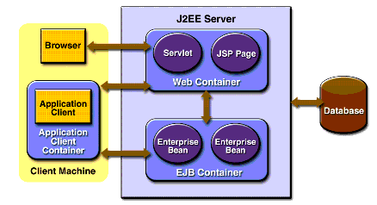
J2EE server
The runtime portion of a J2EE product. A J2EE server provides EJB and web containers.
Enterprise JavaBeans (EJB) container
Manages the execution of enterprise beans for J2EE applications. Enterprise beans and their container run on the J2EE server.
Web container
Manages the execution of JSP page and servlet components for J2EE applications. Web components and their container run on the J2EE server.
Application client container
Manages the execution of application client components. Application clients and their container run on the client.
Applet container
Manages the execution of applets. Consists of a web browser and Java Plug-in running on the client together
Container Types
J2EE Server and Containers

Slide 11
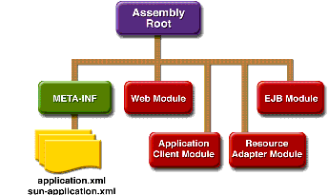
Packing
A J2EE application is delivered in an Enterprise Archive (EAR) file,
An EAR file (see Figure 1-6) contains J2EE modules and deployment descriptors.
At runtime, the J2EE server reads the deployment descriptor and acts upon the application, module, or component accordingly.

Slide 12
Packing
A J2EE module consists of one or more J2EE components for the same container type and one component deployment descriptor of that type. An enterprise bean module deployment descriptor, for example, declares transaction attributes and security authorizations for an enterprise bean. A J2EE module without an application deployment descriptor can be deployed as a stand-alone module. The four types of J2EE modules are as follows:
  EJB modules, which contain class files for enterprise beans and an EJB deployment descriptor. EJB modules are packaged as JAR files with a .jar extension.
  Web modules, which contain servlet class files, JSP files, supporting class files, GIF and HTML files, and a web application deployment descriptor. Web modules are packaged as JAR files with a .war (web archive) extension.
  Application client modules, which contain class files and an application client deployment descriptor. Application client modules are packaged as JAR files with a .jar extension.
  Resource adapter modules, which contain all Java interfaces, classes, native libraries, and other documentation, along with the resource adapter deployment descriptor. Together, these implement the Connector architecture (see ··J2EE Connector Architecture) for a particular EIS. Resource adapter modules are packaged as JAR files with an .rar (resource adapter archive) extension

Slide 13
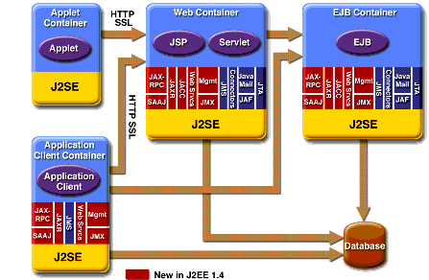
J2EE 1.4 APIs
Enterprise JavaBeans Technology
An Enterprise JavaBeans (EJB) component, or enterprise bean, is a body of code having fields and methods to implement modules of business logic. You can think of an enterprise bean as a building block that can be used alone or with other enterprise beans to execute business logic on the J2EE server.
There are three kinds of enterprise beans: session beans, entity beans, and message-driven beans. Enterprise beans often interact with databases. One of the benefits of entity beans is that you do not have to write any SQL code or use the JDBC API (see JDBC API) directly to perform database access operations; the EJB container handles this for you. However, if you override the default container-managed persistence for any reason, you will need to use the JDBC API. Also, if you choose to have a session bean access the database, you must use the JDBC API.
J2EE Platform APIs

Slide 14
Java Servlet Technology
Java servlet technology lets you define HTTP-specific servlet classes. A servlet class extends the capabilities of servers that host applications that are accessed by way of a request-response programming model. Although servlets can respond to any type of request, they are commonly used to extend the applications hosted by web servers.
      JavaServer Pages Technology
JavaServer Pages (JSP) technology lets you put snippets of servlet code directly into a text-based document. A JSP page is a text-based document that contains two types of text: static data (which can be expressed in any text-based format such as HTML, WML, and XML) and JSP elements, which determine how the page constructs dynamic content.
      Java Message Service API
The Java Message Service (JMS) API is a messaging standard that allows J2EE application components to create, send, receive, and read messages. It enables distributed communication that is loosely coupled, reliable, and asynchronous.
      Java Transaction API
The Java Transaction API (JTA) provides a standard interface for demarcating transactions. The J2EE architecture provides a default auto commit to handle transaction commits and rollbacks. An auto commit means that any other applications that are viewing data will see the updated data after each database read or write operation. However, if your application performs two separate database access operations that depend on each other, you will want to use the JTA API to demarcate where the entire transaction, including both operations, begins, rolls back, and commits.

Slide 15
JavaMail API
J2EE applications use the JavaMail API to send email notifications. The JavaMail API has two parts: an application-level interface used by the application components to send mail, and a service provider interface. The J2EE platform includes JavaMail with a service provider that allows application components to send Internet mail.
JDBC API
The JDBC API lets you invoke SQL commands from Java programming language methods. You use the JDBC API in an enterprise bean when you override the default container-managed persistence or have a session bean access the database. With container-managed persistence, database access operations are handled by the container, and your enterprise bean implementation contains no JDBC code or SQL commands. You can also use the JDBC API from a servlet or a JSP page to access the database directly without going through an enterprise bean.
The JDBC API has two parts: an application-level interface used by the application components to access a database, and a service provider interface to attach a JDBC driver to the J2EE platform.
JNDI
J2EE naming services provide application clients, enterprise beans, and web components with access to a JNDI naming environment. A naming environment allows a component to be customized without the need to access or change the component's source code. A container implements the component's environment and provides it to the component as a JNDI naming context

Slide 16
        Application Clients
An application client runs on a client machine and provides a way for users to handle tasks that require a richer user interface than can be provided by a markup language. It typically has a graphical user interface (GUI) created from the Swing or the Abstract Window Toolkit (AWT) API, but a command-line interface is certainly possible.
Application clients directly access enterprise beans running in the business tier. However, if application requirements warrant it, an application client can open an HTTP connection to establish communication with a servlet running in the web tier

Slide 17
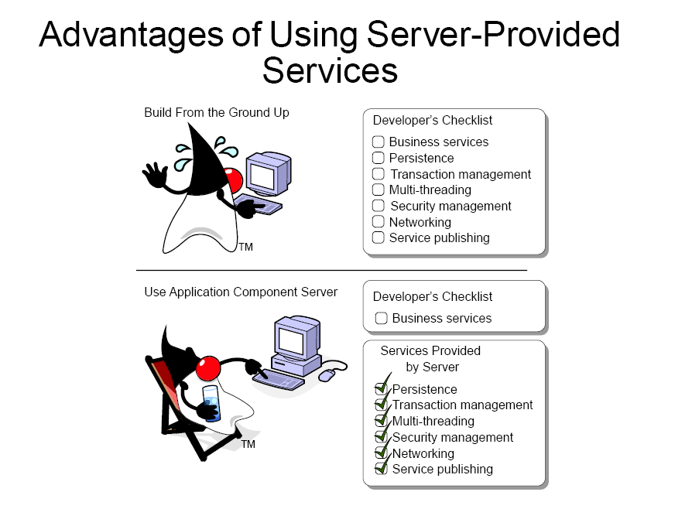

Slide 18
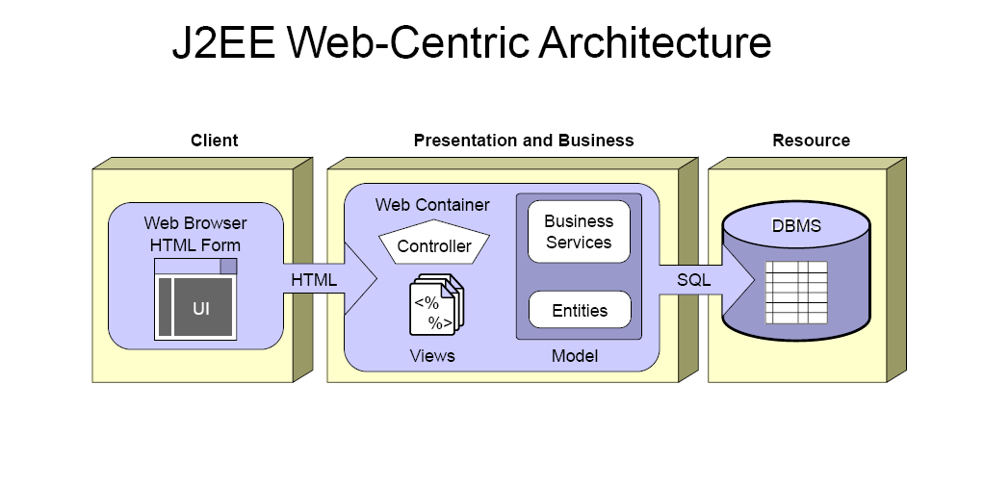

Slide 19
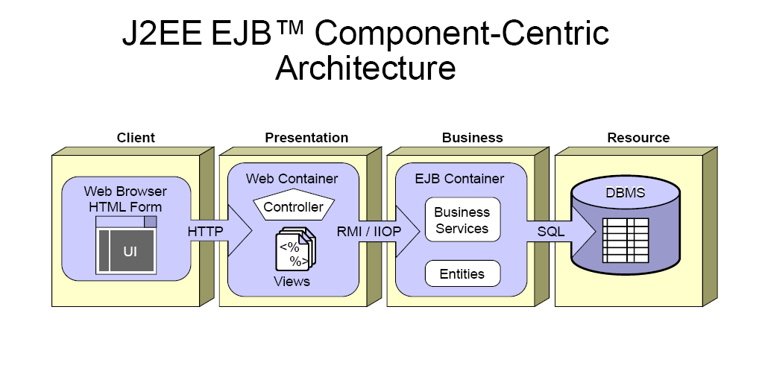

Slide 20
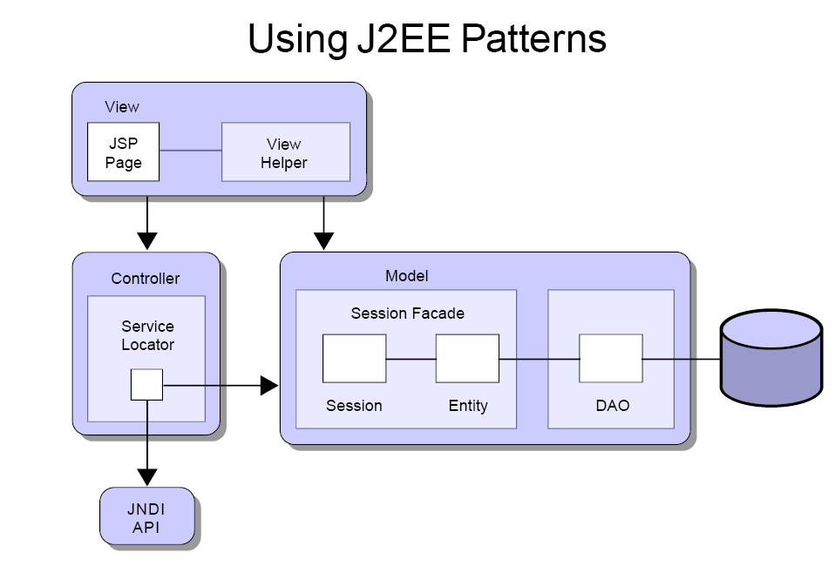

Slide 21
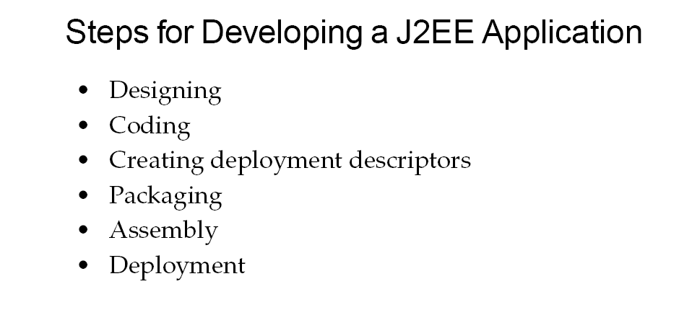

Slide 22
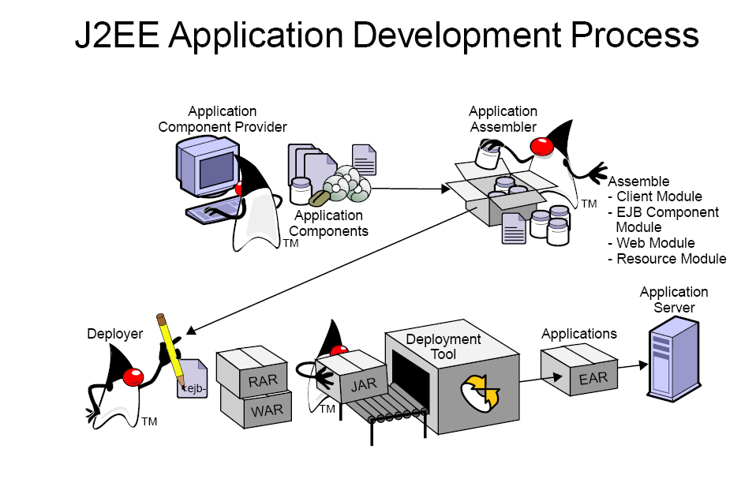

Slide 23
