Slide 1
Hibernate 3.x and JPA 2.x
BY: Amit Srivastava

Slide 2
Day 1 Agenda
Introduction to Hibernate
Hibernate Technology Benefits
Hibernate Architecture Overview
Persistence lifecycle
Object identity
Getting started with Hibernate quickly
Mapping tables to beans
Mapping properties to columns
Using Jakarta commons lang to implement equals and hashCode
Introduction to DBUnit for TDD with ORM
Relationships
Setting up all types of relationships
Setting up a one to many relationship
Creating a simple application user authentication
Setting up a many to many relationship
Setting up a one to one relationship
Setting up an simple inheritance relationship

Slide 3
Java Supported ORMs
ActiveJDBC - Java implementation of Active Record pattern, inspired by Ruby on Rails
Cayenne, Apache, open source for Java
Kodo, commercial implementation of both Java Data Objects and Java Persistence API
Torque, an object-relational mapper for Java
Athena Framework, open source Java ORM, native support for multitenancy SaaS and remoting to Adobe Flex
Carbonado, open source framework, backed by Berkeley DB or JDBC
Ebean, open source ORM framework
EclipseLink, Eclipse persistence platform
Enterprise Objects Framework, Mac OS X/Java, part of Apple WebObjects
Hibernate, open source ORM framework, widely used
MyBatis, formerly named iBATIS, has .NET port
iBATIS, maintained by ASF, inactive as of 2010
Java Data Objects (JDO)
Java Object Oriented Querying (jOOQ)
Java Persistence API (JPA)
DataNucleus, open source JDO and JPA implementation
JPOX, open source JDO 2 reference implementation
Object Relational Bridge (Apache OJB), an object-relational mapper for Java; as of 2011/01/16, Apache ObJectRelationalBridge was retired
OpenJPA, Apache, open source, supports JPA API
ORMLite, lightweight open source framework supporting JDBC and Android
TopLink by Oracle
QuickDB ORM, open source ORM framework (GNU LGPL)
ObjectDB

Slide 4
About Hibernate – www.hibernate.org
Hibernate is a high-performance Object/Relational persistence and query service.
The most popular.
The most flexible and powerful Object/Relational solution on the market.
It provides data query and retrieval facilities that significantly reduce development time. Hibernate’s design goal is to relieve the developer from 95% of common data persistence-related programming tasks by eliminating the need for manual, hand-crafted data processing using SQL and JDBC.

Slide 5
About Hibernate
Hibernate is free software that is distributed under the GNU Lesser General Public License.
Hibernate solves object-relational impedance mismatch problem.
Hibernate was started in 2001 by Gavin King as an alternative to using EJB2-style entity beans.
Notes:
Question

Slide 6
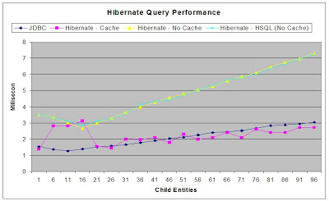
Performance Facts

Slide 7
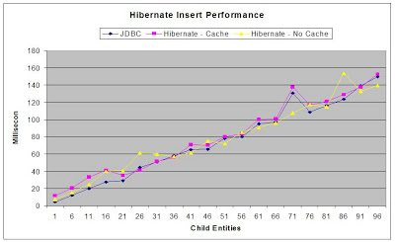
Performance Facts

Slide 8
Benefits of ORM/Hiberate
The SQL code / statements in the application can be eliminated without writing complex JDBC / Entity Bean code.
Distributed transaction can simply be performed by using ORM tools.
Hibernate is an open source ORM tool and a robust framework to perform ORMapping.
Without much of SQL knowledge, one can master Hibernate easily.
Caching objects
Executing SQL statements later, when needed
Never updating unmodified objects
Efficient Collection Handling
Rolling two updates into one
Updating only the modified columns
Outer join fetching
Lazy collection initialization
Lazy object initialization
Transparent persistence & retrieval of objects
Persistence of associations and collections
Guaranteed uniqueness of an object (within a session)

Slide 9
Benefits of Hibernate continued...
O-R mapping using ordinary JavaBeans
Can set attributes using private fields or private setter methods
Lazy instantiation of collections (configurable)
Polymorphic queries, object-oriented query language
Cascading persist & retrieve for associations, including collections and many-to-many
Transaction management with rollback
Can integrate with other container-provided services

Slide 10
Disadvantages of Using Hibernate
High Level abstraction obscuring what is happening under the hood.
Runs on top of JDBC.

Slide 11
Why Hibernate and not JDBC?
JDBC maps Java classes to database tables (and from Java data types to SQL data types)
Hibernate automatically generates the SQL queries.
Hibernate provides data query and retrieval facilities and can significantly reduce development time otherwise spent with manual data handling in SQL and JDBC.
Makes an application portable to all SQL databases.

Slide 12
Hibernate vs. JDBC (an example)
JDBC tuple insertion –
st.executeUpdate(“INSERT INTO book VALUES(“Harry Potter”,”J.K.Rowling”));
Hibernate tuple insertion –
session.save(book1);

Slide 13
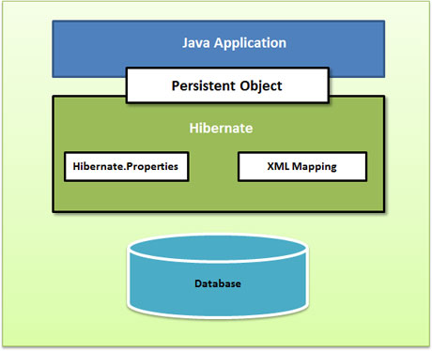
High-Level View
Source: Hibernate Reference Manual (online)

Slide 14
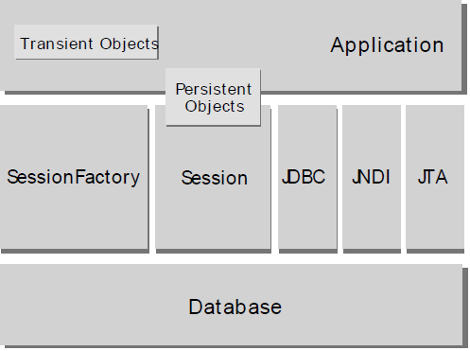
Minimal Architecture
Source: Hibernate Reference Manual (online)
Notes:
The "minimal" architecture has the application manage its own JDBC connections and provide
those connections to Hibernate; additionally the application manages transactions for itself.

Slide 15
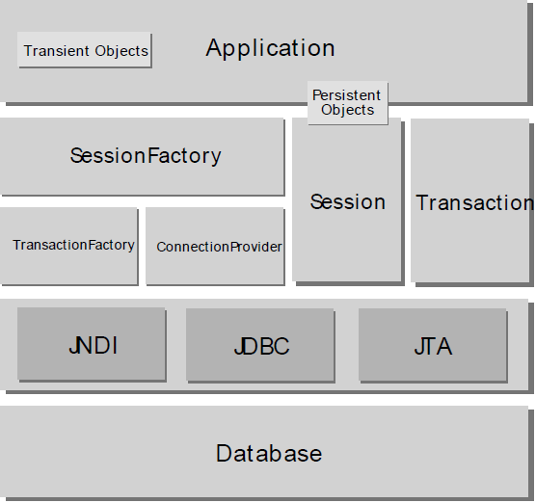
Comprehensive Architecture
Source: Hibernate Reference Manual (online)
Notes:
The "comprehensive" architecture abstracts the application away from the underlying JDBC/JTA
APIs and allows Hibernate to manage the details.

Slide 16
Application Architecture
User Interface
UI event
data xfer object
Application Logic
data request
domain object
Domain Objects
DAO
SessionFactory
Hibernate API
domain object
Hibernate
hibernate.cfg.xml
JDBC API
ResultSet, etc.
*.hbm.xml class mappings
Foundation Classes
JDBC

Slide 17
Basic API
SessionFactory (org.hibernate.SessionFactory)
Session (org.hibernate.Session)
Persistent objects and collections
Transient and detached objects and collections
Transaction (org.hibernate.Transaction)
ConnectionProvider org.hibernate.connection.ConnectionProvider)
TransactionFactory (org.hibernate.TransactionFactory)
Notes:
Contextual Session – Hibernate Reference

Slide 18
Hibernate Framework Objects
SessionFactory Object(org.hibernate.SessionFactory)
Configuration object is used to create a SessionFactory object which in turn configures Hibernate for the application using the supplied configuration file and allows for a Session object to be instantiated.
Heavyweight object hence usually created during application start up and kept for later use.
A thread safe (immutable) cache of compiled mappings for a single database.
One SessionFactory object required per database using a separate configuration file.
Session Object(org.hibernate.Session)
Used to get a Physical connection with a database.
Persistent objects are saved & retrieved through a Session object ONLY.
Lightweight & designed to be instantiated each time an interaction is needed with the database.
Not Thread Safe. Hence, should not be kept open for a long time (should be created & destroyed as needed)
A single-threaded, short-lived object representing a conversation between the application and the persistent store.

Slide 19
Hibernate Framework Objects cont...
Transaction Object(org.hibernate.Transaction)
Transactions in Hibernate are handled by an underlying transaction manager and transaction (from JDBC or JTA).
A single-threaded, short-lived object used by the application to specify atomic units of work.
Abstracts application from underlying JDBC, JTA transactions.
Persistent objects and collections:
Short-lived, single threaded objects containing persistent state and business function.
These might be ordinary JavaBeans/POJOs, the only special thing about them is that they are currently associated with (exactly one) Session.
Changes made to persistent objects are reflected to the database tables.
As soon as the Session is closed, they will be detached and free to use in any application layer(e.g. directly as data transfer objects to and from presentation).
Transient and Detached objects and collections:
Instances of persistent classes that are not currently associated with a org.hibernate.Session. They may have been instantiated by the application and not yet persisted, or they may have been instantiated by a closed org.hibernate.Session.

Slide 20
Hibernate Framework Objects cont...
ConnectionProvider (org.hibernate.connection.ConnectionProvider)
(Optional) A factory for, and pool of, JDBC connections. It abstracts the application from underlying javax.sql.DataSource or java.sql.DriverManager. It is not exposed to application, but it can be extended and/or implemented by the developer.
TransactionFactory (org.hibernate.TransactionFactory)
(Optional) A factory for org.hibernate.Transaction instances. It is not exposed to the application, but it can be extended and/or implemented by the developer.

Slide 21
Hibernate Configuration
Configuration Object:
It represents a configuration or properties file required by the Hibernate and usually created only once during application initialization. It provides two keys components:
  Database Connection: This is handled through configuration file supported by Hibernate hibernate.cfg.xml.
  Class Mapping Setup: This component creates the connection between the Java classes and database tables.

Slide 22
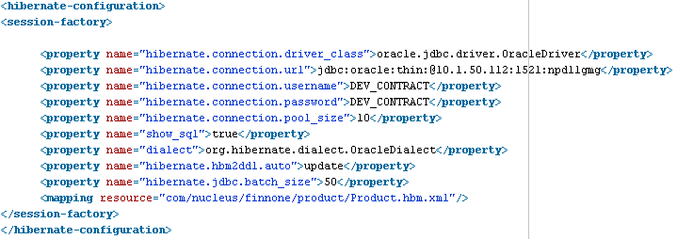
Hibernate Configurations
Configuring hibernate.cfg.xml
Configuration settings related to DB & other related parameters :Connection Driver, URL, username, password.
Defines Mapping information between the Java classes & the database tables.

Slide 23
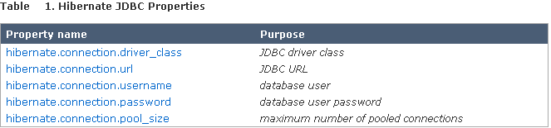
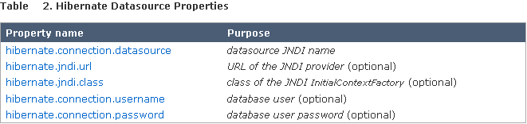
Hibernate Configurations

Slide 24
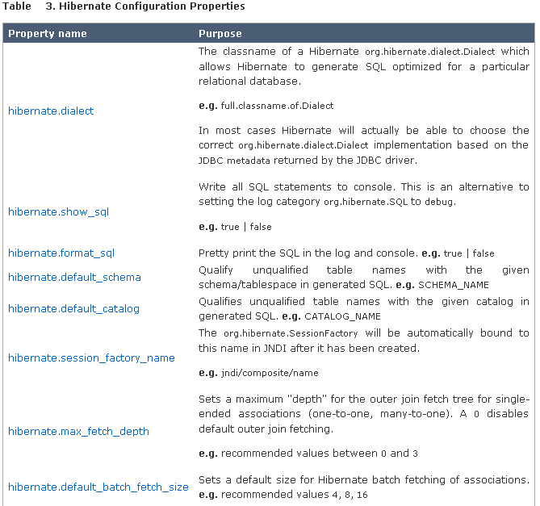
Hibernate Configurations

Slide 25
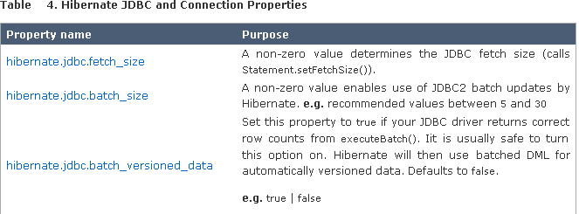
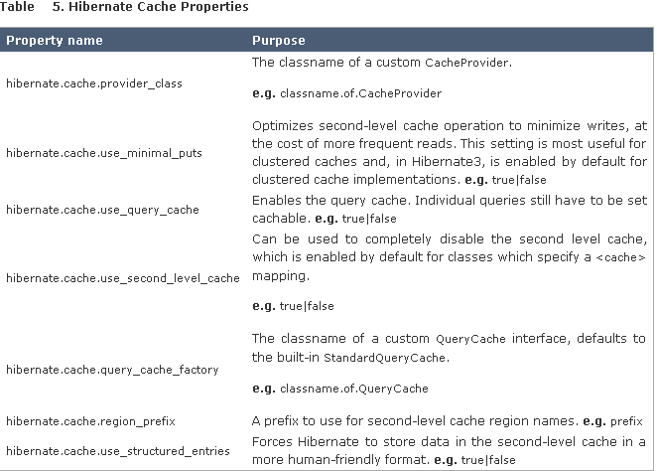
Hibernate Configurations

Slide 26
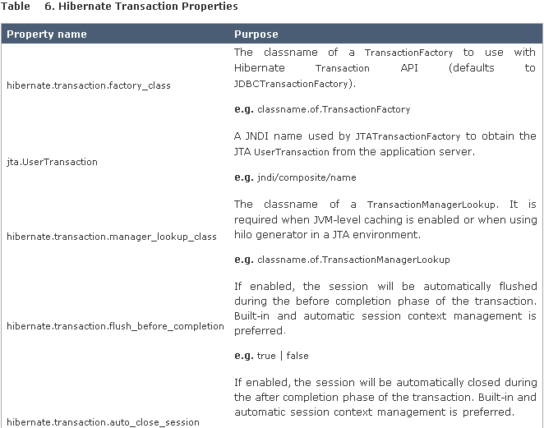
Hibernate Configurations

Slide 27
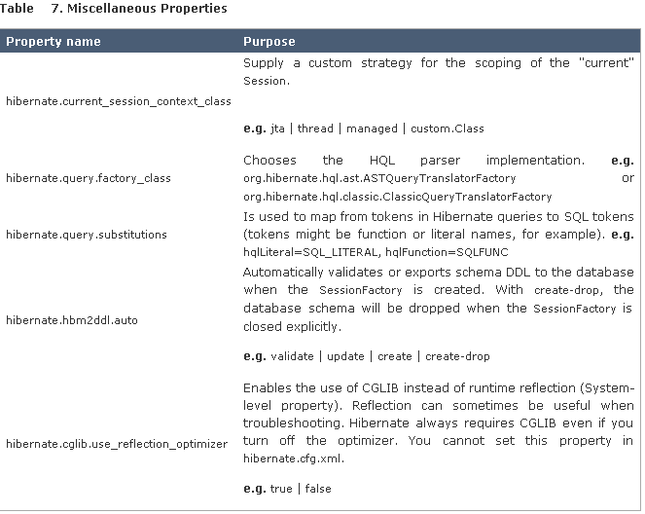
Hibernate Configurations

Slide 28
Hibernate Configurations

Slide 29
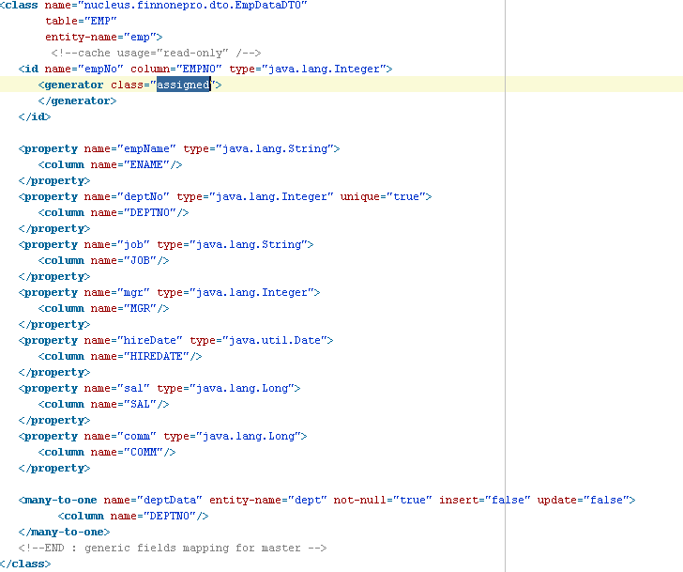
Hibernate Configurations (contd..)
HBM file creation:
ORM Mapping

Slide 30
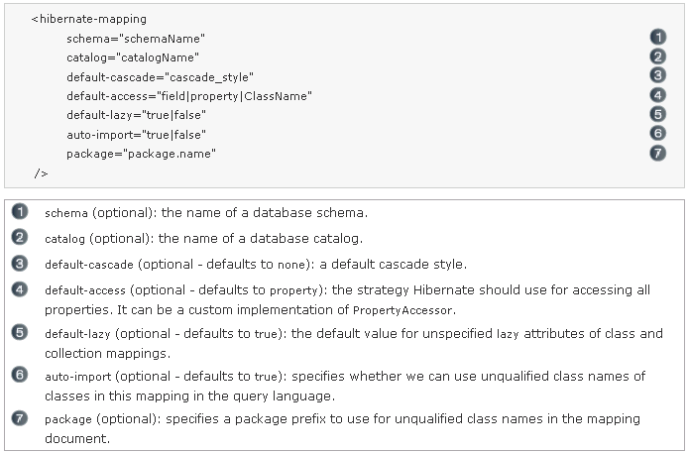
O/R Mappings
Basic O/R Mapping:
Hibernate-Mapping

Slide 31
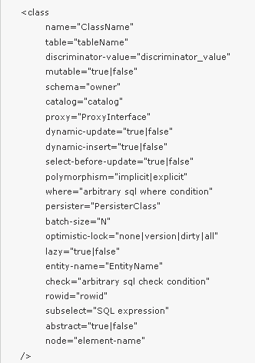
O/R Mappings
Class

Slide 32
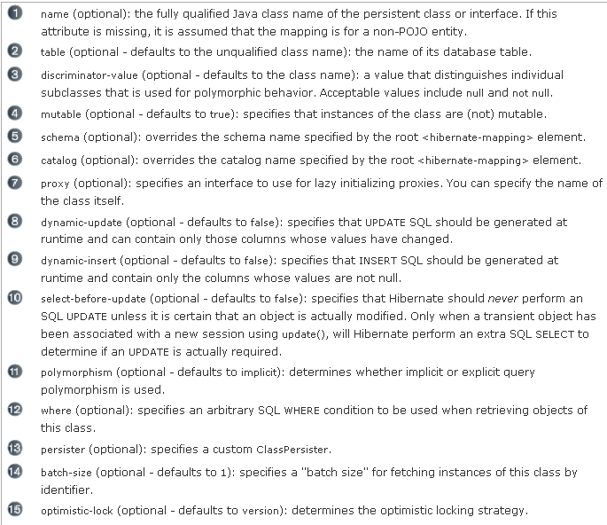
O/R Mappings

Slide 33
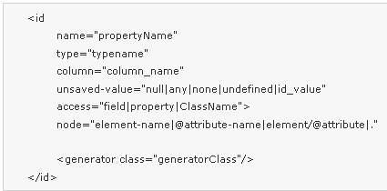
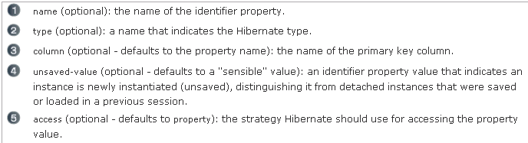
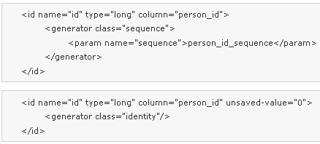

O/R Mappings
Id, Composite Id and Generators

Slide 34
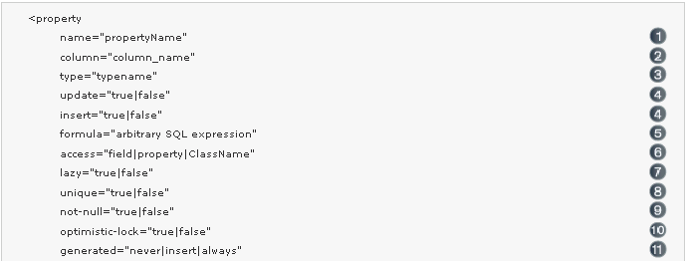
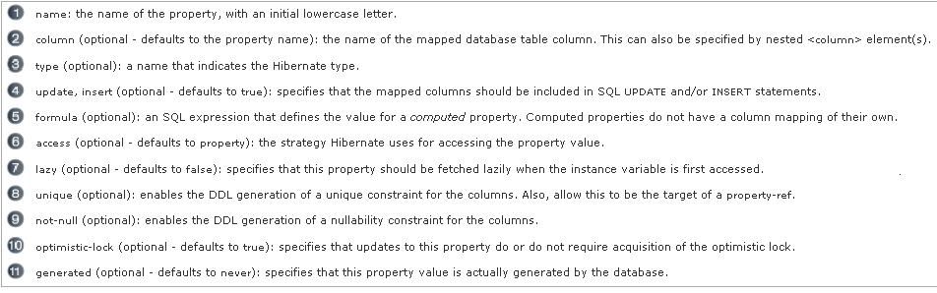
O/R Mappings
Property

Slide 35
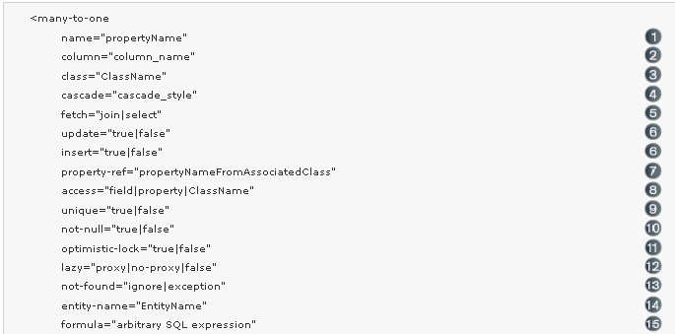
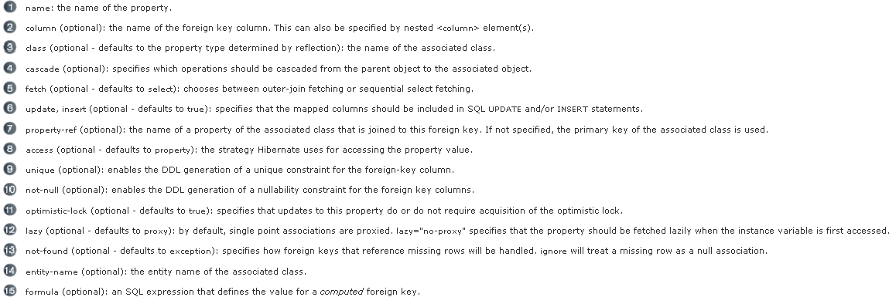
O/R Mappings
many-to-one

Slide 36
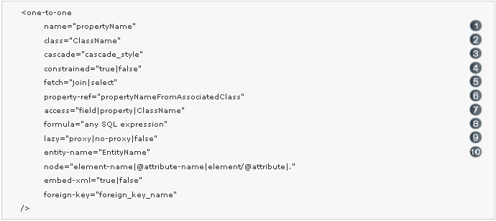
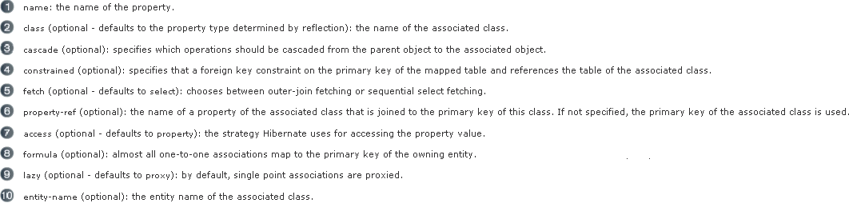
O/R Mappings
One-to-one

Slide 37
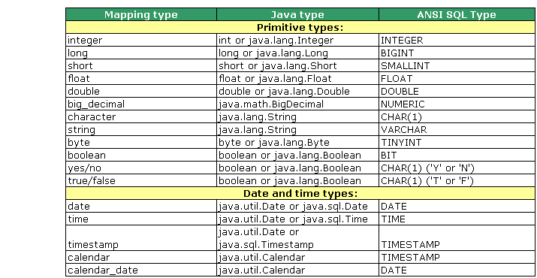
O/R Mappings
Hibernate Mapping Types

Slide 38
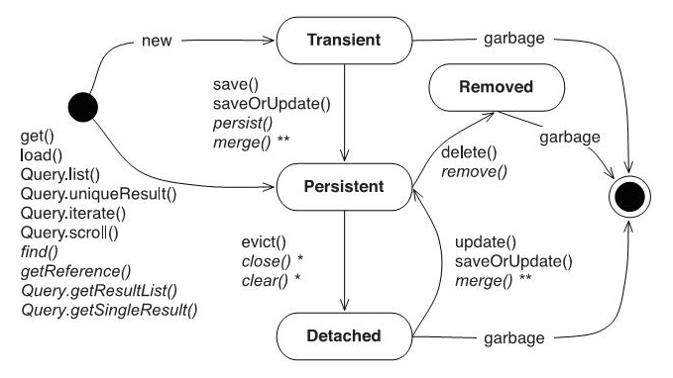
Hibernate LifeCycle

Slide 39
Working with Objects
Hibernate defines and supports the following object states:
Transient - an object is transient if it has just been instantiated using the new operator, and it is not associated with a Hibernate Session. It has no persistent representation in the database and no identifier value has been assigned. Transient instances will be destroyed by the garbage collector if the application does not hold a reference anymore. Use the Hibernate Session to make an object persistent.
Persistent - a persistent instance has a representation in the database and an identifier value. It might just have been saved or loaded, however, it is by definition in the scope of a Session. Hibernate will detect any changes made to an object in persistent state and synchronize the state with the database when the unit of work completes. Developers do not execute manual UPDATE statements, or DELETE statements when an object should be made transient.
Detached - a detached instance is an object that has been persistent, but its Session has been closed. The reference to the object is still valid, of course, and the detached instance might even be modified in this state. A detached instance can be reattached to a new Session at a later point in time, making it (and all the modifications) persistent again. This feature enables a programming model for long running units of work that require user think-time. We call them application transactions, i.e., a unit of work from the point of view of the user.

Slide 40
Working with Objects
Lifecycle operations:
Saving Objects:
Creating an instance of a class you map with Hibernate mapping does not automatically persist the object to the database until you save the object with a valid Hibernate session
An object remains to be in “transient” state until it is saved and moved into “persistent” state.
The class of the object that is being saved must have a mapping file (myclass.hbm.xml)
Methods to save objects provided by Session interface
public Serializable save( Object object)
public void save (String entityName, Object object, Serializable id)

Slide 41
Working with Objects
Loading Objects
  Used for loading objects from the database
  load(..) method requires object's primary key as an identifier
  Each load(..) method also requires which domain class or entity name to use to find the object with the id
  The returned object, which is returned as Object type, needs to be type-casted to the domain class
    - public Object load(Class theClass , Serializable id)
load() vs. get()
  Only use the load() method if you are sure that the object exists
  load() method will throw an exception if the unique id is not found in the database
  If you are not sure that the object exists, then use one of the get() methods
  get() method will return null if the unique id is not found in the database
    public Object get (Class theClass, Serializable id)
    Person person = (Person) session.get(Person.class, id);
    if (person == null){
    logger.info(Person is not found for id ” + id);
    }

Slide 42
Working with Objects
  Updating Objects
  Used for updating object’s state
  Methods to save objects provided by Session interface
    - public void update( Object object)
    - public void saveOrUpdate( Object object) – This method will update the record if it exists in the database. Otherwise will insert a new record.
  Deleting Objects
  Removes an Object from the Database.
  - public void delete( Object object)

Slide 43
Object-relational impedance mismatch
Mismatch | Description
Granularity | Sometimes you will have an object model which has more classes than the number of corresponding tables in the database.
Inheritance | RDBMSs do not define anything similar to Inheritance which is a natural paradigm in object-oriented programming languages.
Identity | A RDBMS defines exactly one notion of 'sameness': the primary key. Java, however, defines both object identity (a==b) and object equality (a.equals(b)).
Associations | Object-oriented languages represent associations using object references where as am RDBMS represents an association as a foreign key column.
Navigation | The ways you access objects in Java and in a RDBMS are fundamentally different.

Slide 44
Object Identity
Equals and HashCode

Slide 45
DB Unit
DbUnit is a JUnit extension (also usable with Ant) targeted at database-driven projects that, among other things, puts your database into a known state between test runs.
DbUnit has the ability to export and import your database data to and from XML datasets.
DbUnit can also work with very large datasets when used in streaming mode.
DbUnit can also help you to verify that your database data match an expected set of values.
Ignoring some columns in comparison
Row ordering
Notes:
The production database. Live data. No testing on this database.
Your local development database, which is where most of the testing is carried out.
A populated development database, possibly shared by all developers so you can run your application and see it work with realistic amounts of data, rather than the hand full of records you have in your test database. You may not strictly need this, but it's reassuring to see your app work with lots of data (i.e., a copy of the production database's data).
A deployment database, or integration database, where the tests are run prior to deployment to make sure any local database changes have been applied. If you're working alone, you may be able to live without this one, but you'll have to be sure any database structure or stored procedure changes have been made to the production database before you go live with your code.

Slide 46
DB Unit
A framework which simplifies operations for each stage in the life cycle of individual database tests.
It provides a very simple XML based mechanism for loading test data.
It provides equally a simple mechanism to export existing test data into the XML format for subsequent use.
It can work with very large datasets.
It can help verify your data matches an expected set of values.
It provides methods for comparing data between flat files, queries and database tables.

Slide 47
Day 2 Agenda
Working with Queries
Problems with implementing equals() and hashcode()
Sequence Generator
Working with Queries
Working with queries
Named queries
Lazy Initialization
Using Hibernate Transaction support
Local transactions, global transaction
Hibernate transaction API
Isolation levels
Optimistic and Pessimistic locking (versioning)

Slide 48
Object Identity
"Never use the database identifier to implement equality; use a business key, a combination of unique, usually immutable, attributes”.
However, the problems stem entirely from allowing objects to exist without an id before they are saved. We can solve these problems by taking the responsibility of assigning object IDs away from object-relational mapping frameworks such as Hibernate. Instead, object IDs can be assigned as soon as the object is instantiated.

Slide 49
List of Main Generators
assigned
increment
sequence
identify
hilo
native
uuid.hex
uuid.string

Slide 50
assigned
This generator supports in all the databases
This is the default generator class used by the hibernate, if we do not specify <generator –> element under id element then hibernate by default assumes it as “assigned”
If generator class is assigned, then the programmer is responsible for assigning the primary key value to object which is going to save into the database
<id name="prodId" column="pid">
<generator />
</id>

Slide 51
Increment
This generator supports in all the databases, database independent
This generator is used for generating the id value for the new record by using the formula
Max of id value in Database + 1
if we manually assigned the value for primary key for an object, then hibernate doesn’t considers that value and uses max value of id in database + 1 concept only
If there is no record initially in the database, then for the first time this will saves primary key value as 1, as…
max of id value in database + 1
0 + 1
result -> 1

Slide 52
sequence
Not has the support with MySql
This generator class is database dependent it means, we cannot use this generator class for all the database, we should know whether the database supports sequence or not before we are working with it
while inserting a new record in a database, hibernate gets next value from the sequence under assigns that value for the new record
If programmer has created a sequence in the database then that sequence name should be passed as the generator
<generator>
<param name="sequence">MySequence</param>
</genetator>

Slide 53
identity
This is database dependent, actually its not working in oracle
In this case (identity generator) the id value is generated by the database, but not by the hibernate, but in case of increment hibernate will take over this
this identity generator doesn’t needs any parameters to pass
this identity generator is similar to increment generator, but the difference was increment generator is database independent and hibernate uses a select operation for selecting max of id before inserting new record
But in case of identity, no select operation will be generated in order to insert an id value for new record by the hibernate

Slide 54
hilo
This generator is database independent
for the first record, the id value will be inserted as 1
for the second record the id value will be inserted as 32768
for the next records the id value will be incremented by 32768 and will stores into the database (i mean adds to the previous)
actually this hibernate stores the count of id values generated in a column of separated table, with name “hibernate_unique_key” by default with the column name “next_hi”
if we want to modify the table and column names theen wee need to pass 2 parameter’s for the hilo generators

Slide 55
native
when we use this generator class, it first checks whether the database supports identify or not, if not checks for sequence and if not, then hilo will be used finally the order will be..
identify
sequence
hilo
For example, if we are connecting with oracle, if we use generator class as native then it is equal to the generator class sequence.

Slide 56
Uuid, guid
It uses 128-bit UUID algorithm to generate id. The returned id is of type String, unique within a network (IP Address). Represented in hexadecimal digits, it is a 32 bit number.
It uses GUID generated by database of type String. It works on MS Sql and MySQL.

Slide 57
Hibernate Query Language (HQL)
Query query = session.createQuery(
"from Event where name='Java Days'");
Query query = session.createQuery(
"select e from Event e where e.name='Java Days'");
Hibernate queries you Hibernate Query Language (HQL).
HQL is object-centric - use class and property names, not SQL table names.

Slide 58
HQL example
Problem: Find all events which are held at Kasetsart
HQL:
String query = "select e from Event e where
e.location.name = 'Kasetsart University'";
Query q = session.createQuery( query );
SQL and JDBC:
String sqlquery = "select * from EVENTS e
join LOCATIONS l ON e.location_id = l.id
where l.name = 'Kasetsart University'";
Statement stmt = connection.createStatement( sqlquery );

Slide 59
Organizing your Work
Use DAO to separate OR behavior from the rest of your project.

Slide 60
A DAO for the Location class
The "useful" methods depend on the domain class and the application.
LocationDao
findById(id: int) : Location
findByName(name : String): Location[*]
find(query: String) : Location[*]
save(loc: Location) : boolean
delete(loc: Location) : boolean

Slide 61
Java code for Simple LocationDao
package eventmgr.dao;
import ...;
public class SimpleLocationDao {
private static final Logger logger =
Logger.getLogger(LocationDao.class);
public LocationDao() { }
public Location findById( int id )
public List<Location> findByName( String name )
public List<Location> find( String query )
public boolean save( Location loc )
public boolean delete( Location loc )
}

Slide 62
The core of findById( ) - use "load"
public Location findById( int id ) {
Location result = null;
Session session = null;
Transaction tx = null;
try {
session = HibernateUtil.getCurrentSession();
tx = session.beginTransaction();
result =
(Location)session.load(Location.class, id);
tx.commit();
session.close( );
} catch ...
}
return result;
}

Slide 63
The details of findById( )
public Location findById( int id ) {
Location result = null;
Session session = null;
Transaction tx = null;
try {
session = HibernateUtil.getCurrentSession();
tx = session.beginTransaction();
result = (Location)session.load(Location.class,id);
tx.commit();
} catch (ObjectNotFoundException e) {
logger.info("Object not found. id = "+id, e);
if ( tx != null && ! tx.wasCommitted() ) tx.rollback();
} catch (HibernateException e) {
logger.error("Hibernate exception", e);
if ( tx != null && ! tx.wasCommitted() ) tx.rollback();
} finally {
if ( session != null && session.isOpen() ) session.close();
}
return result;
}

Slide 64
The core of findByName( ) - "query"
public List<Location> findByName( String name ) {
List<Location> result;
...
try {
session = HibernateUtil.getCurrentSession();
tx = session.beginTransaction();
Query query = session.createQuery(
"from Location where name=:name" );
query.setParameter( "name", name );
result = (List<Location>) query.list( );
tx.commit();
session.close( );
} catch ...
return result;
}

Slide 65
Details of findByName( )
Exercise

Slide 66
The core of save( ) - "saveOrUpdate"
public boolean save( Location location ) {
boolean result = false;
...
try {
session = HibernateUtil.getCurrentSession();
tx = session.beginTransaction();
session.saveOrUpdate( location );
tx.commit();
session.close( );
result = true;
} catch ...
return result;
}

Slide 67
Details of save
Exercise

Slide 68
The core of delete( ) - "delete"
public boolean delete( Location location ) {
boolean result = false;
...
try {
session = HibernateUtil.getCurrentSession();
tx = session.beginTransaction();
session.delete( location ); tx.commit();
session.close( );
result = true;
} catch ...
return result;
}

Slide 69
Redundant Code
Every DAO method has the same boilerplate code:
Session session = null;
Transaction tx = null;
try {
session = HibernateUtil.getCurrentSession();
tx = session.beginTransaction();
do the work here
tx.commit();
} catch (ObjectNotFoundException e) {
logger.info("Object not found. "+id, e);
if ( tx != null && ! tx.wasCommitted() ) tx.rollback();
} catch (HibernateException e) {
logger.error("Hibernate exception", e);
if ( tx != null && ! tx.wasCommitted() ) tx.rollback();
} finally {
if ( session != null && session.isOpen() ) session.close();
}

Slide 70
Factor out Redundant Code
Class SimpleLocationDao {
private Session session; // declare as attributes
private Transaction tx;
public Location findById( int id ) {
try {
beginTransaction( );
do the work here
commitTransaction( );
} catch (ObjectNotFoundException e) {
handleError( e );
} catch (HibernateException e) {
handleError( e );
} finally {
if ( session != null && session.isOpen() )
session.close();
}

Slide 71
Duplicate Code Between DAO
In every DAO, the CRUD methods are almost the same
Consider save( ) ...
public boolean save( Location location ) {
boolean result = false;
...
try {
beginTransaction( );
session.saveOrUpdate( location );
commitTransaction( );
} catch ( ... ) {
handleException( e );
} finally { ... }
return result;
}

Slide 72
Apply the Layer Superclass Pattern
AbstractDao
#load( class, id ) : Object
#find( class, query ) : List
#saveOrUpdate( object: Object )
#delete( object: Object )
LocationDao
EventDao
SpeakerDao

Slide 73
AbstractDao.save
protected Object save( Object obj ) {
Object result = null;
try {
beginTransaction();
result = session.saveOrUpdate( obj );
commitTransaction();
} catch (ObjectNotFoundException e) {
handleError( e );
} catch (HibernateException e) {
handleError( e );
} finally {
  closeSession( );
}
return result;
}

Slide 74
LocationDao using Layer Superclass
public class LocationDao extends AbstractDao {
public boolean save( Location location ) {
return super.save( location );
}

Slide 75
AbstractDao.load
protected Object load( Class clazz,
Serializable id ) {
Object result = null;
try {
beginTransaction();
result = session.load( clazz, id);
commitTransaction()
} catch (ObjectNotFoundException e) {
handleError( e );
} catch (HibernateException e) {
handleError( e );
} finally {
  closeSession( );
}
return result;
}

Slide 76
LocationDao using Layer Superclass
public class LocationDao extends AbstractDao {
public LocationDao( ) { super( ); }
public Location findById( int id ) {
return (Location) super.load(
Location.class, id );
}

Slide 77
Exercise
use your SimpleLocationDao to write a layer superclass named AbstractDao.
write a LocationDao that extends AbstractDao

Slide 78
Hibernate Transaction API
public interface Transaction
Allows the application to define units of work, while maintaining abstraction from the underlying transaction implementation (eg. JTA, JDBC).
A transaction is associated with a Session and is usually instantiated by a call to
Session.beginTransaction()

Slide 79
Hibernate Transaction API
Method Summary
void | begin() Begin a new transaction.
void | commit() Flush the associated Session and end the unit of work (unless we are in FlushMode.NEVER.
boolean | isActive() Is this transaction still active?Again, this only returns information in relation to the local transaction, not the actual underlying transaction.
void | registerSynchronization(Synchronization synchronization) Register a user synchronization callback for this transaction.
void | rollback() Force the underlying transaction to roll back.
void | setTimeout(int seconds) Set the transaction timeout for any transaction started by a subsequent call to begin() on this instance.
boolean | wasCommitted() Check if this transaction was successfully committed.
boolean | wasRolledBack() Was this transaction rolled back or set to rollback only?This only accounts for actions initiated from this local transaction.

Slide 80
Transaction Concepts
A SessionFactory is an expensive-to-create, threadsafe object, intended to be shared by all application threads. It is created once, usually on application startup, from a Configuration instance.
A Session is an inexpensive, non-threadsafe object that should be used once and then discarded for: a single request, a conversation or a single unit of work.

Slide 81
Unit of Work
A unit of work is a design pattern described by Martin Fowler as “[maintaining] a list of objects affected by a business transaction and coordinates the writing out of changes and the resolution of concurrency problems.
In other words, its a series of operations we wish to carry out against the database together. Basically, it is a transaction, though fulfilling a unit of work will often span multiple physical database transactions
The term "business transaction" is also sometimes used in lieu of unit of work.

Slide 82
Anti - Pattern
Do not use the session-per-operation antipattern: do not open and close a Session for every simple database call in a single thread.
The most common pattern in a multi-user client/server application is session-per-request.

Slide 83
Solutions
Start a transaction when a server request has to be processed, and end the transaction before the response is sent to the client.
Common solutions are ServletFilter, AOP interceptor with a pointcut on the service methods, or a proxy/interception container.
In EJB container is a standardized way to implement cross-cutting aspects such as transaction demarcation on EJB session beans, declaratively with CMT.

Slide 84
Long Conversation
The first screen of a dialog opens. The data seen by the user has been loaded in a particular Session and database transaction. The user is free to modify the objects.
The user clicks "Save" after 5 minutes and expects their modifications to be made persistent. The user also expects that they were the only person editing this information and that no conflicting modification has occurred.

Slide 85
Solutions
Automatic Versioning: Hibernate can perform automatic optimistic concurrency control for you. It can automatically detect if a concurrent modification occurred during user think time.
Detached Objects: if you decide to use the session-per-request pattern, all loaded instances will be in the detached state during user think time. Hibernate allows you to reattach the objects and persist the modifications. The pattern is called session-per-request-with-detached-objects. Automatic versioning is used to isolate concurrent modifications.

Slide 86
Solutions continued…
Extended (or Long) Session: The Hibernate Session can be disconnected from the underlying JDBC connection after the database transaction has been committed and reconnected when a new client request occurs. This pattern is known as session-per-conversation and makes even reattachment unnecessary. Automatic versioning is used to isolate concurrent modifications and the Session will not be allowed to be flushed automatically, but explicitly.

Slide 87
Database transaction demarcation
A Hibernate application can run in non-managed (i.e., standalone, simple Web- or Swing applications) and managed J2EE environments.
In a non-managed environment, Hibernate is usually responsible for its own database connection pool. The application developer has to manually set transaction boundaries (begin, commit, or rollback database transactions) themselves.
A managed environment usually provides container-managed transactions (CMT), with the transaction assembly defined declaratively. Programmatic transaction demarcation is then no longer necessary.

Slide 88
Non-managed environment
Session sess = factory.openSession();
Transaction tx = null;
try {
tx = sess.beginTransaction();
// do some work
...
tx.commit();
}
catch (RuntimeException e) {
if (tx != null) tx.rollback();
throw e; // or display error message
}
finally {
sess.close();
}

Slide 89
Managed environment
/ Non-managed environment idiom
// BMT idiom with getCurrentSession()
try {
UserTransaction tx = (UserTransaction)new InitialContext()
.lookup("java:comp/UserTransaction");
tx.begin();
// Do some work on Session bound to transaction
factory.getCurrentSession().load(...);
factory.getCurrentSession().persist(...);
tx.commit();
}
catch (RuntimeException e) {
tx.rollback();
throw e; // or display error message
}

Slide 90
Managed environment - CMT
// CMT idiom
Session sess = factory.getCurrentSession();
// do some work

Slide 91
Exception Handling
If the Session throws an exception, including any SQLException, immediately rollback the database transaction, call Session.close() and discard the Session instance.
No exception thrown by Hibernate can be treated as recoverable. Ensure that the Session will be closed by calling close() in a finally block.
JDBCConnectionException: indicates an error with the underlying JDBC communication.
SQLGrammarException: indicates a grammar or syntax problem with the issued SQL.
ConstraintViolationException: indicates some form of integrity constraint violation.
LockAcquisitionException: indicates an error acquiring a lock level necessary to perform the requested operation.
GenericJDBCException: a generic exception which did not fall into any of the other categories.

Slide 92
Optimistic concurrency control
The only approach that is consistent with high concurrency and high scalability, is optimistic concurrency control with versioning.
Version checking uses version numbers, or timestamps, to detect conflicting updates and to prevent lost updates.

Slide 93
Application Version Checking
/ foo is an instance loaded by a previous Session
session = factory.openSession();
Transaction t = session.beginTransaction();
int oldVersion = foo.getVersion();
session.load( foo, foo.getKey() ); // load the current state
if ( oldVersion != foo.getVersion() ) throw new StaleObjectStateException();
foo.setProperty("bar");
t.commit();
session.close();

Slide 94
Optimistic Vs Pessimistic Locking
Optimistic locking is a technique where you allow your application to perform updates hoping there won't be any simultaneous updates from another process, hence optimistic. Pessimistic locking is the technique where you assume there will be simultaneous updates from another process so you lock the data you are changing before any changes take place.
In Hibernate, optimistic locking is provided fairly seemlesly. You add a version field to your table and a version element to your mapping file. When you update a Hibernate object Hibernate will check the version values match. If they do the update is successful, and the version is incremented, if they are not Hibernate throws a StaleObjectException and you know that something else has updated your data.
Pessimistic locking is provided by specifying a LockMode when you get an object from the database. If you get your object with the LockMode.UPGRADE for example Hibernate will use database specific SQL to lock the record (if your database supports it) such as "select ... for update". Now nothing can update that record till you are finished.

Slide 95
Pessimistic Locking Modes
LockMode.NONE: Don't go to the database
LockMode.READ: Bypass both levels of the cache
LockMode.UPDGRADE: Bypass both levels of the cache, do a version check, and obtain a database-level pessimistic upgrade lock
LockMode.UPDGRADE_NOWAIT: The same as UPGRADE, but use a SELECT...FOR UPDATE NOWAIT on Oracle. this disables waiting for concurrent lock releases, thus throwing a locking exception immediately if the lock can't be obtained.
LockMode.WRITE : Is obtained automatically when Hibernate has written to a row in the current transaction

Slide 96
Automatic Version Checking
@Version
private Integer version;

Slide 97
DATABASE ISOLATION LEVELS
In database systems, isolation is a property that defines how/when the changes made by one operation become visible to other concurrent operations.
hibernate.connection.isolation: Sets the JDBC transaction isolation level.
Most databases do not support all isolation levels and some define additional, non-standard isolations.
The default isolation level of different DBMS's varies quite widely. Most databases that feature transactions allow the user to set any isolation level.

Slide 98
ISOLATION LEVELS
Repeatable reads
In this isolation level, a lock-based concurrency control DBMS implementation keeps read and write locks (acquired on selected data) until the end of the transaction.
Read committed
Read committed is an isolation level that guarantees that any data read is committed at the moment it is read. It simply restricts the reader from seeing any intermediate, uncommitted, 'dirty' read/
Read uncommitted
This is the lowest isolation level. In this level, dirty reads are allowed (see below), so one transaction may see not-yet-committed changes made by other transactions.

Slide 99
Day 3 Agenda
More Mapping Concepts
Hibernate type system
Mapping collections of value types
Three ways to map inheritance
Embedded Objects
Working with Compound Keys
Advance Queries
Working with the Query API
Working with Binding Parameters
Grouping
Subqueries
Optimizing queries
Native SQL query
Fetch Strategies

Slide 100
Data Types
Boolean
Date
Locale & Currency
Custom Value Type

Slide 101
Inheritance Strategies
table per class hierarchy
table per subclass
table per concrete class

Slide 102
Embedded
Composite Key

Slide 103
Criteria API
Hibernate provides alternate ways of manipulating objects and in turn data available in RDBMS tables. One of the methods is Criteria API which allows you to build up a criteria query object programmatically where you can apply filtration rules and logical conditions.
This is a very convenient approach for functionality like "search" screens where there is a variable number of conditions to be placed upon the result set.
Dynamic SQL

Slide 104
Dynamic SQL
A reporting application in a data warehouse environment might not know the exact table name until runtime. These tables might be named according to the starting month and year of the quarter, for example INV_01_1997, INV_04_1997, INV_07_1997, INV_10_1997, INV_01_1998.
You might also want to run a complex query with a user-selectable sort order. Instead of coding the query twice, with different ORDER BY clauses, you can construct the query dynamically to include a specified ORDER BY clause.

Slide 105
Criteria API
List cats = session.createCriteria(Cat.class)
.add( Restrictions.like("name", "Iz%") )
.add( Restrictions.gt( "weight", new Float(minWeight) ) )
.addOrder( Order.asc("age") )
.list();
List cats = session.createCriteria(Cat.class)
.createCriteria("kittens")
.add( Restrictions.like("name", "Iz%") )
.list();
List cats = session.createCriteria(Cat.class)
.createAlias("kittens", "kit")
.add( Restrictions.like("kit.name", "Iz%") )
.list();

Slide 106
Criteria vs HQL
SimpleDateFormat sdf = new SimpleDateFormat("yyyy-MM-dd");
boolean isFirst = true;
StringBuilder query = new StringBuilder("from StockDailyRecord ");
if(startDate!=null){
if(isFirst){
query.append(" where date >= '" + sdf.format(startDate) + "'");
}else{
query.append(" and date >= '" + sdf.format(startDate) + "'");
}
isFirst = false;
}
if(endDate!=null){
if(isFirst){
query.append(" where date <= '" + sdf.format(endDate) + "'");
}else{
query.append(" and date <= '" + sdf.format(endDate) + "'");
}
isFirst = false;
}
if(volume!=null){
if(isFirst){
query.append(" where volume >= " + volume);
}else{
query.append(" and volume >= " + volume);
}
isFirst = false;
}
query.append(" order by date");
Query result = session.createQuery(query.toString());
return result.list();

Slide 107
Criteria vs HQL
Criteria criteria = session.createCriteria(StockDailyRecord.class);
if(startDate!=null){
criteria.add(Expression.ge("date",startDate));
}
if(endDate!=null){
criteria.add(Expression.le("date",endDate));
}
if(volume!=null){
criteria.add(Expression.ge("volume",volume));
}
criteria.addOrder(Order.asc("date"));
return criteria.list();

Slide 108
Dynamic SQL
Applications that allow users to input or choose query search or sorting criteria at runtime
Applications that allow users to input or choose optimizer hints at run time
Applications that query a database where the data definitions of tables are constantly changing
Applications that query a database where new tables are created often

Slide 109
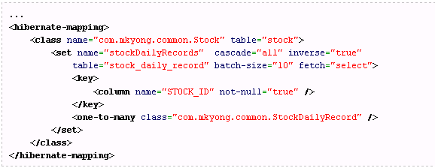
Performance
Fetching Strategies:
  Hibernate uses a fetching strategy to retrieve associated objects if the application needs to navigate the
  association. Fetch strategies can be declared in the O/R mapping metadata, or over-ridden by a particular
  HQL or Criteria query.
  Hibernate3 defines the following fetching strategies:
  fetch-”select” (default) = Lazy load all the collections and entities.
  fetch-”join” = Disable the lazy loading, always load all the collections and entities.
  batch-size=”N” = Fetching up to ‘N’ collections or entities, *Not record*.
  fetch-”subselect” = Group its collection into a sub select statement.

Slide 110
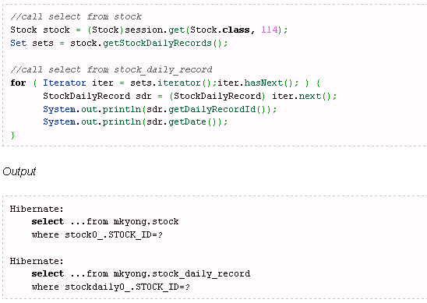
Performance
Fetching Strategies:
  fetch-”select” (default) = Lazy load all the collections and entities.

Slide 111
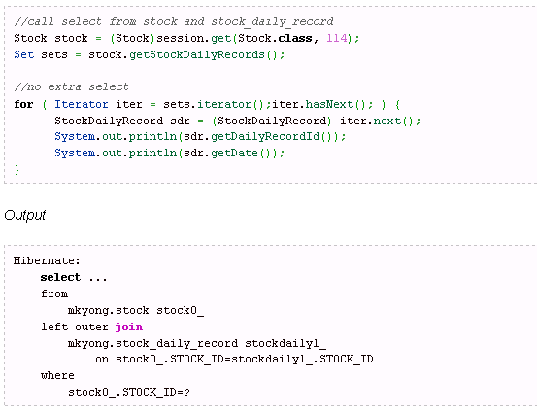
Performance
Fetching Strategies:
  fetch-”join” = Disable the lazy loading, always load all the collections and entities.

Slide 112
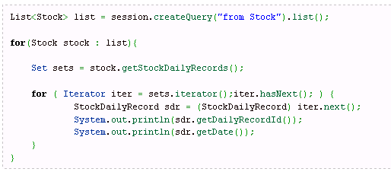
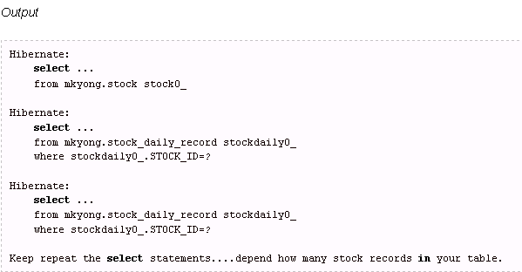
Performance
Fetching Strategies:
  No batch size enabled

Slide 113
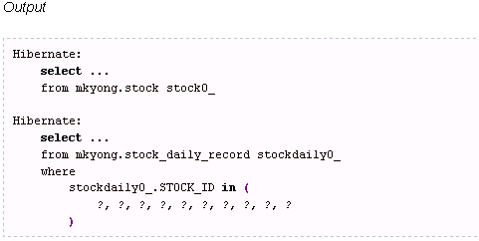
Performance
Fetching Strategies:
  batch-size=”10”

Slide 114
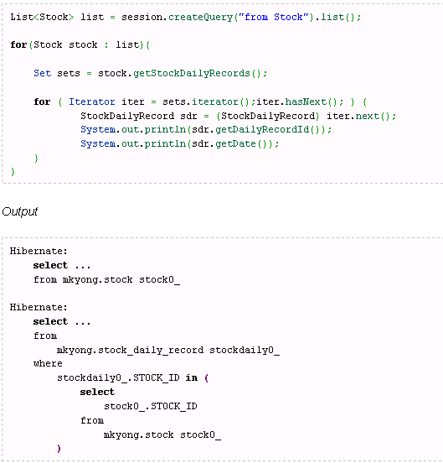
Performance
Fetching Strategies:
  fetch-”subselect” = Group its collection into a sub select statement.

Slide 115
Day 4 Agenda
Hibernate Caching
Caching overview
Hibernate Caching Architecture
Hibernate API to control cache
Working with EHCache
Detach Object
Update on Detached Object
Joins
Inner Join, Left Join, Outer Join
Interceptors and Events

Slide 116
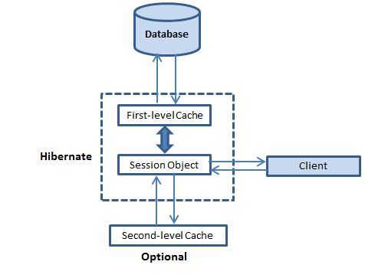
Hibernate Caching

Slide 117
Hibernate Caching
First-level cache:
The first-level cache is the Session cache and is a mandatory cache through which all requests must pass. The Session object keeps an object under its own power before committing it to the database.
If you issue multiple updates to an object, Hibernate tries to delay doing the update as long as possible to reduce the number of update SQL statements issued. If you close the session, all the objects being cached are lost and either persisted or updated in the database.
Second-level cache:
Second level cache is an optional cache and first-level cache will always be consulted before any attempt is made to locate an object in the second-level cache. The second-level cache can be configured on a per-class and per-collection basis and mainly responsible for caching objects across sessions.
Any third-party cache can be used with Hibernate. An org.hibernate.cache.CacheProvider interface is provided, which must be implemented to provide Hibernate with a handle to the cache implementation.

Slide 118
Hibernate Caching
Query-level cache:
Hibernate also implements a cache for query result sets that integrates closely with the second-level cache.
This is an optional feature and requires two additional physical cache regions that hold the cached query results and the timestamps when a table was last updated. This is only useful for queries that are run frequently with the same parameters.

Slide 119
Implement First-Level Cache
DO NOTHING,
MANAGED BY HIBERNATE ITSELF.

Slide 120
Implement Second-Level Cache
Decide which concurrency strategy to use.
Configure cache expiration and physical cache attributes using the cache provider.

Slide 121
Concurrency Strategies
Transactional: Use this strategy for read-mostly data where it is critical to prevent stale data in concurrent transactions,in the rare case of an update.
Read-write: Again use this strategy for read-mostly data where it is critical to prevent stale data in concurrent transactions,in the rare case of an update.
Nonstrict-read-write: This strategy makes no guarantee of consistency between the cache and the database. Use this strategy if data hardly ever changes and a small likelihood of stale data is not of critical concern.
Read-only: A concurrency strategy suitable for data which never changes. Use it for reference data only.

Slide 122
Cache Provider
Cache | read-only | nonstrict-read-write | read-write | transactional
Hashtable (not intended for production use) | yes | yes | yes
EHCache | yes | yes | yes | yes
OSCache | yes | yes | yes
SwarmCache | yes | yes
JBoss Cache 1.x | yes |  |  | yes
JBoss Cache 2 | yes |  |  | yes

Slide 123
Transactional-Aware
A transaction-aware cache implementation might be wrapped by a “synchronous” concurrency strategy, where updates to the cache are written to the cache inside the transaction.
A non transaction-aware cache would be wrapped by an “asynchronous” concurrency strategy, where items are merely “soft locked” during the transaction and then updated during the “after transaction completion” phase;

Slide 124
Cache mappings
The cache concurrency strategy used by default can be set globaly via thehibernate.cache.default_cache_concurrency_strategy configuration property.
Note
It is recommended to define the cache concurrency strategy per entity rather than using a global one. Use the @org.hibernate.annotations.Cache annotation for that.

Slide 125
Managing the caches
Explcitly evicting a cached instance from the first level cache using Session.evict()
ScrollableResult cats = sess.createQuery("from Cat as cat").scroll(); //a huge result set
while ( cats.next() ) {
Cat cat = (Cat) cats.get(0);
doSomethingWithACat(cat);
sess.evict(cat);
}
sessionFactory.evict(Cat.class, catId); //evict a particular Cat
sessionFactory.evict(Cat.class); //evict all Cats
sessionFactory.evictCollection("Cat.kittens", catId); //evict a particular collection of kittens
sessionFactory.evictCollection("Cat.kittens"); //evict all kitten collections

Slide 126
CacheMode
The CacheMode controls how a particular session interacts with the second-level cache:
CacheMode.NORMAL: will read items from and write items to the second-level cache
CacheMode.GET: will read items from the second-level cache. Do not write to the second-level cache except when updating data
CacheMode.PUT: will write items to the second-level cache. Do not read from the second-level cache
CacheMode.REFRESH: will write items to the second-level cache. Do not read from the second-level cache. Bypass the effect of hibernate.cache.use_minimal_puts forcing a refresh of the second-level cache for all items read from the database

Slide 127
Second-level cache entries via the Statistics API
Map cacheEntries = sessionFactory.getStatistics()
.getSecondLevelCacheStatistics(regionName)
.getEntries();
hibernate.generate_statistics true
hibernate.cache.use_structured_entries true

Slide 128
Interceptor
S.N. | Method and Description
1 | findDirty() This method is be called when the flush() method is called on a Session object.
2 | instantiate() This method is called when a persisted class is instantiated.
3 | isUnsaved() This method is called when an object is passed to the saveOrUpdate() method/
4 | onDelete() This method is called before an object is deleted.
5 | onFlushDirty() This method is called when Hibernate detects that an object is dirty (ie. have been changed) during a flush i.e. update operation.
6 | onLoad() This method is called before an object is initialized.
7 | onSave() This method is called before an object is saved.
8 | postFlush() This method is called after a flush has occurred and an object has been updated in memory.
9 | preFlush() This method is called before a flush.

Slide 129
Joins
JOIN is same as INNER JOIN and means to only show records common to both tables. Whether the records are common is determined by the fields in join clause. For example:
FROM t1
JOIN t2 on t1.ID = t2.ID
means show only records where the same ID value exists in both tables.
LEFT JOIN is same as LEFT OUTER JOIN and means to show all records from left table (i.e. the one that precedes in SQL statement) regardless of the existance of matching records in the right table.
RIGHT JOIN is same as RIGHT OUTER JOIN and means opposite of LEFT JOIN, i.e. shows all records from the second (right) table and only matching records from first (left) table.

Slide 130
AND MORE …

Slide 131
Cascading Save & Update
When you save an Event, should Hibernate automatically save the location, too?
no: then you must save the location yourself
Yes: specify cascade = "save-update"
<class name="Event" table="EVENTS">
<id name="id" column="id">
<generator class="native"/>
</id>
...
<many-to-one name="location" column="location_id"
class="Location"
cascade="save-update"/>
</class>
Other choices for cascade: all, none, save-update, delete

Slide 132
Example of Persisting an Object
// get a Hibernate SessionFactory for Session management
sessionFactory = new Configuration()
.configure().buildSessionFactory();
// an Event object that we want to save
Location ku = new Location( "Kasetsart University" );
ku.setAddress( "90 Pahonyotin Road; Bangkok" );
Event event = new Event("Java Days");
event.setLocation( ku );
Session session = sessionFactory.openSession();
Transaction tx = session.beginTransaction();
session.save( event );
tx.commit();
session.close();

Slide 133
Example of Retrieving an Object
// use the existing session factory
Session session = sessionFactory.openSession();
// query Event objects for "Java Days"
Transaction tx = session.beginTransaction();
Query query = session.createQuery(
"from Event where name='Java Days'" );
List events = query.list( );
out.println("Upcoming Java Days events: ");
for( Object obj : events ) {
Event event = (Event) obj;
String name = event.getName( );
Location loc = event.getLocation( );
...
}
tx.commit( );

Slide 134
Using Named Parameters in Query
// use the existing session factory
Session session = sessionFactory.openSession();
// Hibernate Query Language (HQL) can use named params
Query query = session.createQuery(
"from Event where name=:name");
query.setParameter( "name", "Java Days");
List events = query.list( );
out.println("Upcoming Java Days events: ");
for( Object obj : events ) {
Event event = (Event) obj;
String name = event.getName( );
Location loc = event.getLocation( );
...

Slide 135
Exercise 1
Configure a project with Hibernate
  create an EventManager project
  add Hibernate libraries to the project
  add JAR for database driver
  create a hibernate.cfg.xml file
  create log4j.properties

Slide 136
Project Configuration for Hibernate
EventManager/ the project base directory
src/
hibernate.cfg.xml Hibernate configuration file
log4j.properties Log4J configuration file
eventmgr/ base package is "eventmgr"
domain/
Location.java
location.hbm.xml O-R mapping file for a class
build/
hibernate.cfg.xml copied here by IDE during build
log4j.properties copied here by IDE during build
eventmgr/
domain/
Location.class
location.hbm.xml copied here by IDE during build
lib/
hibernate3.jar Hibernate requires several jars
asm.jar
...

Slide 137

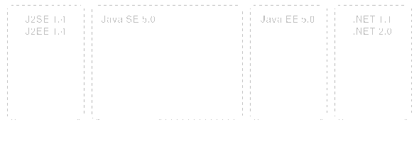
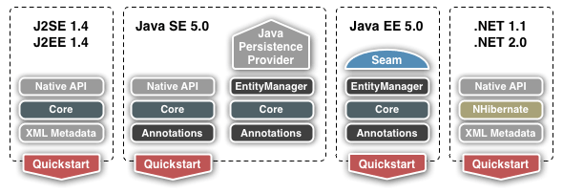
Where to Get Hibernate
http://www.hibernate.org

Slide 138
Required Hibernate Libraries
Libraries are in lib/ directory of Hibernate distribution.
Which ones do you need?
  See _README.txt or my Using Hibernate notes.
In your IDE:
  create a Hibernate "library"
  add JARs to the library
  better than copying JAR files to your project
Required Libraries
hibernate3.jar
antlr-2.7.6.jar
asm.jar
cglib.jar
commons-collections.jar
commons-logging.jar
dom4j.jar
ehcache.jar
jta.jar
log4j.jar
// and maybe
xml-apis.jar

Slide 139
Create a Hibernate Library in Eclipse
1. Project -> Properties -> Java Build Path
2. select Libraries tab.
3. Click "Add Library..." and select "User Library", Next>
4. Create a new user library named "Hibernate"
5. Add Jar files

Slide 140
Add Library or jar for Database Driver
For Embedded Derby Database
/path-to-derby/lib/derby.jar
For HSQLDB
/path-to-hsqldb/lib/hsqldb.jar

Slide 141
hibernate.cfg.xml for Embedded Derby DB
<?xml version='1.0' encoding='utf-8'?>
<!DOCTYPE hibernate-configuration PUBLIC
"-//Hibernate/Hibernate Configuration DTD 3.0//EN"
"http://hibernate.sourceforge.net/hibernate-
configuration-3.0.dtd">
<hibernate-configuration>
<session-factory>
<property name="dialect">
org.hibernate.dialect.DerbyDialect</property>
<property name="connection.driver_class">
org.apache.derby.jdbc.EmbeddedDriver</property>
<property name="connection.url">
jdbc:derby:/temp/eventmgr;create=true</property>
<property name="hbm2ddl.auto">create</property>
<!-- O-R mappings for persistent classes -->
<mapping resource="eventmgr/domain/Location.hbm.xml"/>
</session-factory>
</hibernate-configuration>
Remove after database created

Slide 142
hibernate.cfg.xml for MySQL
<?xml version='1.0' encoding='utf-8'?>
<!DOCTYPE hibernate-configuration PUBLIC ... remainder omitted >
<hibernate-configuration>
<session-factory>
<property name="dialect">
org.hibernate.dialect.MySQLDialect </property>
<property name="connection.driver_class">
com.mysql.jdbc.Driver </property>
<property name="connection.username">student</property>
<property name="connection.password">secret </property>
<property name="connection.url">
jdbc:mysql://se.cpe.ku.ac.th/eventmgr </property>
<!-- Object-Relational mappings for classes -->
<mapping resource="eventmgr/domain/Location.hbm.xml"/>
... other mappings omitted
</session-factory>
</hibernate-configuration>

Slide 143
XML Syntax, 1
XML Declaration: "this file contains XML"
<?xml version='1.0' encoding='utf-8'?>
Root Element: "this whole file is a hibernate-configuration"
<hibernate-configuration>
content of document goes here
<hibernate-configuration>
Child Elements: define content, have a tree-like nested structure
<session-factory>
...
</session-factory>
Tree structure & Scope: all elements must have a closing tag
<class name="Event" table="EVENTS"> a start element
<property name="location" /> element start & end
</class> an end tag
XML is case sensitive

Slide 144
XML Syntax, 2
Attributes: values must always be quotes, no duplicates
<class name="Event" table="EVENTS">
Special characters: < > & ' " must use reference except in CDATA
<message>
&quot;Hello &lt;b&gt;world&lt;/b&gt;&quot
</message>
Child Elements can be repeated (depends on DTD)
<courselist name="courses">
<course>object oriented programming</course>
<course>software spec &amp; design</course>
</courselist>
Elements can sometimes be written as attributes
<course>
<id>219341</id> <course id="219341"/>
</course>

Slide 145
Logging
Hibernate apps will log errors and/or activity.
Two choices:
  Java SDK logging (since JDK 1.4)
  Log4j
  if you use Log4j, create a log4j.properties in your application source root directory.
  Copy this file from the Hibernate etc/ directory.

Slide 146
Sample log4j.properties
Too long to print here
See an actual file, for example:
[hibernate.dir]/doc/tutorial/src/log4j.properties
Configuration logging of Hibernate:
log4j.logger.org.hibernate=warn
Log the SQL generated by Hibernate:
#log4j.logger.org.hibernate.SQL=debug
Log JDBC bind parameters (can be security leak):
log4j.logger.org.hibernate.type=info

Slide 147
Exercise 2
Define a Location class and LOCATIONS table
Write the class
Create a mapping file for Location: Location.hbm.xml

Slide 148
Create the Location class
Location class
Location
id: int
name: String
address: String
LOCATIONS table (Hibernate can auto-generate this)
LOCATIONS
PK id INTEGER
name VARCHAR(80)
address VARCHAR(160)

Slide 149
Write the Location class
package eventmgr.domain;
public class Location {
private int id;
private String name;
private String address;
public Location() { } // a no argument constructor
public int getId( ) { return id; }
public void setId( int id ) { this.id = id; }
public String getName( ) { return name; }
public void setName( String n ) { this.name = n; }
public String getAddress( ) { return address; }
public void setAddress( String a ) { address = a; }
}
Use JavaBean conventions in Persistent object classes.

Slide 150
Hibernate can access private methods
package eventmgr.domain;
public class Location {
private int id;
private String name;
private String address;
public Location() { }
public int getId( ) { return id; }
private void setId( int id ) { this.id = id; }
public String getName( ) { return name; }
private void setName( String n ) { this.name = n; }
public String getAddress( ) { return address; }
private void setAddress( String a ) { address = a; }
}
OK to use "private" or "protected" for mutators.

Slide 151
Hibernate can access private data, too
public class Location {
private int id;
private String name;
private void setName( String name ) {
if ( name.length() < 3 )
new RuntimeException("name too short");
...
}
Some mutator methods contain data validity checks or other complicated logic.
to tell Hibernate to set the field values directly (don't use the "set" method) in the class mapping file write:
<hibernate-mapping default-access="field">
...

Slide 152
Schema to create Locations table
This works for MySQL.
Hibernate can generate table schema at runtime.
CREATE TABLE locations (
id INTEGER NOT NULL,
name VARCHAR(80) NOT NULL,
address VARCHAR(160),
PRIMARY KEY(id)
) DEFAULT CHARSET=utf8 ;
mysql> use eventmgr ;
mysql> source tableschema.sql ;

Slide 153
O-R Mapping for the Location class
Map between object attributes and table columns.
Location
id: int
name: String
address: String
O-R Mapping requires a mapping file
LOCATIONS
PK id INTEGER
name VARCHAR(80)
address VARCHAR(160)

Slide 154
Mapping File Location.hbm.xml
An XML file describing how to map object to table.
Filename: Location.hbm.xml
<!DOCTYPE hibernate-mapping PUBLIC ... remainder omitted >
<hibernate-mapping package="eventmgr.domain">
<class name="Location" table="LOCATIONS">
<id name="id" column="id">
<!-- let hibernate choose id for new entities -->
<generator class="native"/>
</id>
<property name="name" column="name" not-null="true"/>
<property name="address"/>
</class>
</hibernate-mapping>

Slide 155
Mapping File Explained
root element of a hibernate mapping
<hibernate-mapping>
<class name="eventmgr.domain.Location"
table="LOCATIONS"
options... >
<id name="id"
column="id"
unsaved-value="0">
<generator class="native"/>
</id>
object attribute mappings
</class>
</hibernate-mapping>
mapping for one class
Every persistent class needs an "identifier" attribute and column.
The identifier is used to establish object identity (obj1 == obj2) and locate the table row for a persisted object. The id is usually the Primary Key of the table.

Slide 156
Attribute Mapping: <property .../>
Name of the attribute in Java class
Column name in the database table
<property name="name"
column="name“
type=“name“
not-null="true“
/>
Hibernate or Java data type (usually you can omit it)
Constraints
You omit elements if Hibernate can guess the value itself:
<property name="address" column="ADDRESS" type="string"/>
<!-- omit data type and Hibernate will determine it -->
<property name="address" column="ADDRESS"/>
<!-- omit column if same as attribute (ignoring case)-->
<property name="address"/>

Slide 157
What you have so far
Project configured for Hibernate
Hibernate configuration file
Location class and mapping file Location.hbm.xml
Configure a database schema
(for learning, we will auto-generate schema)

Slide 158
HibernateUtil.java
package util;
import org.hibernate.*;
import org.hibernate.cfg.*;
public class HibernateUtil
{
private static final SessionFactory sessionFactory;
static
{ try
{ // Create the SessionFactory from hibernate.cfg.xml
sessionFactory = new Configuration().configure().buildSessionFactory();
} catch (Throwable ex)
{ // Make sure you log the exception, as it might be swallowed System.err.println("Initial SessionFactory creation failed." + ex);
throw new ExceptionInInitializerError(ex); }
}
public static SessionFactory getSessionFactory() { return sessionFactory; }
}
Provides startup and easy use of SessionFactory.

Slide 159
HibernateUtil: a Session Factory (1)
// always use the same sessionFactory (Singleton)
SessionFactory sessionFactory = new Configuration()
.configure().buildSessionFactory();
// use sessionFactory to get a Session
Session session = sessionFactory.openSession();
// or the more convenient:
Session session = sessionFactory.getCurrentSession();
HibernateUtil
-sessionFactory: SessionFactory
+getSessionFactory( ): SessionFactory
+getCurrentSession( ): Session
+openSession( ): Session
1

Slide 160
HibernateUtil: a Session Factory (2)
public class HibernateUtil {
private static SessionFactory sessionFactory = null;
private static final Logger log = Logger.getLogger(..);
public static SessionFactory getSessionFactory() {
if ( sessionFactory == null ) {
try { // Create the SessionFactory
sessionFactory = new Configuration() .configure().buildSessionFactory();
} catch (Exception e) {
System.err.println("sessionFactory error "+ ex);
log.error("SessionFactory creation failed", ex);
//throw new ExceptionInInitializerError(ex);
}
}
return sessionFactory;

Slide 161
HibernateUtil: a Session Factory (3)
/**
* Get the current Hibernate session.
* This creates a new session if no current session.
* @return the current Hibernate Session
*/
public static Session getCurrentSession() {
return getSessionFactory().getCurrentSession();
}
public static Session openSession() {
return getSessionFactory().openSession();
}

Slide 162
Persistence Test: LocationTest.java
public class TestLocation {
public static void testSave() {
Location loc1 = new Location( );
loc1.setName("Kasetsart University");
loc1.setAddress("90 Pahonyotin Rd, Bangkok");
Location loc2 = new Location();
loc2.setName("UCLA");
loc2.setAddress("Westwood, California");
Session session =
HibernateUtil.getCurrentSession();
Transaction tx = session.beginTransaction();
session.saveOrUpdate( loc1 );
session.saveOrUpdate( loc2 );
tx.commit();
System.out.println("Locations saved");
}

Slide 163
Persistence Test: LocationTest.java
public static void testQuery() {
System.out.println("Retrieving locations");
Session session = HibernateUtil.getCurrentSession();
Transaction tx = session.beginTransaction();
Query query = session.createQuery("from Location");
// query.list() returns objects, cast to List<Location>
List<Location> list = (List<Location>)query.list( );
tx.commit();
for(Location l : list ) out.printf("%d %s %s\n",
l.getId(), l.getName(), l.getAddress() );
if ( session.isOpen() ) session.close();
}
public static void main( String [] args) {
testSave( ); testQuery( );

Slide 164
Exercise 3
Test object uniqueness:
  In one session get the same location two times and compare using (ku1 == ku2). Are they same?
  In different sessions get the same location and compare (ku1 == ku2). Are they same?
Test transparent persistence:
  Modify a location inside a session. Does database change?
  Reattach a modified object to new session. Does database change?

Slide 165
Getting a Unique Result
Session session = HibernateUtil.getCurrentSession();
Query query = session.createQuery(
"from Location where name=‘Kasetsart University’");
// query.uniqueResult() returns only first match
Location ku1 = (Location) query.uniqueResult( );
Pattern matches "like" - use "%" as wildcard character
Session session = HibernateUtil.getCurrentSession();
Query query = session.createQuery(
"from Location l where l.name like 'Kasetsart%'");
// query.uniqueResult() returns only first match
Location ku1 = (Location) query.uniqueResult( );

Slide 166
Mapping a Class with Associations
Event
id: long
name: String
startDate: Date
location: Location
Location
id: int
name: String
address: String
*
1
Simplified version of Event class.

Slide 167
O-R Mapping of n-to-1 Associations
Event
id: long
name: String
startDate: Date
location: Location
Location
id: int
name: String
address: String
*
1
The Data Mapper converts a n-to-1 association to a foreign key relation (persist) or foreign key to object (retrieve).
EVENTS
PK id BIGINT
name VARCHAR
start_date TIMESTAMP
FK location_id INTEGER
LOCATIONS
PK id INTEGER
name VARCHAR
address VARCHAR

Slide 168
Mapping for Event (Event.hbm.xml)
Use <many-to-one name="attribute" ... />
to map a reference to another object.
<!DOCTYPE hibernate-mapping PUBLIC ... remainder omitted >
<hibernate-mapping package="eventmgr.domain">
<class name="Event" table="EVENTS">
...
<property name="startDate" column="start_date"
type="timestamp" />
<many-to-one name="location" column="location_id"
class="Location" />
</class>
</hibernate-mapping>
you can omit class (Hibernate can determine itself)

Slide 169
Test: Save an Event
public static void testSave() {
Location loc1 = new Location( );
loc1.setName("Kasetsart University");
loc1.setAddress("90 Pahonyotin Rd, Bangkok");
Event event = new Event( );
event.setName("Java Days");
event.setLocation( loc1 );
event.setStartDate( new Date(108,Calendar.JULY, 1) );
Session session = HibernateUtil.getCurrentSession();
Transaction tx = session.beginTransaction();
session.saveOrUpdate( event );
tx.commit();
System.out.println("Event saved");
}

Slide 170
Did you get an Error?
The Location doesn't exist in database (transient object).
Exception in thread "main“
org.hibernate.TransientObjectException:
object references an unsaved transient instance - save the transient instance before flushing: eventmgr.domain.Location

Slide 171
Persisting the Event location
Solutions:
1. save location during the transaction (manual save)
2. tell Hibernate to cascade the save operation (automatically save Location)
<many-to-one name="location" column="location_id"
class="Location"
cascade="save-update" />
cascade="none" don't cascade operations
"all" cascade all operations (be careful)
"save-update" cascade save and updates
"delete-orphan" cascade all, delete unreferenced orphan children

Slide 172
Test: Retrieve an Event
public static void testRetrieve() {
System.out.println("Retrieving event");
Session session = HibernateUtil.getCurrentSession();
Transaction tx = session.beginTransaction();
Query query = session.createQuery(
"from Event e where e.name= :name");
query.setParameter("name", "Java Days");
// query.list() returns objects, cast to List<Location>
List<Event> list = (List<Event>)query.list( );
tx.commit();
for(Event e : list ) out.printf("%d %s %s\n",
e.getId(), e.getName(), e.getLocation().getName() );
}

Slide 173
Lazy Instances and Proxies
Transaction tx = session.beginTransaction();
Query query = session.createQuery(
"from Event e where e.name=:name");
query.setParameter("name", "Java Days");
List<Event> list = (List<Event>)query.list( );
tx.commit();
for(Event e : list ) out.printf("%d %s %s\n",
e.getId(), e.getName(), e.getLocation().getName() );
Error: LazyInstantiationException
Hibernate uses lazy instantiation and proxy objects
Hibernate instantiates the location object when it is first accessed
We closed the transaction before accessing the location

Slide 174
Two Solutions
Modify our code: getLocation( ) before closing the session.
Tell Hibernate not to use lazy instantiation of Location objects (in Location.hbm.xml)
List<Event> list = (List<Event>)query.list( );
for(Event e : list ) out.printf("%d %s %s\n",
e.getId(), e.getName(), e.getLocation().getName() );
tx.commit( );
<class name="Location" table="LOCATIONS" lazy="false">
...
</class>

Slide 175
Creating a Component for Address
Location
id: int
name: String
address: Address
Address
street: String
city: String
province: String
*
1
LOCATIONS
id name address
101 Kasetsart University street city province
102 Seacon Square

Slide 176
THANKS!!
Further references:
www.tkhts.com
- By Puneet Vashisht

