Slide 1
JDBC

Slide 2
Agenda
1. JDBC Introduction
2. JDBC Architecture
3. JDBC Driver Types
4. JDBC API
5. Steps to Connect to Database
6. Statement
7. Prepared Statement
8. ResultSet
9. Using DAO

Slide 3
JDBC
JDBC is Java application programming interface that allows the Java programmers to access database management system from Java code
It was developed by JavaSoft, a subsidiary of Sun Microsystems.
It is a java API which enables the java programs to execute SQL statements.
In short JDBC helps the programmers to write java applications that manage these three programming activities:
1. It helps us to connect to a data source, like a database.
2. It helps us in sending queries and updating statements to the database and
3. Retrieving and processing the results received from the database in terms of answering to your query

Slide 4
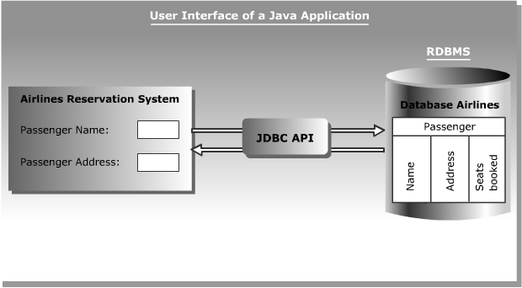
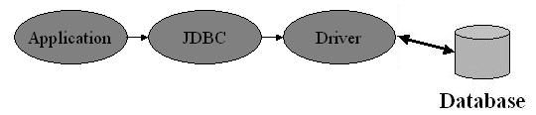
JDBC Architecture
  Sun Microsystems has included JDBC API as a part of J2SDK to develop Java applications that can communicate with databases.
  The following figure shows the Airline Reservation System developed in Java interacting with the Airlines database using the JDBC API:
JDBC

Slide 5
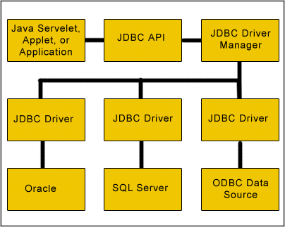
JDBC Driver Types
The JDBC API uses a Driver Manager and database-specific drivers to provide transparent connectivity to heterogeneous databases
Layers of the JDBC Architecture

Slide 6
        JDBC Driver types
      Type -1 JDBC-ODBC Bridge driver
      Type -2 Native-API Partly-Java driver
      Type -3 JDBC-Net Pure-Java driver
      Type -4 Native Protocol Pure-Java driver
JDBC

Slide 7
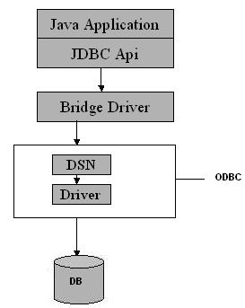
Type 1 Driver
The Type 1 driver translates all JDBC calls into ODBC calls and sends them to the ODBC driver. ODBC is a generic API.
The JDBC-ODBC Bridge driver is recommended only for experimental use or when no other alternative is available
Advantage
The JDBC-ODBC Bridge allows access to almost any database, since the
database’s ODBC drivers are already available.
Disadvantages
1. Since the Bridge driver is not written fully in Java,
Type 1 drivers are not portable.
2. A performance issue is seen as a JDBC call goes through the
bridge to the ODBC driver, then to the database, and this
applies even in the reverse process. They are the slowest of all driver types.
3. The client system requires the ODBC Installation to use the driver.
4. Not good for the Web.
JDBC-ODBC Driver

Slide 8
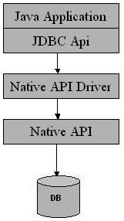
Type 2 Driver
The distinctive characteristic of type 2 jdbc drivers are that Type 2 drivers convert JDBC calls into database-specific
calls i.e. this driver is specific to a particular database. Some distinctive characteristic of type 2 jdbc drivers are
shown below. Example: Oracle will have oracle native api
Advantage
The distinctive characteristic of type 2 jdbc drivers are that they are typically
offer better performance than the JDBC-ODBC Bridge as the layers of
communication (tiers) are less than that of Type-1 and also it uses
Native api which is Database specific.
Disadvantage
1. Native API must be installed in the Client System and hence
type 2 drivers cannot be used for the Internet.
2. Like Type 1 drivers, it’s not written in Java Language
which forms a portability issue.
3. If we change the Database we have to change the native api
as it is specific to a database
4. Mostly obsolete now
5. Usually not thread safe.
Native-API/partly Java driver

Slide 9
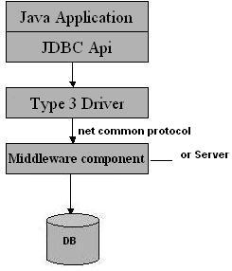
Type 3 Driver
Type 3 database requests are passed through the network to the middle-tier server. The middle-tier then translates the request to the database.
Advantage
1. This driver is server-based, so there is no need for any vendor database
library to be present on client machines.
2. This driver is fully written in Java and hence Portable. It is suitable for the web.
3. There are many opportunities to optimize portability, performance, and
scalability.
4. The net protocol can be designed to make the client JDBC driver very
small and fast to load.
5. The type 3 driver typically provides support for features such as
caching (connections, query results, and so on), load balancing, and advanced
system administration such as logging and auditing.
6. This driver is very flexible allows access to multiple databases using one driver.
7. They are the most efficient amongst all driver types.
Disadvantage
1. It requires another server application to install and maintain.
2. Traversing the recordset may take longer, since the data comes through
the backend server.
All Java/Net-protocol driver

Slide 10
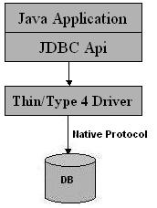
Type 4 Driver
The Type 4 uses java networking libraries to communicate directly with the database server
Advantage
1. The major benefit of using a type 4 jdbc drivers are that they are completely
written in Java to achieve platform independence and eliminate deployment
administration issues. It is most suitable for the web.
2. Number of translation layers is very less i.e. type 4 JDBC drivers
don’t have to translate database requests to ODBC or a native
connectivity interface or to pass the request on to another
server, performance is typically quite good.
3. You don’t need to install special software on the client or server.
Further, these drivers can be downloaded dynamically.
Disadvantage
1. With type 4 drivers, the user needs a different driver for each database.
Native-protocol/all-Java driver

Slide 11
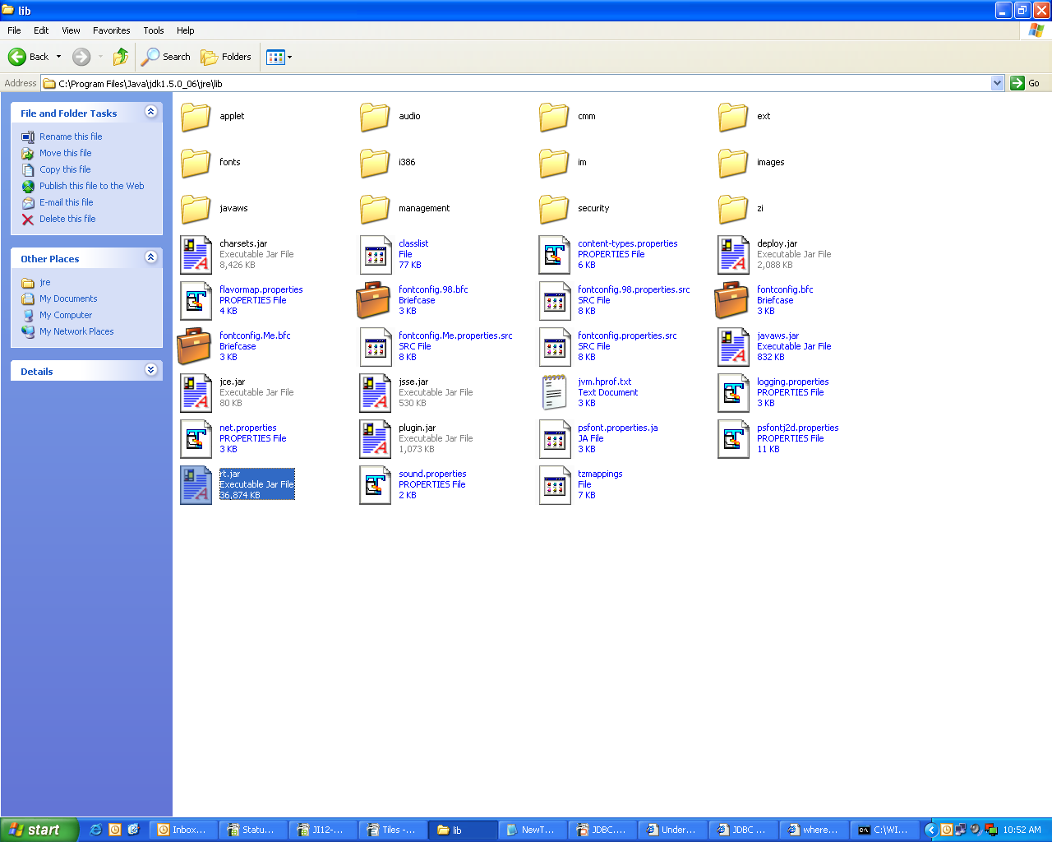
NOTE: Default Driver for JDBC Connectivity
The Implementation for Connection Interface will be there in related Jars
means for Example if you are using database is Oracle 9i then it will be ojdbc14.jar
You can see in that jar for Implementation class .
You can find that file in rt.jar, used for jdbc-odbc driver.

Slide 12
JDBC Versions
Features of JDBC 1.0 API
The JDBC 1.0 API was the first officially JDBC API launched consists of the following java classes and interfaces that you can
open connections to particular databases.
This version includes a completely redesigned administration console with an enhanced graphical interface to manage and monitor
distributed virtual databases.
Features of JDBC 1.2 API
1). It supports Updatabale ResultSets.
2). The DatabaseMetaData code has been refactored to provide more transparency with regard to the underlying database engine.
3) New pass through schedulers for increased performance
Features of The JDBC 2.0 Optional Pacakage API
1). The use of DataSource interface for making a connection.
2). Use of JNDI to specify and obtain database connections.
3). It allows us to use Pooled connections, that is we can reuse the connections.
4). In this version the distrbuted transactions is possible.
5). It provides a way of handling and passing data using Rowset technology.
Features of the JDBC 2.1 core API.
1). Scroll forward and backward in a result set or has the ability to move to a specific row.
2). Instead of using SQL commands, we can make updates to a database tables using methods in the Java programming language
3). We can use multiple SQL statements in a a database as a unit, or batch.
4). It uses the SQL3 datatypes as column values. SQL3 types are Blob, Clob, Array, Structured type, Ref.
5). Increased support for storing persistent objects in the java programming language.
6). Supports for time zones in Date, Time, and Timestamp values.
7). Full precision for java.math.BigDecimal values.

Slide 13
JDBC Versions
Features of JDBC 3.0 API
1). Reusabilty of prepared statements by connection pools.
2). In this version there is number of properties defined for the ConnectionPoolDataSource. These properties can be used to
describe how the PooledConnection objects created by DataSource objects should be pooled.
3) A new concept has been added to this API is of savepoints.
4). Retrieval of parameter metadata.
5). It has added a means of retrieving values from columns containing automatically generated values.
6). Added a new data type i.e. java.sql.BOOLEAN.
7). Passing parameters to CallableStatement.
8). The data in the Blob and Clob can be altered.
9). DatabaseMetaData API has been added.
Features of JDBC 4.0 :
1). Auto- loading of JDBC driver class.
2). Connection management enhancements.
3.) Support for RowId SAL type.
4). SQL exception handling enhancements.
5). DataSet implementation of SQl using Annotations.
6). SQL XML support

Slide 14
Using JDBC API
  The JDBC API classes and interfaces are available in the java.sql and
  the javax.sql packages.
  The commonly used classes and interfaces in the JDBC API are:
    DriverManager class: Loads the driver for a database.
    Driver interface: Represents a database driver. All JDBC driver classes must implement the Driver interface.
    Connection interface: Enables you to establish a connection between a Java application and a database.
    Statement interface: Enables you to execute SQL statements.
    ResultSet interface: Represents the information retrieved from a database.
    SQLException class: Provides information about the exceptions that occur while interacting with databases.

Slide 15
Steps to connect to the database
  The steps to create JDBC (Type -4) application are:
    Load a database driver
    Connect to a database
    Create and execute JDBC statements
    Handle SQL exceptions

Slide 16
A jdbc Connection represents a
session/connection with a specific database.
Within the context of a Connection,
SQL, PL/SQL statements are
executed and results are returned
.An application can have one or
more connections with a single
database, or it can have many
connections with different databases.
The JDBC DriverManager is a very
important class that defines objects
which connect Java applications to
a JDBC driver.
DriverManager class manages the
JDBC drivers that are installed on
the system. Its getConnection()
method is used to establish a
connection to a database.
  Sample Code:
import java.sql.*;
public class TestConnection
{
public static void main(String tr[])
{
try
{
  Class.forName("oracle.jdbc.driver.OracleDriver");
  System.out.println("Driver loaded");
Connection con; con=DriverManager.getConnection("jdbc:oracle:thin:@10.1.50.97:1521:findb","soul_cas","soul_cas");
System.out.println("Connection Established!!!!!!!!!!");
Statement stat=con.createStatement();
ResultSet rs=stat.executeQuery("select * from emp");
while(rs.next())
{
System.out.println(rs.getString(1));
}
}
catch(Exception e)
{
System.out.println(e.toString());
}} }
we load the driver class by calling
Class.forName() with
the Driver class name as an argument
Once a connection is obtained
we can interact with the database.
To execute SQL statements,
you need to instantiate a
Statement object from
your connection object
by using the createStatement()
method.
ResultSet provides access
to a table of data generated
by executing a Statement.
The table rows are retrieved
in sequence. A ResultSet
maintains a cursor pointing
to its current row of data.
The next() method is used
to successively step through
the rows of the tabular results.

Slide 17
Step-1 Loading a Driver
  The forName() method loads the JDBC driver and registers the driver with the driver manager.
  Using the forName() method, for example : Class.forName(“sun.jdbc.odbc.JdbcOdbcdriver”);
  Class.forName(“oracle.jdbc.driver.OracleDriver”);
NOTE:
In this step of the jdbc connection process, we load the driver class by calling Class.forName() with the Driver class name as an argument. Once loaded, the Driver class creates an instance of itself. A client can connect to Database Server through JDBC Driver. Since most of the Database servers support ODBC driver therefore JDBC-ODBC Bridge driver is commonly used.
The return type of the Class.forName (String ClassName) method is “Class”. Class is a class in
java.lang package

Slide 18
Step-2 Connecting to the Database
  Connecting to a Database
    The DriverManager class provides the getConnection() method to create a Connection object.
    Syntax
    Connection con=DriverManager.getConnection("jdbc:oracle:thin:@local
      host:1521:DataBase Name","scott","tiger");
      Sample Code:
      Connection con=DriverManager.getConnection("jdbc:oracle:thin:@10.1.50.97
      :1521:findb","soul_cas","soul_cas");
Refer next
Slide for
details

Slide 19
Connection
Connection- A Connection object represents a connection with a database .
An application may have one or more than one connections with a single database or many connections with the different
databases also.
We can use the Connection object for the following things:
1). It creates the Statement, PreparedStatement and CallableStatement objects for executing the SQL statements.
2). It helps us to Commit or roll back a jdbc transactionn.
3). If you want to know about the database or data source to which you are connected then the Connection object gathers
information about the database or data source by the use of DatabaseMetaData.
String url = "jdbc: odbc: makeConnection";
Connection con = DriverManager.getConnection(url, "userID", "password");

Slide 20
Step-3 Creating and Executing JDBC Statements
    The Connection object provides the createStatement() method to create a Statement object.
    You can use static SQL statements to send requests to a database to retrieve results.
    The Statement interface contains the following methods to send static SQL statements to a database:
      ResultSet executeQuery(String str)
      int executeUpdate(String str)
      boolean execute(String str)

Slide 21
Three kinds of Statements
Statement: Execute simple sql queries without parameters.
Statement createStatement()
Creates an SQL Statement object.
PreparedStatement: Execute precompiled sql queries with or without parameters.
PreparedStatement prepareStatement(String sql)
returns a new PreparedStatement object. PreparedStatement objects are precompiled SQL statements.
Callable Statement: Execute a call to a database stored procedure.
CallableStatement prepareCall(String sql)
returns a new CallableStatement object. CallableStatement objects are SQL stored procedure call statements.

Slide 22
Using Statement
Various Database Operations
  Various database operations that you can perform using a Java application are:
    Querying a table
    Inserting rows in a table
    Updating rows in a table
    Deleting rows from a table

Slide 23
Using Statement
Select
  Querying a Table
    The SELECT statement is executed using the executeQuery() method and returns the output in the form of a ResultSet object.
    The code snippet to retrieve data from the authors table is:
      String str = "SELECT * FROM authors";
      Statement stmt = con.createStatement();
      ResultSet rs = stmt.executeQuery(str);

Slide 24
Using Statement
Insert
  Inserting Rows in a Table
    The executeUpdate() method enables you to add rows in a table.
    The code snippet to insert a row in the authors table is:
    String str = "INSERT INTO authors (au_id, au_lname, au_fname, address, city, state, contract) VALUES ('998-72-3568', 'Ringer','Albert','801 826-0752 67 Seventh Av.', 'Salt Lake City','UT','1')";
    Statement stmt = con.createStatement();
    int count = stmt.executeUpdate(str);

Slide 25
Using Statement
Updating Rows in a Table
    The code snippet to modify a row in the authors table is:
    String str = "UPDATE authors SET address='10932 Second Av.’ WHERE au_id='998-72-3568'";
    Statement stmt = con.createStatement();
    int count = stmt.executeUpdate(str);

Slide 26
Using Statement
  Deleting Rows from a Table
    The code snippet to delete a row from the authors table is:
      String str = "DELETE FROM authors WHERE au_id='998-72-3568'";
      Statement stmt = con.createStatement();
      int count = stmt.executeUpdate(str);

Slide 27
    Prepared Statement
Java JDBC Prepared statements are pre-compiled SQL statements. Precompiled SQL is useful if the same
SQL is to be executed repeatedly, for example, in a loop. Prepared statements in java only save you time if you
expect to execute the same SQL over again.
Prepared statement work same as the statement,but there r some differences. wen u submitting the query
1st time following things happened
1)compiling the query
2)executing the query
3)sending results back to the program
2nd time onwards
1)executing the query directly
2) sending results back to the program

Slide 28
    Using Prepared Statement
    The prepareStatement() method of the Connection object is used to submit parameterized query to a database.
    The SQL statement can contain ‘?’ symbol as placeholders that can be replaced by input parameters at runtime. For example,
    stat=con.prepareStatement("SELECT * FROM authors WHERE au_id = ?");
    The value of each ‘?’ parameter is set by calling an appropriate setXXX() method, where XXX is the data type of the parameter. For example,
    stat.setString(1,"1001");
    ResultSet result=stat.executeQuery();

Slide 29
    Using Prepared Statement
  Inserting Rows
    The code snippet to create a PreparedStatement object that inserts a row into authors table by passing authors data at runtime is:
    String str = "INSERT INTO authors (au_id, au_fname, au_lname) VALUES (?, ?, ?)";
    PreparedStatement ps = con.prepareStatement(str);
    ps.setString(1, "1001");
    ps.setString(2, "Abraham");
    ps.setString(3, "White");
    int rt=ps.executeUpdate();

Slide 30
    Using Prepared Statement
  Updating Rows
    The code snippet to modify the state to CA where city is Oakland in the authors table using the PreparedStatement object is:
      String str = "UPDATE authors SET state= ? WHERE city= ? ";
      PreparedStatement ps = con.prepareStatement(str);
      ps.setString(1, "CA");
      ps.setString(2, "Oakland");
      int rt=ps.executeUpdate();

Slide 31
    Using Prepared Statement
  Deleting Rows
  The code snippet to delete a row from the authors table where author’s first name is Abraham using the PreparedStatement object is:
    String str = "DELETE FROM authors WHERE au_fname= ? ";
    PreparedStatement ps = con.prepareStatement(str);
    ps.setString(1, "Abraham");
    int rt=ps.executeUpdate();

Slide 32
SQL Exception
  Handling SQL Exceptions
    The java.sql package provides the SQLException class, which is derived from the java.lang.Exception class.
    You can catch the SQLException in a Java application using the try and catch exception handling block.
    The SQLException class contains various methods that provide error information, these methods are:
      int getErrorCode(): Returns the error code associated with the error occurred.
      String getSQLState(): Returns X/Open error code.
      SQLException getNextException(): Returns the next exception in the chain of exceptions.

Slide 33
Result Sets
  ResultSet provides access to a table of data generated by executing a Statement. The table rows are retrieved in sequence. A ResultSet maintains a cursor pointing to its current row of data. The next() method is used to successively step through the rows of the tabular results.
  A ResultSet object maintains a cursor that enables you to move through the rows stored in a ResultSet object.

Slide 34
Types of Result Sets
The sensitivity of the ResultSet object is determined by one of three different ResultSet types:
TYPE_FORWARD_ONLY — the result set is not scrollable i.e. the cursor moves only forward, from before
the first row to after the last row.
TYPE_SCROLL_INSENSITIVE — the result set is scrollable; its cursor can move both forward and backward relative
to the current position, and it can move to an absolute position.
TYPE_SCROLL_SENSITIVE — the result set is scrollable; its cursor can move both forward and backward
relative to the current position, and it can move to an absolute position.
Before you can take advantage of these features, however, you need to create a scrollable ResultSet object
The following line of code illustrates one way to create a scrollable ResultSet object:
Statement stmt = con.createStatement(ResultSet.TYPE_SCROLL_SENSITIVE,
ResultSet.CONCUR_READ_ONLY);
ResultSet srs = stmt.executeQuery(”…..”);
The first argument is one of three constants added to the ResultSet API to indicate the type of a ResultSet object:
TYPE_FORWARD_ONLY, TYPE_SCROLL_INSENSITIVE, and TYPE_SCROLL_SENSITIVE.
The second argument is one of two ResultSet constants for specifying whether a result set is read-only or updatable:
CONCUR_READ_ONLY and CONCUR_UPDATABLE.
If you do not specify any constants for the type and updatability of a ResultSet object, you will automatically get one that is TYPE_FORWARD_ONLY and CONCUR_READ_ONLY.

Slide 35
ResultSet Method
When a ResultSet object is first created, the cursor is positioned before the first row.
To move the cursor, you can use the following methods:
next() - moves the cursor forward one row. Returns true if the cursor is now positioned on a row and false if the cursor is
positioned after the last row.
previous() - moves the cursor backwards one row. Returns true if the cursor is now positioned on a row and false if the cursor
is positioned before the first row.
first() - moves the cursor to the first row in the ResultSet object. Returns true if the cursor is now positioned on the first row
and false if the ResultSet object does not contain any rows.
last() - moves the cursor to the last row in the ResultSet object. Returns true if the cursor is now positioned on the last row
and false if the ResultSet object does not contain any rows.
beforeFirst() - positions the cursor at the start of the ResultSet object, before the first row. If the ResultSet object does not contain
any rows, this method hasno effect.
afterLast() - positions the cursor at the end of the ResultSet object, after the last row. If the ResultSet object does
not contain any rows, this method has no effect.
relative(int rows) - moves the cursor relative to its current position.
absolute(int n) - positions the cursor on the n-th row of the ResultSet object

Slide 36
Exercise
1) WAP to print those customer records whose city is delhi.
2) WAP to add,delete, search , update, print customer record.
NOTE:
The Implementation for Connection Interface will be there in related Jars
means for Example if you are using database is Oracle 9i then it will be ojdbc14.jar
You can see in that jar for Implementation class

Slide 37
Important JDBC Concepts
Transaction Management
By Default JDBC Transactions automatically committed immediately after it is
executed and it is treated as a transaction.
But imagine a situation where you want to execute a batch of statements, either
they should commit at on go or they should get failed together.
For this we need to disable the auto- commit mode by using the method:
con.setAutoCommit(false).
After setting the auto- commit as false, no SQL statement will be committed
until we call the con.commit() method.
If there arises any problem while committing then the set of statements will be
rollback, without committing.
con.rollback();

Slide 38
Important JDBC Concepts
import java.sql.Connection;
import java.sql.DriverManager;
import java.sql.Savepoint;
import java.sql.Statement;
public class Main {
public static void main(String[] args) throws Exception {
Connection conn = getConnection();
conn.setAutoCommit(false);
Statement st = conn.createStatement();
st.executeUpdate("create table survey (id int,myURL CHAR);");
st.executeUpdate("insert into survey(id) values(01)");
st.executeUpdate("insert into survey(id) values(02)");
Savepoint mySavepoint = conn.setSavepoint("MYSAVEPOINT");
st.executeUpdate("insert into survey(id) values(03)");
conn.commit();
conn.rollback (mySavepoint);
st.close();
conn.close();
}
private static Connection getConnection() throws Exception {
Class.forName("oracle.jdbc.driver.OracleDriver");
Connection con;
con=DriverManager.getConnection("jdbc:oracle:thin@10.1.53.135:1521:orcl","amit","amit");
return con;
}
}
Rollback to savepoint

Slide 39
Batch Updation
Batch Processing allows you to group related SQL statements into a batch and submit them with one call to the database.
When you send several SQL statements to the database at once, you reduce the amount of communication overhead, thereby improving performance.
JDBC drivers are not required to support this feature. You should use the DatabaseMetaData.supportsBatchUpdates() method to determine if the target database supports batch update processing. The method returns true if your JDBC driver supports this feature.
The addBatch() method of Statement, PreparedStatement, and CallableStatement is used to add individual statements to the batch. The executeBatch() is used to start the execution of all the statements grouped together.
The executeBatch() returns an array of integers, and each element of the array represents the update count for the respective update statement.
Just as you can add statements to a batch for processing, you can remove them with the clearBatch() method. This method removes all the statements you added with the addBatch() method. However, you cannot selectively choose which statement to remove

Slide 40
Batch Updation
Batching with Statement Object:
Here is a typical sequence of steps to use Batch Processing with Statment Object:
Create a Statement object using either createStatement() methods.
Set auto-commit to false using setAutoCommit().
Add as many as SQL statements you like into batch using addBatch() method on created statement object.
Execute all the SQL statements using executeBatch() method on created statement object.
Finally, commit all the changes using commit() method.

Slide 41
Example
// Create SQL statement
String SQL = "INSERT INTO Employees (id, first, last, age) " +
"VALUES(?, ?, ?, ?)";
// Create PrepareStatement object
PreparedStatemen pstmt = conn.prepareStatement(SQL);
//Set auto-commit to false
conn.setAutoCommit(false);
// Set the variables
pstmt.setInt( 1, 400 );
pstmt.setString( 2, "Pappu" );
pstmt.setString( 3, "Singh" );
pstmt.setInt( 4, 33 );
// Add it to the batch
pstmt.addBatch();
// Set the variables
pstmt.setInt( 1, 401 );
pstmt.setString( 2, "Pawan" );
pstmt.setString( 3, "Singh" );
pstmt.setInt( 4, 31 );
// Add it to the batch
pstmt.addBatch();
//Create an int[] to hold returned values
int[] count =pstmt.executeBatch();
//Explicitly commit statements to apply changes
conn.commit();

Slide 42
Scrollable resultset
st = con.createStatement(ResultSet.TYPE_SCROLL_SENSITIVE,
ResultSet.CONCUR_READ_ONLY);
rs.relative(4)
rs.previous()
rs.absolute(3)
rs.last()
rs.first()

Slide 43
Important JDBC Concepts
Working on Image
Class.forName("oracle.jdbc.driver.OracleDriver");
con=DriverManager.getConnection("jdbc:oracle:thin@10.1.53.135:1521:orcl","amit","amit");
stmt = con.createStatement();
rs = stmt.executeQuery("select image from pictures where id = '2'");
if (rs.next()) {
image = rs.getBlob(1);
response.setContentType("image/gif");
InputStream in = image.getBinaryStream();
int length = (int) image.length();
int bufferSize = 1024;
byte[] buffer = new byte[bufferSize];
while ((length = in.read(buffer)) != -1) {
out.write(buffer, 0, length);
}
in.close();
out.flush();

Slide 44
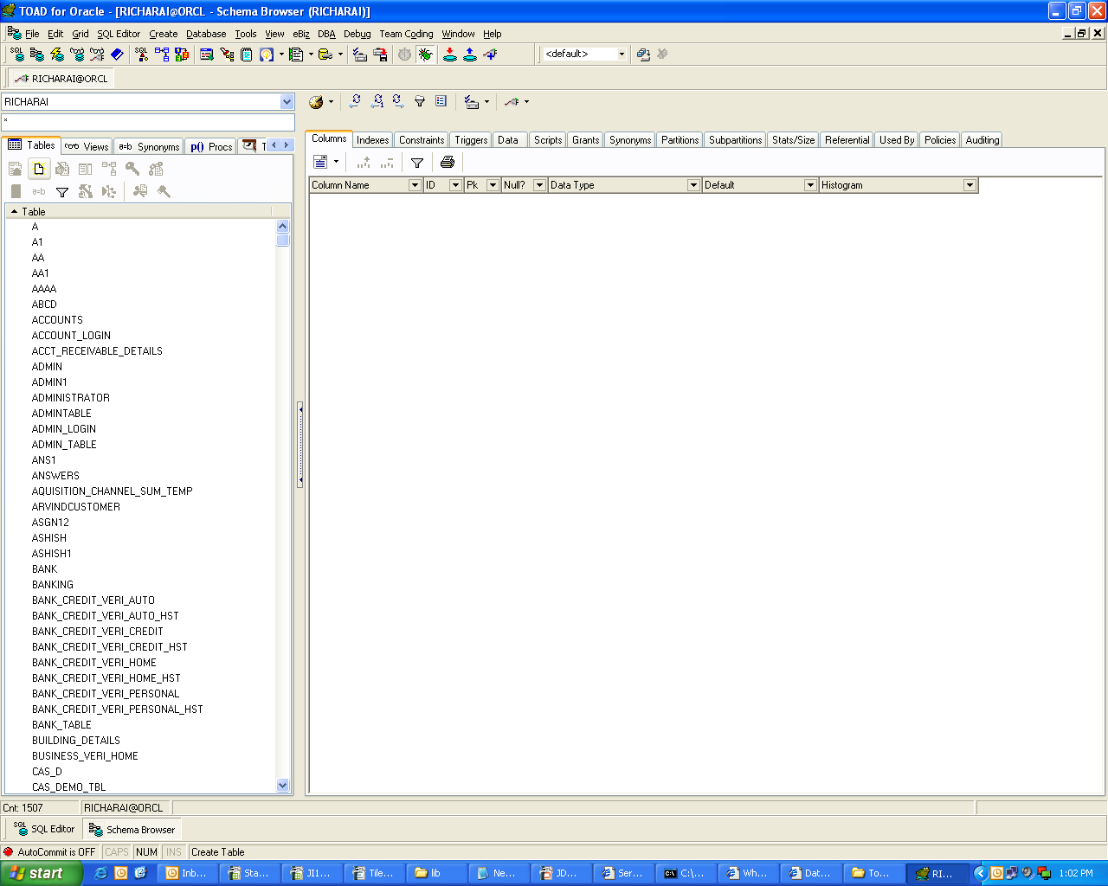
Important JDBC Concepts
Creating Table for storing images
Creating a New
Table

Slide 45
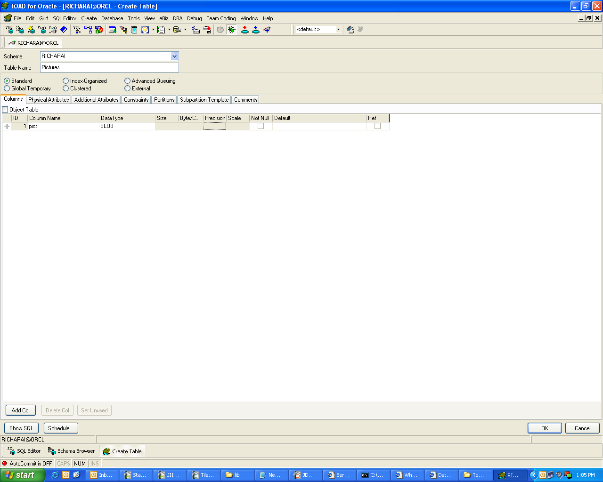
Enter table name
Important JDBC Concepts
Add a new column detail
For image, pdf etc choose
BLOB as Data Type

Slide 46
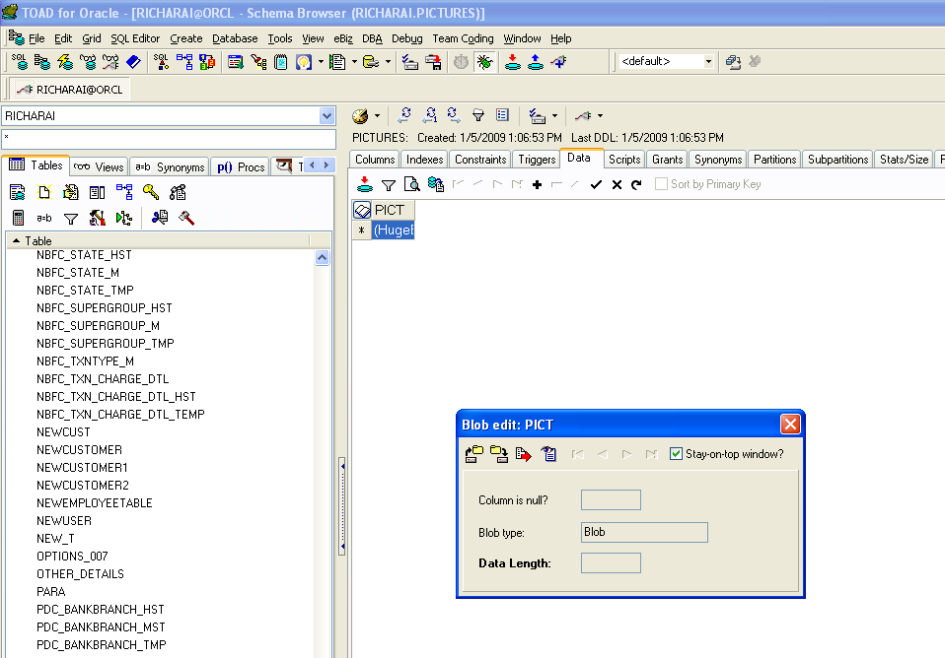
Click on (+) button
to insert a new record.
Click commit to
save
Double click on row and
choose your file.

Slide 47
Important JDBC Concepts
Inserting Date
String INSERT_RECORD = "insert into survey(id, myDate) values(?, ?)";
PreparedStatement pstmt = conn.prepareStatement(INSERT_RECORD);
pstmt.setString(1, "1");
java.sql.Date sqlDate = new java.sql.Date(new java.util.Date().getTime());
pstmt.setDate(2, sqlDate);
pstmt.executeUpdate();

Slide 48
Important JDBC Concepts
Create, drop table using Statement
Statement stmt = conn.createStatement();
stmt.executeUpdate("create table survey (id int, name CHAR(5) );");
stmt.executeUpdate("drop table survey");

Slide 49
Important JDBC Concepts
A JDBC Program to Read Microsoft Excel
import java.sql.Connection;
import java.sql.DriverManager;
import java.sql.ResultSet;
import java.sql.Statement;
public class Main {
public static Connection getConnection() throws Exception {
String driver = "sun.jdbc.odbc.JdbcOdbcDriver";
String url = "jdbc:odbc:excelDB";
String username = "yourName";
String password = "yourPass";
Class.forName(driver);
return DriverManager.getConnection(url, username, password);
}
public static void main(String args[]) throws Exception {
Connection conn = null;
Statement stmt = null;
ResultSet rs = null;
conn = getConnection();
stmt = conn.createStatement();
String excelQuery = "select * from [Sheet1$]";
rs = stmt.executeQuery(excelQuery);
while (rs.next()) {
System.out.println(rs.getString("FirstName") + " " + rs.getString("LastName"));
}
rs.close();
stmt.close();
conn.close();
}}

Slide 50
The CallableStatement
The CallableStatement extends the PreparedStatement interface.
The CallableStatement provides an interface for calling database stored procedures.
the simplest form of this syntax would be:
{call procedure-name}
which represents a call to a stored procedure with no parameters. A call to a stored procedure accepting two input parameters:
{call procedure-name (?, ?)}
CallableStatement callproc = connection.prepareCall("{call updateLast (?, ?)}");
callproc.setInt (1, 5); // 1 specifies the first parameter
callproc.setString (2, "J"); // 2 specifies the second parameter
To now execute the stored procedure, we use the following statement:
callproc.executeUpdate();

Slide 51
Data-Source
The JDBC API provides the DataSource interface as an alternative to the DriverManager for establishing the connection.
A DataSource object is the representation of database
DataSource object can be thought as a factory for making connections to the particular database that the DataSource instance represents.
DataSource object works with JNDI (Java Naming and Directory interface) naming service so application can use the JNDI API to access the DataSource object
In short we can say that the DataSource interface is implemented to provide three kinds of connections:
1). Basic DataSource class
This class is provided by the driver vendor. It is used for portability and easy maintence.
2). To provide connection pooling.
It is provided by the application server vendor or driver vendor. It works with ConnectionPoolDataSource class provided by a driver vendor. Its advantage is portability, easy maintenence and increased performance.
3). To provide distributed transactions
This class works with an XADataSource class, which is provided by the driver vendor. Its advantages are easy maintenence, portability and ability to participate in distributed transactions

Slide 52
META-DATA
DatabaseMetaData
Metadata is data about data. Database metadata is information about a database.
Database metadata provides information about the structure of a database and its tables, views, and stored procedures.
Class.forName("oracle.jdbc.driver.OracleDriver");
con=DriverManager.getConnection("jdbc:oracle:thin@10.1.53.135:1521:orcl","amit","amit");
DatabaseMetaData mtdt = conn.getMetaData();
System.out.println("URL in use: " + mtdt.getURL());
System.out.println("User name: " + mtdt.getUserName());
System.out.println("DBMS name: " + mtdt.getDatabaseProductName());
System.out.println("DBMS version: " + mtdt.getDatabaseProductVersion());
System.out.println("Driver name: " + mtdt.getDriverName());
System.out.println("Driver version: " + mtdt.getDriverVersion());
System.out.println("supp. SQL Keywords: " + mtdt.getSQLKeywords());

Slide 53
META-DATA
ResultSetMetaData
ResultSet rs = st.executeQuery("SELECT * FROM survey");
ResultSetMetaData rsMetaData = rs.getMetaData();
int numberOfColumns = rsMetaData.getColumnCount();
// get the column names; column indexes start from 1
for (int i = 1; i < numberOfColumns + 1; i++) {
String columnName = rsMetaData.getColumnName(i);
String tableName = rsMetaData.getTableName(i);
System.out.println(columnName);
System.out.println(tableName);
}

Slide 54
WHAT IS DAO
The Data Access Object design pattern provides a technique for separating object persistence and data access logic from any particular persistence mechanism or API.
The DAO manages the connection with the data source to obtain and store data.
The DAO implements the access mechanism required to work with the data source. The data source could be a persistent store like an RDBMS.

Slide 55
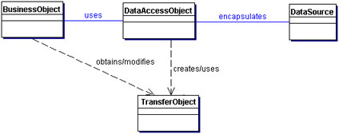
Structure
Below Figure shows the class diagram representing the relationships for the DAO pattern.
EJB
DTO

Slide 57
BusinessObject
The BusinessObject represents the data client. It is the object that requires access to the data source to obtain and store
data. A BusinessObject may be implemented as a session bean, entity bean, or some other Java object, in addition to
a servlet or helper bean that accesses the data source.
        DataAccessObject
The DataAccessObject is the primary object of this pattern. The DataAccessObject abstracts the underlying data access
implementation for the BusinessObject to enable transparent access to the data source.
The BusinessObject also delegates data load and store operations to the DataAccessObject.
        DataSource
This represents a data source implementation. A data source could be a database such as an RDBMS, OODBMS, XML repository
, flat file system, and so forth. A data source can also be another system (legacy/mainframe),
service (B2B service or credit card bureau), or some kind of repository (LDAP).
        TransferObject
This represents a Transfer Object used as a data carrier. The DataAccessObject may use a Transfer Object to return
data to the client. The DataAccessObject may also receive the data from the client in a Transfer Object to update
the data in the data source

Slide 58
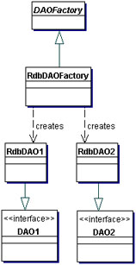
When the underlying storage is not subject to change from one implementation to another, this strategy can be implemented
using the Factory Method pattern to produce a number of DAOs needed by the application.
The class diagram for this case is shown in Figure
Figure Factory for Data Access Object strategy using Factory Method

Slide 59
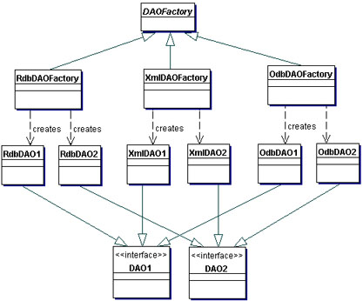
When the underlying storage is subject to change from one implementation to another, this strategy may be implemented
using the Abstract Factory pattern. The Abstract Factory can in turn build on and use the Factory Method implementation,
as suggested in Design Patterns: Elements of Reusable Object-Oriented Software [GoF]. In this case, this strategy provides an
abstract DAO factory object (Abstract Factory) that can construct various types of concrete DAO factories, each factory
supporting a different type of persistent storage implementation. Once you obtain the concrete DAO factory for a specific
implementation, you use it to produce DAOs supported and implemented in that implementation.
The class diagram for this strategy is shown in Figure . This class diagram shows a base DAO factory, which is an abstract
class that is inherited and implemented by different concrete DAO factories to support storage implementation-specific
access. The client can obtain a concrete DAO factory implementation such as RdbDAOFactory and use it to obtain
concrete DAOs that work with that specific storage implementation. For example, the data client can obtain an RdbDAOFactory
and use it to get specific DAOs such as RdbCustomerDAO, RdbAccountDAO, and so forth. The DAOs can extend and
implement a generic base class (shown as DAO1 and DAO2) that specifically describe the DAO requirements for the business
object it supports. Each concrete DAO is responsible for connecting to the data source and obtaining and manipulating data
for the business object it supports

Slide 60
Consequences
•Enables Transparency
Business objects can use the data source without knowing the specific details of the data source's implementation. Access is transparent because the implementation details are hidden inside the DAO.
•Enables Easier Migration
A layer of DAOs makes it easier for an application to migrate to a different database implementation. The business objects have no knowledge of the underlying data implementation. Thus, the migration involves changes only to the DAO layer. Further, if employing a factory strategy, it is possible to provide a concrete factory implementation for each underlying storage implementation. In this case, migrating to a different storage implementation means providing a new factory implementation to the application.
•Reduces Code Complexity in Business ObjectsBecause the DAOs manage all the data access complexities, it simplifies the code in the business objects and other data clients that use the DAOs. All implementation-related code (such as SQL statements) is contained in the DAO and not in the business object. This improves code readability and development productivity.
•Centralizes All Data Access into a Separate Layer
Because all data access operations are now delegated to the DAOs, the separate data access layer can be viewed as the layer that can isolate the rest of the application from the data access implementation. This centralization makes the application easier to maintain and manage.
•Not Useful for Container-Managed Persistence
Because the EJB container manages entity beans with container-managed persistence (CMP), the container automatically services all persistent storage access. Applications using container-managed entity beans do not need a DAO layer, since the application server transparently provides this functionality. However, DAOs are still useful when a combination of CMP (for entity beans) and BMP (for session beans, servlets) is required.
•Adds Extra Layer
The DAOs create an additional layer of objects between the data client and the data source that need to be designed and implemented to leverage the benefits of this pattern. But the benefit realized by choosing this approach pays off for the additional effort.
•Needs Class Hierarchy Design
When using a factory strategy, the hierarchy of concrete factories and the hierarchy of concrete products produced by the factories need to be designed and implemented. This additional effort needs to be considered if there is sufficient justification warranting such flexibility. This increases the complexity of the design. However, you can choose to implement the factory strategy starting with the Factory Method pattern first, and then move towards the Abstract Factory if necessary.

Slide 61
Implementing Factory for Data Access Objects Strategy

Slide 62
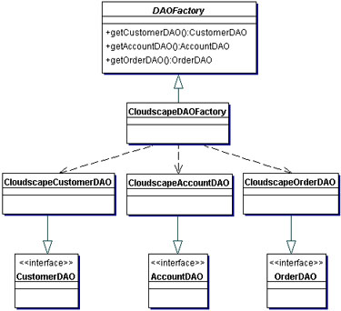
Using Factory Method Pattern
Consider an example where we are implementing this strategy in which a DAO factory produces many DAOs for a single
database implementation (e.g., Oracle). The factory produces DAOs such as CustomerDAO, AccountDAO, OrderDAO, and
so forth. The class diagram for this example is shown in Figure

Slide 63
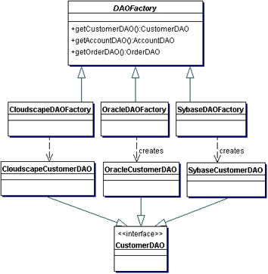
Using Abstract Factory Pattern
Consider an example where we are considering implementing this strategy for three different databases. In this case, the
Abstract Factory pattern can be employed. The class diagram for this example is shown in Figure .
This factory produces DAOs such as CustomerDAO, AccountDAO, OrderDAO, and so forth. This strategy uses the Factory Method implementation in the factories produced by the Abstract Factory.

Slide 64
Abstract DAOFactory Class
// Abstract class DAO Factory
public abstract class DAOFactory {
// List of DAO types supported by the factory
public static final int CLOUDSCAPE = 1;
public static final int ORACLE = 2;
public static final int SYBASE = 3;
...
// There will be a method for each DAO that can be
// created. The concrete factories will have to
// implement these methods.
public abstract CustomerDAO getCustomerDAO();
public abstract AccountDAO getAccountDAO();
public abstract OrderDAO getOrderDAO();
...
public static DAOFactory getDAOFactory(int whichFactory) {
switch (whichFactory) {
case CLOUDSCAPE:
return new CloudscapeDAOFactory();
case ORACLE :
return new OracleDAOFactory();
case SYBASE :
return new SybaseDAOFactory();
...
default :
return null;
}
}
}

Slide 65
Concrete DAOFactory Implementation for Cloudscape
// Cloudscape concrete DAO Factory implementation
import java.sql.*;
//This class basically is a OracleDAOFactory
// And this class contains the logic of Database connectivity,
//reterive, add, delete etc.
public class CloudscapeDAOFactory extends DAOFactory {
public static final String DRIVER=
"COM.cloudscape.core.RmiJdbcDriver";
public static final String DBURL=
"jdbc:cloudscape:rmi://localhost:1099/CoreJ2EEDB";
// method to create Cloudscape connections
public static Connection createConnection() {
// Use DRIVER and DBURL to create a connection
// Recommend connection pool implementation/usage
}
public CustomerDAO getCustomerDAO() {
// CloudscapeCustomerDAO implements CustomerDAO
return new CloudscapeCustomerDAO();
}
public AccountDAO getAccountDAO() {
// CloudscapeAccountDAO implements AccountDAO
return new CloudscapeAccountDAO();
}
public OrderDAO getOrderDAO() {
// CloudscapeOrderDAO implements OrderDAO
return new CloudscapeOrderDAO();
}
...
}

Slide 66
Base DAO Interface for Customer
// Interface that all CustomerDAOs must support
public interface CustomerDAO {
public int insertCustomer(...);
public boolean deleteCustomer(...);
public Customer findCustomer(...);
public boolean updateCustomer(...);
public RowSet selectCustomersRS(...);
public Collection selectCustomersTO(...);
...
}

Slide 67
public boolean deleteCustomer(...) {
// Implement delete customer here
// Return true on success, false on failure
}
public Customer findCustomer(...) {
// Implement find a customer here using supplied
// argument values as search criteria
// Return a Transfer Object if found,
// return null on error or if not found
}
public boolean updateCustomer(...) {
// implement update record here using data
// from the customerData Transfer Object
// Return true on success, false on failure or
// error
}
public RowSet selectCustomersRS(...) {
// implement search customers here using the
// supplied criteria.
// Return a RowSet.
}
public Collection selectCustomersTO(...) {
// implement search customers here using the
// supplied criteria.
// Alternatively, implement to return a Collection
// of Transfer Objects.
}
...
}
Cloudscape DAO Implementation for Customer
CloudscapeCustomerDAO implementation of the
// CustomerDAO interface. This class can contain all
// Cloudscape specific code and SQL statements.
// The client is thus shielded from knowing
// these implementation details.
import java.sql.*;
public class CloudscapeCustomerDAO implements
CustomerDAO {
public CloudscapeCustomerDAO() {
// initialization
}
// The following methods can use
// CloudscapeDAOFactory.createConnection()
// to get a connection as required
public int insertCustomer(...) {
// Implement insert customer here.
// Return newly created customer number
// or a -1 on error
}

Slide 68
Customer Transfer Object (DTO)
public class Customer implements java.io.Serializable {
// member variables
int CustomerNumber;
String name;
String streetAddress;
String city;
...
// getter and setter methods...
...
}

Slide 69
Using a DAO and DAO Factory - Client Code
// create the required DAO Factory
DAOFactory cloudscapeFactory = DAOFactory.getDAOFactory(DAOFactory.DAOCLOUDSCAPE);
// Create a DAO
CustomerDAO custDAO = cloudscapeFactory.getCustomerDAO();
// create a new customer
int newCustNo = custDAO.insertCustomer(...);
// Find a customer object. Get the Transfer Object.
Customer cust = custDAO.findCustomer(...);
// modify the values in the Transfer Object.
cust.setAddress(...);
cust.setEmail(...); // update the customer object using the DAO
custDAO.updateCustomer(cust); // delete a customer object custDAO.deleteCustomer(...); // select all customers in the same city Customer criteria=new Customer();
criteria.setCity("New York");
Collection customersList = custDAO.selectCustomersTO(criteria);
// returns customersList - collection of Customer
// Transfer Objects. iterate through this collection to // get values.

Slide 70
Customer related CRUD
methods signature defined
here
CRUD Operations with
Hardcore
Database Coding
ORACLEDAO Factory
CustomerDAO Interface
HAS-A
IS-A
DAO -I
DAO Use
Class OracleCustomerDAO implements DAO and
HAS-A ORACLEDAO Factory

Slide 71
Product Example
AddressDetailDAO Interface
OracleAddressDAO ISA AddressDetailDAO interface HAS-A OracleFactory class
OracleDAOFactory class
AddressDetail class
PreparedStmtDTO class

Slide 72
Exercise
Create a Customer Bean (Act as a DTO)
Create a OracleDAO Factory (Hardcore JDBC code)
Create a CustomerDAO interface (Argument DTO in
methods)
Create a OracleCustomerDAO and provide the
add,delete,search and print facility.

