Slide 1
Web Service
A Primer
Amit Srivastava

Slide 2
Prerequisites
Good knowledge of Java Programming language
Basic Knowledge of XML (eXtensible Markup Language) and XSD (XML Schema Definition)

Slide 3
Contents
Acronyms
XML – Purpose
XML – A brief anatomy
XSD – Purpose
XSD – A brief anatomy
Web Service
SOAP
SOAP – A Brief anatomy
WSDL
WSDL – A Brief anatomy
Next Steps?

Slide 4
Acronyms
XML :eXtensible Markup Language
XSD :XML Schema Definition
JAX-WS :Java API for XML based Web Service
SOAP :Simple Object Access Protocol
WSDL :Web Service Description Language
JAXB :Java API for XML Binding

Slide 5
XML
XML
Is a markup language
Defines set of rules for encoding documents
Document is readable by both the machine and human
Is used to communicate data in textual format among applications
Is used for representation of arbitrary data structures

Slide 6
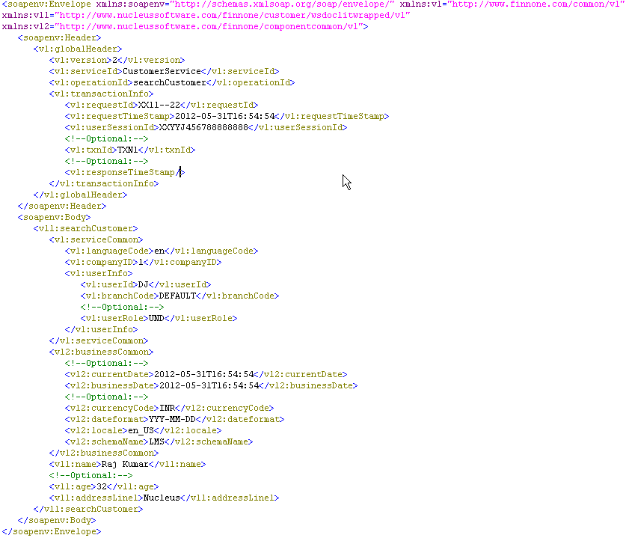
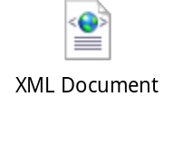
Root tag
Tag
XML - A brief anatomy
Tag - Start tag
Prefix
Name space
Content
Element
Tag - Empty tag
Markup
Tag - End tag
XML Document
Comment
Parent Element
Child Element

Slide 7
XSD
XSD
In simple words, describes the structure of XML document. Such as
  Elements that can appear in a document
  Defines relationship among elements such as parent and child element
  Order of child elements
  Number of child elements. (i.e., cardinality of an element 0, 1, 0-n, 1-n etc.)
  Mandatory or optional presence of the element
  Data types of the elements
  Default and fixed value of the document
  And many more customized rules (including regular expression)…
In other words,
  is used to express a set of rules to which an XML document must conform in order to be considered valid according to that schema
  Is a description of a type of XML document, typically expressed in terms of constraints on the structure and content of documents of that type above and beyond the basic syntactical constraints imposed by XML itself

Slide 8
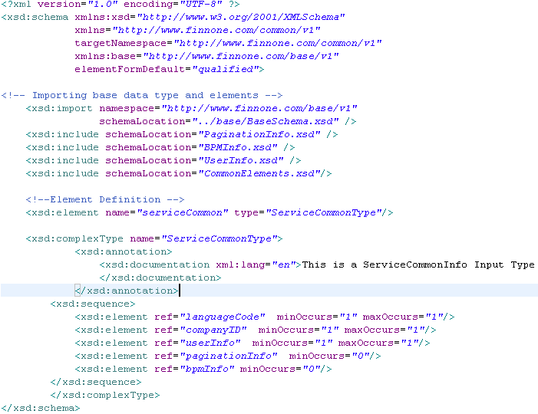
Schema starts here
Default Namespace of the document
XSD – A brief anatomy
Defining prefix for other namespace used in the document
Target Namespace Of the document
Importing schema of other namespace
Including schema of same namespace
Giving element a name
Defining an element
Defining a complex type
Giving type a name
Documentation of a type
Ordering of elements
Putting restriction on number of appearance
Referring a pre-defined element

Slide 9
Web Service
“Web service is a software system designed to support interoperable machine-to-machine interaction over a network”
Web services primarily uses following:
SOAP messages – An XML document
Communication protocol – Primarily HTTP (JMS, SMTP are also used)
WSDL – An interface described in machine-processable format

Slide 10
SOAP
SOAP is a protocol specification for exchanging structured information in the implementation of web services in computer networks. It relies on XML for its message format and relies on application layer protocol, primarily on HTTP (JMS and SMTP etc. are also used)

Slide 11
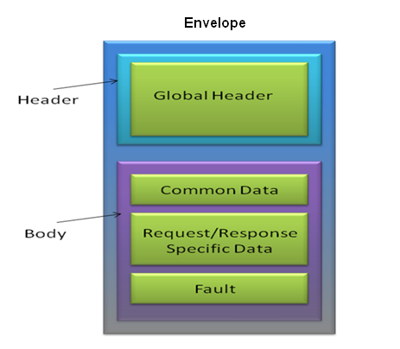
SOAP – A brief anatomy

Slide 12
SOAP – A brief anatomy (Contd.)
SOAP envelope – The SOAP <Envelope> is the root element in every SOAP message, and contains two child elements, an optional <Header> and a mandatory <Body>
SOAP header – The SOAP <Header> is an optional sub-element of the SOAP envelope, and is used to pass application-related information that is to be processed by SOAP nodes along the message path.
SOAP body – The SOAP <Body> is a mandatory sub-element of the SOAP envelope, which contains information intended for the ultimate recipient of the message
The SOAP fault – The SOAP <Fault> is a sub-element of the SOAP body, which is used for reporting errors

Slide 13
WSDL
A WSDL of a web service (also referred to as a WSDL file) provides a machine-readable description of how the service can be called, what parameters or data structure it expects, and what data structure it returns
A WSDL (version 1.1) contains
Types– a container for data type definitions, using some type system (such as XSD), used to describe the messages exchanged
Message– an abstract, typed definition of the data being transmitted or communicated.
Operation– an abstract description of an action supported by the service.
Port Type–an abstract set of operations supported by endpoints.
Binding– a concrete protocol and data format specification for a particular port type.
Port– a single endpoint defined as a combination of a binding and a network address.
Service– a collection of related endpoints.

Slide 14
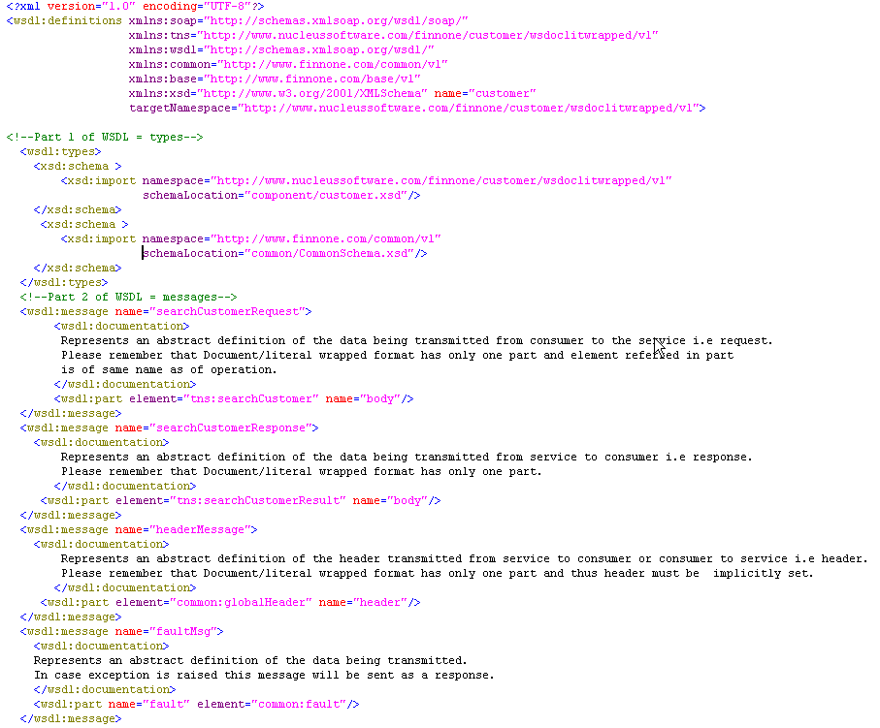
Declaration of target namespace and mention of namespace to be used along with its prefix
WSDL – A brief anatomy
Types (XSD) import or definition for data structures to be used in Body, Header or Fault
Messages created from types imported or created in types section

Slide 15
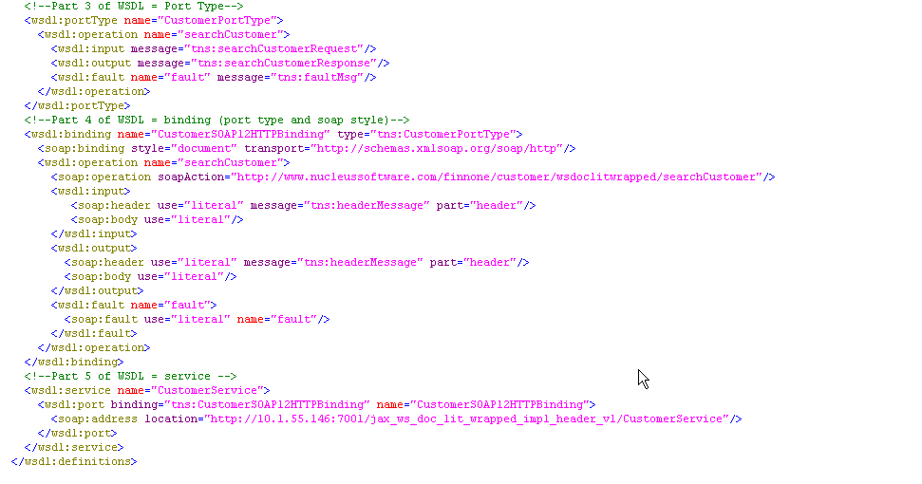
Port Type
WSDL – A brief anatomy (Contd.)
Operation
Transport
Port Type
Data Format
Message used for SOAP Header
Fault
Service
Port & Binding mapping for Service
Network address of the service
Port

Slide 16
Web Service Approaches
Contract last or Bottom up approach:
When using contract last approach, you first write your java code then you create web service contract(WSDL) .There are various kinds of tools which can generate WSDL on the basis of java code.
Contract first or Top Down Approach :
It is reverse of contract first. Here you first define web service contract. You define all the elements of WSDL first then after that you create your java logic.

Slide 17
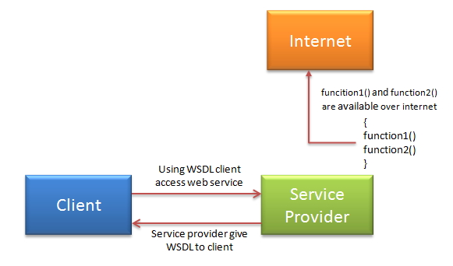
Ways to Access Web Service
If Service Provider knows Client:

Slide 18
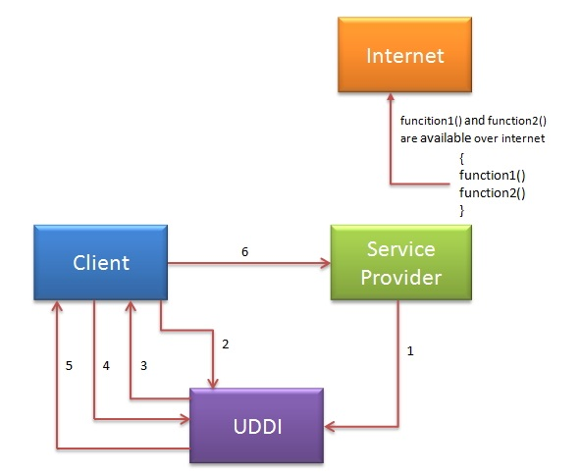
Ways to Access Web Service
UDDI Registry

Slide 19
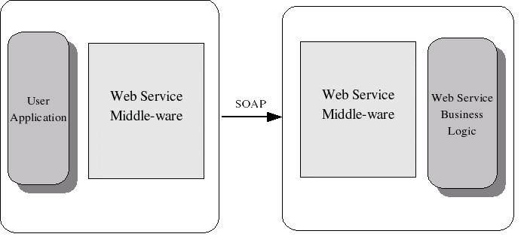
Axis 2 – Web Service Middleware

Slide 20
Axis 2 – Web Service Middleware
Axis2 handles SOAP processing along with numerous other tasks. This makes life of a Web service developer a whole lot easier. Following are the identified requirements:
Provide a framework to process the SOAP messages. The framework should be extensible and the users should be able to extend the SOAP processing per service or per operation basis. Furthermore, it should be able to model different Message Exchange Patterns (MEPs) using the processing framework.
Ability to deploy a Web service (with or without WSDL)
Provide a Client API that can be used to invoke Web services. This API should support both the Synchronous and Asynchronous programming models.
Ability to configure Axis2 and its components through deployment.
Ability to send and receive SOAP messages with different transports.

Slide 21
JAX-WS vs JAX-RS
JAX-WS: addresses advanced QoS requirements commonly occurring in enterprise computing. When compared to JAX-RS, JAX-WS makes it easier to support the WS-* set of protocols, which provide standards for security and reliability, among other things, and interoperate with other WS-* conforming clients and servers.
JAX-RS: makes it easier to write web applications that apply some or all of the constraints of the REST style to induce desirable properties in the application, such as loose coupling (evolving the server is easier without breaking existing clients), scalability (start small and grow), and architectural simplicity (use off-the-shelf components, such as proxies or HTTP routers). You would choose to use JAX-RS for your web application because it is easier for many types of clients to consume RESTful web services while enabling the server side to evolve and scale. Clients can choose to consume some or all aspects of the service and mash it up with other web-based services.
Notes:
JAX-WS means WSDL/SOAP
JAX-RS means RESTful

Slide 22
REST – Representational State Transfer
In a REST based architecture everything is a resource. A resource is accessed via a common interface based on the HTTP standard methods.
In a REST based architecture you typically have a REST server which provides access to the resources and a REST client which accesses and modify the REST resources.
Every resource should support the HTTP common operations. Resources are identified by global IDs (which are typically URIs).
REST allows that resources have different representations, e.g. text, xml, json etc. The rest client can ask for specific representation via the HTTP protocol (content negotiation).
Notes:
JAX-WS means WSDL/SOAP
JAX-RS means RESTful

Slide 23
Jersey – Reference Implementation
Java defines REST support via the Java Specification Request 311 (JSR). This specificiation is called JAX-RS (The Java API for RESTful Web Services). JAX-RS uses annotations to define the REST relevance of Java classes.
Jersey is the reference implementation for this specification. Jersey contains basically a REST server and a REST client. The core client can be used provides a library to communicate with the server.
Notes:
JAX-WS means WSDL/SOAP
JAX-RS means RESTful

Slide 24
Next Steps?
Let’s Jump start to implement it!
But how?
Using Spring or Using JWS?

