Slide 1
EJB
Amit Srivastava
Notes:
<number>

Slide 2
Motivations for EJB
Prior to EJB specification, reusable middleware was hard to create.
EJB borrowed many concepts defined by servlets and adapted them to middle tier.
Notes:
In 90s, 10 middleware companies were compete ting.. Corba
<number>

Slide 3
Component-Based Development
Take code reuse to a whole new level.
Instead of code, reuse a bigger chunk of functionality.

Slide 4
What is EJB
A reusable component
A Java Object
An encapsulation of enterprise business logic and data
Executed in Containers
Notes:
MainFrame or Unix Server – Business Logic.. Embedded Implementation??
<number>

Slide 5
Facilities
Provides services so that you don’t have to write them yourself.
Transaction Management
Security
Concurrency Management
Networking
Resource Management
Persistence
Messaging
Pooling
Notes:
<number>

Slide 6
History of EJB
EJB 1.0 – All Java Based; cumbersome
EJB 2.0 – Java Based + xml; tedious
EJB 2.1 – Java Based + xml; slightly easier
EJB 3.0 – Java Based + xml + annotations; easier
EJB 3.1 – Java based + xml + annotations; easiest
EJB 3.2 - Java based + xml + annotations; best available
Most legacy applications are built using EJB 2.x specification.
Notes:
Convention over Configuration from 3.0
<number>

Slide 7
EJB 2.x Strengths
More capabilities than EJB 1.0 spec
Clean separation of business services
Persistence supports usable object/relational mapping
Message oriented middleware capabilities
Performance improvements

Slide 8
EJB 2.x Weaknesses
Cumbersome programming model
Complex deployment model
Mediocre object/relational mapping.

Slide 9
EJB 3.x Strengths
Simplified programming model
Simplified deployment model
More robust persistence structure.

Slide 10
EJB 3.x Weaknesses
Yet another programming model
Aspect Oriented Programming and Dependency Injection not as robust as other frameworks
Limited vendor support

Slide 11
New Features of EJB 3.0
Annotations instead of Deployment Descriptors
Callback methods and listeners
Interceptors
Dependency Injection
Notes:
If I wanted to receive a notification from container as my object transitioned from lifecyle states, would have to adopt specific coding conventions.. More specifically method signatures.
Interceptors: Aspect Oriented Program
<number>

Slide 12
New Features of EJB 3.1
Simplified EJB development – no interfaces
Singleton Session Beans
Enhanced Timer Service
Application Profiles
Notes:
If I wanted to receive a notification from container as my object transitioned from lifecyle states, would have to adopt specific coding conventions.. More specifically method signatures.
Interceptors: Aspect Oriented Program
<number>

Slide 13
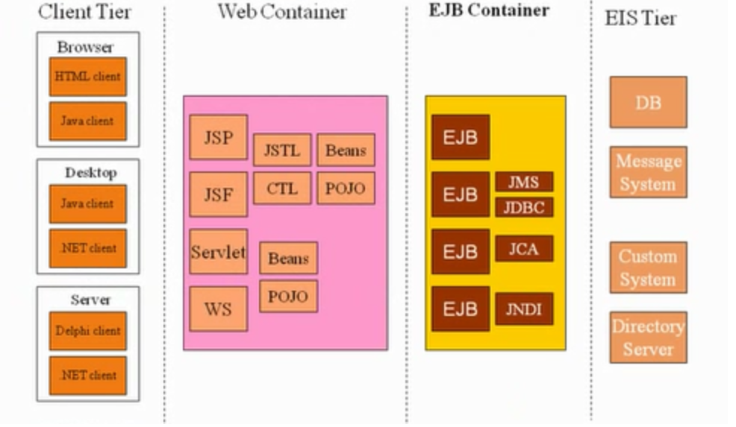
EJBs within JEE

Slide 14
EJB Development Concepts
Type of Enterprise Java Beans
EJB Client Access Modes
EJB Instance Management
EJB Development Elements

Slide 15
Enterprise Java Beans
Designed to provide:
Exists as
Database abstraction
Reusable business logic components
Workflow components
Transportable implementation

Slide 16
Types of Enterprise Java Beans
Three Main Categories
Business Logic – SessionBean
Workflow Logic – MessageDrivenBean
Persistence Logic - JPA Entity

Slide 17
Session Beans
Reusable business logic components
Can be used to manage state across client interactions
Three types
Stateless (SLSB)
Stateful (SFSB)
Singleton (SSB) [3.1 or higher]

Slide 18
Message Driven Beans [MDB]
Reusable workflow logic components
Rely of Java Messaging System
Supports Transactions
Similar to Stateless Session Beans
MDBs have no client-oriented state
No distinction across client or bean
Different from Stateless Session Beans
No direct client access
Asynchronous interactions

Slide 19
Entity Beans
Persistence model for EJB
Focused on automatic persistence through object model
Three primary types:
Bean Managed Persistence (BMP)
Container Managed Persistence (CMP)
JPA Entities [EE5 or higher]
Notes:
<number>

Slide 20
Category Related Annotations
Bean Type | Annotation
Session Bean | @Stateless @Stateful @Singleton
Message Driven Bean | @MessageDriven
JPA Entities | @Entity @Entity Manger

Slide 21
EJB Client Access Modes
Three client access modes
Local Client Access
Remote Client Access
Web Service Client Access
Client access mode is specified by Annotation
Notes:
<number>

Slide 22
EJB Classfications [cont.]
Local Beans are accessible
Only by other EJBs in the same context
All categories of beans can be local
Remote Beans are accessible
By EJBs in the same context or outside the context
By other “objects” outside the container
Only Session Beans can be remote
Web Service end-points
Translate SB and MDBs into Web-Services
Container manages WSDL/SOAP mappings
Notes:
Contexts for WAR, JAR, EAR. Local cannot be accessed if in two separate JAR files.
Optimization in Remote.. They don’t always make use of RMI if in the same context
<number>

Slide 23
Access Mode Annotations
Bean Type | Annotation
Session Bean | @Local @Remote @LocalBean* @WebService
Message Driven Bean | @WebService
JPA Entities | N/A
* In EJB 3.1
Notes:
LocalBean without creating a interface
<number>

Slide 24
EJB Instance Management
Two management modes:
Container Managed
Bean Managed
Management modes specified by Annotations

Slide 25
EJB Classifications
In container-managed, container manages:
Transactions
Roles
Security
Persistence and Entities (Persistence Context)
Otherwise it is the job of bean.
@TransactionManagement(BEAN)
In any case, bean creation and lifecycle is handled by the container.

Slide 26
EJB Access
EJB Instance access is controlled by container
There is no direct client access
Automatic creation by container
Transaction
Security
Interceptors
Client
Proxy
EJB
EJB
EJB

Slide 27
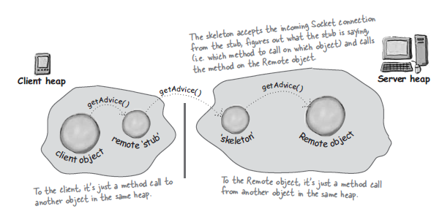
Underlying RMI

Slide 28
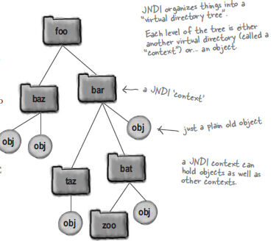
JNDI
Java Naming and Directory Interface.
An API for accessing naming and directory services.

Slide 29
EJB Instantiation
Instantiation of EJB is handled by container
Container determines when and “How Many”
Uses standard instantiation mechanism
Creates an EJBObject (proxy)
Create an EJB instance (actual bean instance)
Earlier was done by Home Interface, which created an EJBObject. Now by lookup and dependency injection.

Slide 30
EJB Life Cycle
Life Cycle of an instance is managed by container
Life Cycle phases:
Does not exist: no bean instance in memory
Post-Construct/Not-Ready: bean instance exists but isn’t ready for client interaction
Ready: exists, initialized and ready for interactions
Pre-removal: bean instance is about to be removed
Life Cycle transition notifications are handled through callbacks

Slide 31
Elements of EJB
Each EJB is implemented by:
Home Interface *
Business Interface
Implementation
* Deprecated in EJB 3.0

Slide 32
Elements of EJB [cont.]
Each EJB is described by meta-data
Tells container how to manage EJB
Annotation-based in Java code
Or, XML based
ejb-jar.xml
Server specific xml file
Key description elements
EJB Name
EJB JNDI
EJB Type
Security and Transaction Information

Slide 33
EJB Development Cycle
Write Client
Write EJB
Interfaces
Implementation
Define Configuration
Annotate
Or create descriptors
Compile
Package
Generate Client access classes
Deploy
Test
Repeat 2-8

Slide 34
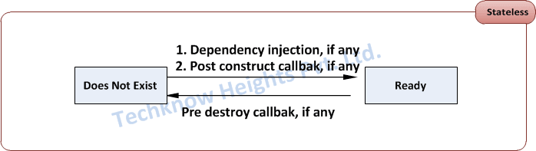
Life Cycle of Stateless Session Beans

Slide 35
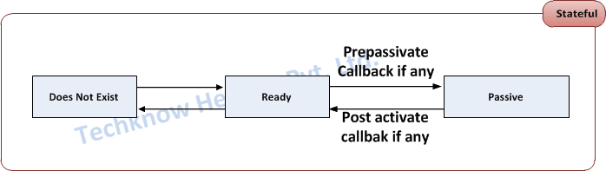
Life Cycle of Stateful Session Beans

Slide 36
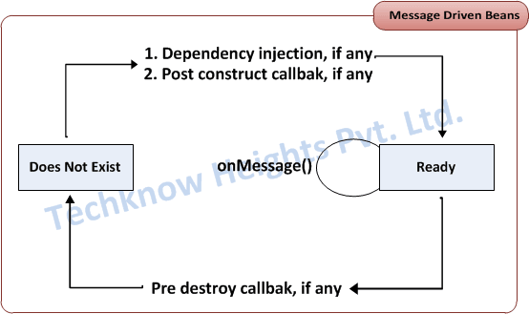
Life Cycle of Message Driven Beans

Slide 37
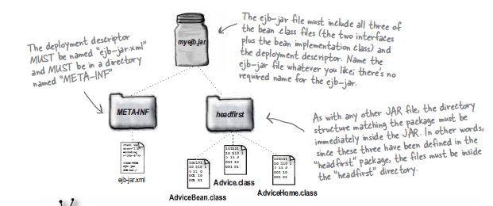
EJB Deployment

Slide 38
JPA Steps
Create Database Table
Create JPA Entity
POJO class with @Entity annotation
persistence.xml
[optional] orm.xml if object relational mapping is defined in XML
Create Stateless Session Bean
Bean interface
Bean Implementation class
Create Client
Adding MySQL data source in JBoss AS
Module.xml
MySQL Connection JAR

Slide 39
New Things
Elimination of Home and Remote Interfaces
Elimination of Component Interface
Simplified Access to Environment
Dependency Injection
EJB Context
Enhanced Lifecycle Methods and Callback Listener
Classes
Interceptors
Simple JNDI lookup of EJB

Slide 40
Transaction Attributes
Transaction Attribute | Client's Transaction | Business Method's Transaction
Required | None | T2
T1 | T1
RequiresNew | None | T2
T1 | T2
Mandatory | None | Error
T1 | T1
NotSupported | None | None
T1 | None
Supports | None | None
T1 | T1
Never | None | None
Ti | Error

Slide 41
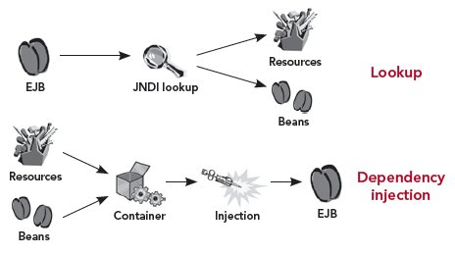
Lookup vs. Dependency Injection

Slide 42
What can Inject What?
Resources | Stateless | Stateful | MDB | Interceptors
JDBC DataSource | Yes | Yes | Yes | Yes
JMS Destinations, Connection Factories | Yes | Yes | Yes | Yes
Mail Resources | Yes | Yes | Yes | Yes
UserTransaction | Yes | Yes | Yes | Yes
Environment Entries | Yes | Yes | Yes | Yes
EJBContext | Yes | Yes | Yes | No
Timer Service | Yes | No | Yes | No
Web Service reference | Yes | Yes | Yes | Yes
EntityManager, EntityManagerFactory | Yes | Yes | Yes | Yes

