Slide 1

Drone Identification Using Micro-Doppler
Project number: 3174
Student: Amit Stein
Student: Niv Avivi
Supervisor: Omer Tzdiki
Project Carried Out at: Tel Aviv University – Radar Laboratory (Principal Investigator: Prof. Pavel Ginzburg)

Slide 2
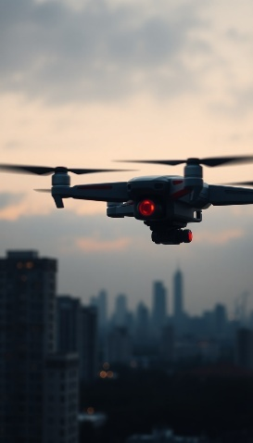
Motivation
Today, the use of drones and UAV (unmanned aerial vehicle) systems is steadily increasing in both military and civilian domains, offering effective solutions across a wide range of fields.
As these technologies become more prevalent, there is a growing need to develop reliable control and monitoring systems that can accurately detect and distinguish between UAVs with different purposes—especially under adverse conditions where optical and thermal cameras alone prove insufficient.

Slide 3


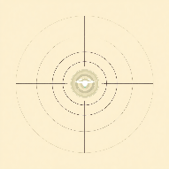
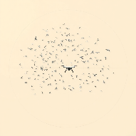
Motivation
Challenges in Drone Detection and Classification:
1. Adverse Weather Conditions- harsh weather can severely affect drone detection, especially when using optical or thermal methods.
2. Low-Altitude Flight- ground reflections and environmental noise complicate detection, requiring resilience to high signal-to-noise ratio (SNR).
3. Low Radar Cross-Section (RCS)- drones produce weak and small radar signatures (reflected radar signals or echoes) that make detection difficult.
4. Distinguishing Between Similar Objects- radar signatures of drones often closely resemble those of birds or other drones, complicating their identification

Slide 4
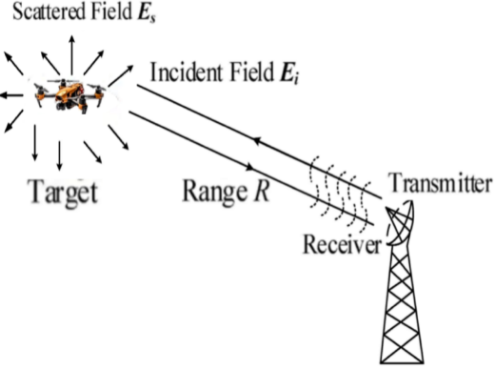
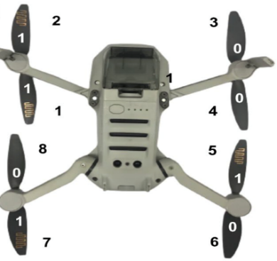

Motivation
Solution to Challenges:
A study conducted at the Radar Laboratory of Tel Aviv University (TAU) has shown that by affixing dipole tags in specific orientations to a drone’s rotor blades, each configuration yields a distinctive micro-Doppler signature which can be encoded as an 8-bit binary string.
This technique both overcomes the low radar cross-section (RCS) of small UAVs-by exploiting enhanced scattering returns - and provides a means of identifying individual drones based on tag orientation, regardless of adverse Weather Conditions, low visibility ,lighting conditions and noisy environments.
The dipole tag

Slide 5
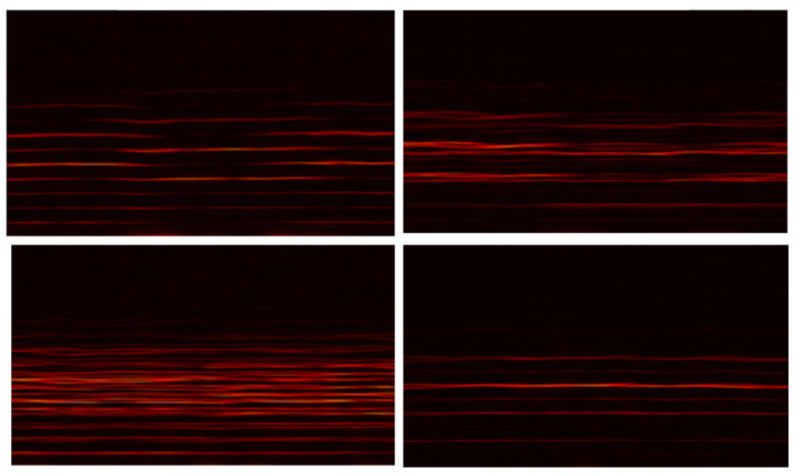
Project Topic and Objective
Spectrogram
Each sampled signal taken over a duration of 10 seconds, consisting of 50,001 complex values samples ,which their pattern represented by 8-bit signature.
The sampled signal is presented as spectrogram – 3D matrix of frequency versus time versus magnitude (FFT of the signal).
10000000
11111111
10101010
00001111

Slide 6
Project Topic and Objective
Project Objective: Accurate Classification of Noisy Micro-Doppler Signals Using CNN
In our project, we implement the classifier component of this research, using measured micro-Doppler signatures from 34 unique tag configurations.
Our objective is to accurately classify noisy micro-Doppler signals at low signal-to-noise ratios (SNRs). To achieve this, we employ a convolutional neural network (CNN) trained with a synthetic data pipeline and extensive augmentation, demonstrating the robustness of our approach in challenging SNR environments.

Slide 7

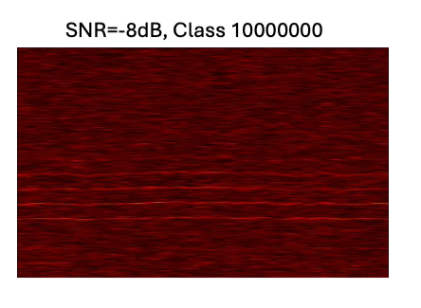
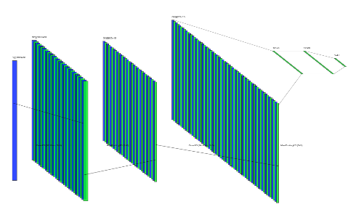
Project Block diagram
Micro-doppler analysis
C/D
CNN Classifier
Signiture Spectogram
10000000
10000000
Class Number

Slide 8
Methods and Implementation
Synthetic Data Pipeline: Preprocessing, Augmentation, and Dataset Splitting
We were given six 10-second signals (50 001 complex samples) for each of 34 tag configurations indoors.
Preprocessing and Data Preparation
Each micro-Doppler signal was divided into overlapping segments of 7,700 samples, with a 50% overlap between consecutive segments.
From each segment, we generated seven additional time-shifted versions, resulting in eight total variants per original segment.
Spectrogram Generation and Dataset Splitting
For each segment, a normalized spectrogram was computed using the Short-Time Fourier Transform (STFT) with a 256-sample Hann window and 50% frame overlap.
The resulting spectrograms were stratified and split into:
70% for training
20% for validation
10% for hold-out testing

Slide 9
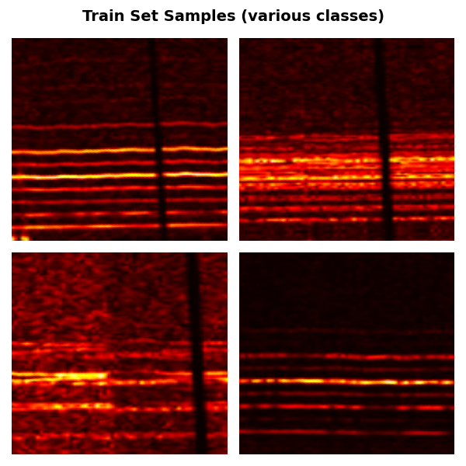
Methods and Implementation
Training dataset augmentations of segements augmentations:
Data Augmentation and Noise Injection
To enhance model robustness, the training set was augmented with:
Random affine transformations (±4° rotation, ±10% scaling)
Time-masking
Gaussian noise with SNRs randomly sampled from 0 to 32 dB
For the validation set, only mild augmentations were applied:
Slight affine transformations (±1° rotation, ±2% scaling)
No time-masking, same SNR range (0–32 dB)
Hold-Out Test Sets
From the 10% hold-out set, dedicated evaluation datasets were created at fixed SNR levels.
These datasets were used to rigorously evaluate model performance under controlled noise conditions.
It is important to note that the data in the test set was never seen by the model during training.
10000000
11111111
10101010
00001111

Slide 10
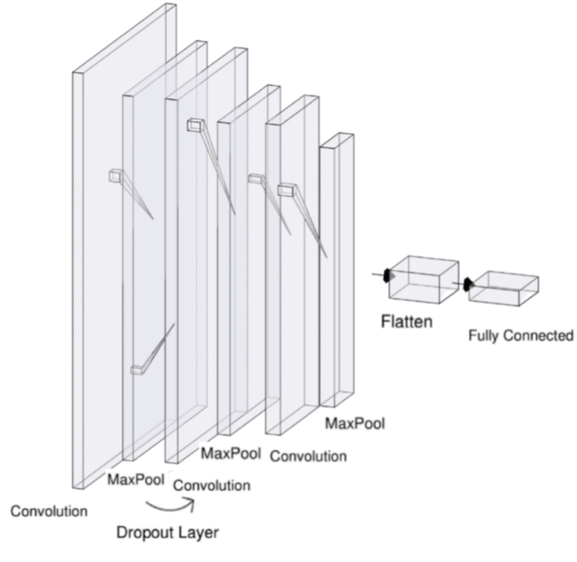
Methods and Implementation
CNN Model
We used 3 convolutional layers 32→64→128 filters
Each convolutional layer is followed by a ReLU activation function, a 2x2 MaxPooling layer, and a Dropout layer.
In the head, we applied dropout and a fully connected layer ending with a softmax output layer .

Slide 11
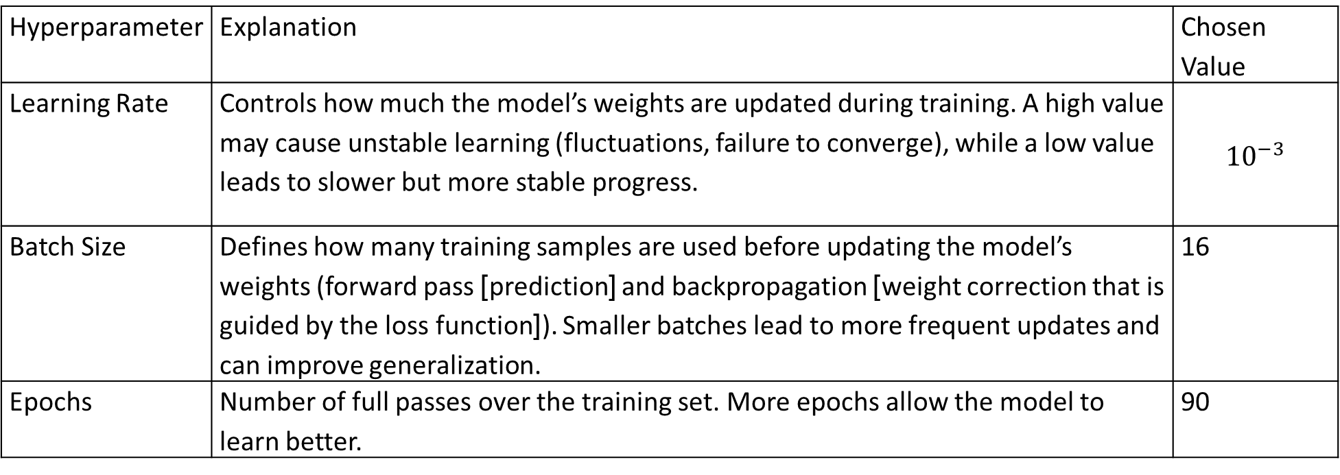
Methods and Implementation
CNN Hyperparameters – Summary
After extensive hyperparameter tuning and repeated training runs, the selected hyperparameters yielded a high-performing model with strong accuracy, robustness to noise, and reliability - ensuring effective learning, generalization, and minimal overfitting.
Hyperparameter | Explanation | Chosen Value
Learning Rate | Controls how much the model’s weights are updated during training. A high value may cause unstable learning (fluctuations, failure to converge), while a low value leads to slower but more stable progress. | $${10}^{−3}$$
Batch Size | Defines how many training samples are used before updating the model’s weights (forward pass ]prediction[ and backpropagation ]weight correction that is guided by the loss function[). Smaller batches lead to more frequent updates and can improve generalization. | 16
Epochs | Number of full passes over the training set. More epochs allow the model to learn better. | 90

Slide 12
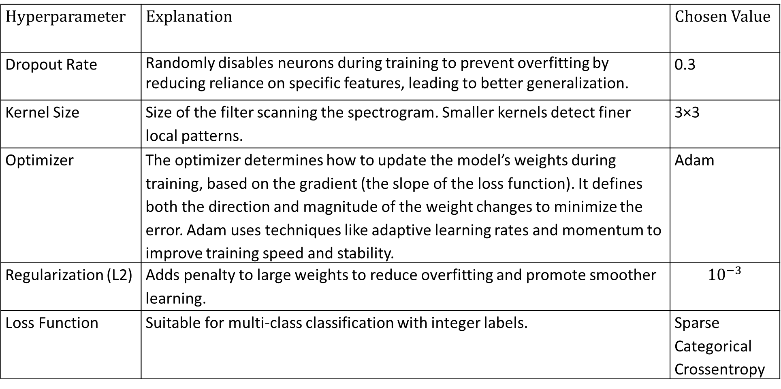
Methods and Implementation
Hyperparameter | Explanation | Chosen Value
Dropout Rate | Randomly disables neurons during training to prevent overfitting by reducing reliance on specific features, leading to better generalization. | 0.3
Kernel Size | Size of the filter scanning the spectrogram. Smaller kernels detect finer local patterns. | 3×3
Optimizer | The optimizer determines how to update the model’s weights during training, based on the gradient (the slope of the loss function). It defines both the direction and magnitude of the weight changes to minimize the error. Adam uses techniques like adaptive learning rates and momentum to improve training speed and stability. | Adam
Regularization (L2) | Adds penalty to large weights to reduce overfitting and promote smoother learning. | $${10}^{−3}$$
Loss Function | Suitable for multi-class classification with integer labels. | Sparse Categorical Crossentropy

Slide 13
Methods and Implementation
Project Folder Structure
Drone Classifier
data
models
training
evaluation
cnn.py
Plot_holdout_summery.py
evaluation.py
raw_data
datasets
create_synthetic.py
train.py
outputs
plot_utils.py
dataset1_name
dataset2_name
…
xp
Id_Experimental_number1
Id_Experimental_number2
…
Train.npz
Val.npz
Holdout_SNR_10.npz
Holdout_SNR_12.npz
…
Training_results
holdout_results
Classes.npz

Slide 14
Methods and Implementation
Project Workflow
Create synthetic dataset
Train it
evaluation
Synthetic Data Generation – Empirical Trial-and-Error Process
Selected Hyperparameters values used for training the CNN model after tuning and experimentation.

Slide 15
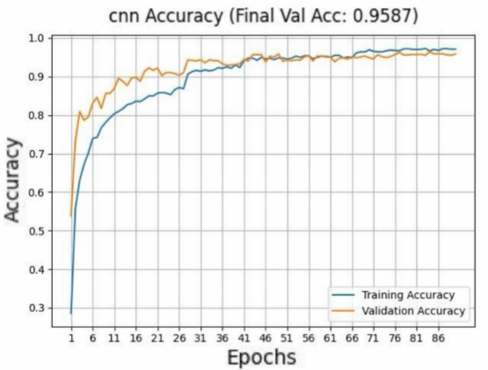
Results & Conclusions
Peak Validation Performance After extensive hyperparameter
tuning and repeated training runs,
our CNN reached its highest
validation accuracy at 90 epochs,
with both training and validation
curves nearly overlapping.
This close alignment indicates
excellent generalization and minima overfitting.

Slide 16
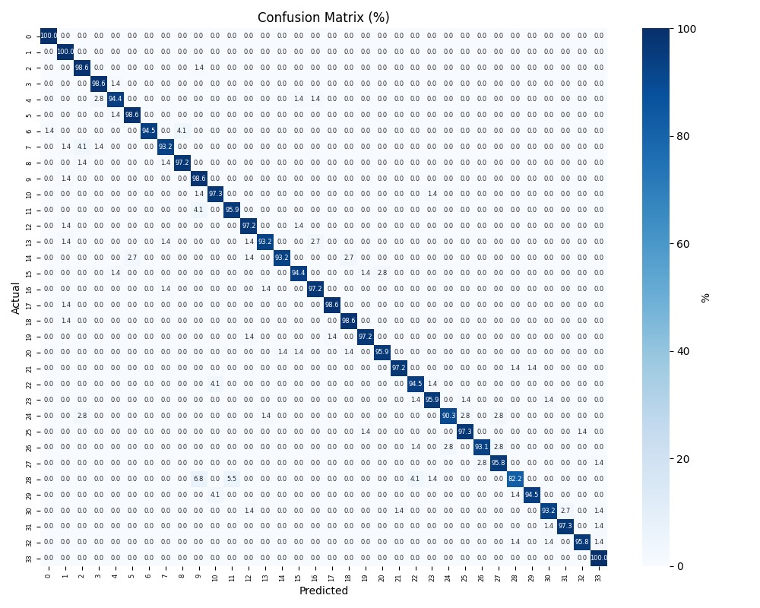
Results & Conclusions
Confusion Matrix
The confusion matrix provides a visual representation of the model’s classification performance, indicating how well it distinguishes between the different classes.
The confusion matrix demonstrates the model’s high classification performance while also revealing where and why errors occur. It helps us understand which classes are more likely to be confused and guides improvements in model design.

Slide 17
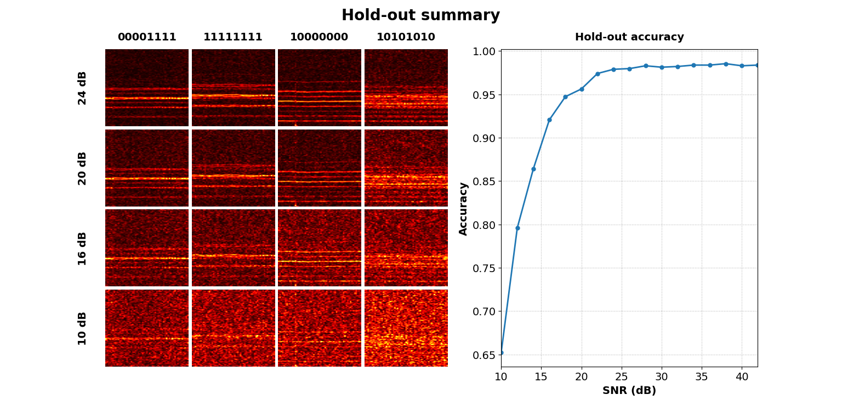
Results & Conclusions
CNN Validation Accuracy Across Datasets with Fixed SNR Levels
The accuracy curve demonstrates that our classifier exceeds 90 % once the SNR reaches 15 dB, and climbs to 97 % at 24 dB and above.

Slide 18
Summary Conclusions: Model Strengths and Practical Contributions
Model Robustness to Real Noise & Data
Demonstrates strong model robustness across a wide range of SNR levels, including challenging noise conditions.
Advanced augmentation methods — such as time-masking, affine transformations, and variable SNR noise — were applied to further enhance robustness to signal variability.
The synthetic data was designed to be not only realistic, but also more diverse and noisier than real-world data, exposing the model to harsher conditions and improving its resilience to extreme scenarios.

Slide 19
Summary Conclusions: Model Strengths and Practical Contributions
Reliable Learning & Evaluation
Close alignment between training and validation accuracy curves demonstrates consistent learning and minimal overfitting.
Evaluation was performed using fixed-SNR datasets, allowing for fine-grained analysis of model robustness.
Validation relied on a truly unseen dataset, ensuring clean separation from training data and preventing data leakage.

Slide 20
Summary Conclusions: Model Strengths and Practical Contributions
Smart Design & Targeted Optimization
The CNN architecture was selected through extensive hyperparameter tuning.
Data was split into training, validation, and hold-out test sets with customized augmentation strategies per subset:
Training data underwent broader, more aggressive augmentations to improve model resilience.
Validation and test sets received lighter augmentations to preserve resemblance to real-world signal conditions.

Slide 21
Future Work – Proposed Direction
Transfer Learning with Partial Fine-Tuning: The current model demonstrates strong performance and robustness across a wide SNR range, including low-SNR conditions. Integrating transfer learning with partial fine-tuning into the existing model could further improve adaptability and efficiency, especially in scenarios with even more degraded signal quality. This approach uses pretrained models while adapting only selected layers to the task, enabling efficient training and maintaining strong generalization. It may further improve classification accuracy — reaching 99–100% — and enhance the model’s ability to operate reliably under even lower SNR conditions.
Quantitative Assessment of Cross-Set Diversity The current model already ensures proper separation between training, validation, and test sets — with tailored data augmentations and unseen evaluation data. As a future direction, one could explore the use of quantitative tools to further validate and analyze the diversity between these datasets. Measuring differences in signal distributions — such as spectral content, temporal dynamics, and noise characteristics — can complement the current evaluation process and offer a deeper understanding of how the model generalizes across varied and realistic conditions.

Slide 22
Your Logo

