Slide 1
Lecture 12: Cache Basics
ECE4100/ECE6100/CS4290/CS6290
Advanced Computer Architecture
Fall 2016
http://tusharkrishna.ece.gatech.edu/teaching/aca_f16/
Tushar Krishna
School of Electrical and Computer Engineering
Georgia Institute of Technology
tushar@ece.gatech.edu
Acknowledgment: Lecture slides adapted from UCB CS252 (K. Asanovic),
MIT EECS 6.823 (Arvind and J. Emer) and GT CS 4290/6290 (M. Pruvolic)

Slide 2
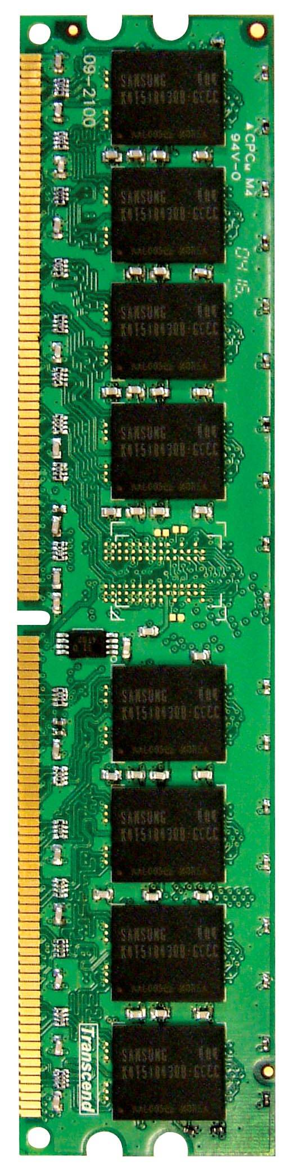
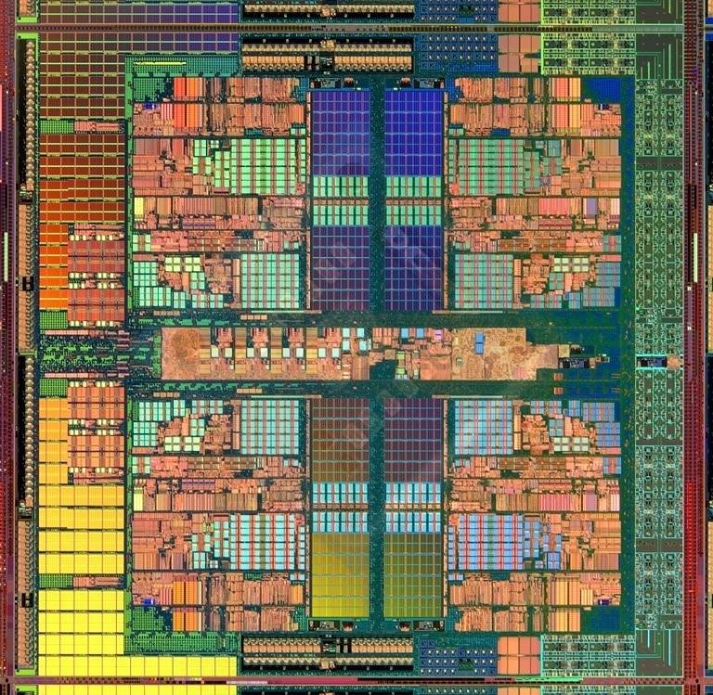
Memory in a Modern System
CPU
CORE 0
L2 CACHE 1
CORE 1
L2 CACHE 0
Memory
SHARED L3 CACHE
DRAM INTERFACE
DRAM MEMORY CONTROLLER
DRAM BANKS
50-80% of area dedicated to memory!
L2 CACHE 2
CORE 3
CORE 2
L2 CACHE 3

Slide 3
CPU-Memory Bottleneck
Memory
CPU
Performance of high-speed computers is usually limited by memory latency & bandwidth
Latency (time for a single access)
Memory access time >> Processor cycle time
Bandwidth (number of accesses per unit time)
if fraction m of instructions access memory,
=> 1+m memory references / instruction
=> For CPI = 1, need 1+m memory refs / cycle

Slide 4

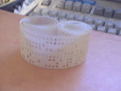
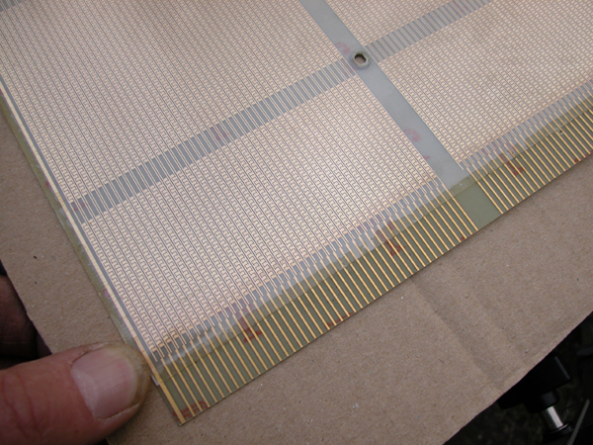
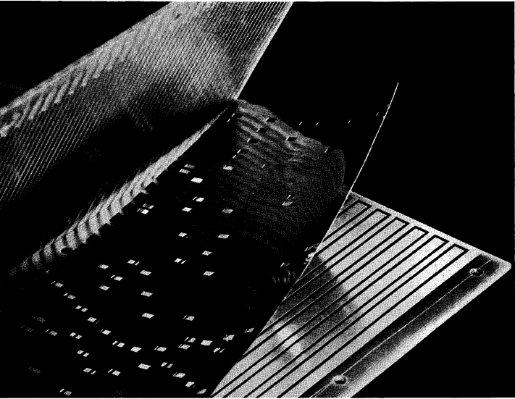
Early Read-Only Memory Technologies
Punched cards, From early 1700s through Jaquard Loom, Babbage, and then IBM
Punched paper tape, instruction stream in Harvard Mark 1
Diode Matrix, EDSAC-2 µcode store
IBM Balanced Capacitor ROS
IBM Card Capacitor ROS

Slide 5
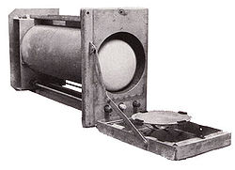
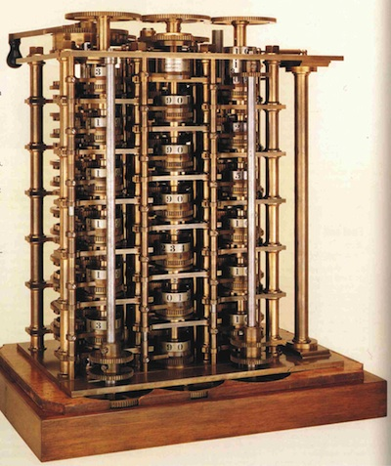
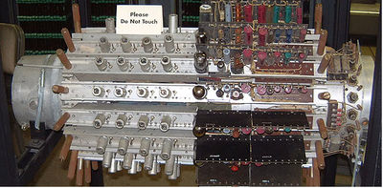
Early Read/Write Memory Technologies
Babbage, 1800s: Digits stored on mechanical wheels
Williams Tube, Manchester Mark 1, 1947
Mercury Delay Line, Univac 1, 1951
Also, regenerative capacitor memory on Atanasoff-Berry computer, and rotating magnetic drum memory on IBM 650

Slide 6
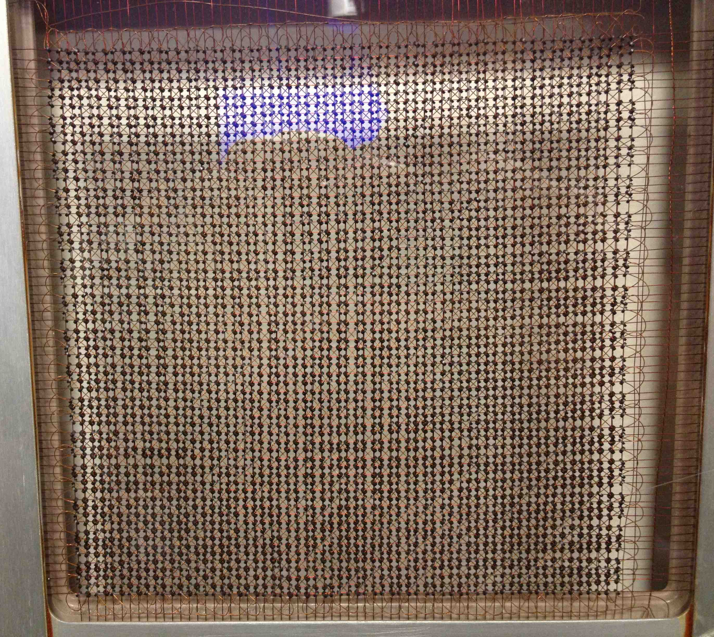
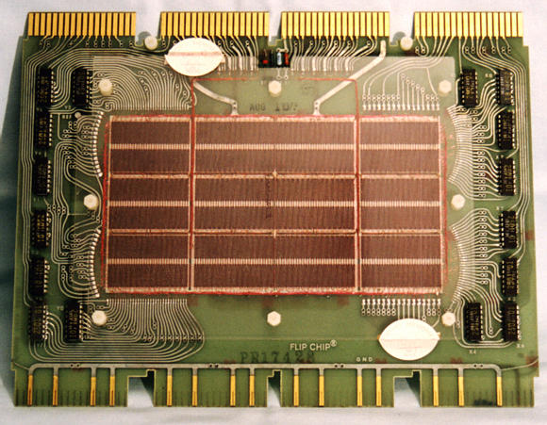
Core Memory
Core memory was first large scale reliable main memory
invented by Forrester in late 40s/early 50s at MIT for Whirlwind project
Robust, non-volatile storage
Bits stored as magnetization polarity on small ferrite cores threaded onto two-dimensional grid of wires
Cores threaded onto wires by hand (25 billion a year at peak production)
Core access time ~ 1µs
Coincident current pulses on X and Y wires would write cell and also sense original state (destructive reads)
Used on space shuttle computers
MIT Whirlwind Core Memory
DEC PDP-8/E Board,
4K words x 12 bits, (1968)
Notes:
What is non-volatile?

Slide 7
Semiconductor Memory
Semiconductor memory began to be competitive in early 1970s
Intel was formed to exploit market for semiconductor memory
Early semiconductor memory was Static RAM (SRAM). SRAM cell internals similar to a latch (cross-coupled inverters).
First commercial Dynamic RAM (DRAM) was Intel 1103
1Kbit of storage on single chip
charge on a capacitor used to hold value
Semiconductor memory quickly replaced core in ‘70s

Slide 8
“Memory” Today ➔ DRAM
Dynamic random access memory
Capacitor charge state indicates stored value
Whether the capacitor is charged or discharged indicates storage of 1 or 0
1 capacitor
1 access transistor
Capacitor leaks through the RC path
DRAM cell loses charge over time
DRAM cell needs to be refreshed
Select (word line)
Data (bitline)

Slide 9
DRAM Organization
bit lines
Col.
1
Col. 2^{M}
word lines
Row 1
N
Row Address Decoder
Row 2^{N}
DRAM cell (one bit)
N+M
M
Column Decoder & Sense Amplifiers
More on DRAM in a later lecture!
Data
D
Bits stored in 2-dimensional arrays on chip
Modern chips have around 4 logical banks on each chip
each logical bank physically implemented as many smaller arrays

Slide 10
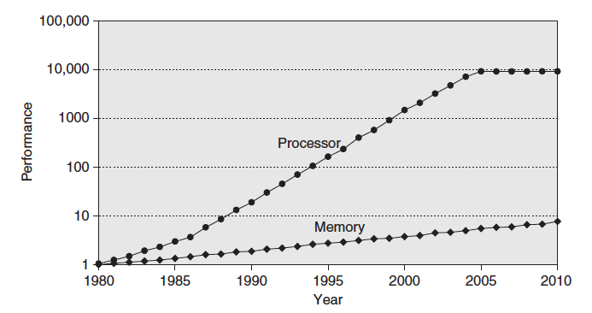
Processor-DRAM Gap (latency)
What happened?
Later!
MicroProccessors:
60%/year
“Moore’s Law”
Processor-Memory
Performance Gap: (grows 50% / year)
DRAM:
7%/year
Four-issue 2GHz superscalar accessing 100ns DRAM could execute 800 instructions during time for one memory access!

Slide 11
Little’s Law
Table of accesses in flight
Memory
CPU
Throughput (T) = Number in Flight (N) / Latency (L)
Example:
--- Assume infinite bandwidth memory
--- 100 cycles / memory reference
--- 1 + 0.2 memory references / instruction
Table size = 1.2 * 100 = 120 entries
Is it even possible for CPU to generate 120 independent memory requests?
120 independent memory operations in flight!
Notes:
We saw multi-threading as one solution for this.

Slide 12
Mitigate Latency using Caches
Reduce average memory access latency (and energy) by using caches – small and fast memories that retain recently-accessed data
Why would this help?
Locality: Patterns of memory references made by a processor are often highly predictable
PC
96 …
100 loop: ADD r2, r1, r1
104 SUBI r3, r3, #1
BNEZ r3, loop
112 …

Slide 13
Why would Caches help?
Two predictable properties of memory references:
Temporal Locality: If a location is referenced it is likely to be referenced again in the near future.
Spatial Locality: If a location is referenced it is likely that locations near it will be referenced in the near future.
Memory addresses A, A+1, A+2, A+3, A+4
Spatial
Memory addresses A, B, C, A, B, C, A, B, C
Temporal

Slide 14
Exploiting Locality
Temporal locality
Store recently accessed data in cache
Anticipation: the data will be accessed again soon
Spatial locality
Store addresses adjacent to the recently accessed one in automatically managed fast memory
Logically divide memory into equal size blocks (called cache block or cache line)
On accessing any word in the block, fetch the entire line
Anticipation: nearby data will be accessed soon

Slide 15
Caches ➔ SRAM
Static random access memory
Two cross coupled inverters store a single bit
Feedback path enables the stored value to persist in the “cell”
4 transistors for storage
2 transistors for access
Word line
bitline
_bitline

Slide 16
Memory Hierarchy
On-chip
Off-chip
Big, Slow Memory
(DRAM)
A
Small,
Fast Memory
(RF, SRAM)
B
CPU
holds frequently used data
Cost
size: Register << SRAM << DRAM why?
latency: Register << SRAM << DRAM why?
bandwidth: on-chip >> off-chip why?
On a data access:
hit (data ∈ fast memory) ➔ low latency access
miss (data ∉ fast memory) ➔ high latency access (DRAM)
Size
Cost + wire-delays
Notes:
Due to cost
Due to size of DRAM
Due to cost and wire delays (wires on-chip cost much less, and are faster)

Slide 17
Memory Hierarchy
Capacity
Access Time
Cost
Staging
Transfer Unit
CAPACITY
SPEED and COST
100s Bytes
<10 ns
$$$
Registers
Instr. Operands
Compiler
1-8 bytes
K Bytes
10-100 ns
1-0.1 cents/bit
Cache
Cache controller
8-128 bytes
Cache Lines
M Bytes
200ns- 500ns
$.0001-.00001 cents /bit
Memory
Pages
Operating system
512-4K bytes
G Bytes, 10 ms (10,000,000 ns)
10 - 10 cents/bit
Disk
-5
-6
Files
User
Mbytes
infinite
sec-min
10 cents/bit
-8
Tape
Notes:
Memory: DRAM
Cache: SRAM

Slide 18
Cache Basics
When data referenced
HIT: If in cache, use cached data instead of accessing memory
Hit ratio: hits/accesses
MISS: If not in cache, bring block into cache from memory
Maybe have to kick something else out to do it
Time taken: miss penalty
Miss ratio: misses/accesses = 1 – hit ratio

Slide 19
Cache Design Decisions
Placement: where in the cache can a block go?
Identification: how do we find a block in cache?
Replacement: what to kick out to make room in cache?
Write policy: What do we do about stores?

Slide 20
Cache Design Decisions
Placement: where in the cache can a block go?
Identification: how do we find a block in cache?
Replacement: what to kick out to make room in cache?
Write policy: What do we do about stores?

Slide 21
Cache Placement
Word Number
0
1
2
3
4
5
6
7
8
9
10
11
12
13
14
15
16
17
18
19
20
21
22
23
24
25
26
27
28
29
30
31
Set #
Searching easy but inefficient use of space
0
1
2
3
4
5
6
7
Direct
Mapped
one location
Way #
0
1
2
3
0
1
Line Number
?
0
1
(2-way) Set
Associative
2 locations
0
1
Cache
0
1
0
1
2
3
4
5
6
7
Fully
Associative
anywhere
Searching more expensive
DRAM

Slide 22
Cache Design Decisions
Placement: where in the cache can a block go?
Identification: how do we find a block in cache?
Replacement: what to kick out to make room in cache?
Write policy: What do we do about stores?

Slide 23
Basic Principle: Address Breakdown
20
12
4 byte (32-bit) word
Page #/Page address
Byte within a page
Same address can be interpreted in more than one way
0x80080000
16 byte line
0x80080004
0x80080008
Used by Cache
0x8008000C
4KB page
0x80080010
Line #/address
Word in a line
Byte in a line
28
2
2
0x80081000
tag
index
offset
Remaining bits
Depends on number of lines in the cache
Depends on size of cache line, i.e., no of bytes in a cache line
Memory

Slide 24
Microarchitecture: Direct Mapped Cache
Block number
Block offset
Address:
Tag
Index
Offset
t-bits
k-bits
b-bits
index | v | tag | Data block
2^{k}
lines
Tag Array
Data Array

Slide 25
Microarchitecture: Direct Mapped Cache
Block number
Block offset
Address:
Tag
Index
Offset
t
b
k
index | v | tag | Data block
2^{k}
lines
t
=
HIT
Data Word or Byte

Slide 26
Microarchitecture: Direct Mapped Cache
Block number
Block offset
Address:
Tag
Index
Offset
t-bits
k-bits
b-bits
index | v | tag | Data block
2^{k}
lines
Tag Array
Data Array
Cache Data Array Size?
2^{k} x 2^{b}
Usually just called Cache Size
Cache Tag Array Size?
2^{k} x (1+t)
What is a bad reference pattern?
Strided at size of cache
Notes:
Corresponding misses are called “conflict misses”

Slide 27
Direct Mapped Cache: higher-order vs. lower-order address bits
Block number
Block offset
Address:
Index
Tag
Offset
t
b
k
index | v | tag | Data block
2^{k}
lines
t
=
HIT
Data Word or Byte
Why might this be undesirable?
Spatially local blocks conflict

Slide 28
Hash Address Selection
Address
Offset
t
b
index | v | tag | Data block
Hash
k
2^{k}
lines
t
=
HIT
Data Word or Byte
What are the tradeoffs of hashing?
Good: Regular strides don’t conflict
Bad: Hash adds latency Tag is larger

Slide 29
Microarchitecture : Set-Associative Cache
t-bits
k-bits
b-bits
a = associativity
Address:
Tag
Index
Offset
t
b
k
Way 0
Way (a-1)
index | v | tag | Data block
v | tag | Data block
…
2^{k}
lines
t
t
=
Data
Word
or Byte
=
…

Slide 30
Microarchitecture : Set-Associative Cache
t-bits
k-bits
b-bits
Address:
Tag
Index
Offset
a = associativity
Way 0
Way (a-1)
index | v | tag | Data block
v | tag | Data block
…
Cache Data Array Size?
2^{k} x 2^{b} x a
Cache Tag Array Size?
2^{k} x (1+t) x a

Slide 31
Microarchitecture: Fully Associative Cache
V
Tag
Data Block
Cache Data Array Size?
2^{b} x a
t
Cache Tag Array Size?
=
(1+t) x a
Tag
t
=
HIT
Block
Offset
Data
Word
or Byte
=
b

Slide 32
Cache Design Decisions
Placement: where in the cache can a block go?
Identification: how do we find a block in cache?
Replacement: what to kick out to make room in cache?
Write policy: What do we do about stores?

Slide 33
Cache Replacement
Direct Mapped?
Kick out the line in the set
Set-Associative / Fully-Associative?
Kick out one of the lines in the set
Which one?
Any empty one
What if no line empty?
“Replacement Policy”
Random
Least-Recently Used (LRU)
Most-Recently Used (MRU)
FIFO
Most Popular

Slide 34
LRU Policy Example
MRU
MRU-1
LRU+1
LRU
A
B
C
D
Access C
C
A
B
D
Access D
D
C
A
B
Access E
MISS, replacement
needed
E
D
C
A
Access C
C
E
D
A
Access G
MISS, replacement
needed
G
C
E
D
What happens to the line that is kicked out?
Discard it as it is just a copy from memory, unless it is “dirty” (later in the lecture)

Slide 35
Implementing LRU
True LRU
Need to remember order in which all N lines were last accessed
N! scenarios
2 ways → AB BA = 2 = 2!
3 ways → ABC ACB BAC BCA CAB CBA = 6 = 3!
Need O(log N!) bits ≈ O(N log N) LRU bits
True LRU only feasible for small associativity

Slide 36
Pseudo LRU
Are all 4 lines valid?
State | Replace
00x | Way A
01x | Way B
1x0 | Way C
1x1 | Way D
Y
N
B0 == 0
Use an invalid line
Y
N
x: don’t care
B1 == 0
B2 == 0
Ref | Next state
A | 11_
B | 10_
C | 0_1
D | 0_0
Y
N
Y
N
Way A
Way B
Way C
Way D
_: unchanged
Notes:
Example Access Pattern:
B 10x
A 11x
C 011
D 010
Replace B =>
B 100
Replace C [should have been A in true LRU]

Slide 37
Cache Design Decisions
Placement: where in the cache can a block go?
Identification: how do we find a block in cache?
Replacement: what to kick out to make room in cache?
Write policy: What do we do about stores?

Slide 38
Write Policies
Write Hit Policy
If a write hits in the cache, should the updated value stay in cache or go to memory?
Write Miss Policy
If a write misses in the cache, should the line be brought into cache?

Slide 39
Write Hit Policy: When to Write?
Write-through Cache
The value is written to both the cache line and to the next level of memory concurrently
+ Keeps next-level cache / memory updated
- has high memory traffic
Write-back Cache
The value is written only to the cache line. The modified cache line is written to next level / main memory only when it has to be replaced.
+ Less memory traffic
Typically preferred if lot of writes before a read!
- Contents of next-level cache / memory can be stale
Notes:
Suppose access stream:
LD 0x160 (A=3)
ST 0x160, 5
ST 0x160, 7
ST 0x160, 8
LD 0x160
Which is better?
Writeback.
Suppose 2 processors
P1: LD 0x160 (A=3)
ST A 0x160
P2: LD 0x160
Which is better?
Write-through

Slide 40
Writeback Cache Microarchitecture
index | v | dirty | tag | Data block
Each cache line has an additional dirty bit
Policy for dirty bit?
When line first brought into cache, valid = 1, dirty = 0 (i.e., line is clean)
On first write to (any word) on the line, dirty = 1
Memory not updated yet, cache has the only up-to-date copy of data for a dirty line
On replacement, dirty line written to memory

Slide 41
Write Miss Policy: Allocate or not?
Write-Allocate
The line is allocated on a write miss, followed by the write hit actions
Write misses first act like read misses
Mostly used with write-back caches
Write No-Allocate
Line is only updated in the lower level memory and not brought into the cache
Mostly used with write-through caches
Notes:
Question: Why does write miss need to bring line into cache? It will be over-written anyway.
Ans) A word in the line will be over-written. Still need rest of the line.
If a line is written but not likely to be read, better to do write no-allocate.
Otherwise it may kick out a useful line.

