Slide 1
Lecture 13: Cache Optimizations
ECE4100/ECE6100/CS4290/CS6290
Advanced Computer Architecture
Fall 2016
http://tusharkrishna.ece.gatech.edu/teaching/aca_f16/
Tushar Krishna
School of Electrical and Computer Engineering
Georgia Institute of Technology
tushar@ece.gatech.edu
Acknowledgment: Lecture slides adapted from MIT EECS 6.823 (Arvind and J. Emer) and GT ECE 4100/6100 (T. Conte)

Slide 2
Cache Performance
Hit: data is in the cache
Hit Time: Time to get data from the cache to the processor
Miss: date is not in the cache
Miss Rate: Number of Misses / Total Accesses
Miss Penalty: Time to get a missing block from lower levels of memory and get the data to the processor

Slide 3
Types of Cache Misses
Compulsory
first-reference to a block a.k.a. cold start misses
misses that would occur even with infinite cache
Capacity
cache is too small to hold all data the program needs
misses that would occur even under perfect placement & replacement policy
Conflict
misses from collisions due to block-placement strategy
misses that would not occur with full associativity

Slide 4
Effect of Cache Parameters on Performance
 | Larger capacity cache | Higher associativity cache | Larger Block Size*
Compulsory misses
Capacity misses
Conflict misses
Hit time
Miss penalty
*assume substantial spatial locality
Notes:
Larger block size:
Miss Penalty might go up since more data has to be brought into cache as lower levels now take longer to access and require higher bandwidth

Slide 5
AMAT
Average Memory Access Time (AMAT) =
Hit time + Miss rate x Miss penalty
How to reduce AMAT?
reduce the hit time
reduce the miss rate
reduce the miss penalty
We will discuss a few cache optimizations in class for attacking each of these terms. More optimizations from Hennessy & Patterson Book are in T-square in Supplementary Material.
Notes:
Example:
Hit Time = 1 cycle
Miss Rate = 8%
Miss Penalty = 100 cycles
AMAT = 1 + 0.08*100 = 9 cycles

Slide 6
Reducing Miss Rate
Cache Parameters
Size
Associativity
Block Size
Prefetch
Victim Cache

Slide 7
Cache Parameters
 | Advantages | Disadvantages | Limit
Larger Cache Size | Fewer Capacity Misses | Larger Hit Latency Larger Area
Higher Associativity | Fewer Conflict Misses | Slower search time
Larger Block Size | More spatial locality | Higher Miss Penalty Cache Pollution
Compulsory Misses
“diminishing returns”
Miss rate
log(cache size)
Capacity Misses
“diminishing returns”
Miss rate
log(associativity)
Cache Pollution
“cache pollution”
Miss rate
Block size

Slide 8
Reducing Miss Rate
Cache Parameters
Size
Associativity
Block Size
Prefetch
Victim Cache

Slide 9
Prefetching
Idea: get it before you need it
Easier for instructions
Harder for data
How does prefetching affect cache misses?
Compulsory
Capacity
Conflict
Reduce
Increase
Increase

Slide 10
Hardware Prefetching
+1 prefetch: fetch missing block, and next sequential block
Works great for streams with high sequential locality -- e.g., instruction caches
Uses unused memory bandwidth between misses
Can affect miss penalty if bus to memory is busy and there’s a demand miss by the CPU
Strided prefetch
Suppose the following code is being executed
for (i = 1; i < MAX; i += n)
a[i] = b[i];
Prefetch block(s) +k, +2k, +3k, … +d*k

Slide 11
Challenges with Prefetching
Prefetch on Miss or Access?
Usefulness – should produce hits
Timeliness – not late and not too early
Cache and bandwidth pollution

Slide 12
Reducing Miss Rate
Cache Parameters
Size
Associativity
Block Size
Prefetch
Victim Cache

Slide 13
Victim Caches
CPU
L2 or Mem
RF
L1 Data Cache
Evicted data from L1
Victim Cache
FA, 4 blocks
Evicted data from VC discarded since already send to Mem
Hit data (miss in L1)
Victim cache is a small associative back up cache, added to a direct mapped cache, which holds recently evicted lines
Fast hit time of direct mapped but with reduced conflict misses!
First look up in direct mapped cache
If miss, look in victim cache
If hit in victim cache?
If miss in victim cache?
swap hit line with line now evicted from L1
L1 victim → VC, VC victim→?

Slide 14
Reducing Miss Penalty
Multi-level Caches
Early Restart/Critical Word First
Sectored Cache

Slide 15
Reducing Miss Penalty
Multi-level Caches
Early Restart/Critical Word First
Sectored Cache

Slide 16
Multilevel Caches
A memory cannot be large and fast
Add level of cache to reduce miss penalty
Each level can have longer latency than level above
So, increase sizes of cache at each level
DRAM
CPU
L2
L1
Metrics:
Local miss rate = misses in cache/ accesses to cache
Global miss rate = misses in cache / CPU memory accesses
Misses per instruction = misses in cache / number of instructions

Slide 17
A typical memory hierarchy
Split instruction & data primary caches
(on-chip SRAM)
Multiple interleaved memory banks (DRAM)
L1 Instruction Cache
Unified L2 Cache
Memory
CPU
Memory
L1 Data Cache
Memory
RF
Memory
Multiported register file (part of CPU)
Large unified secondary cache (on-chip SRAM)

Slide 18
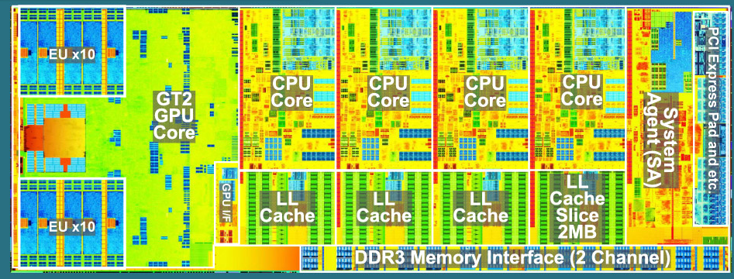
Intel Haswell (2013)
64B Cache Lines
L1 Instruction Cache: 32 KB, 8-way, 4-cycle latency
L1 Data Cache: 32 KB, 8-way, 4-5 cycle latency
L2 Cache: 256 KB, 8-way, 12 cycles
L3 Cache: 8 MB, 12-way, 36 cycles
(Last Level Cache or LLC)
22nm
1.4B Transistors
Die Size: 177mm²

Slide 19
Example: AMAT with L2
AMAT = Hit Time_{L1} + Miss Rate_{L1} x Miss Penalty_{L1}
Miss Penalty_{L1} = Hit Time_{L2} + Miss Rate_{L2} x Miss Penalty_{L2}
Suppose
Miss Rate_{L1} = 10%
Miss Rate_{L2} = 6%
L1 cache
2 cycles
L2 cache
5 cycles
Miss Penalty_{L1} = 5 + 0.06x50 = 8 cycles
AMAT_{L1} = 2 + 0.1x8 = 2.8 cycles
main memory
50 cycles
If no L2:
AMAT_{L1} = 2 + 0.1x50 = 7 cycles
ignore interconnect delays

Slide 20
Inclusion Policy
Inclusive multi-level cache:
Inner cache holds copies of data in outer cache
Exclusive multi-level caches:
Inner cache data is not in outer cache
Swap lines between inner/outer caches on miss
Non-inclusive multi-level cache
Inner cache may hold data not in the outer cache

Slide 21
Miss, Replacement and Invalidation with L1 and L2
Inclusion Policy | L1 Miss |  | L1 Replace-ment | L2 Invalidation
 | L2 Miss | L2 Hit
Inclusive L2
Non-Inclusive L2
Exclusive L2
Allocate L1 and L2
Allocate L1
L2 untouched*
Check L1 only if present in L2
*except Writeback
Allocate both L1 and L2
Allocate L1
If not in L2, add to L2
Always check L1
Allocate only L1
Swap line with L1
Allocate
in L2
Check L1 only if not present in L2
L2 replacement?
Kick out line from L1 in case of Inclusive
Notes:
L1 replacement needs to writeback to L2 in Inclusive L2 design.

