Slide 1
Lecture 25: Memory Consistency
ECE4100/ECE6100/CS4290/CS6290
Advanced Computer Architecture
Fall 2016
http://tusharkrishna.ece.gatech.edu/teaching/aca_f16/
Tushar Krishna
School of Electrical and Computer Engineering
Georgia Institute of Technology
tushar@ece.gatech.edu
Acknowledgment: Some lecture slides adapted from MIT EECS 6.823 (Arvind and J. Emer) and UCB CS 252 (K. Asanovic)

Slide 2
Memory Ordering
ST (A) 100
ADDI R0, R0, 1
ST (B) R0
Initially,
R0 = 0
Mem[B] = 0
Mem[A] = -999
Core 0
Can A and B get updated out of order?
Yes!
Everything we have talked about in class so far allows A and B to get updated out of order since they are different addresses
ROB, LSQ, Store Buffer
→ Memory update to same address in order
Cache Coherence, Directories
→ All cores see writes to same address in order

Slide 3
Memory Ordering
ST (A) 100
ADDI R0, R0, 1
ST (B) R0
spin: LD R1, (B)
BEQZ R1, spin
LD R2, (A)
Initially,
R0 = 0
Mem[B] = 0
Mem[A] = -999
Core 0
Core 1
What are the possible values of (R1, R2)?
(0, 100) (1, 100) (0, -999) (1, -999)
the stores got re-ordered
Could this lead to any problem?
Hint: The programmer might have written these lines of code in a particular order for some reason.

Slide 4
Synchronization
The need for synchronization arises whenever there are concurrent processes in a system
(even in a uniprocessor system).
Two classes of synchronization:
Producer-Consumer: A consumer process must wait until the producer process has produced data
Mutual Exclusion: Ensure that only one process uses a resource at a given time
producer
consumer
P1
P2
Shared Resource

Slide 5
Simple Producer Consumer Example
ST (A) 100
ADDI R0, R0, 1
ST (B) R0
spin: LD R1, (B)
BEQZ R1, spin
LD R2, (A)
Initially,
R0 = 0
Mem[B] = 0
Mem[A] = -999
Core 0
Core 1
Addr B
Producer
Consumer
flag
data
Addr A
Initially flag=0
(1, -999) means consumer reads flag = 1 before data written by producer!
Notes:
Producer writes data, and then updates flag to 1.
Consumer spins on flag till it becomes 1, and then reads data

Slide 6
Sequential Consistency
The result of any execution should be the same as if the accesses executed by each processor were kept in order and the accesses among different processors were arbitrarily interleaved
The same interleaved order seen by everybody

Slide 7
Simple Producer Consumer Example
ST (A) 100
ADDI R0, R0, 1
ST (B) R0
spin: LD R1, (B)
BEQZ R1, spin
LD R2, (A)
Initially,
R0 = 0
Mem[B] = 0
Mem[A] = -999
Core 0
Core 1
Addr B
Producer
Consumer
flag
data
Addr A
Initially flag=0
Dependencies from sequential ISA
Dependencies added by sequentially consistent memory model

Slide 8
Implementing SC
SC is easy to understand but architects and compiler writers want to violate it for performance
Architectural optimizations that are correct for uniprocessors, often violate sequential consistency and result in a new memory model for multiprocessors

Slide 9
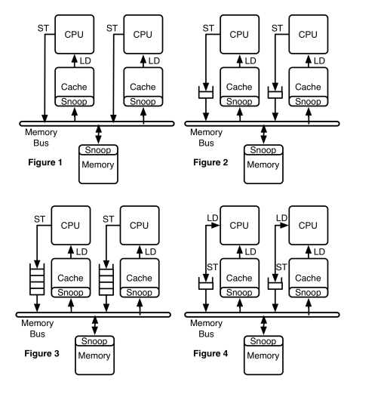
Example
D E S I G N | CPU stalls till store broadcasts on bus (after arbiter grant) updating all caches (including own) | CPU writes Store to 1-entry Write Buffer and executes, On next LD/ST it stalls and waits for Wr Buffer to drain. | CPU keeps pushing Stores into multi-entry Write Buffer and executes. On a LD, waits for Wr Buffer to drain. | CPU writes Store to 1-entry Write Buffer and executes. On next ST it stalls. On next LD it can fwd data from Wr Buffer or Cache.
SC?
Yes
Yes
Yes
No
Both might load 0
Until CPU executes a LD, stores not “visible”
CPU0
ST (X), 1
LD R1, (Y)
CPU1
ST (Y), 1
LD R2, (X)
Example from UCB CS 152
Notes:
Suppose X = 0 and Y = 0 initially.
Valid values returned by loads.
(R1, R2):
Order 1:
ST X
LD R1
ST Y
LD R2
(0, 1)
Order 2:
ST Y
LD R2
ST X
LD R1
(1, 0)
Order 3:
ST X
ST Y
LD R1
LD R2
(1, 1)
With store buffer, might load (0, 0).

Slide 10
Sequential Consistency
Implementing SC
Simplest implementation?
Problem?
Hardware optimizations can reorder LD/ST instructions to different addresses
Out-of-order execution capability
Load(a); Load(b) yes
Load(a); Store(b) yes if a ≠ b
Store(a); Load(b) yes if a ≠ b
Store(a); Store(b) yes if a ≠ b
Caches
Caches can prevent the effect of a store from being seen by other processors
Store Buffers, Addr Speculation, …
Software can also reorder LD/ST instructions to different addresses
a processor issues next memory access only when its previous access is complete
Slow!!!!!

Slide 11
Sequential Consistency
Typical implementations
Processor issues accesses as it sees fit, but detects and fixes potential violations of sequential consistency
Beyond scope of this class
Support a weaker, non SC memory consistency model
Neither x86 nor ARM are SC

Slide 12
Memory Consistency Model
Sequential ISA only specifies that each processor sees its own memory operations in program order
Memory model describes what values can be returned by load instructions across concurrent processes/threads
Needed for synchronization between the processes/threads

Slide 13
Example
Process 1 Process 2
Store (X),1; Store (Y),1;
Load R₁, (Y); Load R₂, (X);
Question: Is it possible that R₁=0 and R₂=0?
Sequential consistency:
No
Suppose Loads can go ahead of Stores waiting in the store buffer:
Yes !
Total Store Order (TSO):
IBM 370, Sparc’s TSO memory model

Slide 14
Weaker Consistency and Memory Fence/Barrier Instructions
ST (A) 100
ADDI R0, R0, 1
FENCE_{WW}
ST (B) R0
spin: LD R1, (B)
BEQZ R1, spin
FENCE_{RR}
LD R2, (A)
Initially,
R0 = 0
Mem[B] = 0
Mem[A] = -999
Core 0
Core 1
Similarly,
FENCE_{WW,} FENCE_{RR}, FENCE_{WR}, FENCE_{RW}
Loads and stores could be reordered if Addr A ≠ Addr B depending on Memory Model.
Insertion of FENCE will disallow this reordering
Example: For TSO model, ST→ST, LD→LD and LD→ST reordering not done by HW, so FENCE_{WW,} FENCE_{RR} and FENCE_{RW} not required
But ST→LD reordering can be done, so FENCE_{WR} should be added in SW to get same behavior as SC HW.

Slide 15
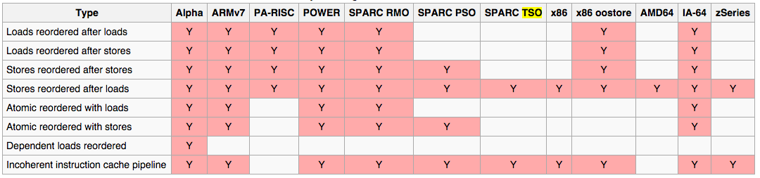
Weaker (Relaxed) Memory Models
Alpha, Sparc
PowerPC, ...
Store is globally
performed
Source: wikipedia
TSO, PSO,
RMO, ...
Write-
buffers
RMO=WO?
SMP, DSM

Slide 16
Synchronization
The need for synchronization arises whenever there are concurrent processes in a system
(even in a uniprocessor system).
Two classes of synchronization:
Producer-Consumer: A consumer process must wait until the producer process has produced data
Mutual Exclusion: Ensure that only one process uses a resource at a given time
producer
consumer
P1
P2
Shared Resource

Slide 17
Mutual-Exclusion
Thread 1
Memory
Thread 2
data
data_ptr
data_ptr
data = 0 initially
// Both threads execute:
LD R5, (data_ptr)
ADDI R5, 1
ST R5, (data_ptr)
Problem?
Both threads might read R5 = 0, update it to 1, and then write 1 (in some order). Correct value of data should be 2.
Will SC (or Weak + Fences) solve it?
No. This does not have to do with re-ordering within thread
Solution?
Locks

Slide 18
Locks
Thread 1
Memory
Thread 2
lock_ptr
lock_ptr
lock
data
data_ptr
Data_ptr
AMSWP: Read lock, and update its value to 1 atomically.
// Both threads execute:
LD R5, (data_ptr)
ADDI R5, 1
ST R5, (data_ptr)
// R0 = 0, R1 = 1
spin: AMSWP lock, R1, (lock_ptr)
BNEZ lock, spin
Acquire Lock
Critical Section
ST R0, (lock_ptr)
Release Lock
Assumes SC memory model

Slide 19
ISA support for Mutual Exclusion
ISA provides atomic read-modify-write instructions
Example atomic swap (“AMSWP”) in prev slide
No other interleaving of any memory access between the Read and Write
Not just program order, but need to ensure no other core inserts its LD/ST instruction between the lock read and write
Examples of atomic read-modify-write instructions in hardware
Test&Set
Compare&Swap
Load-Linked Store-Conditional (LLSC)

Slide 20
Load-linked Store-Conditional
LLSC instructions used to implement atomic read-modify-write in hardware
This can be used by software to implement “locks”
Examples
warx/stwcx (PowerPC), ll/sc (MIPS), ldrexr/strexr (ARM v8)

Slide 21
Load-linked Store-Conditional
Optimized for LD/ST architectures with separate load and store instructions
A load-linked (LL) instruction
Like a normal load, but also remembers the address in a special “link” register
A store-conditional (SC) instruction
Like a normal store, but fails (returns 0) if
its address is not the same as that in the link register
link register is clear
If link register address matches, SC is successful (returns 1) and clears link register
In some implementations, even regular stores to any address clears the link register (to ensure atomic LL and SC).
Notes:
Example 1:
Two cores will both Load lock at address (A).
LL by Core 1 => Link Reg = (A)
LL by Core 2 => Link Reg = (A)
If it is zero, both will try and do a store.
SC by Core 1 => Link Reg = ()
SC by Core 2 => Fails.
Example 2:
LL by Core 1 for Addr A => Link Reg = (A)
LL by Core 2 for Addr B => Link Reg = (B)
If it is zero, both will try and do a store.
SC for Addr A by Core 1 => Fails (since address mis-match)
SC by Core 2 => Wins, Link Reg = ()

Slide 22
Final thoughts on Consistency
Performance vs. Complexity vs. Programmability
Easier to write and debug with stronger consistency
Easier to get performance with weaker consistency
Can add hardware to close performance gap
Good old days:
Hardware was expensive
Expert programmers: can use weaker consistency
Result: weaker consistency invented (and used)
Now: cheap HW, lots of different programmers

Slide 23
Parallel Programming is HARD
Divide algorithm into tasks
Map tasks to parallel threads
Add synchronization (locks, barriers, …) to avoid data races and ensure proper task ordering
Too much synchronization
Performance loss and non-scalable
Too little synchronization
Deadlock, livelock, fairness, races

Slide 24
An Alternative Approach: Transactional Memory
Get rid of synchronization entirely!
Use transactions
Idea: processor X begins a transaction by checkpointing memory
It modifies whatever it wants.
When the transaction ends, it checks for any conflicts (i.e., what it modified != what is there now)
If conflict, retry transaction
Can be implemented in software with huge cost
Helped if the L1$ can be locked so it does not update main memory until end of transaction, but not enough…
Hardware support is an active research area
Example: Intel TSX, AMD ASF, …

