Slide 1
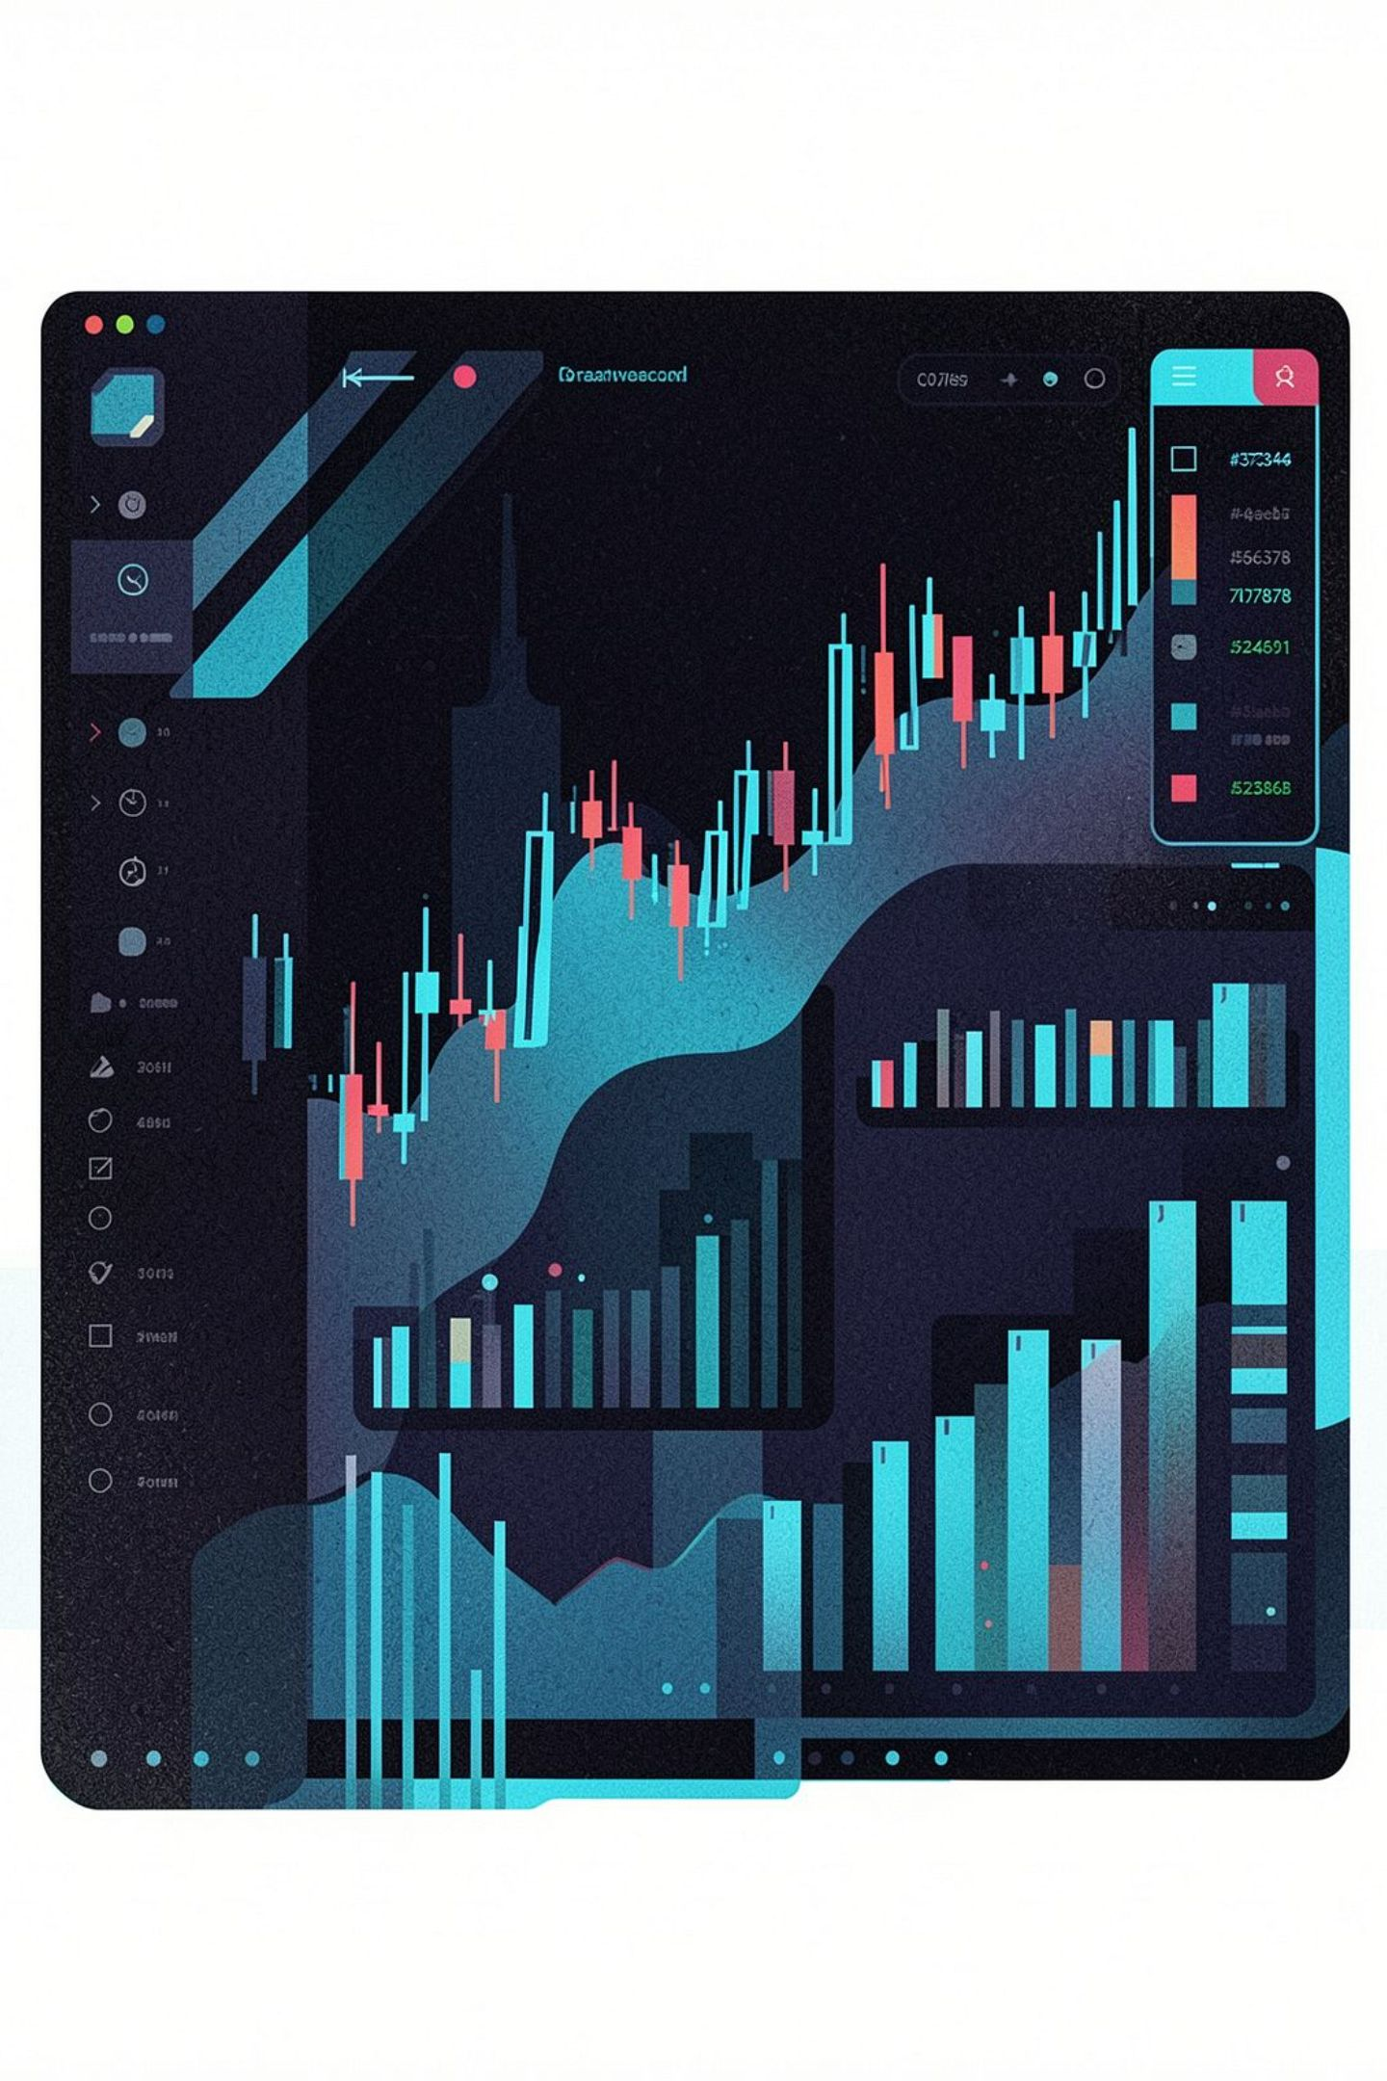
StockPulse: Real-Time Stock Analytics Web Application
A Full-Stack Python & Streamlit Solution for Multi-Market Portfolio Management
UID : 25MCC20030

Slide 2


Project Overview & Motivation
The Problem
Retail investors lack unified, real-time analytics across Indian & US markets — forced to juggle multiple fragmented platforms simultaneously.
The Solution
StockPulse integrates live market data, technical analysis, and sentiment tracking into one cohesive dashboard interface.
Tech Stack
Python · Streamlit · Plotly · SQLite · Yahoo Finance API — fully open-source, free-tier, and reproducible.

Slide 3

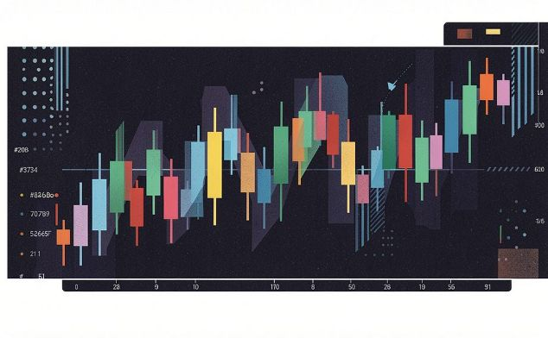


Core Features: Market Dashboards & Data
Dual-Market Support
Interactive Charts
Smart Search
Real-time Indian (NSE/BSE) and US (NASDAQ/NYSE) stock data via Yahoo Finance — 5,000+ tickers covered.
Plotly candlestick and area charts with zoom, pan, and hover analytics for deep price exploration.
Company-name autocomplete with fuzzy matching — type partial names and instantly surface matching tickers.

Slide 4
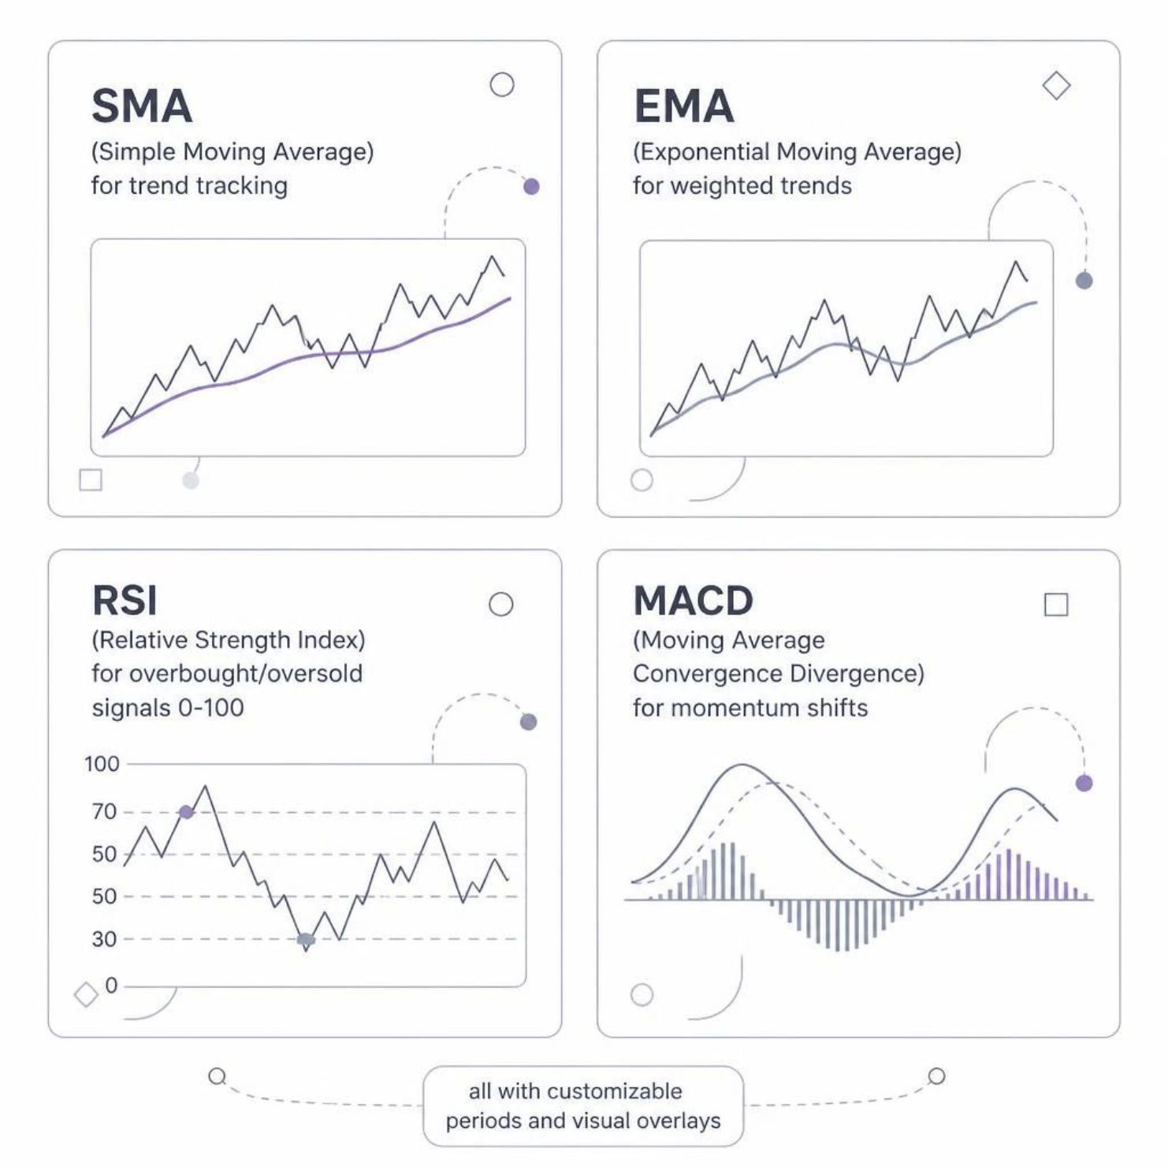
Technical Indicators & Sentiment Analysis
Indicators
SMA & EMA track price trends with customizable periods and visual overlays on live charts.
RSI identifies overbought/oversold conditions; MACD reveals momentum shifts in real time.
Sentiment Layer
Fear & Greed Gauge: Real-time sentiment index (0–100 scale) synthesizing multiple market psychology signals.
Treemap Heatmap: Sector-level performance visualization for rapid macro-level market scanning and rotation analysis.

Slide 5
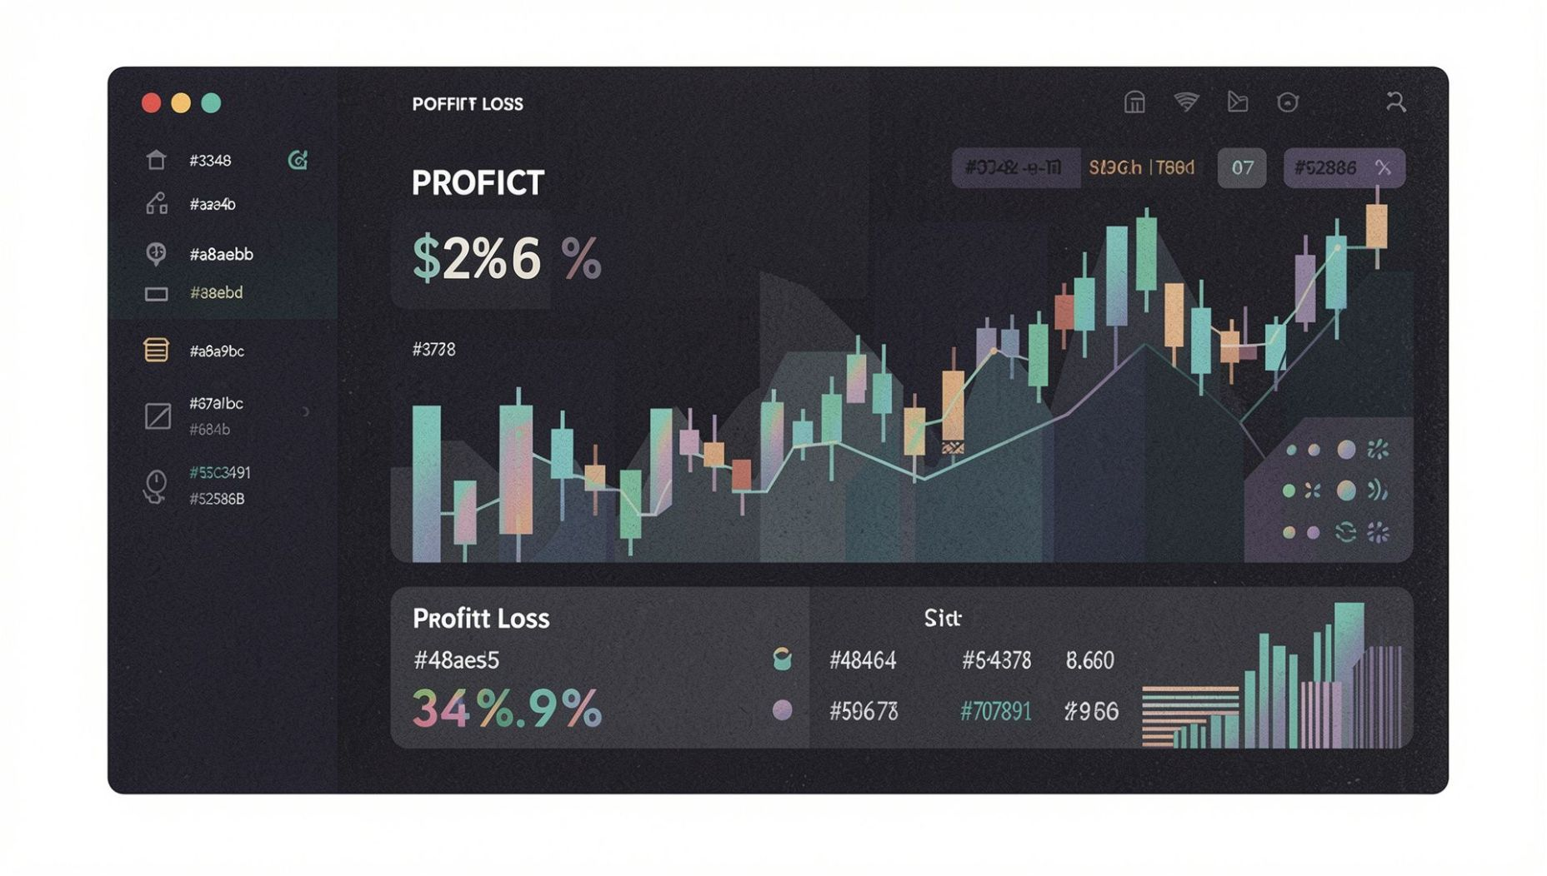
Portfolio & Watchlist Management
🔐 User Authentication
Secure login system with session management for multi-user support and data privacy.
🗄️ SQLite Backend
Lightweight, serverless persistence for portfolios, watchlists, and full transaction history.
📈 Live P&L Tracking
Real-time profit/loss calculations with cost-basis, absolute gains, and percentage returns.

Slide 6
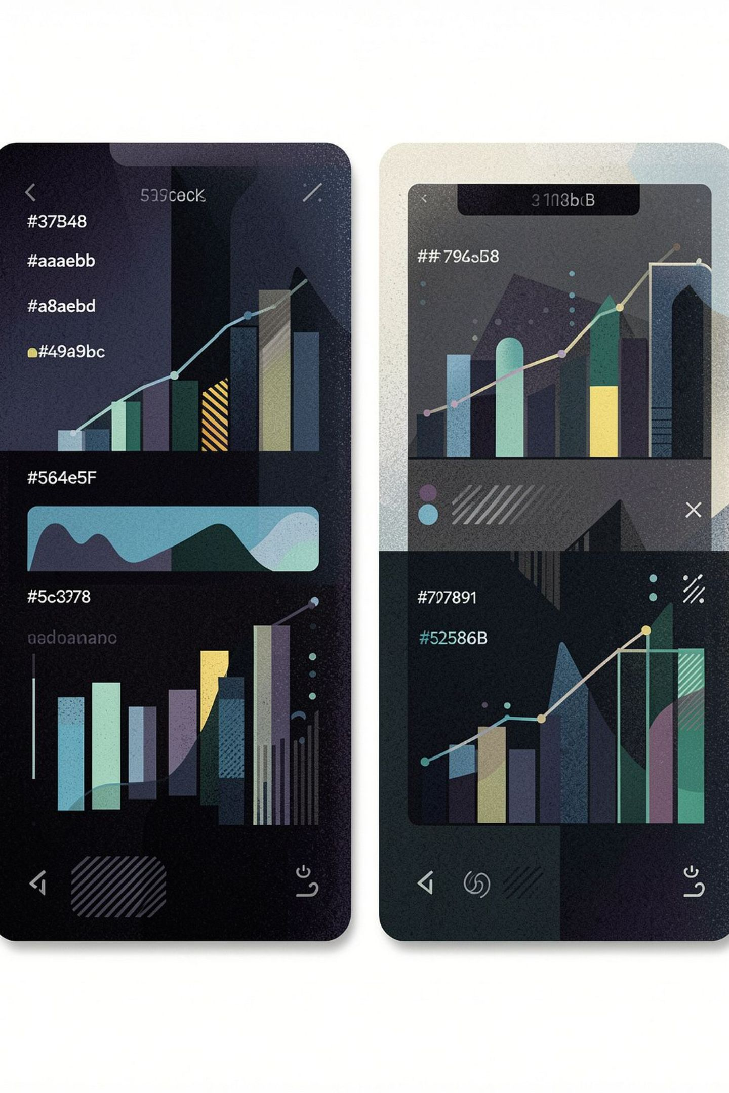
Multi-Stock Comparison & UI Design
Comparison Engine
Dark Glassmorphism UI
Side-by-side analysis of up to 5 stocks with synchronized charts for relative valuation and peer benchmarking.
Custom CSS with frosted-glass effects, dark theme, and fully responsive design — aesthetics meeting usability.
Performance Metrics
Volatility, Sharpe ratio, and correlation matrix empower users to optimize diversification and risk-adjusted returns.

Slide 7
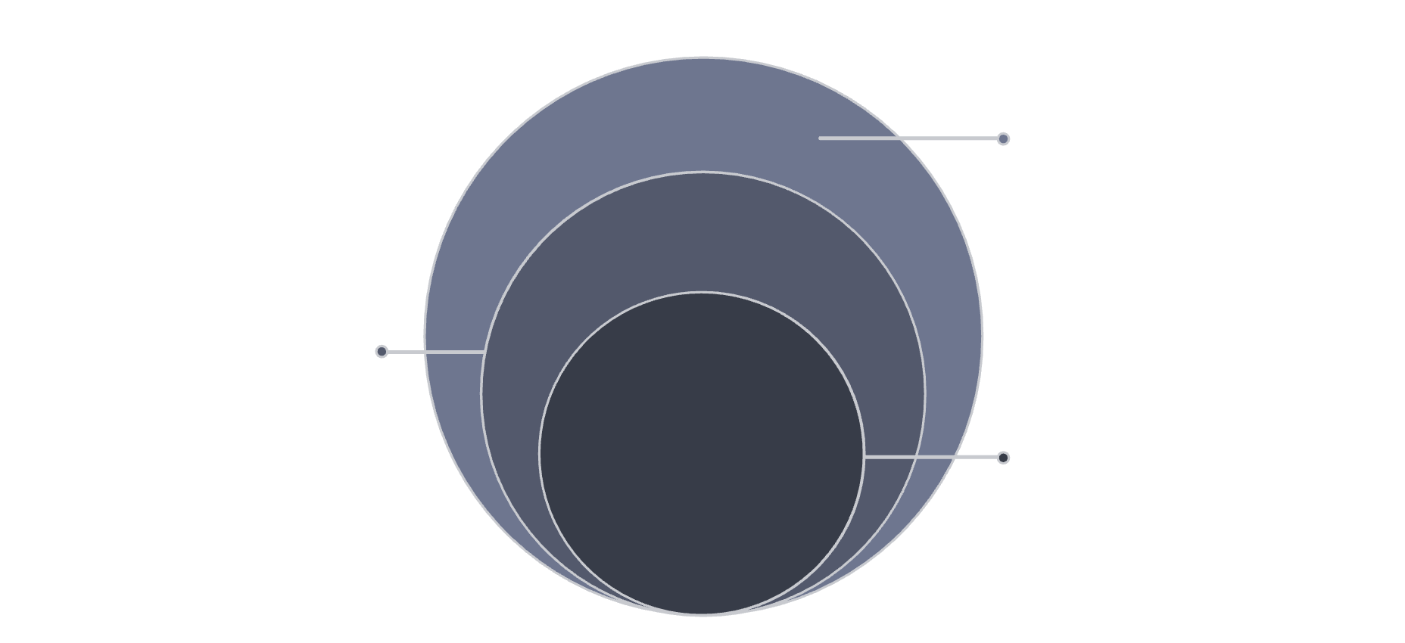
Architecture & Technology Stack
Frontend
Streamlit with custom CSS delivers a responsive, interactive UI — no separate frontend framework required.
Data Processing
Backend
Python with pandas and NumPy
Python ecosystem: pandas & NumPy for data processing; yfinance for live market feeds.
Market Data
Database
Yahoo Finance via yfinance (free tier)
Core Database
SQLite manages user accounts, portfolios, and watchlists — serverless, zero-cost, and fully portable.
SQLite: users, portfolios, watchlists
APIs
Yahoo Finance free-tier; optional sentiment APIs for the Fear & Greed index. Zero infrastructure costs.

Slide 8




Future Scope & Conclusions
ML Enhancements
Scalability
Impact
LSTM/GRU neural networks for price prediction; sentiment-driven trading signals leveraging temporal dependencies.
PostgreSQL migration, cloud deployment on AWS/GCP, and real-time WebSocket feeds supporting thousands of concurrent users.
Democratizes professional-grade analytics for retail investors and students — tools once exclusive to institutions, now open to all.
StockPulse empowers the next generation of data-driven investors with institutional-grade analytics built entirely on open-source, free-tier technology.

