Slide 1
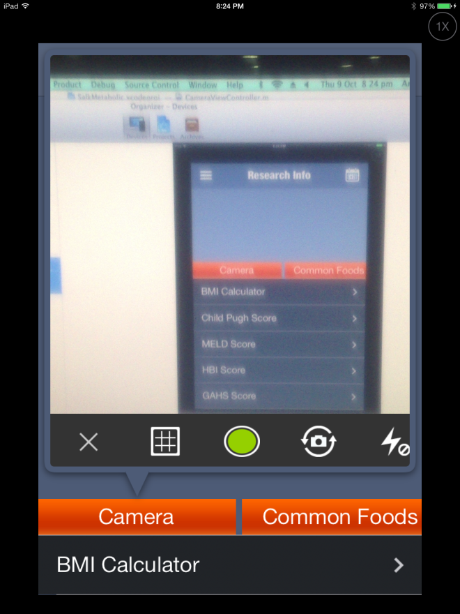
Front/back camera
Flash sign
Camera functions are typically on top of the image window. Leave these two functions here, so that the person will find them in usual place
We don’t need “Zoom” function, as almost all pictures will be taken from close range. If zoom is needed, can the user use two fingers to zoom in?
Remove this BMI calculator from this screen.

Slide 2

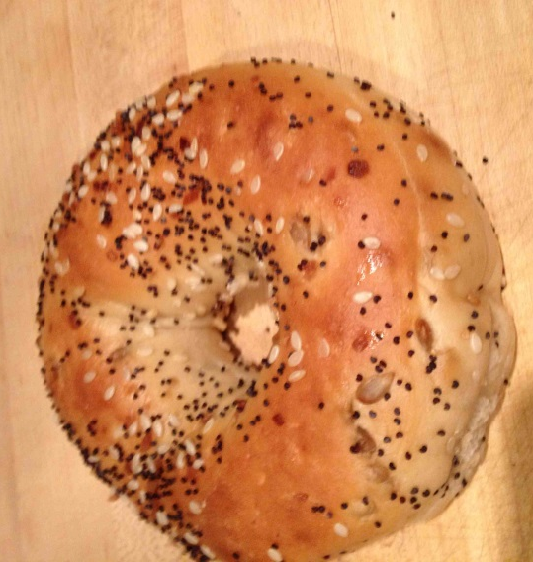
Retake
Add annotation
1
2
If Picture is selected; After
taking pic
“T”
Water
Food/beverages
Rx & Supplements
These are the 4 different input options.
“T” or text entry,
Menu or preset foods/beverages.
Camera (default).
Barcode.
They can be selected by sliding them from left to right, so that the one at the center is active. (e.g, picture modes in iPhone 5S)
3. Now the user can slide the picture to “Water”. “Food…” or “Rx..” bins. Or the user clicks those bins.

Slide 3
4
If “retake” is selected – screen goes back to #1. If “Add annotation is selected” – pop up annotation
As soon as one starts typing, the system may offer options based on previous entries.
After typing starts, “Accept” and “Cancel” button become active.
If the person wants to delete the text and retype, the sign may be pressed. It should be intuitive.
If “Accept” is pressed, the annotation window disappears.
Now the user can slide or tap the three bins at the bottom.
If “cancel” is selected, the screen goes back to #2. User can choose step #3 or #4.
Name food and quantity
How long ago?
Hour min
Accept
Cancel
Water
Food/beverages
Rx & Supplements
5. After completion of “3” or “4” the screen returns to “1”.

Slide 4
6. IF “T” or text is selected
Name food and quantity
How long ago?
Hour min
a. Embed the time wheel here
Default should be “0” h “0” min, so that if someone presses accept, the default is “now”.
b. For subsequent steps, see step #4.
Accept
Cancel
“T”
Water
Food/beverages
Rx & Supplements

Slide 5
7. IF “Menu” is selected
This menu window pops up. Content of the “Menu” window is editable. It can be edited from the “Settings” window.
Person can select one item, the item names automatically appears in the text box at the top and all buttons become “inactive”.
Optional: One can press the “+” button. It will add a “Comma” and then all buttons again become “active”. One can now add another item… and so on.
If the person presses “Accept” – it means “now”. Else, s/he can select how long ago from the “time wheel” and then press “accept”.
“Cancel” takes the window back to step #1.
Coffee
Tea
Toast
Yogurt
Ice cream
Burger
Orange
Apple
Banana
Nuts
Chips
Soda
Orange
Apple
Banana
“T”
Water
Rx
Rx
How long ago?
Hour min
Accept
Cancel

Slide 6
After the data is recorded
Note: After pressing “Accept” or tapping the “Water”, “Food..” or “Rx..” buttons, the system must do the followings.
If camera was used, down sample the image to <300kb.
Create a text file for annotation, add the annotation to it. If “Water”, “Food..” or “Rx..” was selected, the annotation will start with “Water”, “Food..” or “Rx..” and then append the name of the food item.
Create a geo location file and add the geo location. If the phone is in aeroplane mode or there is no GPS data available, it will use the last geo location.
The picture file, text annotation file and the location file should have the same file name – “subject ID_date_Time”
These files are sent to the buffer and the app becomes functional.
In the background the app will try to send the files to the server. If no internet is available, it will wait till internet becomes available again. The buffer should be ~5Mb, so that one full day of data can be stored.

Slide 7
Setting the “Menu” from “Settings”
The Menu can be completely user specified.
For each of the 15 or so buttons, one can type a food item or select from a preset menu.
For example, if the person selects or types “Coffee”, it should offer the roll down options of “Coffee with sugar”, “Coffee with sugar and cream”, “Black coffee with sugar” etc. We can discuss this later.
Two buttons by default are medicines or supplement buttons. If a person edits those buttons and adds a medication or supplement, it will also ask if the person wants to set a reminder for the medication/supplement. It should then link that selection to “Calendar” function and offer to set a reminder at a set time.
Water will remain as a default button.
Will the menu items be part of the scroll down options available in text fields (Step #4 or #6)?

Slide 8
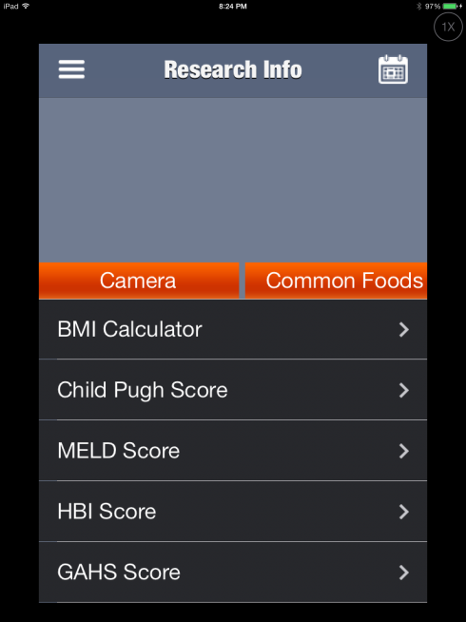
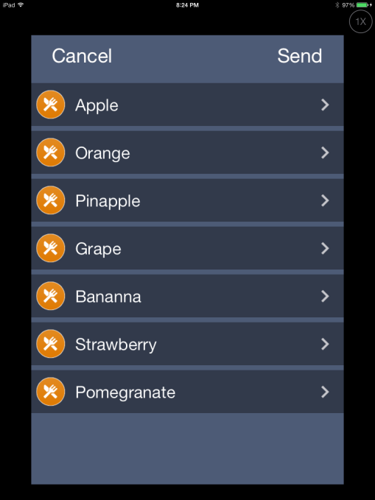
Don’t spend time on this window. This is not high priority now.
Remove this screen and replace with the text/menu windows as instructed in earlier slides

