Slide 1
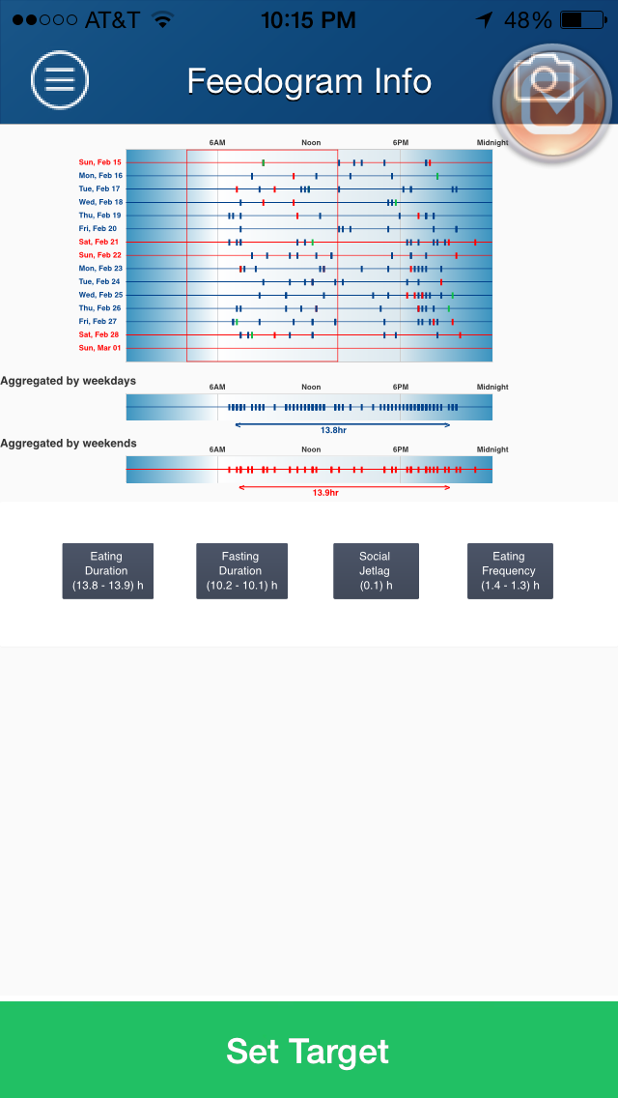
The default is “All” events. By clicking “Water” or “Medication”, only those events will be shown in the feedogram.
Current view
Proposed view
All
Water
Meds
To improve clarity, we can have a bounding box around all events of a day. The box is made only after the completion of the day.
An arrow at the current time
(if it is within the target zone, it will be green. If it is outside the target zone, it will be red and blinking)
Today
An active timer will show the time since the last non-water event. This may also be added to the picture and menu section.
Target
7:30am
11 h
6:30pm
Weekday
7:10am
12 h 03min
7:13pm
Weekend
7:12am
13 h 09 min
8:21pm
Time since last calorie 2:56
History
Tag Cloud
Set Target

Slide 2
Proposed view of “view chart”. By clicking “history” the feedogram area converts to horizontal bars showing eating duration in the past few weeks
All
Water
Meds
6:10am
13 h 0min
7:10pm
5:12am
15 h 09 min
8:21pm
7:00am
12 h 13min
7:13pm
9:12am
11 h 00 min
8:12pm
5:40am
13 h 33min
7:13pm
7:12am
13 h 09 min
8:21pm
7:10am
12 h 03min
7:13pm
7:12am
13 h 09 min
8:21pm
7:10am
12 h 03min
7:13pm
7:12am
13 h 09 min
8:21pm
7:10am
12 h 03min
7:13pm
7:12am
13 h 09 min
8:21pm
7:10am
12 h 03min
7:13pm
7:12am
13 h 09 min
8:21pm
Today
Target
7:30am
11 h
6:30pm
Weekday
7:10am
12 h 03min
7:13pm
Weekend
7:12am
13 h 09 min
8:21pm
Time since last calorie 2:56
History
Tag Cloud
Set Target

