Slide 1
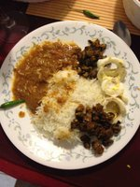
Rice, Vegetables, Daal, Egg
_Not a food picture
_Fuzzy picture
_Text entry
_Water
_ Medications/Supplements
Search
Rice, white, medium grained, cooked 100g
Done

Slide 2
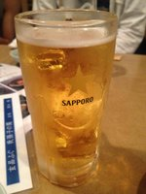
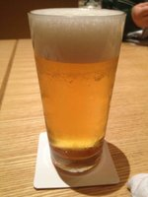
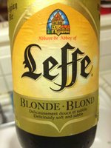
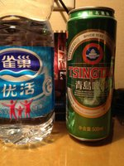
Beer
_Not a food picture
_Fuzzy picture
_Text entry
_Water
_ Medications/Supplements
Search
14006, Alcoholic beverage, beer, light 300 ml
Select
Confirm
14003, Alcoholic beverage, beer, regular, all 1 bottle
Select
Confirm
14305, Malt beverage, includes non-alcoholic beer 300ml
14555, Water, bottled, generic 300ml
Select
Confirm
Select
Confirm

Slide 3
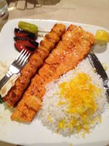
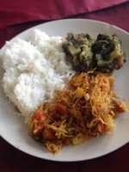
Rice, chicken, Vegetables
_Not a food picture
_Fuzzy picture
_Text entry
_Water
_ Medications/Supplements
Search
Rice, white, medium grained, cooked 100g
11986 Malabar spinach, cooked 50g
20115 noodles, Japanese, cooked 100g
Select
Confirm
Select
Confirm
Select
Confirm
Rice, white, medium grained, cooked 100g
06620 SMART SOUP, French Lentil 50g
01129 Egg, whole, cooked, hard-boiled 1
11803 Okra, cooked, boiled, drained, with salt 50g
Select
Confirm
Select
Confirm
Select
Confirm
Select
Confirm

