Slide 1

Improving Performance through Customer Segmentation and Shipping Cost Optimization
Presented by
Amit Kulkarni
23f1001947

Slide 2
Contents
01. About The Company
02. Challenges faced
A brief introduction of the organization.
An overview of the problems faced in the project.
03. Key Findings
04. Recommendations
05. Closing
Results and Key findings found after the data analysis.
Recommendations to the organization after analysis.
Thank You .
November 27, 2024

Slide 3
About The Company
Walmart Inc., founded in 1962 by Sam and Bud Walton in Rogers, Arkansas, operates 10,586 stores across 24 countries under 46 different names. Headquartered in Bentonville, Arkansas, it is the world’s largest private employer, with over 2.1 million employees globally.
The company’s vast transportation network includes 9,000 tractors, 80,000 trailers, and 11,000 drivers, ensuring daily delivery of merchandise and groceries.
Walmart’s business model emphasizes offering low prices and popular products, avoiding slotting fees for suppliers, and incentivizing store managers to optimize inventory by discontinuing less popular items.
November 27, 2024

Slide 4
Dataset Overview
Dataset Size: 1M+ transactions across 23 features.
Covers: Customer demographics, sales, product info, shipping, and financial metrics.
Key Insights:
High variability in profit and shipping costs.
Balanced distribution across customer segments, order priorities, and shipping modes.
Office Supplies dominate product sales, followed by Technology and Furniture.
November 27, 2024

Slide 5
Challenges faced
Shipping Cost Optimization: Inefficient allocation of shipping modes—such as using Express Air for low-priority orders leads to increased costs, delivery delays, reduced profit margins, and lower customer satisfaction.
Customer Retention: Walmart’s diverse customer base requires tailored marketing and inventory strategies to meet their preferences. Failing to adapt to these variations impacts customer satisfaction, retention, and inventory efficiency.
November 27, 2024

Slide 6
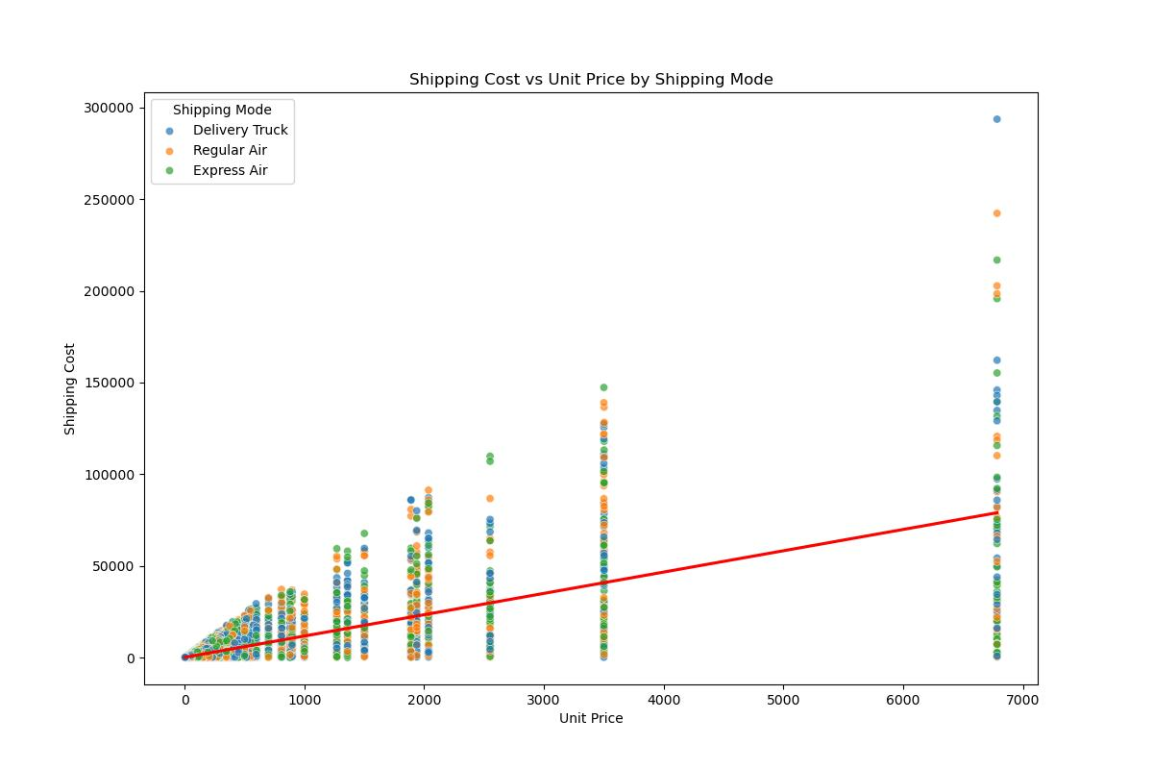
Key Findings – Shipping Cost Optimization
Low Unit Price Concentration: Most data points are clustered at unit prices between 0–1,000, showing significant variation in shipping costs across modes.
Peak at 7,000 Unit Price: A sharp increase in shipping costs is observed around a 7,000 unit price, with Delivery Truck and Regular Air preferred for high-value items, likely due to security or logistical concerns.
November 27, 2024

Slide 7
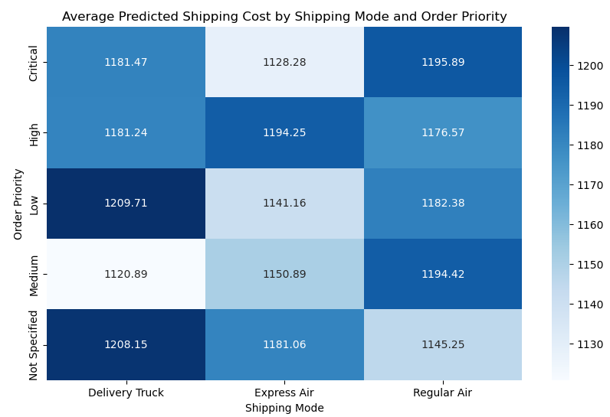
Key Findings – Shipping Cost Optimization
Critical Orders: Express Air is the most cost-effective option, with lower costs compared to Regular Air.
High Priority Orders: Regular Air is more economical than Express Air and Delivery Truck.
Medium Priority Orders: Delivery Truck offers the lowest shipping cost compared to other modes.
Non-Specified Priority Orders: Regular Air is the most cost-efficient option with Delivery Truck and Express Air being more expensive.
November 27, 2024

Slide 8
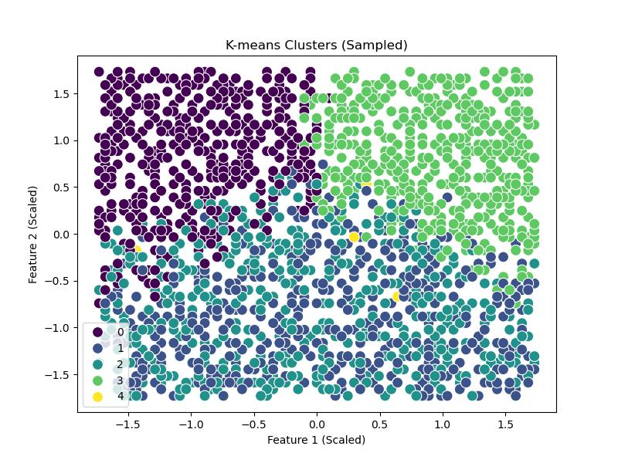
Key Findings – Customer Segmentation
Cluster 0: Average age 35.87, high order quantity (36.97), profit ($7,661.33) focuses on Furniture and Office Supplies.
Cluster 1: Older customers (average age 56.93), lower order quantity (13.89), profit ($17,819.96) diverse product categories.
Cluster 2: Similar to Cluster 1 (average age 53.29, order quantity 13.97), but with negative profit (-$4,805.41).
Cluster 3: Oldest group (average age 74.10), high order quantity (37.07), profit ($5,524.61), potential for frequent purchases.
Cluster 4: Mid-age (54.68), high order quantity (36.05), extremely high sales ($112,140.86); mainly interested in Technology and Office Supplies.
November 27, 2024

Slide 9
Recommendations
Bulk Shipping & Negotiated Rates: Explore bulk shipping and negotiate rates for high-value items to reduce costs and improve efficiency.
Targeted Marketing by Customer Cluster:
Cluster 0: Introduce loyalty programs and small-business discounts.
Clusters 1 2 & 3: Focus on personalized service and senior-friendly promotions.
Cluster 4: Offer exclusive tech product releases, bulk discounts, and specialized services.
Tiered Shipping Policy:
Critical Orders: Prioritize Express Air for speed.
High Priority Orders: Shift to Regular Air or Delivery Truck for cost savings.
Medium & Low Priority Orders: Use Delivery Truck for bulk or low-margin products.
November 27, 2024

Slide 10

Thank you
Thank you for your time and thank you for all the support throughout the project.
Amit Kulkarni
23f1001947
10

