Slide 1
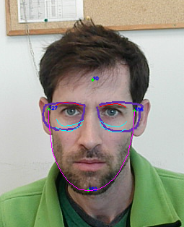
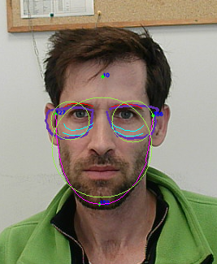
Frame sections which should correlate to the eyebrows
Frame symmetry line
Face height
Frame symmetry line
Right eyebrow
Left eyebrow
Face width
Face width
Frame width
Frame width
Right eyebrow
Left eyebrow
Right lower cheek line
Left lower cheek line
Jaw line
Face height
Face width
Right lower cheek line
Left lower cheek line
Best fit circles
Jaw line

Slide 2
DBL
Face nose width
Frame color
Skin color
Face height
Right eyebrow
Left eyebrow
Face width
Frame width
Right lower cheek line
Left lower cheek line
Jaw line

Slide 3
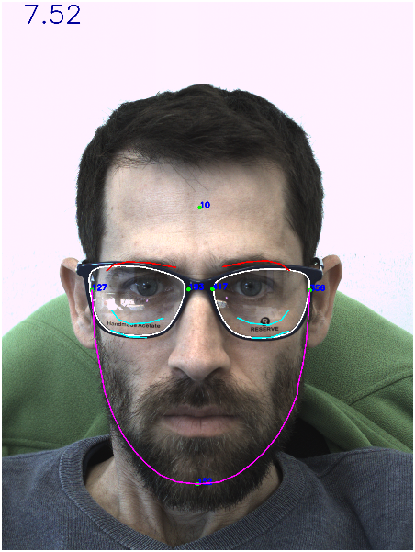
Frame symmetry line
Frame width
Right eyebrow
Left eyebrow
Face width
Frame sections which should correlate to the eyebrows
Face height
Face width
Right lower cheek line
Left lower cheek line
Best fit circles
Jaw line

Slide 4
DBL
Face nose width
Frame color
Skin color
Face height
Right eyebrow
Left eyebrow
Frame width
Face width
Right lower cheek line
Left lower cheek line
Frame contours
Jaw line
Face contour

