Slide 1
POSETRON TECHNOLOGY SOLUTIONS

Slide 2

Vision
To provide business leverage for our partners by providing state of the art high performance applications with various front end and backend technologies exploiting the cloud platforms.

Slide 3


Technology stack our developers work on currently
A
It has been seen that most of the applications are moving to angular based framework for their business applications due to its client side solutions

Slide 4

Technology stack our developers work on currently
React Js is another front end framework from Facebook famous for its JSX html inside JavaScript and helps in creating interactive UI.
React is flexible and provides hooks that allow you to interface with other libraries and frameworks

Slide 5

Technology stack our developers work on currently
Vue JS:It is a progressive front end frame work for creating.
You can control a part of an application through Vue and others through native application

Slide 6
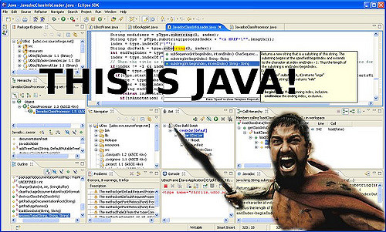
Java and its robust nature and security
Java has dominated the market for years together.
It has always been the centre of excellence with frameworks like Spring boot which helps in the creation of micro services.

Slide 7

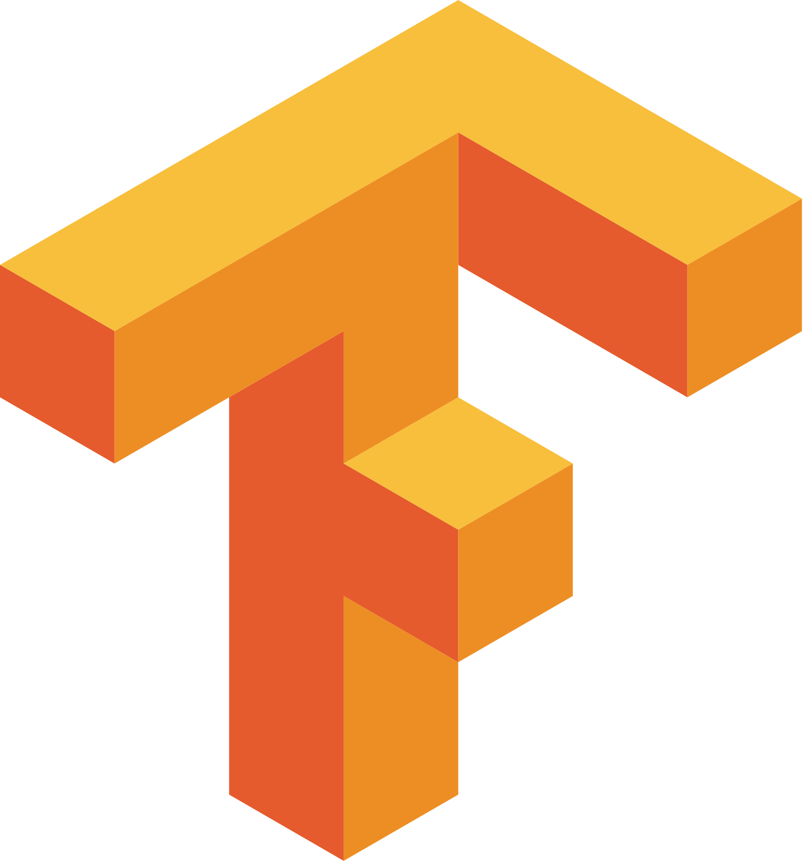
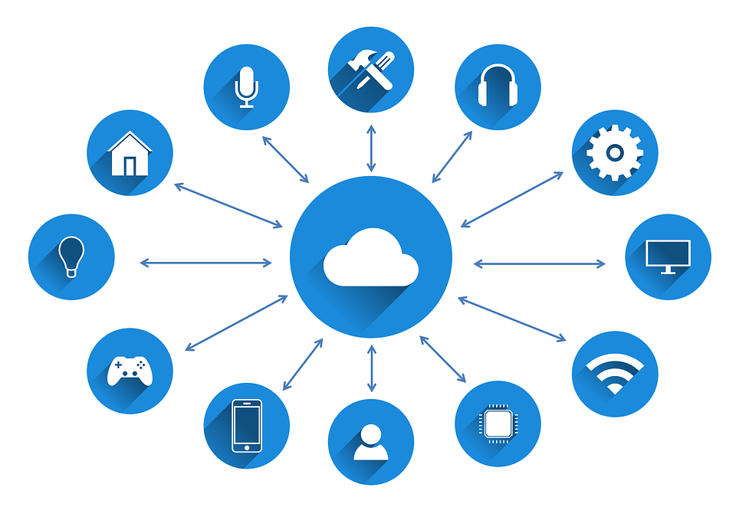
Path forward and future vision
Currently team is getting skilled in artificial intelligence and data sciences for new business opportunities.
Tensor Flow, AWS, IOT home automation systems

Slide 8
Thank You

