Slide 1


NETWORKING

Slide 2

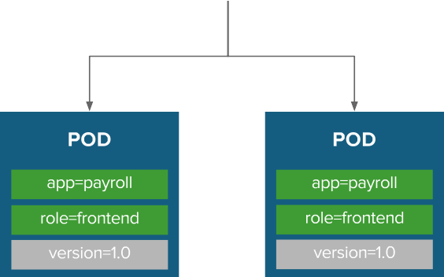
BUILT-IN SERVICE DISCOVERY INTERNAL LOAD-BALANCING

Slide 3

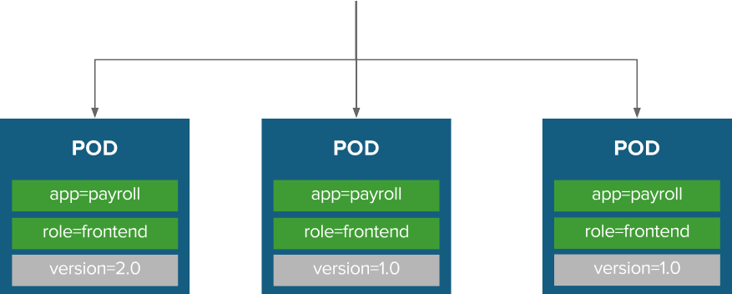
BUILT-IN SERVICE DISCOVERY INTERNAL LOAD-BALANCING

Slide 4


ROUTE EXPOSES SERVICES EXTERNALLY

Slide 5


ROUTING AND EXTERNAL LOAD-BALANCING
Pluggable routing architecture
HAProxy Router
F5 Router
Multiple-routers with traffic sharding
Router supported protocols
HTTP/HTTPS
WebSockets
TLS with SNI
Non-standard ports via cloud load-balancers, external IP, and NodePort

Slide 6

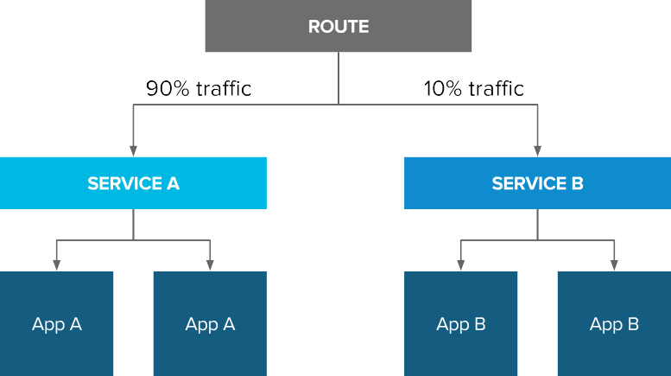
ROUTE SPLIT TRAFFIC
Split Traffic Between Multiple Services For A/B Testing, Blue/Green and Canary Deployments

Slide 7
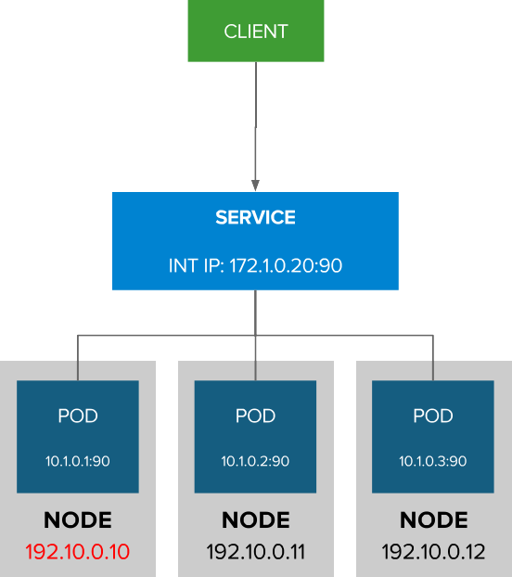

EXTERNAL TRAFFIC TO A SERVICE ON A RANDOM PORT WITH NODEPORT
NodePort binds a service to a unique port on all the nodes
Traffic received on any node redirects to a node with the running service
Ports in 30K-60K range which usually differs from the service
Firewall rules must allow traffic to all nodes on the specific port

Slide 8
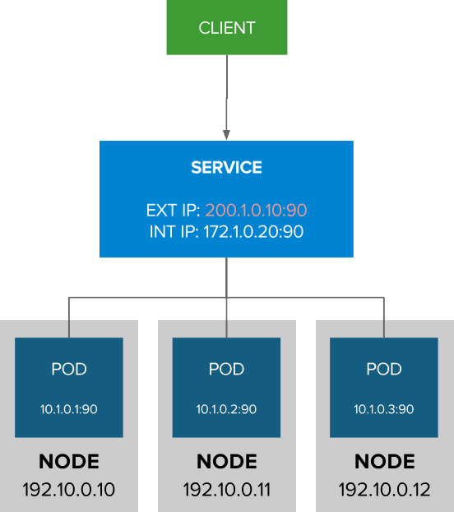

EXTERNAL TRAFFIC TO A SERVICE ON ANY PORT WITH INGRESS
Access a service with an external IP on any TCP/UDP port, such as
Databases
Message Brokers
Automatic IP allocation from a predefined pool using Ingress IP Self-Service
IP failover pods provide high availability for the IP pool

Slide 9
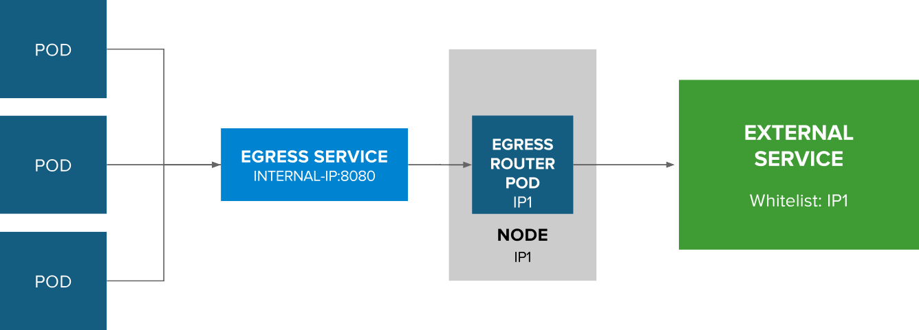
CONTROL OUTGOING TRAFFIC SOURCE IP WITH EGRESS ROUTER

Slide 10



OPENSHIFT NETWORKING
Built-in internal DNS to reach services by name
Split DNS is supported via SkyDNS
Master answers DNS queries for internal services
Other nameservers serve the rest of the queries
Software Defined Networking (SDN) for a unified cluster network to enable pod-to-pod communication
OpenShift follows the Kubernetes
Container Networking Interface (CNI) plug-in model

Slide 11
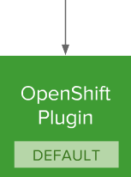

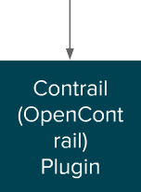

OPENSHIFT NETWORK PLUGINS
* Flannel is minimally verified and is supported only and exactly as deployed in the OpenShift on OpenStack reference architecture

Slide 12
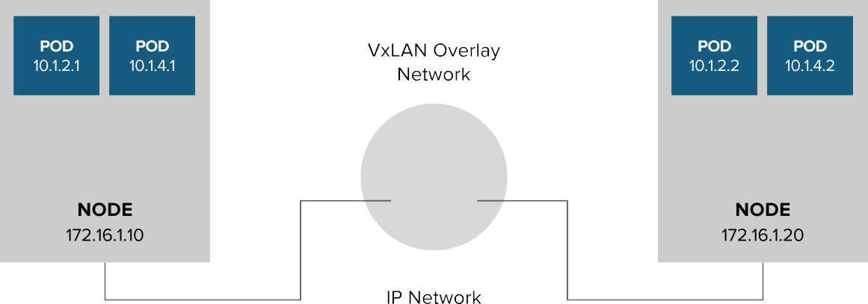

OPENSHIFT NETWORKING

Slide 13

OPENSHIFT SDN
FLAT NETWORK (Default)
All pods can communicate with each other across projects
MULTI-TENANT NETWORK
Project-level network isolation
Multicast support
Egress network policies
NETWORK POLICY (Tech Preview)
Granular policy-based isolation
NODE
NODE
POD
POD
POD
POD
POD
POD
POD
POD

Slide 14
OPENSHIFT SDN - NETWORK POLICY
Example Policies
Allow all traffic inside the project
Allow traffic from green to gray
Allow traffic to purple on 8080
apiVersion: extensions/v1beta1 kind: NetworkPolicy
metadata:
name: allow-to-purple-on-8080 spec:
podSelector: matchLabels:
color: purple ingress:
- ports:
- protocol: tcp port: 8080

Slide 15
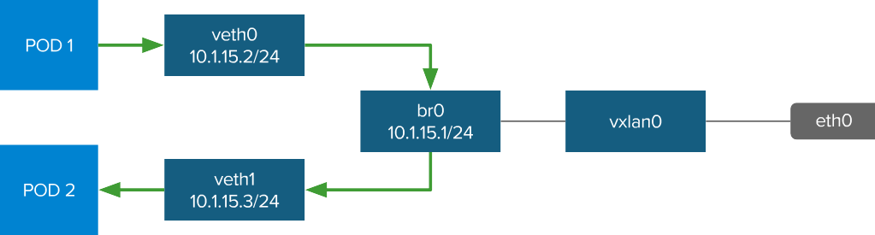
OPENSHIFT SDN - OVS PACKET FLOW
Container to Container on the Same Host

Slide 16
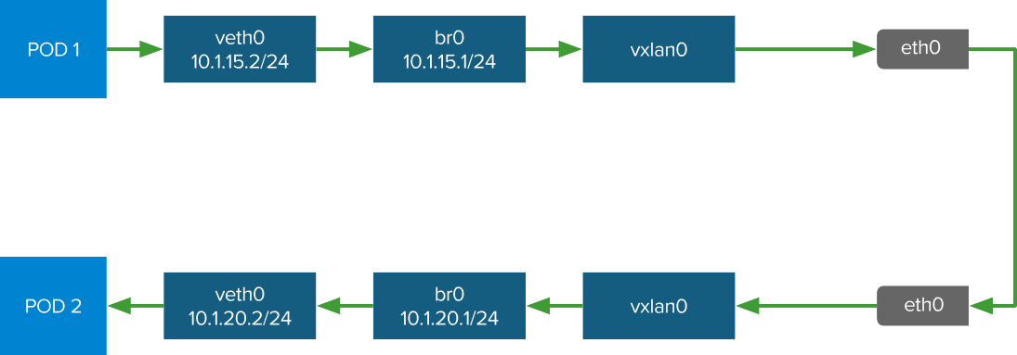
OPENSHIFT SDN - OVS PACKET FLOW
Container to Container on the Different Hosts

Slide 17
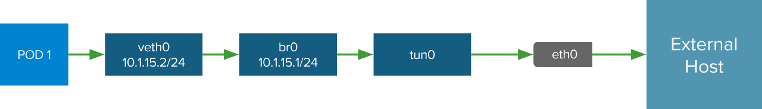
OPENSHIFT SDN - OVS PACKET FLOW
Container Connects to External Host

Slide 18

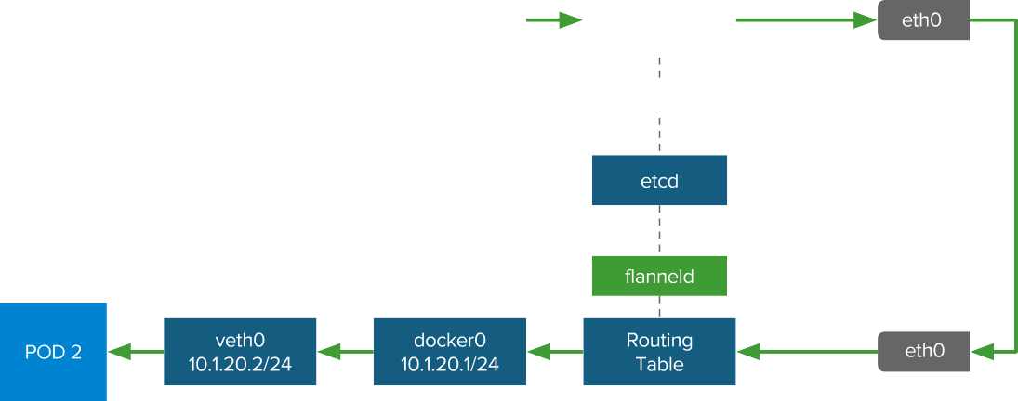
OPENSHIFT SDN WITH FLANNEL FOR OPENSTACK
Flannel is minimally verified and is supported only and exactly as deployed in the OpenShift on OpenStack reference architecture https://access.redhat.com/articles/2743631

Slide 19
Thank You

