Slide 1


PERSISTENT STORAGE

Slide 2

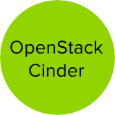


Persistent Volume (PV) is tied to a piece of network storage
Provisioned by an administrator (static or dynamically)
Allows admins to describe storage and users to request storage
Assigned to pods based on the requested size, access mode, labels and type

Slide 3


PERSISTENT STORAGE

Slide 4

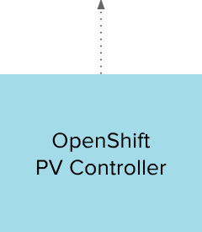
DYNAMIC VOLUME PROVISIONING

Slide 5


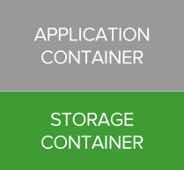
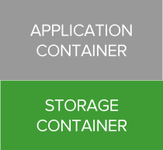
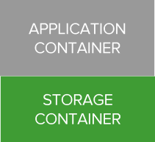
CONTAINER-NATIVE STORAGE
Containerized Red Hat Gluster Storage
Native integration with OpenShift
Unified Orchestration using Kubernetes for applications and storage
Greater control & ease of use for developers
Lower TCO through convergence
Single vendor Support

Slide 6



CONTAINER-NATIVE STORAGE
MASTER
NODE
NODE
NODE
NODE
POD
POD
POD
POD
POD | POD | POD
POD | POD | POD
POD | POD | POD

Slide 7
Thank You

