Slide 1
Orecast
Mineral intelligence over time
Orecast
OXHack 2026
25 October 2026
Notes:
Slide 1. Orecast
Timing: 20 seconds.
Orecast investigates how evidence, an assumed gold forecast and the time available to find a buyer affect one mineral decision. This local review uses one explicit synthetic contract and makes the effect of its fee assumptions visible.
Local unpublished source revision: 69a0b5b4d2ca8db16cc46f15ff0b07f954e72ed2. Model: tok-option-demo-v2.
Sources:
Local unpublished source: model/tok-option/workbench.mjs (runWorkbench and compareFeePolicies).
Local unpublished source: model/tok-option/lot-basis.mjs (SYNTHETIC_LOT_PROFILE).
Local source: model/tok-option/gold.mjs, valuation.mjs, liquidity.mjs and diagnostics.mjs.
Imagery: Esri, Maxar, Earthstar Geographics. Terrain: Mapzen Terrarium (AWS Open Data).
https://server.arcgisonline.com/ArcGIS/rest/services/World_Imagery/MapServer
https://registry.opendata.aws/terrain-tiles/

Slide 2
01
Time and evidence
Orecast
One hypothetical contract.
One fixed exposure, compared over time.
Assumed exposure: 23,076.92 troy oz and $184,615.38 buyer consideration.
Frozen invented-reference scale: 30,000 / 650. One contract, not multiple lots.
Historical signing payments do not value this invented mineral interest.
Fixed $50 entry / exit fees: 12.35% return. Proportional fees: 1.09% and a failed risk cap.
Evidence
COLLECTED
PUBLISHED
June–July 2016
November 2016
Simulation
Five simulated days
News at day 3
DAY 1
DAY 2
DAY 3
DAY 4
DAY 5
HOLDING PERIOD
Assignment
30 DAYS
90 DAYS
180 DAYS
Timelines are illustrative. The holding period and closing buffer must fit before expiry.
Notes:
Slide 2. One hypothetical contract over time
Timing: 30 seconds.
We hold one synthetic contract fixed across every comparison. Its invented reference exposure is scaled by 30,000 divided by 650, giving 23,076.92 assumed ounces and 184,615.38 dollars buyer consideration. Historical signing payments only motivate the entry scale; they do not value this interest. We assume 50-dollar entry and exit fees. Proportional fees instead give 1.09% return and fail the risk cap.
Preparation / Q&A: Three clocks stay distinct: observed collection/publication in 2016; five simulated days with news on day 3; and 30/90/180-day holding horizons. The simulated fund remains $1,502,500, with a $30,050 per-option cap, $150,250 open/lifetime commitment caps and at most five positions. The scale factor does not mean multiple contracts.
Local unpublished source revision: 69a0b5b4d2ca8db16cc46f15ff0b07f954e72ed2. Model: tok-option-demo-v2.
Sources:
Local unpublished source: model/tok-option/workbench.mjs (runWorkbench and compareFeePolicies).
Local unpublished source: model/tok-option/lot-basis.mjs (SYNTHETIC_LOT_PROFILE).
Local source: model/tok-option/gold.mjs, valuation.mjs, liquidity.mjs and diagnostics.mjs.
https://www.tectonicmetals.com/_resources/financials/MDA-Q2-2019-FINAL.pdf?v=070606
https://www.tectonicmetals.com/_resources/financials/FS-Tectonic-2018YE-AUDITED.pdf?v=090403

Slide 3
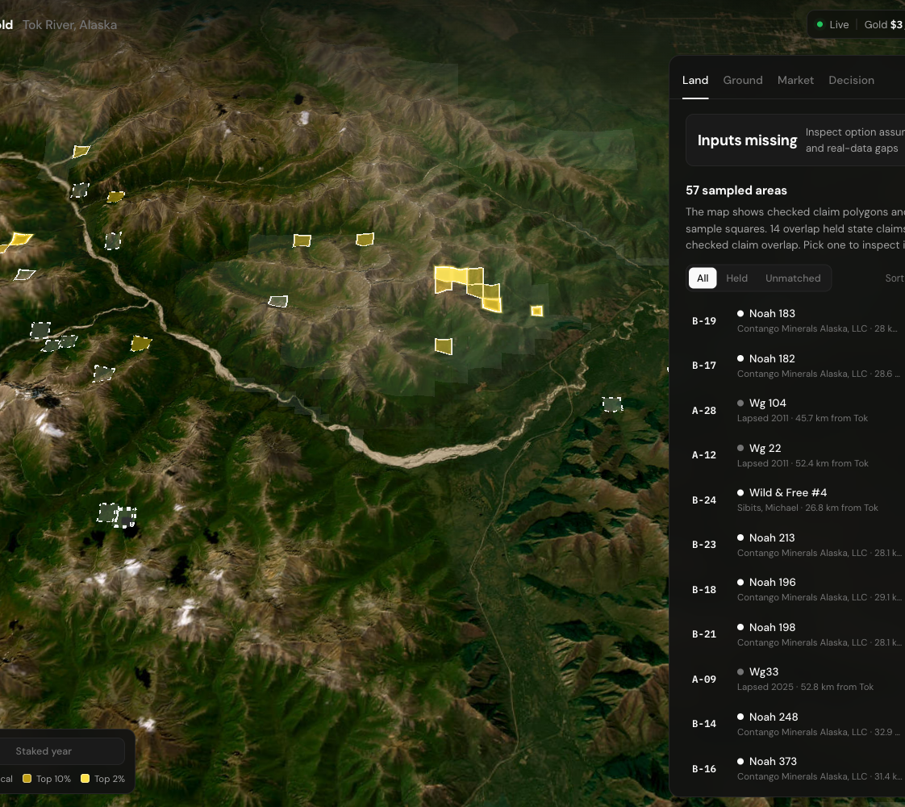
02
Observed evidence
The evidence explorer
Orecast
We begin with
67
measured sediment samples
from Tok River, Alaska.
A has 33 samples. B has 34.
Primary gold assays screen the evidence.
Recoverable ounces remain a separate assumption.
Alaska DGGS RDF 2016-10. Comparison areas, not available listings.
Notes:
Slide 3. Observed evidence
Timing: 30 seconds.
We begin with 67 measured sediment samples from Tok River, Alaska: 33 in Area A and 34 in B. Source provenance stays attached to each observation. Under the proposed gold-assay screen, A passes and B fails. The samples provide observed evidence, not recoverable ounces or geological success probabilities. Those remain separate assumptions. Map claims and illustrative squares provide context; they do not establish available mineral rights or an investment.
Local unpublished source revision: 69a0b5b4d2ca8db16cc46f15ff0b07f954e72ed2. Model: tok-option-demo-v2.
Sources:
https://doi.org/10.14509/29688
Local unpublished source: model/tok-option/workbench.mjs (runWorkbench and compareFeePolicies).
Local unpublished source: model/tok-option/lot-basis.mjs (SYNTHETIC_LOT_PROFILE).
Local source: model/tok-option/gold.mjs, valuation.mjs, liquidity.mjs and diagnostics.mjs.
Imagery: Esri, Maxar, Earthstar Geographics. Terrain: Mapzen Terrarium (AWS Open Data).
https://server.arcgisonline.com/ArcGIS/rest/services/World_Imagery/MapServer
https://registry.opendata.aws/terrain-tiles/

Slide 4
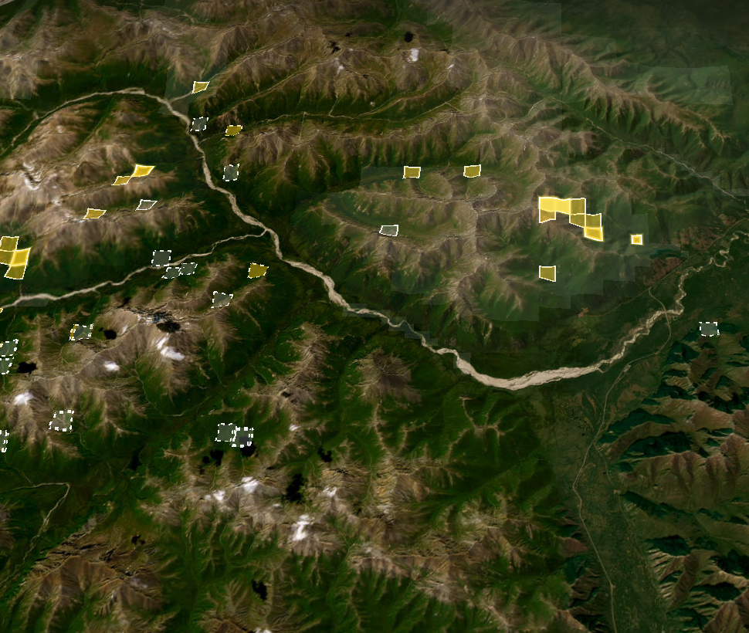
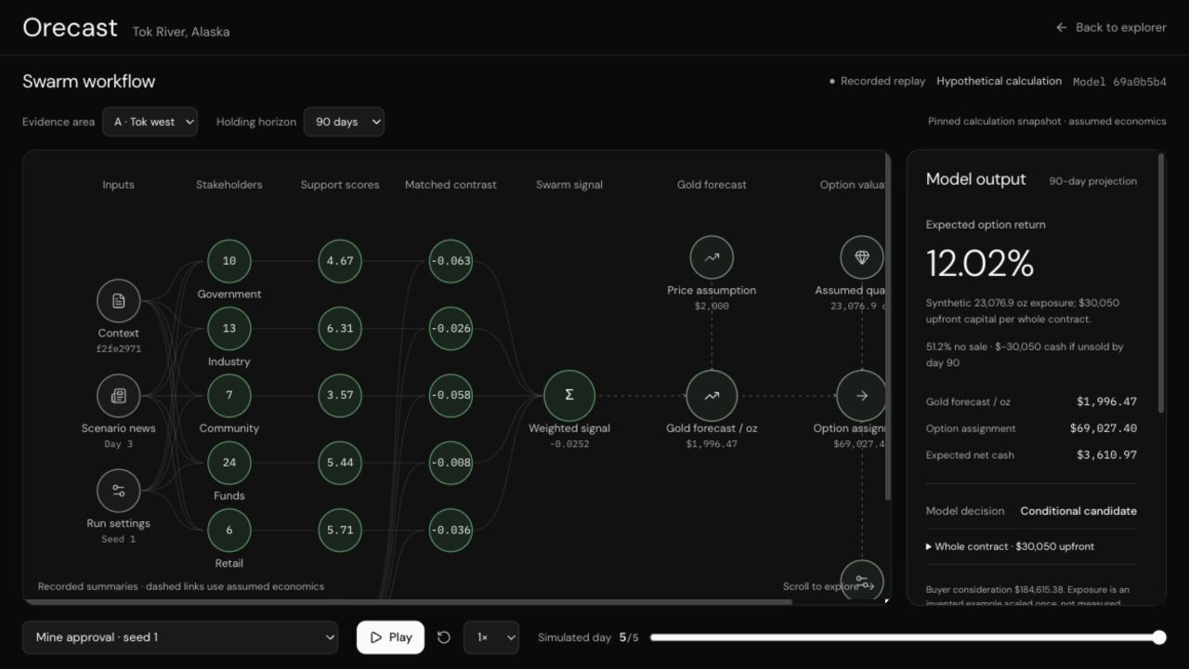
03
Algorithm
Orecast
Observed
evidence
Primary assays
Orecast adjusts the
gold forecast, then
recomputes mineral
and interest value,
assignment and cash.
Recorded
support
Simulated
Gold
forecast
Assumed
Assignment
and cash
Observed assays screen evidence.
The synthetic exposure stays fixed.
Gold response, fees and liquidity are assumed.
Assumed
Notes:
Slide 4. Gold forecast and assignment
Timing: 60 seconds.
Read the layers from top to bottom. Primary assays screen eligibility. Recorded simulated support is compared against the matching sports-placebo reference. The model adjusts an assumed gold forecast, then recomputes material value, interest value, assignment proceeds and cash at each possible sale date. The same synthetic quantity and buyer consideration remain fixed across scenarios, horizons and premium edits. They are not inferred from assays or from the historical payments. The 7% gold response is uncalibrated and is not a loss cap. Geological success, ownership, conversion, contract permission, costs and sale hazard are assumptions. Candidate is conditional on those assumptions and screens. There is no execution, borrowing, exercise or reinvestment.
Local unpublished source revision: 69a0b5b4d2ca8db16cc46f15ff0b07f954e72ed2. Model: tok-option-demo-v2.
Sources:
Local unpublished source: model/tok-option/workbench.mjs (runWorkbench and compareFeePolicies).
Local unpublished source: model/tok-option/lot-basis.mjs (SYNTHETIC_LOT_PROFILE).
Local source: model/tok-option/gold.mjs, valuation.mjs, liquidity.mjs and diagnostics.mjs.
Imagery: Esri, Maxar, Earthstar Geographics. Terrain: Mapzen Terrarium (AWS Open Data).
https://server.arcgisonline.com/ArcGIS/rest/services/World_Imagery/MapServer
https://registry.opendata.aws/terrain-tiles/

Slide 5
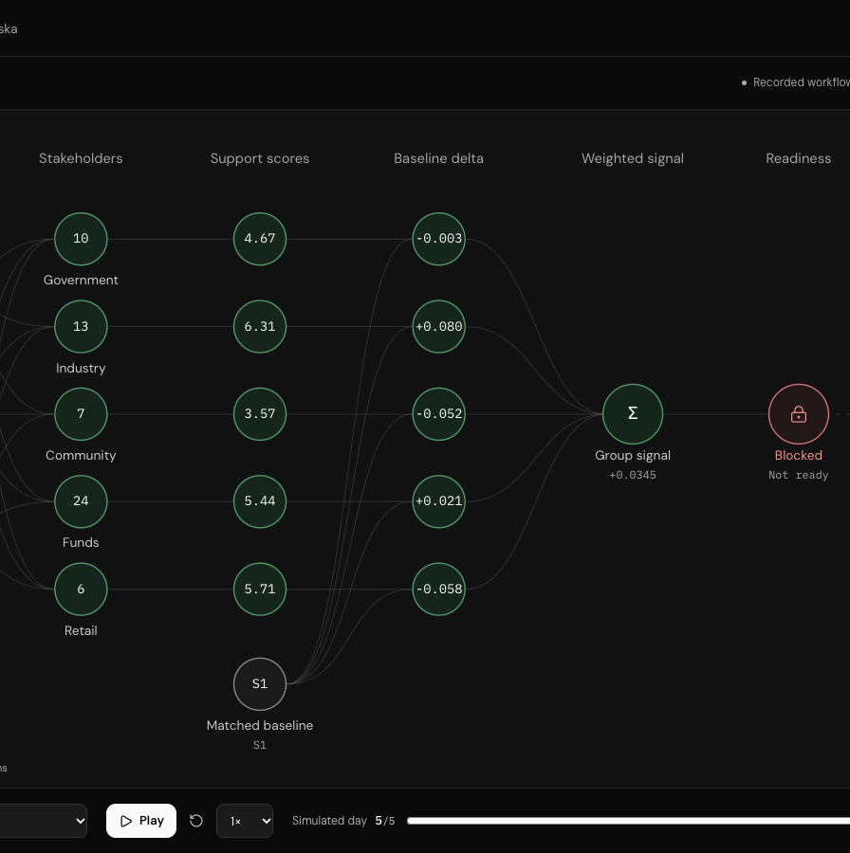
03
Recorded scenario contrast
Orecast
Recorded support changes assumed gold.
The same synthetic contract is held fixed.
Mine approval
Court blockage
−0.0252 support · $1,996.47/oz gold
+0.0307 support · $2,004.30/oz gold
$3,610.97 cash · 12.02% return
$3,831.36 cash · 12.75% return
Fixed $50 entry / exit fees.
Conditional candidates, not trades.
Research checks failed.
Gold response uncalibrated.
Matching sports-placebo reference, days 3–5.
Support scale −1 to +1. Area A, 90 days.
Notes:
Slide 5. Recorded scenario contrast
Timing: 55 seconds.
The same synthetic contract is used in both recorded comparisons. Mine approval has support minus 0.0252 and assumed gold of 1996.47 dollars an ounce; court blockage has plus 0.0307 and 2004.30 dollars. At 90 days, expected cash is 3610.97 dollars for approval and 3831.36 for blockage, or 12.02% and 12.75% on 30,050 dollars upfront. The quantities, buyer consideration and fixed 50-dollar fees do not change. These are conditional hypothetical candidates, not trades or observed margins. Research checks remain failed; the matching sports placebo is not an untreated control. The recorded signs and the uncalibrated financial mapping remain visible.
Local unpublished source revision: 69a0b5b4d2ca8db16cc46f15ff0b07f954e72ed2. Model: tok-option-demo-v2.
Sources:
Local unpublished source: model/tok-option/workbench.mjs (runWorkbench and compareFeePolicies).
Local unpublished source: model/tok-option/lot-basis.mjs (SYNTHETIC_LOT_PROFILE).
Local source: model/tok-option/gold.mjs, valuation.mjs, liquidity.mjs and diagnostics.mjs.
Imagery: Esri, Maxar, Earthstar Geographics. Terrain: Mapzen Terrarium (AWS Open Data).
https://server.arcgisonline.com/ArcGIS/rest/services/World_Imagery/MapServer
https://registry.opendata.aws/terrain-tiles/

Slide 6
04
Time and return
Orecast
At $30,050 upfront,
the 90-day fixed-fee case has
12.35%
expected option return, while
51.2%
of paths have no sale.
Fixed $50 entry / exit fees. Median cash: −$30,050.
Proportional fees: 1.09% return; risk cap fails. See appendix 10.
Non-annualized. Gold growth zero; 20% assumed 30-day hazard.
Sale chance
20.0%
48.8%
73.8%
Same synthetic exposure · fixed-fee baseline
Notes:
Slide 6. Time, return and fees
Timing: 60 seconds.
With one fixed synthetic exposure and 50-dollar entry and exit fees, the 90-day baseline has 3710.22 dollars expected cash and 12.35% expected option return. This is non-annualized and not a gold return. The 30-day case skips; the 180-day case has more assumed chances to sell. At 90 days, 51.2% of paths still have no sale and median cash is minus 30,050 dollars. The higher headline return depends on the fixed-fee assumption. If both reference fees scale with exposure, each is 2307.69 dollars: return falls to 1.09% and upfront capital exceeds the current risk cap. No exposure was chosen from a 25% target. Its 77,022.34-dollar required-resale hurdle is separate, not a forecast.
Local unpublished source revision: 69a0b5b4d2ca8db16cc46f15ff0b07f954e72ed2. Model: tok-option-demo-v2.
Sources:
Local unpublished source: model/tok-option/workbench.mjs (runWorkbench and compareFeePolicies).
Local unpublished source: model/tok-option/lot-basis.mjs (SYNTHETIC_LOT_PROFILE).
Local source: model/tok-option/gold.mjs, valuation.mjs, liquidity.mjs and diagnostics.mjs.

Slide 7
05
Live demonstration
Orecast
Trace the evidence,
forecast and valuation.
Then check the price
paid for the lot.
Fixed assumptions. Inspect both cash branches.
Then test costs, rights and real liquidity.
Live demonstration
Financial outputs are hypothetical.
The pilot event adjustment did not beat baseline.
Imagery: Esri, Maxar, Earthstar Geographics. Terrain: Mapzen.
Notes:
Slide 7. Local demonstration
Timing: 45 seconds.
Compare approval with blockage for Area A at 90 days. Expected return changes from 12.02% to 12.75%, using the synthetic contract and fixed fees. These are conditional candidates, not trades. No sale remains possible. The fee sensitivity is essential: proportional fees reduce the baseline to 1.09% and fail the risk cap. Next, validate resources, full costs and real assignment liquidity.
Preparation / Q&A: Allow up to 20 seconds for the rehearsed local /swarm comparison. Use the new synthetic-exposure review capture, Area A, 90 days and simulated day 5. If the browser differs, explain the saved image. Do not use the previously published SKIP fixture or a different startup scenario as this controlled comparison.
Local unpublished source revision: 69a0b5b4d2ca8db16cc46f15ff0b07f954e72ed2. Model: tok-option-demo-v2.
Sources:
Local unpublished source: model/tok-option/workbench.mjs (runWorkbench and compareFeePolicies).
Local unpublished source: model/tok-option/lot-basis.mjs (SYNTHETIC_LOT_PROFILE).
Local source: model/tok-option/gold.mjs, valuation.mjs, liquidity.mjs and diagnostics.mjs.
Imagery: Esri, Maxar, Earthstar Geographics. Terrain: Mapzen Terrarium (AWS Open Data).
https://server.arcgisonline.com/ArcGIS/rest/services/World_Imagery/MapServer
https://registry.opendata.aws/terrain-tiles/

Slide 8
A
Appendix
Orecast
Baseline cash and option return at 90 days
Hypothetical cash branches after all entry and exit costs. All amounts USD.
Outcome by day 90 | Probability | Net cash | Weighted cash
Sale | 48.8% | $39,130.77 | $19,095.82
No sale | 51.2% | −$30,050.00 | −$15,385.60
Expected net cash | 100.0% |  | $3,710.22
0.488 × ($69,230.77 − $50) − $30,050 ≈ $3,710.22
Expected option return: 12.35%, non-annualized. Conditional candidate.
For a 25% expected return, required conditional resale is $77,022.34.
A hurdle, not a forecast. Synthetic assignment is $69,230.77; no input was chosen from the target.
Notes:
Slide 8. Cash reconciliation
Appendix for questions.
Baseline conditional assignment is 69,230.76923 dollars. Less the 50-dollar exit fee and 30,050-dollar upfront commitment, the sale branch has 39,130.76923 dollars cash. The no-sale branch has minus 30,050. Weighting by 48.8% and 51.2% gives 3710.21538 dollars mean cash and 12.3468066% expected return. The median is still minus 30,050. The 25% expected-return hurdle requires 77,022.34 dollars constant gross assignment proceeds at each possible sale date. That hurdle is not a forecast and did not determine the frozen exposure. The model quantity, consideration, success and conversion inputs are synthetic, not a real valuation inferred from two historical payments.
Local unpublished source revision: 69a0b5b4d2ca8db16cc46f15ff0b07f954e72ed2. Model: tok-option-demo-v2.
Sources:
Local unpublished source: model/tok-option/workbench.mjs (runWorkbench and compareFeePolicies).
Local unpublished source: model/tok-option/lot-basis.mjs (SYNTHETIC_LOT_PROFILE).
Local source: model/tok-option/gold.mjs, valuation.mjs, liquidity.mjs and diagnostics.mjs.
https://www.tectonicmetals.com/_resources/financials/MDA-Q2-2019-FINAL.pdf?v=070606
https://www.tectonicmetals.com/_resources/financials/FS-Tectonic-2018YE-AUDITED.pdf?v=090403

Slide 9
A
Appendix
Orecast
Historical pilot: the event adjustment did not beat baseline
12 selected equity events. Five held-out observations per horizon, in distinct cohorts. Lower MAE is better.
Model | 5-session MAE (pp) | 20-session MAE (pp)
No change | 2.5562 | 5.9474
Gold-only | 3.1291 | 7.5670
Gold + event | 8.0596 | 14.3108
Retrospective equity component test, not Tok option returns.
Event adjustment did not beat baseline.
No paired historical swarm outcomes.
Next: paired prospective outcomes and calibrated assignment liquidity.
Notes:
Slide 9. Historical pilot
Appendix for questions.
This remains a small retrospective equity component test, not Tok option returns. Twelve selected events produce five held-out observations for each horizon, in different cohorts. Mean absolute errors in percentage points, lower is better: no change 2.5562/5.9474; gold-only 3.1291/7.5670; gold plus event 8.0596/14.3108 for five/twenty sessions. The event adjustment did not beat baseline. No historical swarm outcomes are paired with realized option returns. Repeated issuers, a selected incomplete sample, current-vintage prices and date uncertainty limit inference.
Local unpublished source revision: 69a0b5b4d2ca8db16cc46f15ff0b07f954e72ed2. Model: tok-option-demo-v2.
Sources:
https://github.com/amitvijapur/oxhack-2026/blob/37991ad5de416e5abf8541264c5f4926a2ec91e8/research/event-study/RESULTS.md
https://github.com/amitvijapur/oxhack-2026/blob/37991ad5de416e5abf8541264c5f4926a2ec91e8/research/event-study/protocol.md

Slide 10
A
Fee sensitivity
Orecast
The fee assumption changes the result
One synthetic contract, the same gold forecast and sale hazard. Returns over 90 days are non-annualized.
Fee assumption | Entry fee | Exit fee | Upfront capital | Expected return
Fixed fees | $50.00 | $50.00 | $30,050.00 | 12.35%
Proportional fees | $2,307.69 | $2,307.69 | $32,307.69 | 1.09%
Proportional fee = $50 × (30,000 / 650) = $2,307.69 per fee.
$350.77 expected cash / $32,307.69 = 1.09% return.
$32,307.69 exceeds the $30,050 per-option cap. The model skips this case.
The higher fixed-fee result is an assumed sensitivity, not a measured margin.
Notes:
Slide 10. Fee sensitivity on the same exposure
Appendix for questions.
Both cases use the same one-contract exposure, premium, gold forecast and sale hazard. Fixed fees are 50 dollars each, upfront capital is 30,050, expected cash is 3710.21538 and expected return is 12.3468066%. Proportional fees are the invented reference 50 times the frozen factor 30,000/650: each fee is 2307.6923 dollars. Upfront becomes 32,307.6923, expected cash is 350.76923 and return is 1.0857143%. This exceeds the 30,050 per-option risk cap and the model skips. The comparison identifies the fee assumption driving the return difference. Neither case is calibrated to real transaction costs, resources or realized market returns.
Local unpublished source revision: 69a0b5b4d2ca8db16cc46f15ff0b07f954e72ed2. Model: tok-option-demo-v2.
Sources:
Local unpublished source: model/tok-option/workbench.mjs (runWorkbench and compareFeePolicies).
Local unpublished source: model/tok-option/lot-basis.mjs (SYNTHETIC_LOT_PROFILE).
Local source: model/tok-option/gold.mjs, valuation.mjs, liquidity.mjs and diagnostics.mjs.
https://www.tectonicmetals.com/_resources/financials/MDA-Q2-2019-FINAL.pdf?v=070606
https://www.tectonicmetals.com/_resources/financials/FS-Tectonic-2018YE-AUDITED.pdf?v=090403

