Slide 1
OXHack 2026
Orecast
Orecast
Team: Amit (evidence and app) · Salman (decision model) · Muhd (stakeholder simulations) · Arjin (land and claims)
Local prototype
25 October 2026
Notes:
Slide 1. Orecast
Timing: 20 seconds. Main sequence totals 300 seconds.
We are investigating Tok River, Alaska. We built a way to investigate a mineral opportunity and test what could change before you find a buyer. Our prototype brings geological evidence, simulated reactions and exit timing into one decision you can inspect. The project is called Orecast. Our team: Amit built the evidence packs and the app, Salman the decision model, Muhd the stakeholder simulations and Arjin the land and claim data.
Evidence sources:
Current explorer design and terrain capture from the local prototype.
Satellite terrain is geographic context. Alaska DGGS sediment assays are a separate evidence source.
Imagery: Esri, Maxar, Earthstar Geographics. Terrain: Mapzen Terrarium (AWS Open Data).
https://server.arcgisonline.com/ArcGIS/rest/services/World_Imagery/MapServer
https://registry.opendata.aws/terrain-tiles/
Design composition reference: Palantir Q2 2021 Business Update, PDF page 1. https://investors.palantir.com/files/Palantir%20Q2%202021%20Business%20Update.pdf . Design reference only; its business claims and branding are not copied.

Slide 2
01
Time and evidence
OXHack
Mineral evidence, changing conditions and time
to exit belong in the same decision.
For an investor holding a mineral option who must find a buyer before it expires,
our prototype tests whether it can produce cash within the time available.
Evidence
COLLECTED
PUBLISHED
June–July 2016
November 2016
Simulation
Five simulated days
News at day 3
DAY 1
DAY 2
DAY 3
DAY 4
DAY 5
HOLDING PERIOD
Assignment
30 DAYS
90 DAYS
180 DAYS
Timelines are illustrative. The holding period and closing buffer must fit before expiry.
Notes:
Slide 2. The decision has three clocks
Timing: 35 seconds. Main sequence totals 300 seconds.
Old geological evidence, new events and an eventual buyer arrive on different clocks. Collection happened in June and July 2016; publication followed in November. News changes a hypothetical scenario. A buyer may take 30, 90 or 180 days to arrive. An assignable option is a temporary contractual interest that a holder could transfer to a future buyer under assumed permission and terms. We model assignment, not purchasing a mine or exercising the option.
Evidence sources:
https://doi.org/10.14509/29688
model/tok-option/workbench.mjs and liquidity.mjs in the current main-integration checkout.
Design composition reference: Palantir Q2 2021 Business Update, PDF page 12. https://investors.palantir.com/files/Palantir%20Q2%202021%20Business%20Update.pdf . Design reference only; its business claims and branding are not copied.

Slide 3
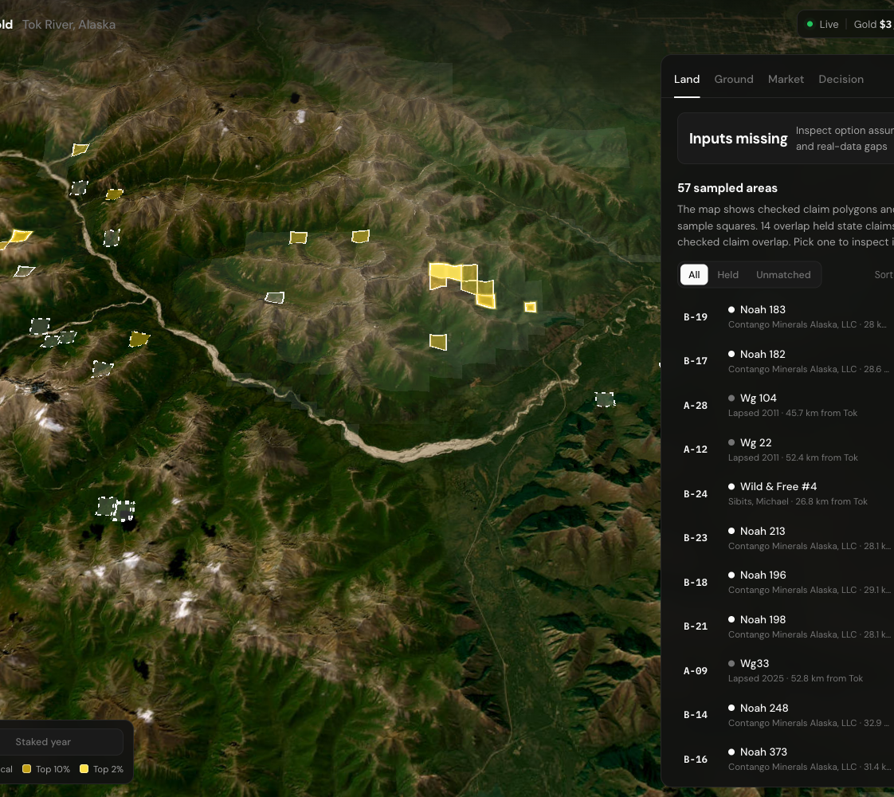
02
Observed evidence
The evidence explorer
OXHack
We begin with
67
measured sediment samples
from Tok River, Alaska.
A: 25/33 pass the gold screen; 2 in active claims.
B: 16/34 pass; 20 in active claims.
Land: Alaska DNR state claims, 24 Oct 2026. A was staked in 2011 and mostly dropped; Delta, a 249-claim block beside A, was agreed for sale in September 2026. Recoverable ounces remain a separate assumption.
Alaska DGGS RDF 2016-10. Comparison areas, not available listings.
Notes:
Slide 3. The evidence starts with measured samples
Timing: 35 seconds. Main sequence totals 300 seconds.
These are 67 measured sediment samples from Alaska DGGS. We preserve their primary assay qualification, retests and provenance. A contains 33 samples, B 34, and both have checked land-source context. The canonical Au screen uses 0.01 ppm, at least ten classified samples and a qualifying lower bound of 50%. A has 25/33 passing; B has 16/34 and fails. The screen does not convert concentration into recoverable ounces. Dots, claim overlaps and illustrative squares do not establish a deposit or available investment. The map’s 57 sampled areas are not tradable listings. Land context: only 2 of A's 33 samples sit inside an active state claim. A was staked in 2011 and 112 of those 114 claims are now closed. B has 20 of 34 samples inside active claims, mostly Contango's. Next to A, Agnico Eagle agreed on 8 September 2026 to sell the 249-claim Delta project to Vizsla Copper. So the stronger gold evidence sits on the less-claimed ground.
Evidence sources:
https://doi.org/10.14509/29688
https://arcgis.dnr.alaska.gov/arcgis/rest/services/OpenData/NaturalResource_StateMiningClaim/FeatureServer
https://github.com/amitvijapur/oxhack-2026/tree/34eaf1d6e87fedd54c46b04dec093b0cc2b18581/research/tok-land
Screenshot: current local explorer. Basemap attribution remains separate from DGGS.
Imagery: Esri, Maxar, Earthstar Geographics. Terrain: Mapzen Terrarium (AWS Open Data).
https://server.arcgisonline.com/ArcGIS/rest/services/World_Imagery/MapServer
https://registry.opendata.aws/terrain-tiles/
Design composition reference: Palantir Q2 2021 Business Update, PDF page 5. https://investors.palantir.com/files/Palantir%20Q2%202021%20Business%20Update.pdf . Design reference only; its business claims and branding are not copied.

Slide 4
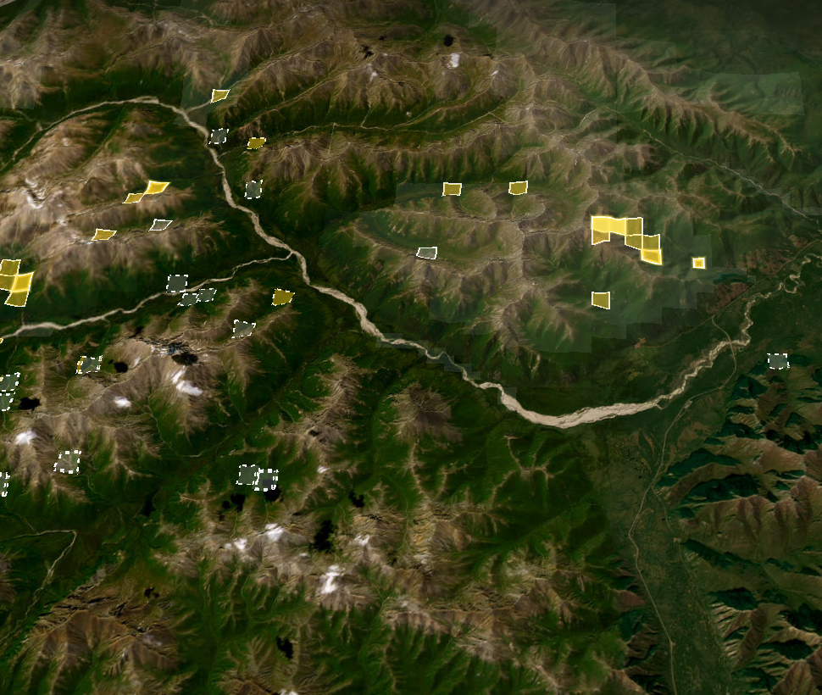
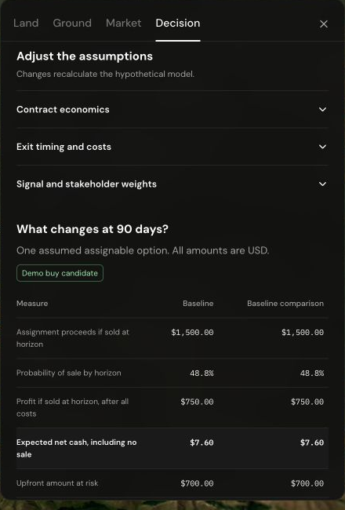
03
Algorithm
OXHack
Evidence
Observed
The algorithm connects
mineral evidence and
explicit assumptions
to an assignment
decision.
Assumed option
Assumed
Scenario
Simulated
Observations screen evidence.
Simulations test reactions.
Economics remain assumed.
Exit model
Assumed
Notes:
Slide 4. One algorithm connects evidence to a cash decision
Timing: 55 seconds. Main sequence totals 300 seconds.
Read the layers from top to bottom. First, actual assays screen evidence. Next, assumed recoverable resources, prices and contract terms create a baseline option proxy. A scenario contrast can enter an explicitly hypothetical sensitivity transfer capped at plus or minus 7%. That cap limits one price adjustment, not the investment loss. Finally, the engine accounts for sale timing, fees, no sale, expiry, assignability and fund limits. Ounces and success probabilities are separate assumptions, not inferred from sediment concentration. Candidate means the hypothetical opportunity passes those screens. There is no trade execution, exercise, borrowing or reinvestment.
Evidence sources:
Canonical engine: model/tok-option/evidence.mjs, valuation.mjs, liquidity.mjs, portfolio.mjs, workbench.mjs and illustrative.mjs.
The model uses a 365-day maturity and requires a 15-day closing buffer.
Imagery: Esri, Maxar, Earthstar Geographics. Terrain: Mapzen Terrarium (AWS Open Data).
https://server.arcgisonline.com/ArcGIS/rest/services/World_Imagery/MapServer
https://registry.opendata.aws/terrain-tiles/
Design composition reference: Palantir Q2 2021 Business Update, PDF page 11. https://investors.palantir.com/files/Palantir%20Q2%202021%20Business%20Update.pdf . Design reference only; its business claims and branding are not copied.

Slide 5
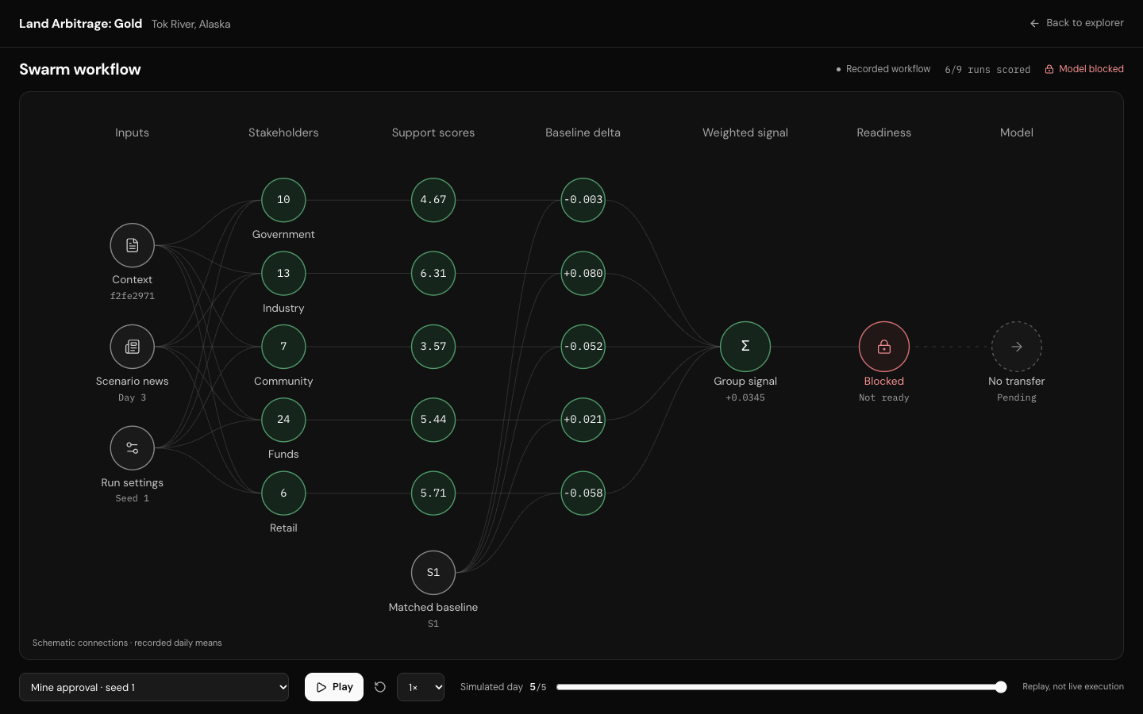
04
Recorded simulations
OXHack
Recorded stakeholder reactions let us inspect how
a news scenario changes the model.
Mine approval
−0.0252 support contrast
Court blockage
+0.0307 support contrast
6 of 9 planned runs scored
Matching Claude sports-placebo reference, days 3–5.
Normalized support scale −1 to +1.
Recorded research context. Checks failed.
Financial mapping is illustrative.
Notes:
Slide 5. Recorded simulations make the assumptions inspectable
Timing: 50 seconds. Main sequence totals 300 seconds.
We aggregate simulated mining-support scores within five groups and weight days equally. The six scored five-day runs include three baseline seeds, one sports placebo and approval and court-blockage runs. In the explicit what-if lane, actual recorded posts are compared with the matching Claude sports-placebo reference over days 3 through 5. Mine approval has a normalized support contrast of minus 0.0251792588; court blockage has plus 0.0307343316. These signs oppose the simple headline narrative, so we expose the result rather than force a direction. The sports run is not an untreated control. Configuration, interview, placebo, grounding and mirror checks fail, and the input knowledge cutoff is unknown. The strict research lane stays blocked. A financial what-if transfer is an assumption, not a learned market effect.
Evidence sources:
https://github.com/amitvijapur/oxhack-2026/tree/f2fe2971d9f041a819f7b7ff4a78e10f840884f5/swarm
model/tok-option/illustrative.mjs: matching-provider sports-placebo reference.
Financial transfer: 0.07 × support contrast, capped by the hypothetical policy.
Imagery: Esri, Maxar, Earthstar Geographics. Terrain: Mapzen Terrarium (AWS Open Data).
https://server.arcgisonline.com/ArcGIS/rest/services/World_Imagery/MapServer
https://registry.opendata.aws/terrain-tiles/
Design composition reference: Palantir Q2 2021 Business Update, PDF page 13. https://investors.palantir.com/files/Palantir%20Q2%202021%20Business%20Update.pdf . Design reference only; its business claims and branding are not copied.

Slide 6
05
Time and cash
OXHack
At 90 days, the same
hypothetical option has
$7.60
expected net cash, while
51.2%
of paths have no sale.
$700 upfront. Cash if unsold: −$700.
20% assumed conditional sale chance per 30 days.
Fixed assignment price. All amounts USD.
Sale chance
20.0%
48.8%
73.8%
Hypothetical baseline
Notes:
Slide 6. Time changes the same hypothetical option
Timing: 60 seconds. Main sequence totals 300 seconds.
At 30 days, the assumed sale chance is 20% and expected net cash is minus $410. At 90 days, sale chance is 48.8% and expected cash is $7.60. At 180 days, sale chance is 73.7856% and expected cash is $369.8912. We held assignment price fixed and annual growth at zero; more time accumulates opportunities to exit. Focus on 90 days. A positive expectation still coexists with 51.2% no sale and a median cash outcome of minus $700. An unsold contract can remain held, so cash shortfall at the horizon is not necessarily a final realized economic loss. The upfront amount is a $650 premium plus $50 entry fee. A $660 premium changes expected cash to minus $2.40 and the action to skip. Use that flip in the live demo if ready.
Evidence sources:
Canonical engine: model/tok-option/workbench.mjs, liquidity.mjs and diagnostics.mjs.
Values independently checked by runWorkbench and 0.488 × (1500 − 50) − 700 = 7.60.
The 180-day horizon plus the required 15-day closing buffer fits within the assumed 365-day maturity.
Design composition reference: Palantir Q2 2021 Business Update, PDF page 20. https://investors.palantir.com/files/Palantir%20Q2%202021%20Business%20Update.pdf . Design reference only; its business claims and branding are not copied.

Slide 7
06
Live demonstration
OXHack
Every decision can be
traced to its evidence,
scenario and timing
assumptions.
Inspect the evidence. Compare a scenario.
Change time. Explain the result.
Live demonstration
Financial outputs use hypothetical assumptions.
Imagery: Esri, Maxar, Earthstar Geographics. Terrain: Mapzen.
Notes:
Slide 7. The prototype makes each decision traceable
Timing: 45 seconds. Main sequence totals 300 seconds.
Use up to twenty seconds for a live demonstration, or point to saved slide captures if switching will be slow. In the current local Decision tab, reset Area A to baseline and 90 days. Change the option premium from $650 to $660. Expected cash changes from $7.60 to minus $2.40, and the action changes to skip. Restore the premium. Finish on the takeaway: this working prototype makes the evidence, timing and assumptions visible in a mineral-option decision. Next, test it against dated option prices, completed assignments and unsold cases. Invite questions.
Evidence sources:
Current prototype: http://127.0.0.1:3000/
Canonical model and hypothetical demo assumptions.
The main seven-slide timing totals exactly 300 seconds.
Imagery: Esri, Maxar, Earthstar Geographics. Terrain: Mapzen Terrarium (AWS Open Data).
https://server.arcgisonline.com/ArcGIS/rest/services/World_Imagery/MapServer
https://registry.opendata.aws/terrain-tiles/
Design composition reference: Palantir Q2 2021 Business Update, PDF page 23. https://investors.palantir.com/files/Palantir%20Q2%202021%20Business%20Update.pdf . Design reference only; its business claims and branding are not copied.

Slide 8
A
Appendix
OXHack
The 90-day cash calculation
Hypothetical cash branches after all entry and exit costs. All amounts USD.
Outcome by day 90 | Probability | Net cash | Weighted cash
Sale | 48.8% | +$750.00 | +$366.00
No sale | 51.2% | −$700.00 | −$358.40
Expected net cash | 100.0% |  | +$7.60
0.488 × $750 + 0.512 × (−$700) = $7.60
Median cash: −$700. Break-even premium: $657.60.
A $660 premium changes expected cash to −$2.40 and the decision to skip.
Notes:
Slide 8. The 90-day cash calculation
Appendix for questions.
The sale branch yields $1,500 assignment proceeds less a $50 exit fee and $700 upfront commitment, so net cash is plus $750. The no-sale branch has no sale proceeds and $700 committed, so net cash is minus $700. Their probability-weighted average is $7.60. The largest supported branch is no sale, so median cash is minus $700. Break-even premium is $657.60; equality gives zero expected cash and does not pass the strictly positive-cash gate. Default valuation assumptions: 500 recoverable troy ounces at $2,000/oz, zero growth, 50% interest, 2% conversion, 25% geological success, and $4,000 remaining buyer exercise consideration. This gives $1,500 conditional assignment proceeds. Geological success is independent of the sample passing fraction. Maturity is 365 days, closing buffer 15 days.
Evidence sources:
model/tok-option/valuation.mjs, liquidity.mjs, diagnostics.mjs, workbench.mjs.
0.488 × 750 + 0.512 × (−700) = 7.60.
Design composition reference: Palantir Q2 2021 Business Update, PDF page 43. https://investors.palantir.com/files/Palantir%20Q2%202021%20Business%20Update.pdf . Design reference only; its business claims and branding are not copied.

Slide 9
A
Appendix
OXHack
Evidence, simulations and remaining validation
The prototype retains the provenance of each input.
Observed | Simulated | Assumed
67 measured sediment samples | Five stakeholder groups | Option terms and recoverable ounces
Checked land-source context | Six scored five-day runs | Sale chance per 30-day interval
Historical gold records | Research diagnostics failed | Capped financial scenario transfer
Next: chronological validation with dated option prices,
completed assignments and unsold cases.
Predictive performance remains unmeasured.
Notes:
Slide 9. Evidence, simulations and remaining validation
Appendix for questions.
Current observed inputs provide measurements and source context. They do not establish available rights, executable option terms, recoverable resources or resale liquidity. The recorded simulated runs test stakeholder-response hypotheses and expose failed checks. Mining support is not buyer willingness. Economic quantities, terms, sale hazard and the price transfer remain assumptions. Empirical validation needs dated real option-price observations and completed and unsold assignment outcomes, evaluated chronologically with a simple baseline. We have not measured investment edge or forecast accuracy.
Evidence sources:
https://doi.org/10.14509/29688
https://github.com/amitvijapur/oxhack-2026/tree/34eaf1d6e87fedd54c46b04dec093b0cc2b18581/research/tok-land
https://github.com/amitvijapur/oxhack-2026/tree/f2fe2971d9f041a819f7b7ff4a78e10f840884f5/swarm
Design composition reference: Palantir Q2 2021 Business Update, PDF page 44. https://investors.palantir.com/files/Palantir%20Q2%202021%20Business%20Update.pdf . Design reference only; its business claims and branding are not copied.

