Slide 1
API-Gateway
Workshop

Slide 2
AGENDA
What is API Gateway?
It provides a single entry point for all clients to interact with the system, allowing for better scalability, security, and control over the API’s. To put it simply, API Gateway takes all API requests from a customer, determines which services are demanded, and combines them into a unified, flawless experience for users.
Why we use API Gateway? Advantages of API Gateway.
It improves the security of the microservices as we limit the access of external calls to all our services.
The cross-cutting concerns like authentication, monitoring/metrics, and resiliency will be needed to be implemented only in the API Gateway as all our calls will be routed through it.
The client does not know about the internal architecture of our microservices system. The client will not be able to determine the location of the microservice instances.
How to implement? Best Practices?
Using Spring Cloud Gateway we can create routes in either of the two ways –
1) Use java based configuration to programmatically create routes
2) Use property based configuration(i.e. application.properties or application.yml) to create routes.*
Implement API Gateway using Spring-Cloud, example:
1) Create 2 microservices with eureka client, 2) Create Eureka Server and 3) Spring Gateway Project.

Slide 3
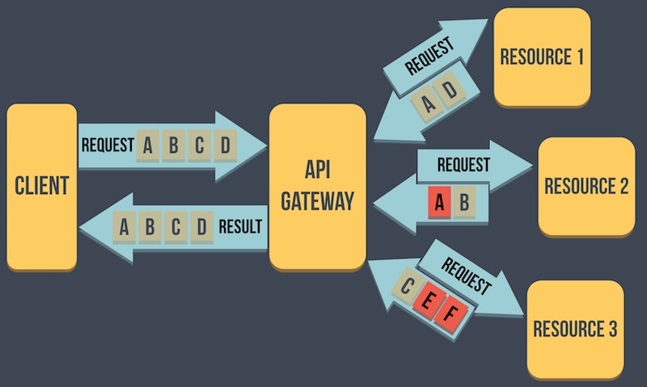
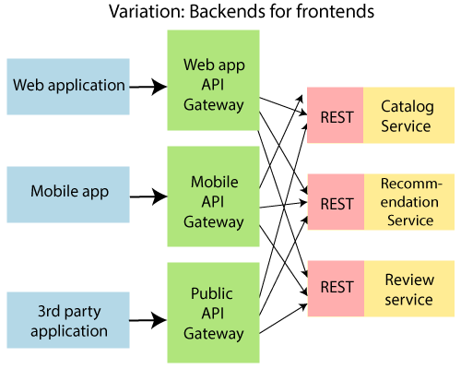
The API Gateway is a Server

Slide 4
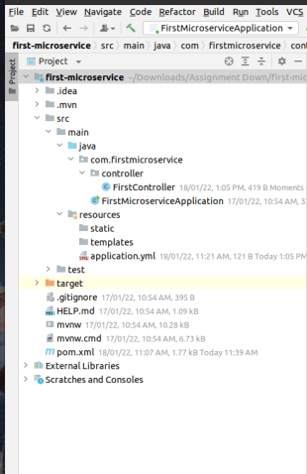
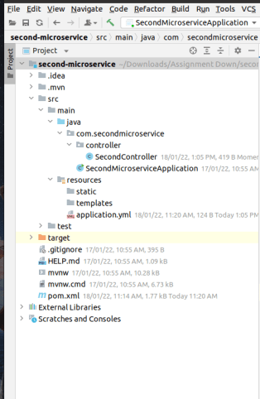
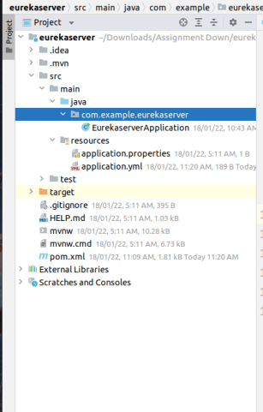
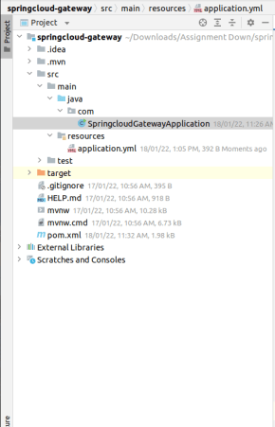
Eureka Server is an application that holds information Above all, client-service applications. Every Microservice will register into the Eureka server and the Eureka server knows all the client applications running on each port and IP address.
Eureka Server is also known as Discovery Server.

Slide 5
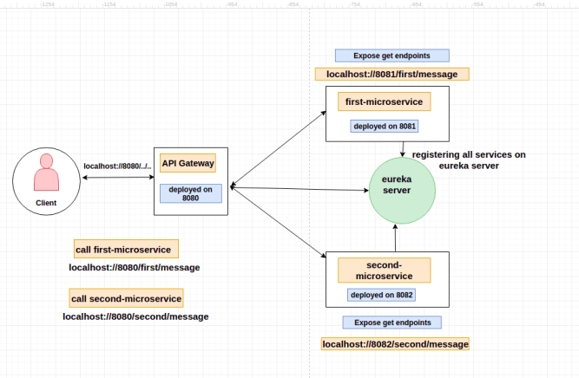
Implementing Spring Cloud API Gateway
server:
port: 8080
eureka:
instance:
hostname: localhost
spring:
application:
name: api-gateway
cloud:
gateway:
routes:
- id: first-microservice
uri: http://localhost:8081/
predicates:
- Path=/first/**
- id: second-microservice
uri: http://localhost:8082/
predicates:
- Path=/second/**

Slide 6
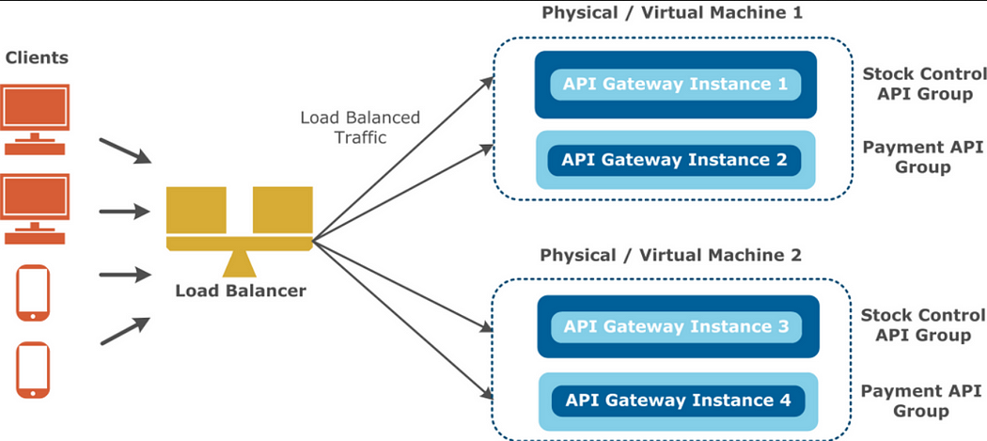
API Gateway vs Load Balancer
API Gateway and Load Balancer are both important components in microservices architecture, but they serve different purposes.
By using an API gateway, you can simplify the client-side code, reduce the number of requests that need to be made, and provide a unified interface for clients to interact with the microservices.
A load balancer is a component that distributes incoming network traffic across multiple servers or nodes in a server cluster, not just in Microservices architecture but any architecture.
A load balancer ensures that no single server is overloaded with traffic while others remain idle.

Slide 7
API- Gateway FAQ
API Gateway Drawback- Is it single point of failure?

Slide 8
References
API Gateway Design Diagram
https://github.com/amitvsolutions/51systemDesign/blob/main/designDiagrams/api-gateway.excalidraw

