Slide 1
Docker Workshop
Docker is an open platform for developing, shipping, and running applications

Slide 2
AGENDA
Introduction: What is Docker?
Why Docker? What Problem it solves?
How it works?
Docker Architecture
Installation and Setup
Components and Commands
Demo-1: CLI
Demo-2: Ubuntu as Container
Demo-3: Spring docker application
Advance Topics: Docker Compose, Storage and Networking.

Slide 3
Introduction
Docker is an open-source containerization platform by which you can pack your application and all its dependencies into a standardized unit called a container.
You can run the docker image as a docker container in any machine where docker is installed without depending on the operating system.
The Dockerfile uses DSL (Domain Specific Language) and contains instructions for generating a Docker image. You should create a Dockerfile in order since the Docker daemon runs all of the instructions from top to bottom.
It is a text document that contains necessary commands which on execution help assemble a Docker Image. Dockerfile is the source code of the image.
Docker container is a runtime instance of an image. Allows developers to package applications with all parts needed such as libraries and other dependencies.

Slide 4
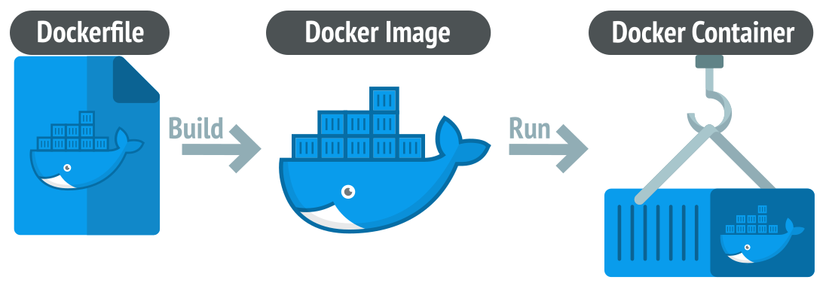

Slide 5
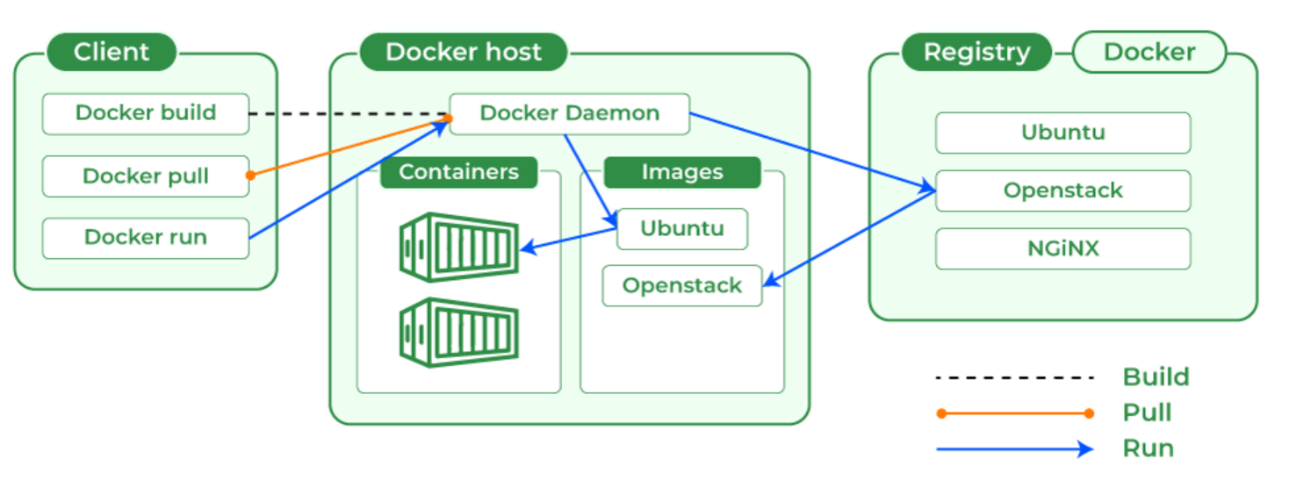
Docker makes use of a client-server architecture. The Docker client talks with the docker daemon which helps in building, running, and distributing the docker containers. The Docker client runs with the daemon on the same system or we can connect the Docker client with the Docker daemon remotely. With the help of REST API over a UNIX socket or a network, the docker client and daemon interact with each other.

Slide 6
Docker Engine and Docker Hub
The software that hosts the containers is named Docker Engine. Docker Engine is a client-server based application. The docker engine has 3 main components:
Server: It is responsible for creating and managing Docker images, containers, networks, and volumes on the Docker. It is referred to as a daemon process.
REST API: It specifies how the applications can interact with the Server and instructs it what to do.
Client: The Client is a docker command-line interface (CLI), that allows us to interact with Docker using the docker commands.
Docker Hub is a repository service and it is a cloud-based service where people push their Docker Container Images and also pull the Docker Container Images from the Docker Hub anytime or anywhere via the internet.
It is like storage where we store the images and pull the images when it is required. When a person wants to push/pull images from the Docker Hub they must have a basic knowledge of Docker.

Slide 7
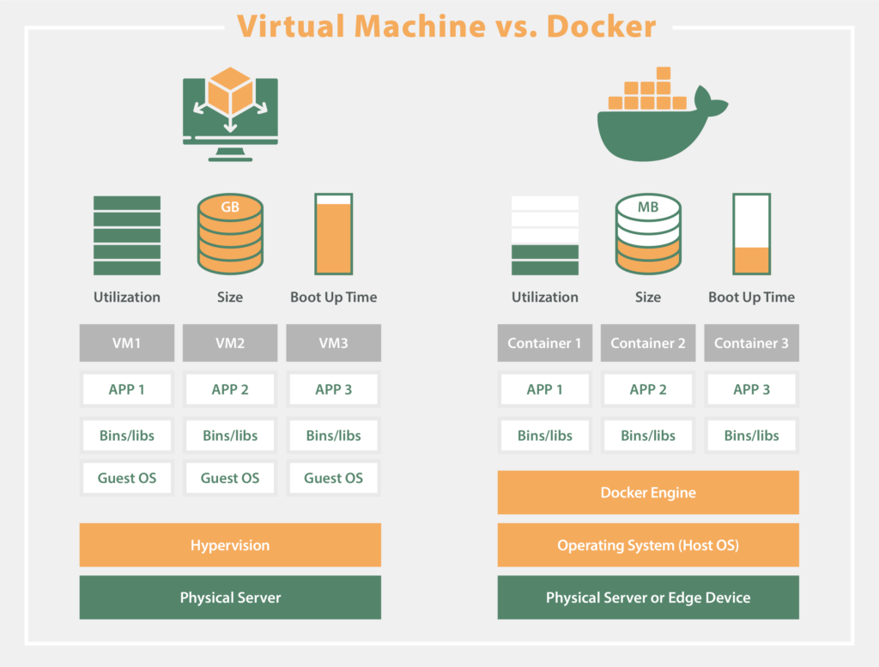

Slide 8
Problem Statement
Consider a software development team working on a modern web application for an e-commerce platform. The application comprises multiple components including a frontend built with Angular, a backend API developed using Node.js, and a PostgreSQL database.
Challenges Without Docker:
Environment Consistency: Each developer's machine may have different configurations, dependencies, and versions of software installed. This inconsistency often leads to the infamous "it works on my machine" problem.
Deployment Complexity: Deploying the application to production involves setting up servers, installing dependencies, configuring load balancers, and ensuring scalability and reliability. Ensuring consistency between development, testing, and production environments can be challenging.
Dependency Management: Managing dependencies across different components of the application becomes cumbersome, especially when different components require conflicting versions of libraries or runtime environments.

Slide 9
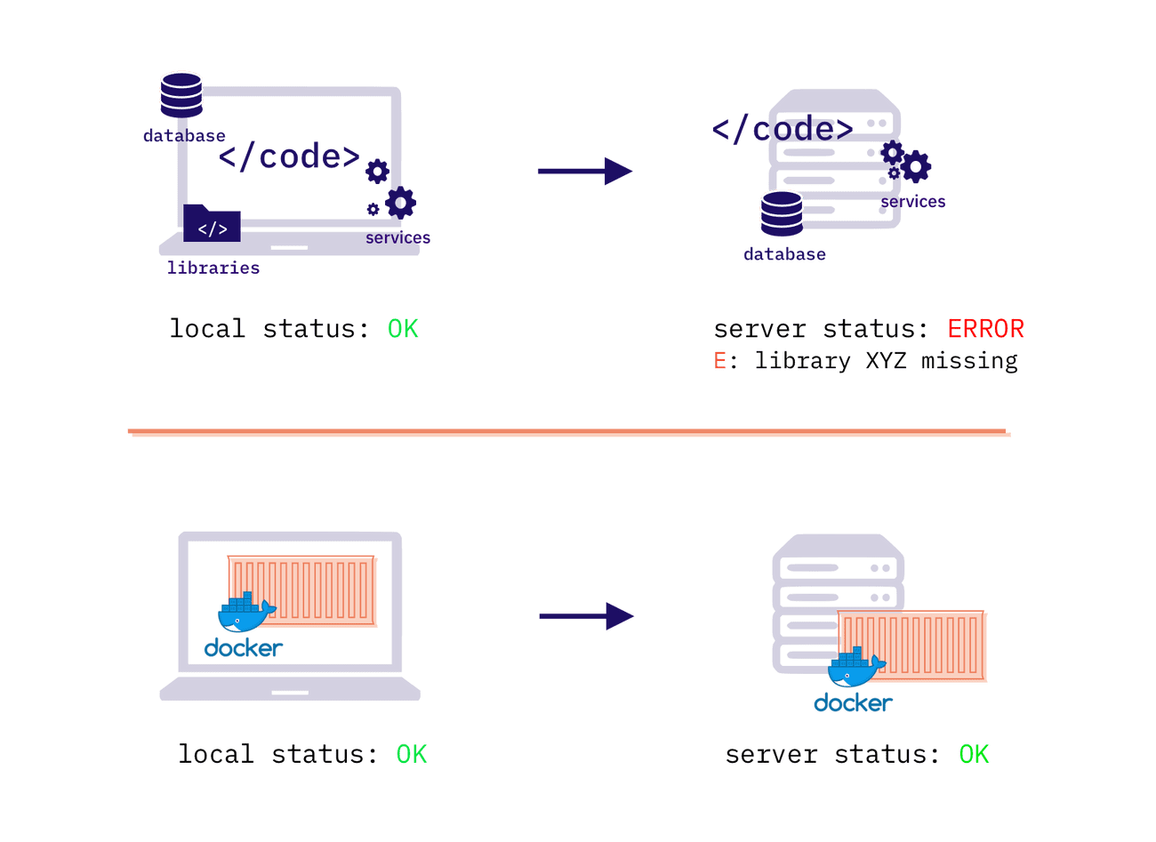

Slide 10
How Docker Addresses These Challenges:
Environment Consistency:
Docker enables developers to define the application's runtime environment using Dockerfiles. These Dockerfiles specify the base image, dependencies, configurations, and commands needed to build a Docker container. Developers can create Docker images containing their application and its dependencies. These images are portable and can be run consistently across different environments, ensuring that the application behaves the same way from development to production.
Deployment Simplification:
With Docker, deploying the application becomes streamlined. Docker images serve as a unit of deployment, encapsulating the application and its dependencies. Container orchestration tools like Kubernetes or Docker Swarm can automate deployment, scaling, and management of containers in production environments.
Dependency Management:
Docker containers isolate dependencies, allowing different components of the application to run in their own containers without interference. This isolation prevents conflicts between dependencies and ensures that each component operates reliably. Developers can leverage Docker's layering mechanism to share common dependencies across multiple containers, reducing the size of Docker images and improving resource utilization.

Slide 11
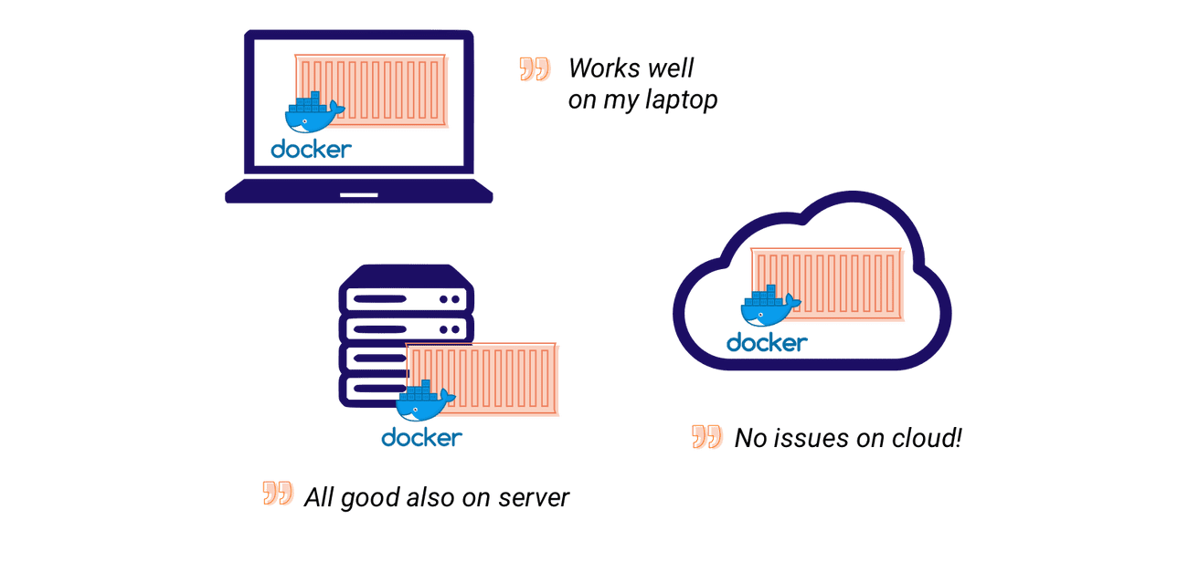
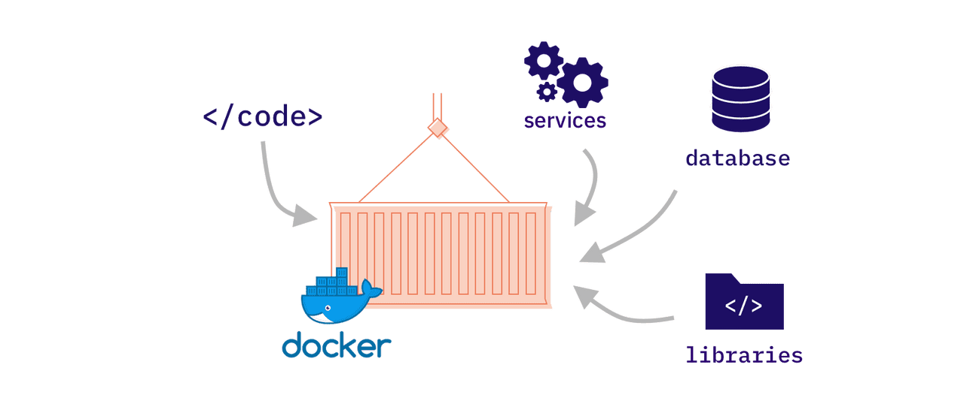

Slide 12
Benefits of Docker:
Docker provides the ability to package and run an application in a loosely isolated environment called a container.
Consistency: Applications run consistently across different environments, eliminating "works on my machine" issues.
Portability: Docker containers can be deployed to any platform that supports Docker, whether it's a developer's laptop, on-premises servers, or cloud infrastructure.
Efficiency: Containers are lightweight and start quickly, enabling rapid development iteration and efficient resource utilization.
Scalability: Docker containers can be easily scaled horizontally to accommodate increasing workloads, ensuring high availability and performance of the application.
Docker can be used to pack the application and its dependencies which makes it lightweight and easy to ship the code faster with more reliability.

Slide 13
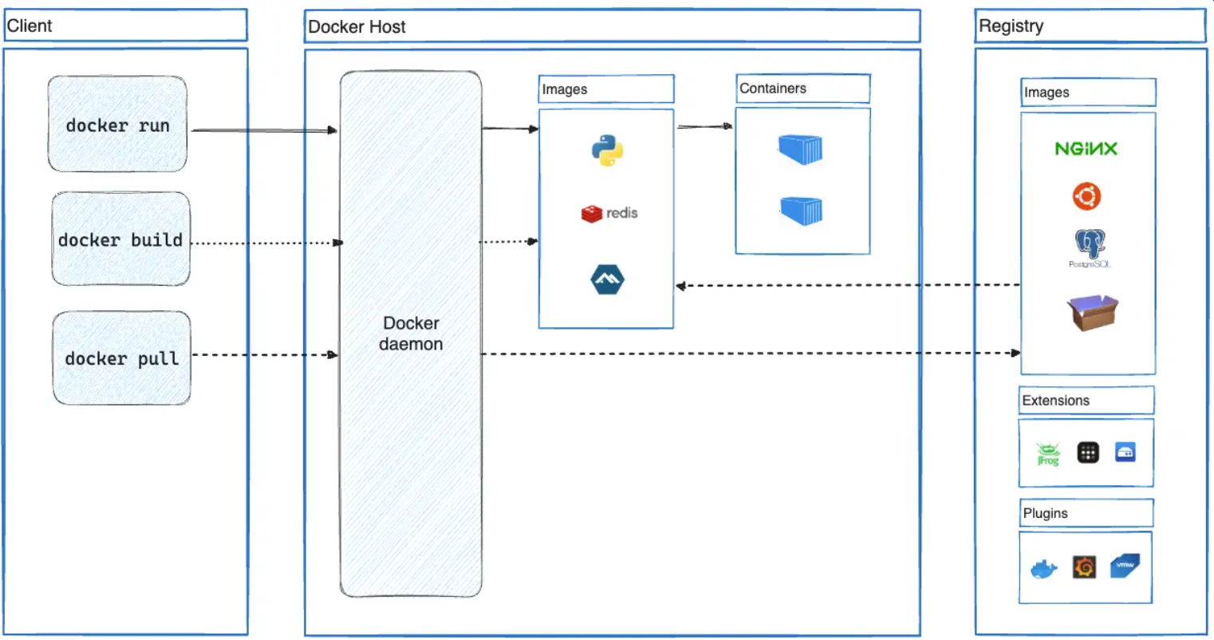

Slide 14
Docker Architecture
Docker uses a client-server architecture. The Docker client talks to the Docker daemon, which does the heavy lifting of building, running, and distributing your Docker containers. The Docker client and daemon can run on the same system, or you can connect a Docker client to a remote Docker daemon. The Docker client and daemon communicate using a REST API. Another Docker client is Docker Compose, that lets you work with applications consisting of a set of containers.
The Docker daemon
daemon (dockerd) listens for Docker API requests and manages Docker objects such as images, containers, networks, and volumes. A daemon can also communicate with other daemons to manage Docker services.
The Docker client
Docker client (docker) is the primary way that many Docker users interact with Docker. When you use commands such as docker run, the client sends these commands to dockerd, which carries them out. The docker command uses the Docker API. The Docker client can communicate with more than one daemon.
Docker Desktop
Docker Desktop is an easy-to-install application for your Mac, Windows or Linux environment that enables you to build and share containerized applications and microservices. Docker Desktop includes the Docker daemon (dockerd), the Docker client (docker), Docker Compose, Docker Content Trust, Kubernetes, and Credential Helper. For more information, see Docker Desktop.

Slide 15
Docker registries
A Docker registry stores Docker images. Docker Hub is a public registry that anyone can use, and Docker looks for images on Docker Hub by default. You can even run your own private registry.
When you use the docker pull or docker run commands, Docker pulls the required images from your configured registry. When you use the docker push command, Docker pushes your image to your configured registry.
Docker objects
When you use Docker, you are creating and using images, containers, networks, volumes, plugins, and other objects. This section is a brief overview of some of those objects.
Images
An image is a read-only template with instructions for creating a Docker container. Often, an image is based on another image, with some additional customization. For example, you may build an image which is based on the ubuntu image, but installs the Apache web server and your application, as well as the configuration details needed to make your application run.

Slide 16
You might create your own images or you might only use those created by others and published in a registry. To build your own image, you create a Dockerfile with a simple syntax for defining the steps needed to create the image and run it. Each instruction in a Dockerfile creates a layer in the image. When you change the Dockerfile and rebuild the image, only those layers which have changed are rebuilt. This is part of what makes images so lightweight, small, and fast, when compared to other virtualization technologies.
Containers
A container is a runnable instance of an image. You can create, start, stop, move, or delete a container using the Docker API or CLI. You can connect a container to one or more networks, attach storage to it, or even create a new image based on its current state.
By default, a container is relatively well isolated from other containers and its host machine. You can control how isolated a container's network, storage, or other underlying subsystems are from other containers or from the host machine.
A container is defined by its image as well as any configuration options you provide to it when you create or start it. When a container is removed, any changes to its state that aren't stored in persistent storage disappear.

Slide 17
The Construction Project
Imagine you're managing a construction project to build a multi-story building. Each floor of the building represents a different component of your application.
1. Docker Client: The Architect
The Docker client is like the architect of your construction project. The architect (client) designs the building (application) and communicates the requirements to the construction workers (Docker daemon) using blueprints (Docker commands).
2. Docker Host: The Construction Site
The Docker host is the construction site where the building is being constructed. It consists of all the necessary infrastructure, resources, and tools needed to build the building (application). This includes workers, materials, and equipment.
3. Docker Daemon: The Construction Workers
The Docker daemon is like the construction workers who actually build the building based on the architect's (client's) instructions. Each construction worker (daemon) is responsible for carrying out specific tasks, such as laying bricks, installing windows, or painting walls. Similarly, Docker daemons manage containers, which are like individual components of the application.

Slide 18
4. Docker Registry: The Materials Warehouse
The Docker registry is like a materials warehouse where all the necessary building materials are stored. This includes bricks, cement, glass, steel, and other construction materials. Similarly, the Docker registry stores container images, which are like blueprints for building containers. When the construction workers (daemons) need a particular material (container image), they fetch it from the materials warehouse (registry).
5. Docker Containers: The Building Blocks
Docker containers are like individual building blocks that make up the building (application). Each container encapsulates a specific component of the application, such as the frontend, backend, database, etc. These containers are built and managed by the construction workers (daemons) based on the architect's (client's) instructions.
Putting It All Together:
The architect (client) designs the building (application) and communicates the requirements to the construction workers (daemons) using blueprints (Docker commands).
The construction workers (daemons) work on the construction site (host) and build the building (application) using the materials (container images) stored in the materials warehouse (registry).
As the construction progresses, the architect (client) oversees the project and makes adjustments to the design as needed, which are then communicated to the construction workers (daemons) through updated blueprints (Docker commands).

Slide 19
Installation and Setup
There are “n” no. of commands in docker following are some of the commands mostly used.
Docker Run
Docker Pull
Docker PS
Docker Stop
Docker Start
Docker rm
Docker RMI
Docker Images
Docker exec
Docker Login
Go to https://hub.docker.com/ to download the docker to know more about how to install docker on Windows.
Docker Desktop provides GUI to work on docker containers, docker images and docker networks. Docker desktop provides and separate environment which contains Docker Engine, Docker CLI, Docker Compose, Kubernetes, and other tools which are needed to build, ship and run the applications in the form of containerization which make it more user friendly.

Slide 20
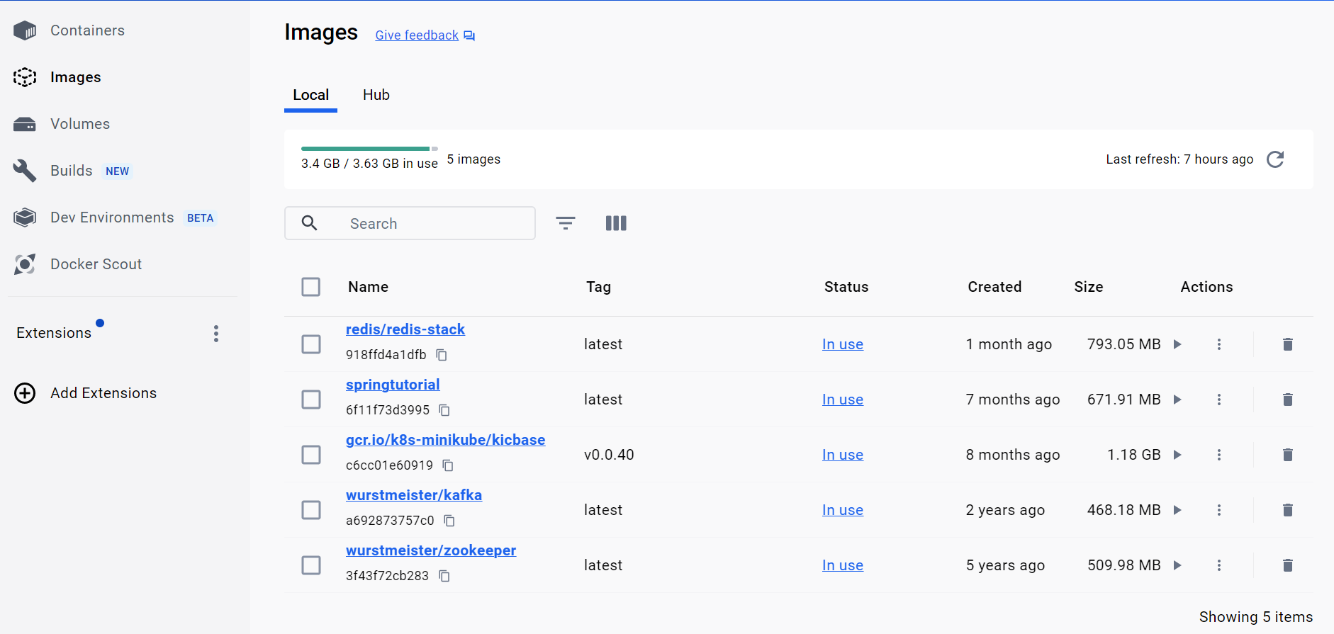

Slide 21
Demo-1: Create container
Create a folder with 2 files (Dockerfile and main.py file) in it.
1) Dockerfile and 2) main.py
Step-1: Edit main.py with the below code.
#!/usr/bin/env python3
print("Hello Docker and Python!")
Step-2: Edit Dockerfile with the below commands.
FROM python:latest
COPY main.py /
CMD [ "python", "./main.py" ]
Step-3: Create Docker Image [The ‘-t’ option allows to define the name of your image.]
sudo docker build -t pythondemo-image .
Step-4: Run Docker Image
sudo docker run pythondemo-image

Slide 22
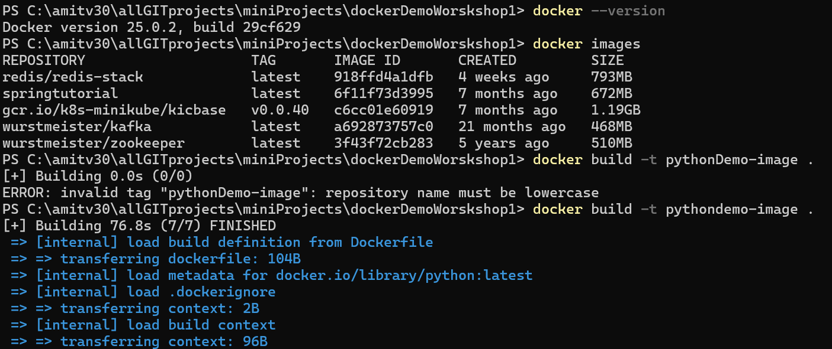
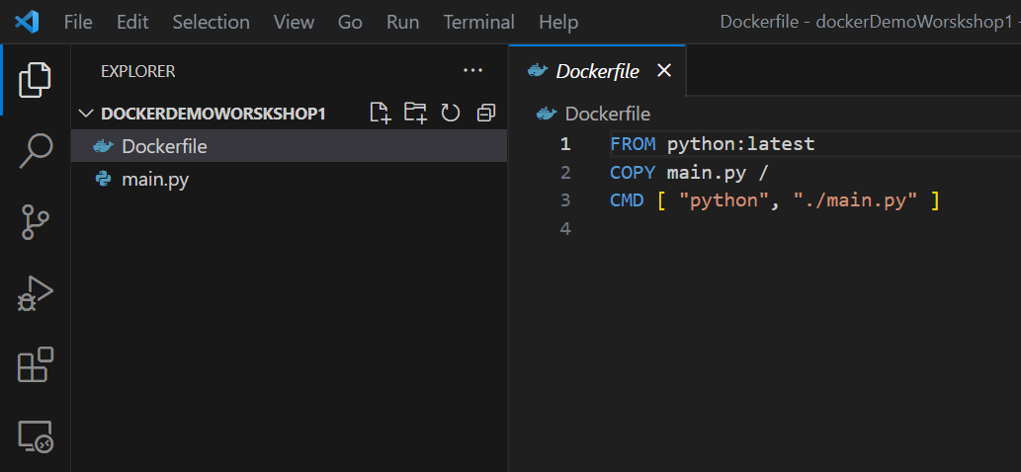
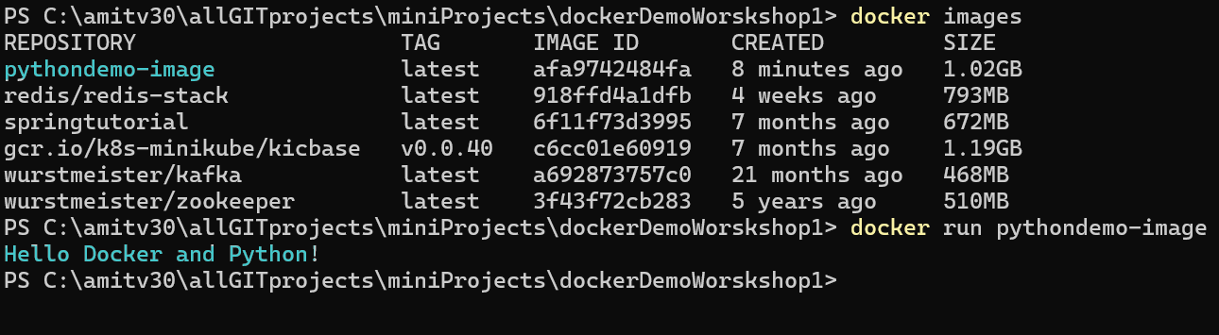

Slide 23
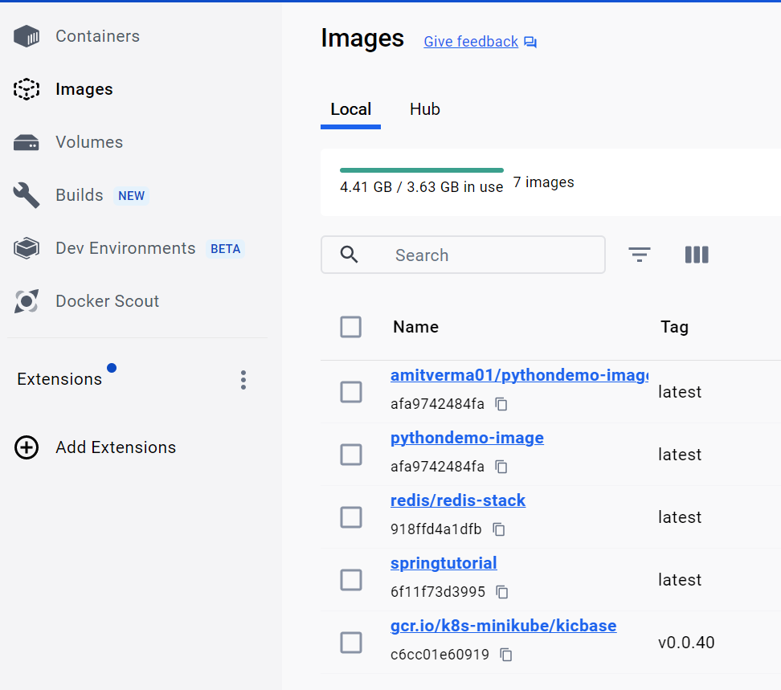
Demo-2: Push image in Docker Hub
Create an account on Docker Hub or use an existing one if you already have one.
Click on the “Create Repository” button, put the name of the file, and click on “Create”.
Now will “tag our image” and “push it to the Docker Hub repository” which we just created.
Image ID is used to tag the image. The syntax to tag the image is:
docker tag <image-id> <your dockerhub username>/pythondemo-image:latest
docker tag afa9742484fa amitverma01/pythondemo-image:latest
Push image in Docker-Hub
docker push amitverma01/pythondemo-image

Slide 24
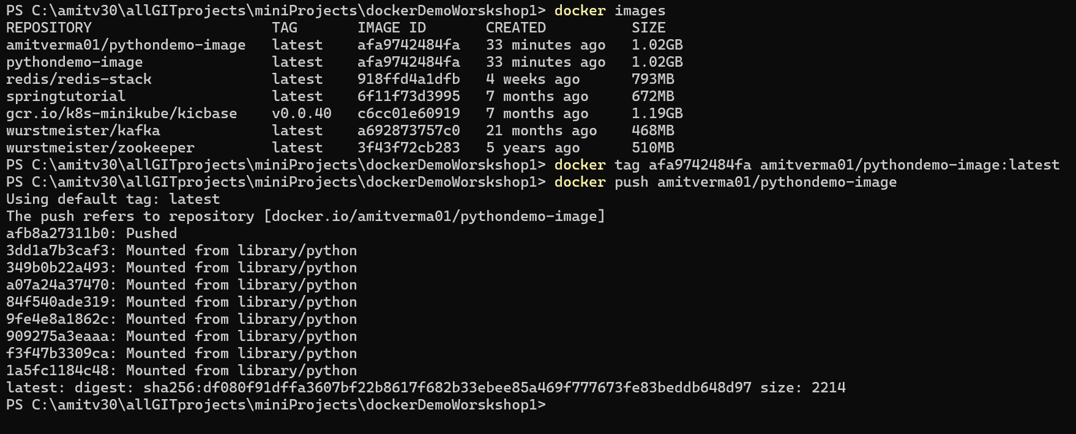

Slide 25
Fetch and run the image from Docker Hub
To remove all versions of a particular image from our local system, we use the Image ID for it.
docker rmi -f af939ee31fdc
Now run the image, it will fetch the image from the docker hub if it doesn’t exist on your local machine.
docker run amitverma01/pythondemo-image
Check Logs for a Specific Container:
docker logs [OPTIONS] CONTAINER_ID_or_NAME
Replace CONTAINER_ID_or_NAME with the ID or name of the container whose logs you want to view.
Example: View the last 100 lines of logs for a container
docker logs --tail 100 CONTAINER_ID_or_NAME

Slide 26
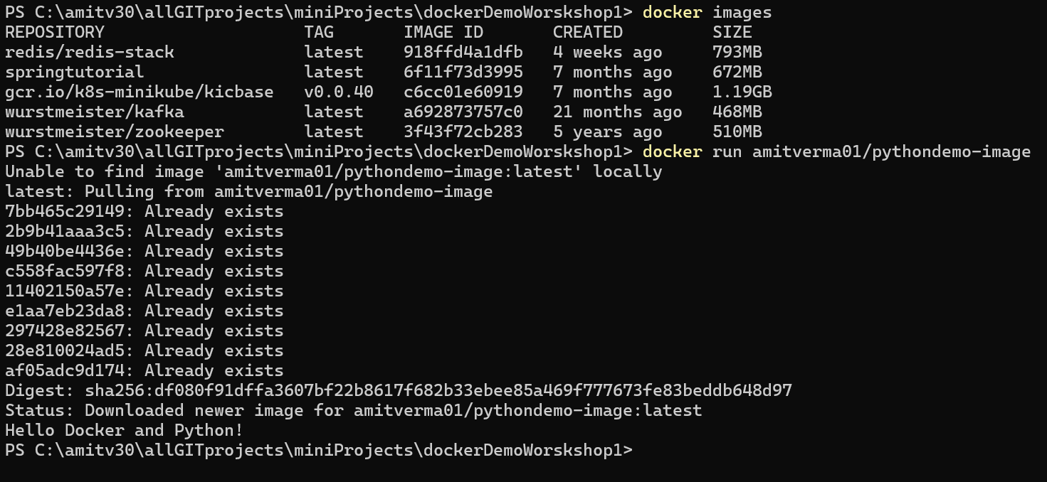

Slide 27
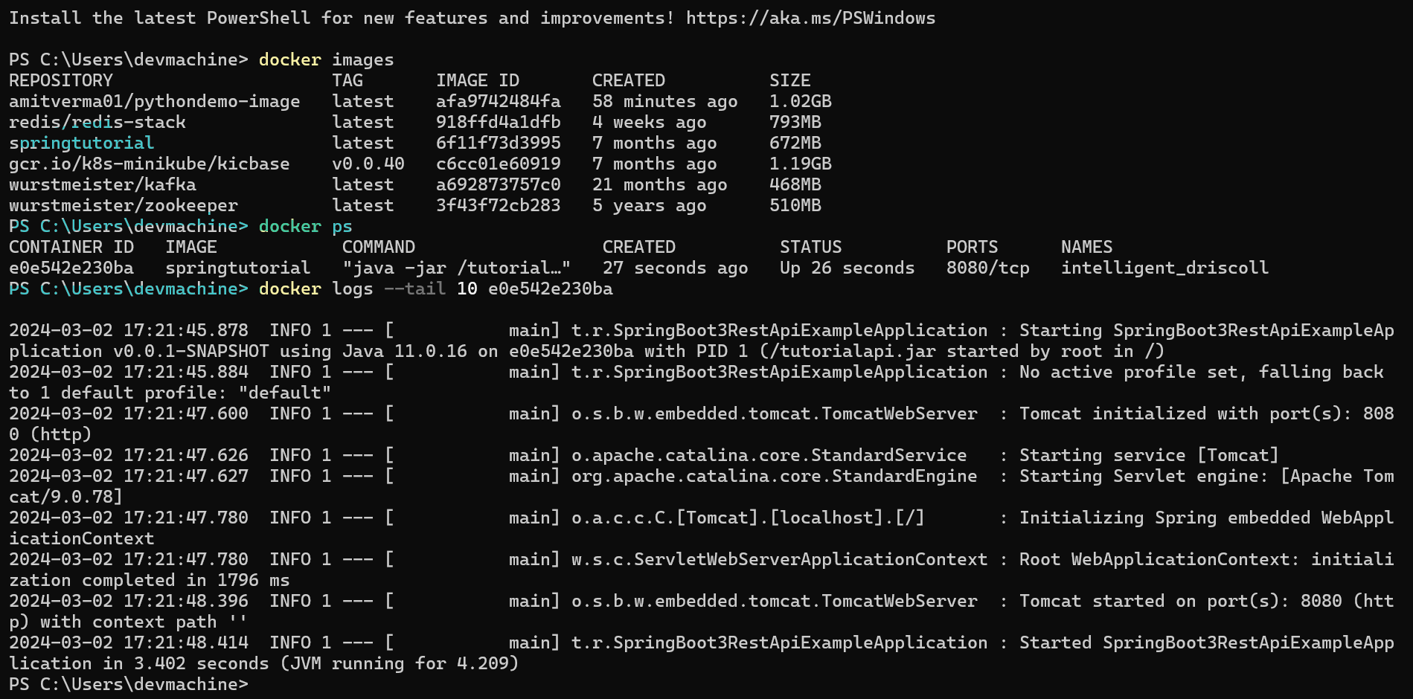
Docker Logs

Slide 28
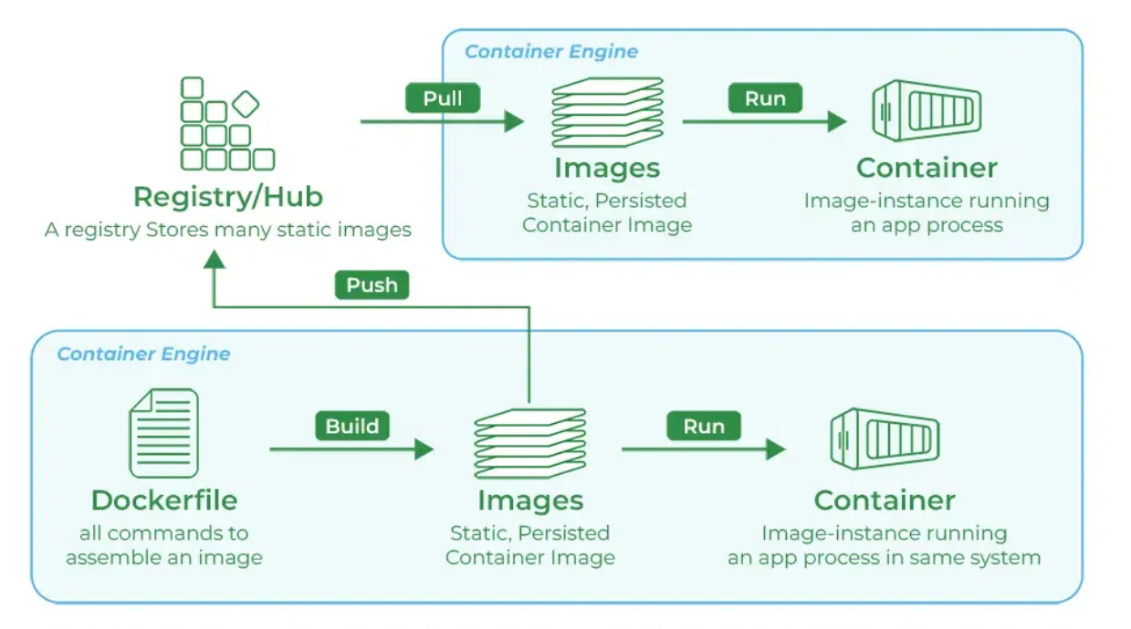

Slide 29
Demo-3: Ubuntu as Container
How to run Ubuntu as Container?
How to interact and run commands in Ubuntu?
docker run -it ubuntu
Docker please run a container for me in interactive mode.
Check commands like- ls, whoami etc. and then exit by using – ‘ctrl+D’
Check containers- docker container ls –a
Start Container- docker start <container name>
Stop Container- docker stop <container name>
Interactive mode- docker exec -it <ubuntu container name> bash
Inside ubuntu container we can run commands.

Slide 30
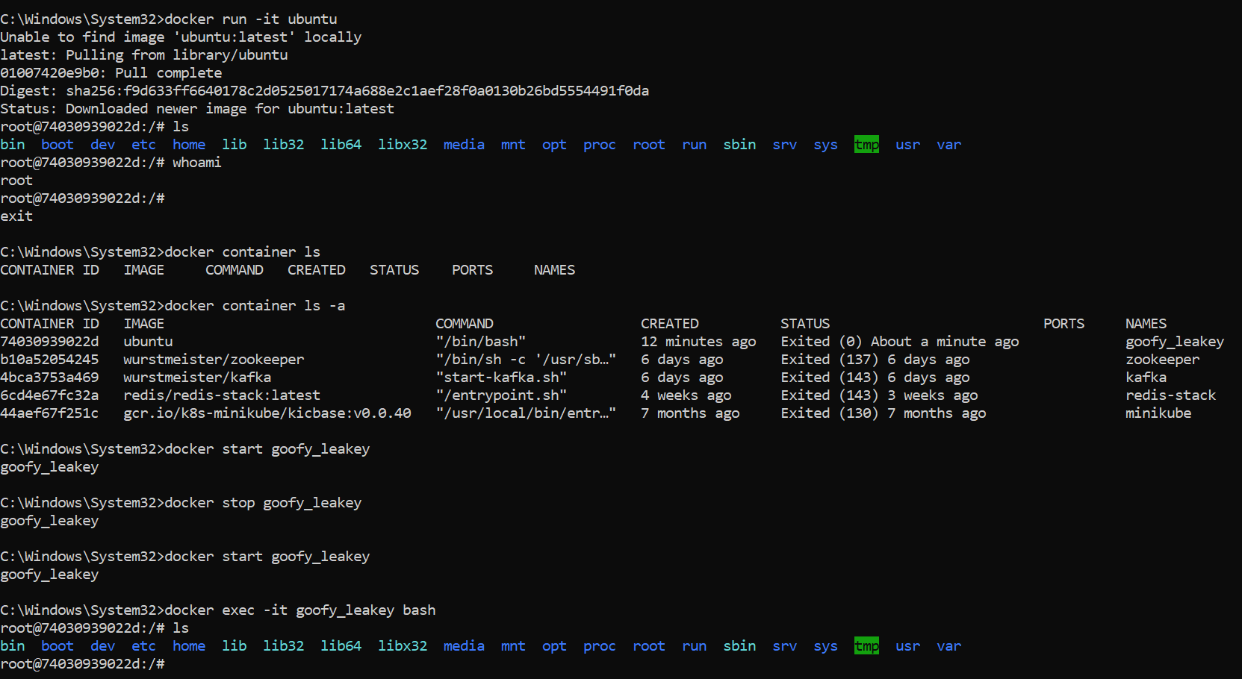

Slide 31
Demo-4: REST API as Container
Let’s create a spring REST API/Project.
Create image and run this REST service as a container.
Create Image: docker build -f Dockerfile -t springtutorial .
Run as Container: docker run springtutorial
Test in Postman with this url: http://localhost:8080/
Why error? and How to solve this?
because that port(8080) is running inside a container, so we need to expose it.
Run again: docker run -p 9900:8080 springtutorial
I am saying please map/expose container’s port(8080) to my machine port(9900)
Test in postman with: http://localhost:9900/api/tutorials

Slide 32
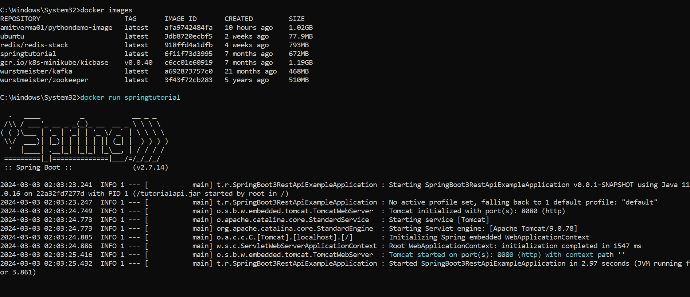
Not Reachable: We can’t access http://localhost:8080/ in browser, because it’s running inside container, how can I access it?

Slide 33
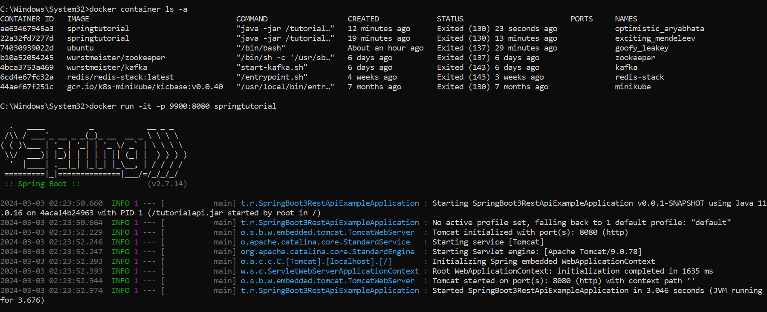
It’s working now

Slide 34
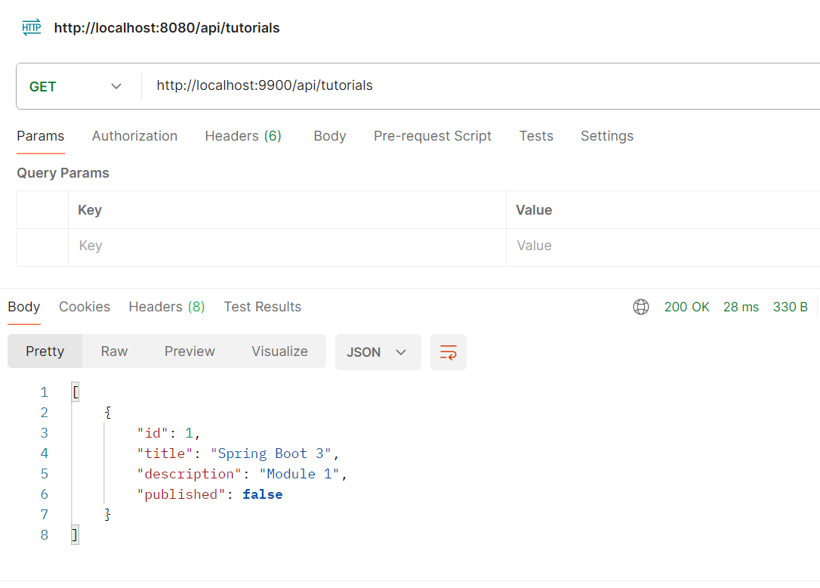
Postman Testing

Slide 35
References
https://accesto.com/blog/what-is-docker-and-why-to-use-it/
https://docs.docker.com/get-started/overview/
https://www.geeksforgeeks.org/introduction-to-docker/?ref=lbp
https://www.geeksforgeeks.org/how-to-install-docker-on-windows/
https://github.com/amitvsolutions/miniProjects/tree/main/spring-rest-docker
https://www.youtube.com/watch?v=31k6AtW-b3Y

