Slide 1

MSPM’S Deogiri Institute of Engineering and Management Studies, Aurangabad Academic Year 2019-20 Department of Computer Science and Engineering Subject: Theory of Computations Topic: Pattern Searching
Git-hub link: Mrunmayee0902
Amitwa07
Submitted By
Amit Yeola (36103)
Mrunmayee Aundhekar (36104)
Under the Guidance of
Dr. S. M. Chavan
Asst. Prof. Department of CSE
(Deogiri Institute of Engineering and Management Studies)

Slide 2
Pattern Searching
It is used in notepad and Microsoft word for pattern or string searching.
In FA based algorithm, we pre-process the pattern and build a 2D array that represents a Finite Automata.
At every step, we consider next character of text, look for the next state in the built FA and move to a new state.
If we reach the final state, then the pattern is found in the text.

Slide 3
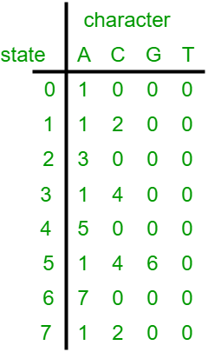
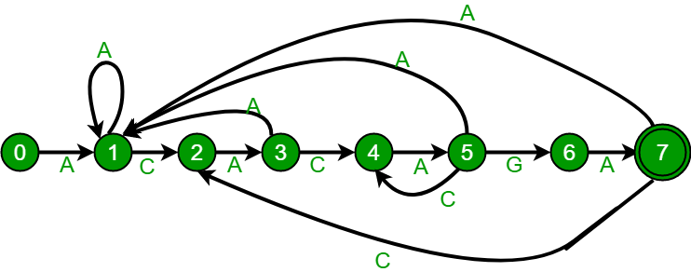
Finite Automata Algorithm
Number of states in FA will be M+1 where M is length of the pattern.
A character x and a state k, we can get the next state by considering the string “pat[0..k-1]x” which is basically concatenation of pattern characters pat[0], pat[1] … pat[k-1] and the character x.
The idea is to get length of the longest prefix of the given pattern such that the prefix is also suffix of “pat[0..k-1]x”.
The value of length gives us the next state.

Slide 4
Applications
Information retrieval
Virus scanning
DNA sequence analysis
Data mining
Machine learning
Network security
Pattern recognition
Pattern matching

Slide 5
Conclusion
Finite Automata (FA) based pattern searching algorithm. In FA based algorithm, we pre-process the pattern and build a 2D array that represents a Finite Automata. When we search for any pattern it will go on each state present there and check separately on each state. Then it gives output in the form of state number where our required pattern is present. This is highly use in notepad, visual studio, sublime text editor , Microsoft word and any other compilers.

Slide 6

THANK YOU

