Slide 1


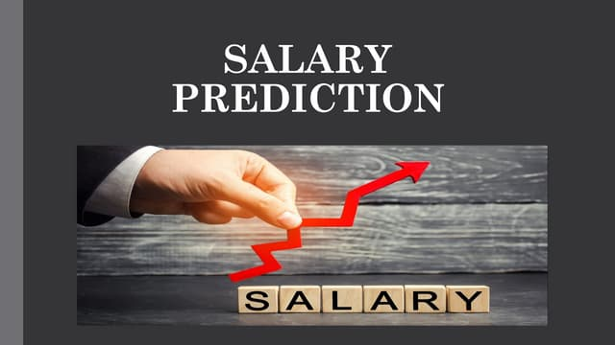
Salary Prediction
Artificial Intelligence and MA
Salary
Prediction
using linear regression
Name
Guide Name
Amit Kumar Singh
Himanshu Souda
College
Techno India University

Slide 2


Salary Prediction
Agenda
Introduction to Salary Prediction App
Tools and Technologies Used
Project Workflow and Output Screenshots
Applications of the App
Problems Faced and Solutions
Future Scope
Project Repository Link

Slide 3
Salary Prediction
Page 1
Introduction
The Salary Prediction App leverages machine learning regression models to predict employee salaries based on input features such as years at the company, satisfaction level, and average monthly hours worked.
Goal One
Goal Two
Goal Three
Traditional salary determination can be biased or inaccurate—ML-based prediction introduces consistency and data-driven insight.
The project showcases a full machine learning pipeline, from data preprocessing to deployment, for real-world HR analytics.
Novelty: Interactive web deployment using Streamlit for user engagement and demonstration

Slide 4

Salary Prediction
Page 2
Languages/Frameworks:
Libraries:
Tools and
Technologies
  Pandas & NumPy: data manipulation and processing
  Scikit-learn: model building, feature scaling, evaluation
  Matplotlib & Seaborn: charts and exploratory visuals
  Python: core language for all analytics and modeling
  Jupyter Notebook: iterative development and EDA, easy visualization
Deployment/UI:
  Streamlit: fast deployment, live interaction with model​
  Canva Pro: UI/UX enhancements, marketing graphics
Python, Jupyter Notebook, and Scikit-learn were used to build and analyze regression models for predicting salary, with Streamlit enabling an interactive app interface. Data was processed using Pandas and visualized with Matplotlib, while Canva Pro enhanced the user interface and presentation graphics.
Version Control/Github:
  For collaborative development and sharing

Slide 5
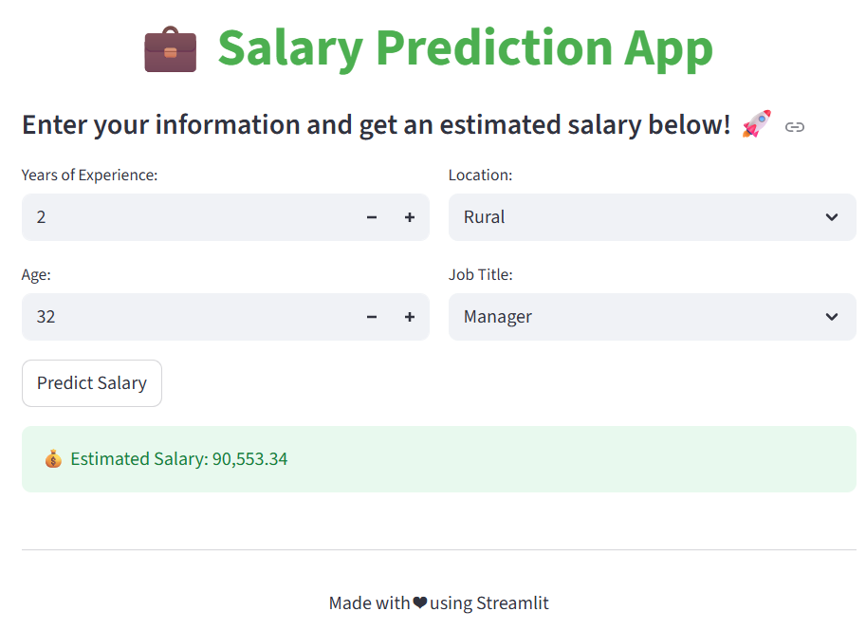
Salary Prediction
Page 3
Project Workflow
The salary prediction app collects user input data (like experience and satisfaction level), preprocesses and scales it, and then applies trained regression models to generate an estimated salary in real-time through the Streamlit interface. The workflow covers data cleaning, feature selection, model training, and interactive prediction for easy and accurate results.
App Interface

Slide 6
Salary Prediction
Page 4
Applications
  Assists HR professionals in automating and standardizing salary offers using data-driven predictions.​
  Enables job seekers to estimate expected salaries and make informed career decisions.​
  Helps companies identify competitive pay ranges to attract and retain top talent.​
  Provides insights into market trends, department-wise salary averages, and position level growth.​
  Acts as an educational tool to demonstrate data analysis and regression techniques in practical scenarios.​
  Supports fairness and transparency in salary negotiations, fostering positive relationships between employers and employees

Slide 7
Salary Prediction
Page 5
Data Quality Issues:
Feature Selection Difficulty:
Problems Faced & Solutions
The initial dataset had missing or duplicate entries, which could compromise model accuracy.
Solution: Used Pandas to clean, fill, or remove problematic rows, ensuring a reliable dataset for analysis.
Some variables introduced noise instead of contributing to prediction.
Solution: Performed correlation analysis and kept only the most relevant features such as experience, satisfaction level, and average work hours.
Model Selection and Tuning:
User Interface Limitations:
Achieving high accuracy required testing and comparing several algorithms.
Solution: Trained multiple regression models and optimized hyperparameters with GridSearchCV for the best performance
Early versions of the app were not user-friendly or visually appealing.
Solution: Improved design with Streamlit for interactivity and Canva Pro for enhanced graphics, making the app practical for all users.
Developing the salary prediction app involved several technical and design challenges; each was addressed with targeted solutions for robust results.

Slide 8

Salary Prediction
Page 6
Expanded Feature Set
Personalized
Analytics
Include more attributes like education, job role, company sector, and location for personalized predictions.
Offer AI-driven career advice and long-term salary projections for user-centric experience.
Future Scope
Advanced Algorithms
Localization and Global Reach
Employ ensemble learning and deep neural networks for improved prediction accuracy and scalability
Support multiple languages, local currencies, and region-specific salary norms for a worldwide audience.
As the field of salary prediction evolves, there is significant potential to make apps more powerful, accurate, and widely applicable. By integrating richer data sources, leveraging advanced machine learning, and focusing on user experience, the future development of these applications can create deeper impact for HR, employees, and job seekers.
Real-time Integration
Enterprise API Integration
Connect with live HR databases or external APIs for up-to-date salary forecasts
Develop endpoints and full-stack compatibility for seamless adoption in HRMS and business platforms.

Slide 9

Salary Prediction
Project Link:
https://github.com/amitx22/SALARY_PREDICTION_APP
Demo Link:
https://youtu.be/gC6SL7TDIBU
Thank Youa

