Slide 1
Multithreading
NAME-Parth Dubey
Employee id-189105

Slide 2

A multi tasking lady

Slide 3
Need of Multi tasking
It is the ability of the system to perform more than one task simultaneously
Types of multitasking
Process based multi tasking
Thread Based Multitasking
Process is program under execution. For example- Running FIFA on your system .

Slide 4
Process and Process Based Multitasking
Copying a piece of text from Word to PowerPoint while listening music on YouTube.
Process involved-
Power point
Word
Chrome
The ability of the system to perform all the above tasks simultaneously is process based multitasking

Slide 5
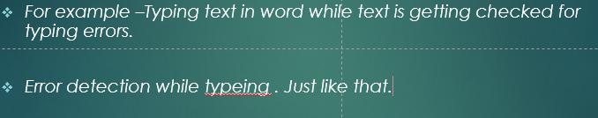
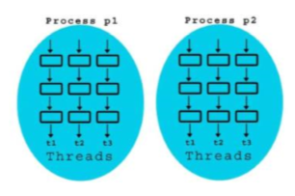
Multithreading and Thread
Multithreading is technique used to perform multiple task in a given process simultaneously.
For example –Typing text in word while text is getting checked for typing errors.
The below pictures shows the multiple process taking place while multiple threads are running in a process.

Slide 6
Need of Multithreading
As multiple threads exist in a single process the data can easily be share between the threads unlike process.
Context switching is easy and inexpensive in case of threads in comparison to objects
(Note)Context switching involves storing the context or state of a process so that it can be reloaded when required and execution can be resumed from the same point as earlier.

Slide 7
How to use a thread
To use a thread there are two methods
Extending java.lang.Thread class
Implementing Runnable interface
Extending Thread class
Create an object of the class that extends thread
To start a thread use .start() function
Implementing Runnable interface
Create the object of the class implementing Runnable
Create the object of thread class and pass the above
In either of the case run() function is over ridden and the task to be performed by a thread is passed into that thread.

Slide 8
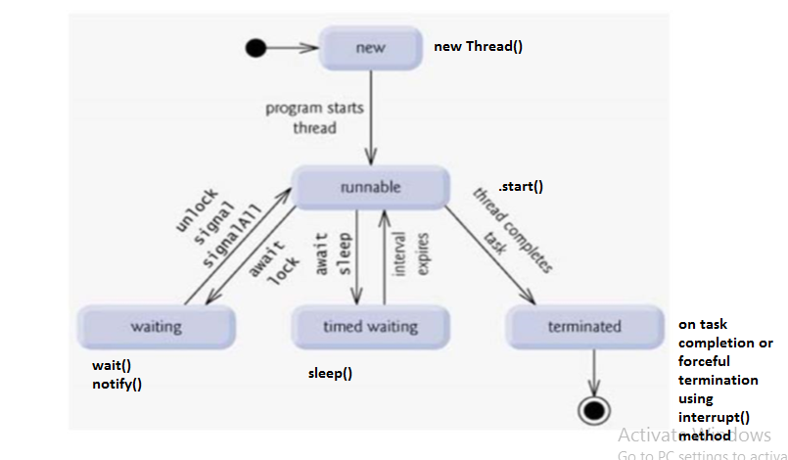
Thread life cycle

Slide 9
Scheduling Threads
We have to set the priorities of the threads to decide the order in which the threads are being executed.
It does not guarantee the order in which the threads will be executed. The thread scheduler is the part of the JVM that decides which thread should run at any given moment, and also takes threads out of the run state.
One can modify the thread priority using the setPriority(PRIORITY_LEVEL) method.
Thread Priority level and their constant Values:
MIN_PRIORITY – 1
NORM_PRIORITY - 5
MAX_PRIORITY - 10
Default priority of a thread is always 5 .

Slide 10
Controlling Threads
Following Function can be used to control a thread in blocked state
Sleep()
Join()
Sleep()- it is used to put a thread to sleep for a specific time.
Join()- it is used to put the current thread in blocked state until the thread on which it is blocked is dead.

Slide 11
Synchronization
If we want only one thread should access the resource at a time in parallel environment we use synchronization .
It is used to prevent thread interference and to avoid consistency problem .
If this is not used and two threads are sharing the same resource a deadlock situation arises.

Slide 12

Deadlock
Rahul Dravid- Neither he scores runs nor he gets out this is deadlock situation.

Slide 13
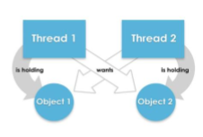
Deadlock
Thread1 wants object2 which is blocked by thread 2 and thread2 wants object1 but it is locked
by thread1 so the process will never get completed.

Slide 14
Thank you

