Slide 1
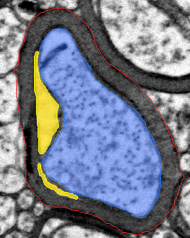
VACUOLE-AWARE
MYELIN QUANTIFICATION
Detecting pathological vacuolar disruption in electron-microscopy fibers
Noy Elyasi · Roni Hagai · Amit Yehezkel
Course project · final presentation
Notes:
Timing: 0:30
Introduce the biological measurement problem and the team. State the one-sentence goal: detect vacuolar disruption inside a myelin sheath so damaged myelin is not mistaken for healthy thickness.
[Sources]
- Local project asset: work/benchmark_three_mode_overlays/p1292_neo5_axon-01/01_annotation_overlay.png
[/Sources]

Slide 2
The outer boundary can make damaged myelin look deceptively thick
Conventional view
g = √(Aaxon / Aouter)
Everything inside the red boundary contributes to apparent sheath thickness.
Pathological failure mode
Yellow clefts expand the gross envelope but are not compact myelin.
Our question: how much intact sheath remains?
VACUOLE-AWARE MYELIN MVP
02
Notes:
Timing: 1:05
Explain blue = axon, red = outer fiber, yellow = vacuole. The standard g-ratio sees the outer envelope, so separated lamellae can look like additional thickness. Emphasize that the project does not replace established biology; it adds a damage-aware area measurement.
[Sources]
- Fischer et al., Science Advances 10, eadl4573 (2024).
- Kaiser et al., eNeuro 8(4), ENEURO.0558-20.2021 (2021).
- Local project asset: work/benchmark_three_mode_overlays/p1292_neo5_axon-01/01_annotation_overlay.png
[/Sources]

Slide 3
We subtract disruption from the gross sheath
Gross sheath
Stable outputs
Vacuole area, vacuole burden, intact-myelin area, conventional g-ratio, and intact-equivalent g-ratio.
Aouter − Aaxon
Deliberately omitted
Intact myelin
Vacuole count and mean component size: one biological cleft can fragment into several image components.
Agross sheath − Avacuole
Interpretation
Intact-equivalent g-ratio
The intact-equivalent metric is a project measure that still requires biological validation.
√[Aaxon / (Aouter − Avacuole)]
VACUOLE-AWARE MYELIN MVP
03
Notes:
Timing: 0:55
Walk through the area subtraction. Explain why count was removed: component splitting makes it unstable. Keep the claim cautious: this is a useful area-based correction, not yet a validated replacement for conventional g-ratio.
[Sources]
- Local project: TECHNICAL_MODEL_GUIDE.md, sections 1 and 9.
[/Sources]

Slide 4
Five entry paths, one shared vacuole detector
1
2
3
4
5
Auto whole
Guided whole
Guided crops
One masked
Masked batch
Whole image + scale AxonDeepSeg → fibers
or
Whole-image folder unlimited crops → masks
or
Crop folder + scale sequential two-mask step
or
One crop + scale supplied masks
or
Crop/mask folders match → validate
One wizard → five entry paths → same frozen detector
VACUOLE-AWARE MYELIN MVP
04
Notes:
Timing: 1:10
Walk through the five alternatives from left to right. These are entry paths, not five different vacuole models. Users can now start with python -m mvp_pipeline: the terminal wizard asks what inputs exist, validates paths and scale information, checks environment readiness, and shows the equivalent explicit command before dispatch. Automatic whole-image analysis requires explicit experimental-mode opt-in. The explicit commands remain available for reproducibility and scripting. Emphasize that usability was not formally evaluated: the launcher and guided interface are engineering and reproducibility contributions.
[Sources]
- Local project: mvp_pipeline/wizard.py, mvp_pipeline/cli.py, tests/test_wizard.py, START_HERE.md, and TECHNICAL_MODEL_GUIDE.md.
[/Sources]

Slide 5
Detector logic: conservative seeds, then guarded recovery
1
2
3
4
5
Normalize
Seed
Clean
Refine
Rescue
Sheath-only 1st–99th percentiles; CLAHE; Gaussian smoothing
→
Otsu + 0.20 strong pixels; connected weak pixels above +0.10
→
0.02 µm closing/opening; remove components <0.01 µm²
→
Grow a seed within 0.05 µm down to Otsu−0.05; cap at 1.5× area
→
Gentler branch for thin clefts; filter by thickness, position, shape
Final prediction = refined main branch ∪ accepted rescue components, clipped to gross sheath
VACUOLE-AWARE MYELIN MVP
05
Notes:
Timing: 1:35
Spend most of the methods time here. Explain hysteresis: a high threshold finds trustworthy seeds, while a lower threshold is accepted only when connected. Refinement improves borders but cannot invent a seed. Rescue revisits the raw candidate with gentler morphology and rejects line-like or outer-edge texture using context features.
[Sources]
- Otsu, IEEE Transactions on Systems, Man, and Cybernetics 9(1), 62–66 (1979).
- Zuiderveld, Contrast Limited Adaptive Histogram Equalization, Graphics Gems IV (1994).
- Local project: TECHNICAL_MODEL_GUIDE.md, sections 4–8.
[/Sources]

Slide 6
The benchmark is small, split by source image, and transparently limited
43
20
23
labeled fibers
development
test (21 eligible)
What was tuned
What reduces leakage
Detector parameters were selected on development annotations.
Related crops were assigned by source image, not randomly by individual crop.
Caveat
Student annotations; some test images were inspected during iteration. Results are descriptive proof-of-concept evidence, not independent clinical validation.
VACUOLE-AWARE MYELIN MVP
06
Notes:
Timing: 0:55
State the benchmark honestly. Mention the two QC-excluded test fibers. The split by source reduces leakage, but repeated visual inspection means this is not a fully untouched test set. This transparency strengthens the report.
[Sources]
- Local project: work/benchmark/benchmark.csv and work/best_model_results/summary.json.
[/Sources]

Slide 7
Cropped-mask mode achieves strong precision with incomplete recall
0.00628 µm²
median test absolute area error
20.29%
median test percentage area error
Interpretation
False-positive area is relatively controlled; missed or partial vacuole area remains the larger error.
VACUOLE-AWARE MYELIN MVP
07
Notes:
Timing: 1:25
Define Dice and IoU briefly as overlap metrics. Precision is higher than recall, so the detector is conservative. There is no universal submission threshold; this is best presented as a successful proof of concept with clear remaining under-segmentation.
[Sources]
- Local project: work/best_model_results/summary.json and evaluation_per_axon.csv.
[/Sources]

Slide 8
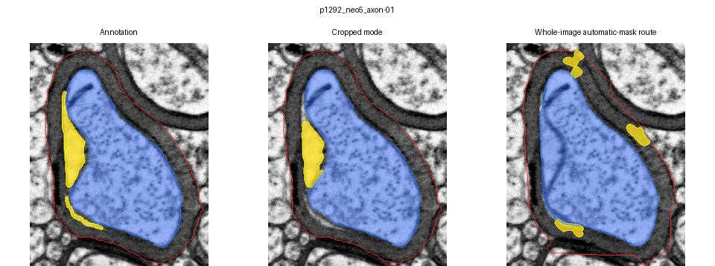
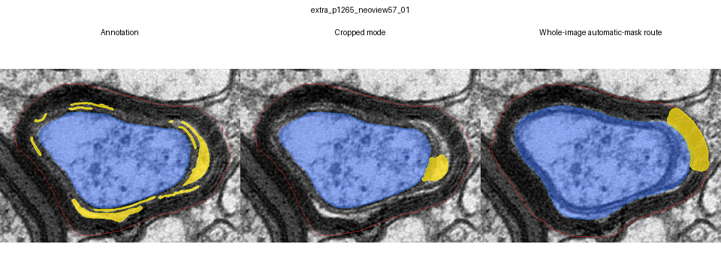
Qualitative review explains what the summary metrics hide
Good localization
The cropped detector recovers the main annotated vacuole but not every thin extension.
Hard case
Long low-contrast lamellar clefts remain partial; permissive growth risks labeling intact sheath.
VACUOLE-AWARE MYELIN MVP
08
Notes:
Timing: 1:20
Use the top row to show that the detector often finds the correct region but may not cover the entire annotation. Use the bottom row to explain the hard trade-off: thin lamellar clefts resemble normal myelin spacing. Lowering the threshold globally increased compact-fiber false positives, so the final rescue branch is selective.
[Sources]
- Local project asset: work/benchmark_three_mode_overlays/p1292_neo5_axon-01/00_three_way_comparison.png
- Local project asset: work/benchmark_three_mode_overlays/extra_p1265_neoview57_01/00_three_way_comparison.png
- Local project: TECHNICAL_MODEL_GUIDE.md, section 8.
[/Sources]

Slide 9
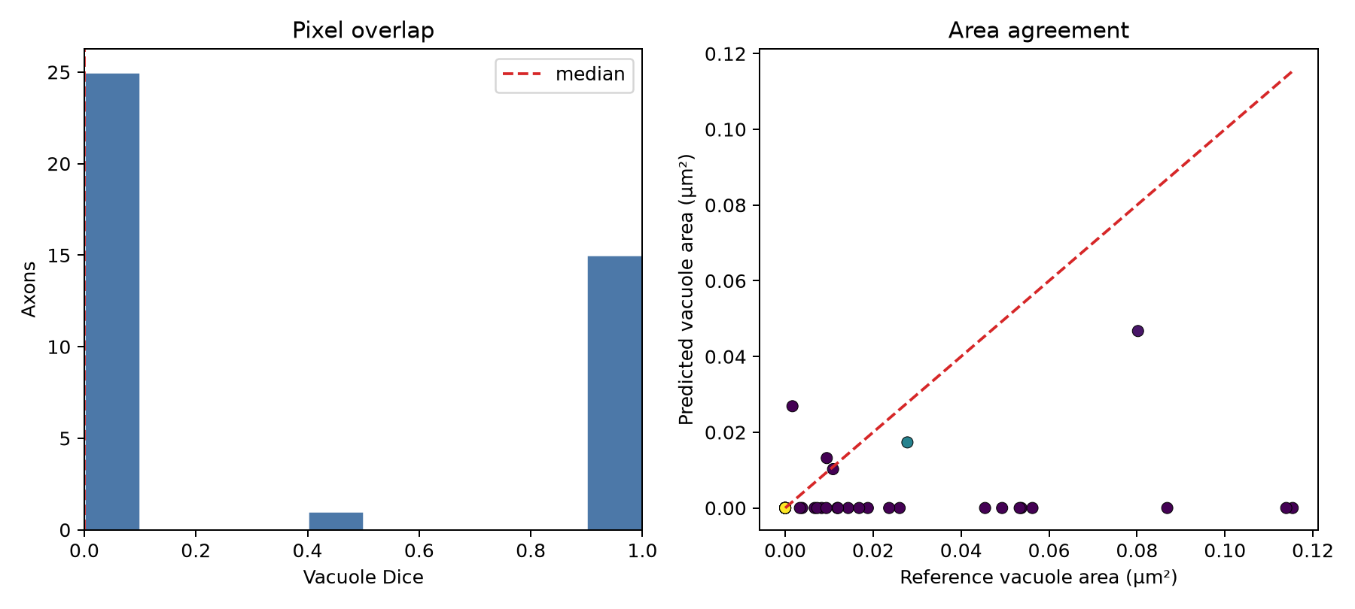
Whole-image mode fails before vacuole detection
25 / 43
target fibers recovered
15 / 43
both automatic masks passed
18
complete target misses
End-to-end median vacuole Dice: 0.000
VACUOLE-AWARE MYELIN MVP
09
Notes:
Timing: 1:15
Do not compare this zero directly with cropped-mode Dice as if they were the same experiment. Whole-image mode adds target finding and automatic axon/outer masks. Those masks transfer poorly to this local domain, so many fibers never reach the shared detector correctly. Present mode 1 as a proposal-and-review workflow.
[Sources]
- Local project: work/separate_mode_results/whole_image_mode/summary.json.
- Local project asset: work/separate_mode_results/whole_image_mode/end_to_end_evaluation_overview.png
[/Sources]

Slide 10
A useful proof of concept—with a clear validation path
What we can claim
What comes next
Cropped-mask feasibility
Expert ground truth
Median test Dice 0.752 and precision 0.930.
Blinded multi-rater labels and inter-rater agreement.
Interpretable logic
Independent test set
Predictions follow explicit intensity, connectivity, morphology, and context rules.
Hold out animals and source images before further tuning.
Portable workflow
Local front-end training
One launcher, five entry paths, frozen configuration, saved progress, and tests.
Fine-tune axon/outer segmentation before claiming whole-image automation.
Questions?
Planned talk: ~10–11 min · Q&A: 3–5 min
Notes:
Timing: 0:45 + 3–5 min Q&A
Close with a two-part claim: the cropped-mask core is promising; automatic whole-image segmentation remains future work. Invite questions. If asked whether the model is good enough, answer: yes for a transparent course proof of concept, no for clinical or definitive biological use.
[Sources]
- Local project: work/best_model_results/summary.json, TECHNICAL_MODEL_GUIDE.md, and final report draft.
[/Sources]

