Slide 1
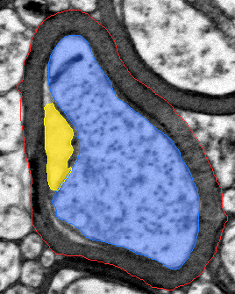
VACUOLE-AWARE
MYELIN QUANTIFICATION
A practical way to measure disrupted myelin in electron-microscopy images
Noy Elyasi · Roni Hagai · Amit Yehezkel
Course project · final presentation · proof of concept
Notes:
Suggested time: 35–45 seconds.
Open with the image, not the software. Blue is the axon, red is the outer fiber boundary, and yellow is the disrupted area we want to measure.
Our project asks a simple question: when the sheath contains bright gaps, how much intact myelin is actually left?
[Sources]
- Project benchmark overlay generated by this pipeline; source deck slide 1.
[/Sources]

Slide 2
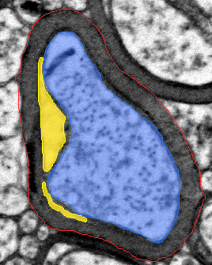
A thicker outline can hide damaged myelin
Traditional measurement
Compares the inner and outer fiber boundaries
Everything inside the outer boundary contributes to the apparent sheath thickness.
Why this can be misleading
Bright gaps expand the fiber outline without adding healthy, compact myelin.
Our question: how much intact sheath remains?
VACUOLE-AWARE MYELIN MVP
02
Notes:
Suggested time: about 1 minute.
The g-ratio is useful when myelin is compact. The problem appears when lamellae separate and pale gaps form inside the sheath.
A boundary-only measure can then call the sheath thick even though part of that area is disruption rather than intact material.
This is the scientific motivation for adding a vacuole-aware measurement.
[Sources]
- Kaiser et al., MyelTracer, eNeuro 2021: https://doi.org/10.1523/ENEURO.0558-20.2021
- Fischer et al., Science Advances 2024: https://doi.org/10.1126/sciadv.adl4573
- Project benchmark overlay generated by this pipeline; source deck slide 2.
[/Sources]

Slide 3
Our solution measures intact myelin separately
1. Gross sheath
Questions the output can answer
How much disruption is present, and how much apparently intact myelin remains?
Everything between the outer boundary and the axon
Reports both perspectives
2. Intact myelin
The conventional g-ratio is retained alongside vacuole-aware area measurements.
Gross sheath minus the detected bright gaps
Important caution
3. Vacuole burden
The new measurements are project outputs and still require biological validation.
Vacuole area ÷ gross-sheath area
VACUOLE-AWARE MYELIN MVP
03
Notes:
Suggested time: about 1 minute.
We do not replace the existing measurement. We keep it and add a second view of the same fiber.
The program first defines the gross sheath, detects disrupted regions inside it, and subtracts their area.
The most useful outputs are total vacuole area, vacuole burden, and intact-myelin area. We removed vacuole count because one cleft can fragment into several image components.
[Sources]
- Vacuole_Aware_Myelin_Final_Report.docx, Methods sections 3.3 and 3.6.
[/Sources]

Slide 4
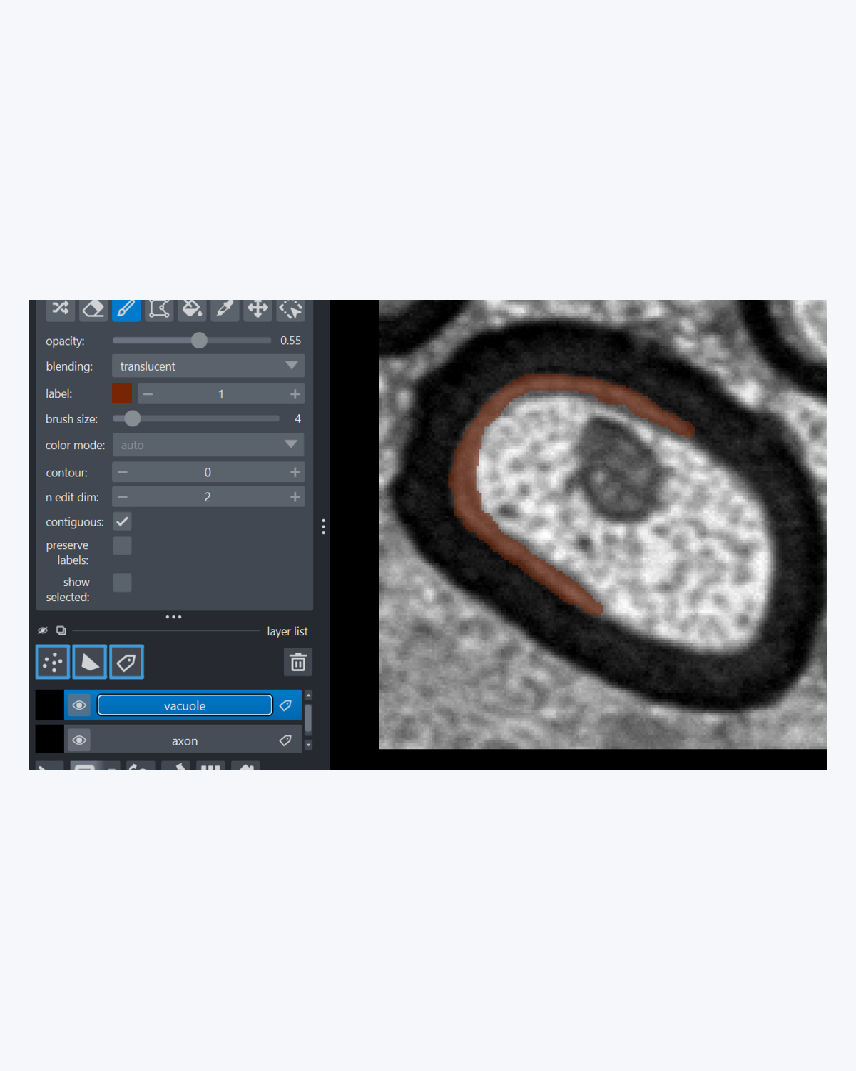
The guided interface turns images into results
1. Choose a starting point
Whole images, existing crops, or prepared masks
One launcher asks only for the image paths and physical scale needed for that route.
2. Follow the guided steps
Napari opens each image in sequence for crop selection and two simple masks. Progress is saved.
3. Review the overlay and exported measurements
VACUOLE-AWARE MYELIN MVP
04
Notes:
Suggested time: 1–1¼ minutes.
This is the part a normal user sees. They start one command and choose the situation that matches their data.
For the reliable route, the program opens Napari and asks the user to mark the axon and the complete fiber boundary. It saves progress after each image.
At the end, it automatically creates masks, colored overlays, a CSV report, and summary files. The same detector runs regardless of the entry path.
The fully automatic whole-image path is available but is clearly labeled experimental.
[Sources]
- User-provided project screenshot: codex-clipboard-117d1a51-f059-4aef-ad21-aa20b595d8b2.png.
- Vacuole_Aware_Myelin_Final_Report.docx, Methods section 3.2 and Results section 4.5.
[/Sources]

Slide 5
The detector follows the same five steps for every fiber
1
2
3
4
5
Focus
Propose
Confirm
Follow edges
Recover thin gaps
Look only inside the myelin sheath and balance local brightness
→
Start from unusually bright regions that could represent internal gaps
→
Keep connected regions and remove isolated speckle or tiny artifacts
→
Extend each detection toward its likely boundary—within strict limits
→
Accept thin clefts only when their size, shape, and location are plausible
Every decision is scale-aware, restricted to the sheath, and visible in the exported overlay
VACUOLE-AWARE MYELIN MVP
05
Notes:
Suggested time: 1–1¼ minutes.
Keep the spoken explanation at the level shown on the slide. The detector is transparent rather than a black box.
Technical detail if asked: intensities are normalized within each sheath; Otsu supplies a crop-specific baseline; strong seeds use Otsu + 0.20 and connected weaker pixels use Otsu + 0.10.
Main components below 0.01 µm² are removed. Boundary growth is limited to 0.05 µm and 1.5 times the seed area. A selective rescue branch retains plausible thin clefts down to 0.0015 µm².
[Sources]
- Vacuole_Aware_Myelin_Final_Report.docx, Methods sections 3.3–3.5.
[/Sources]

Slide 6
We tested the method on 43 manually labeled fibers
43
20
23
manually labeled fibers
used to choose settings
test fibers (21 eligible)
How settings were chosen
How related images were separated
Only the development fibers were used to select detector settings.
Crops from the same source image stayed together instead of being split randomly.
Caveat
Student annotations and a small dataset: these results support a proof of concept, not clinical or independent biological validation.
VACUOLE-AWARE MYELIN MVP
06
Notes:
Suggested time: about 50–60 seconds.
Twenty fibers were used to choose settings and 23 were reserved for testing; two test fibers were excluded by a pre-existing quality-control rule.
We split by source image to reduce the chance that nearly related crops appear on both sides.
Be explicit about the limitation: the masks are student annotations, and this is a small course-project benchmark.
[Sources]
- Vacuole_Aware_Myelin_Final_Report.docx, Methods sections 3.1 and 3.7.
- work/benchmark/benchmark.csv, 43 labeled fibers.
[/Sources]

Slide 7
With supplied masks, predictions are precise but incomplete
93%
of predicted vacuole pixels agreed with the annotation
71%
of annotated vacuole pixels were found
75% overall overlap
The detector is conservative: false detections are limited, but some true area remains partial or missed.
VACUOLE-AWARE MYELIN MVP
07
Notes:
Suggested time: 1¼–1½ minutes.
The chart shows development and test medians for four common overlap measures. Focus the audience on the three plain-language takeaways at right.
Precision of 0.930 means that when the detector marks a pixel, it is usually supported by the annotation.
Recall of 0.714 means it finds roughly seven tenths of the annotated vacuole area. Dice of 0.752 summarizes their overlap.
The result is promising for a proof of concept, but it still underestimates some vacuoles.
[Sources]
- Vacuole_Aware_Myelin_Final_Report.docx, Results section 4.1 and Discussion section 5.1.
- work/best_model_results/evaluation_summary.json and generated evaluation chart in the source deck.
[/Sources]

Slide 8
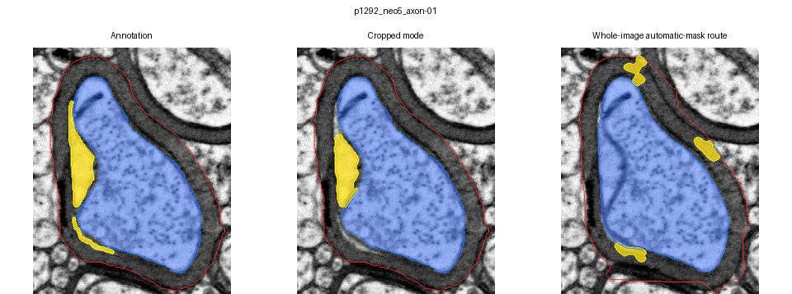
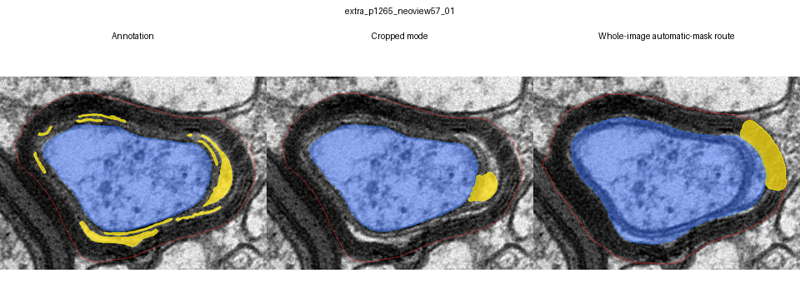
Examples show both the strength and the limitation
Good agreement
With valid masks, the prediction closely follows the main annotated vacuole.
Thin clefts
The model finds part of the structure but misses some of its extent.
VACUOLE-AWARE MYELIN MVP
08
Notes:
Suggested time: 1–1¼ minutes.
Each row compares the manual annotation, cropped mode, and whole-image route.
The first example shows why the cropped result is useful: the main vacuole is localized well.
The second shows the precision–recall trade-off. Thin lamellar clefts are hard to extend fully without also labeling normal sheath texture.
[Sources]
- Project three-mode overlays: p1292_neo5_axon-01 and extra_p1265_neoview57_01.
[/Sources]

Slide 9
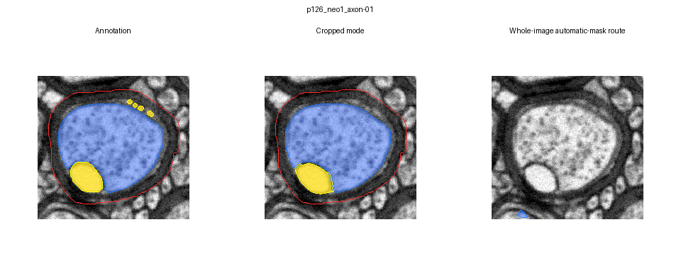
Crop and whole-image modes tell different stories
25 / 43
target fibers found automatically
15 / 43
fibers with acceptable automatic masks
18
fibers missed before vacuole detection
Crop mode is promising; whole-image automation still needs work
VACUOLE-AWARE MYELIN MVP
09
Notes:
Suggested time: 1–1¼ minutes.
The vacuole detector is the same in both modes. What changes is how the axon and outer boundary masks are obtained.
In crop mode, a person supplies those masks, so the result mainly tests vacuole detection.
In whole-image mode, AxonDeepSeg must first find and separate the fibers. Only 25 of 43 targets were recovered, and both masks passed the criterion for 15.
Therefore the whole-image result is a front-end segmentation problem, not evidence that the crop detector suddenly changed.
[Sources]
- Zaimi et al., AxonDeepSeg, Scientific Reports 2018: https://doi.org/10.1038/s41598-018-22181-4
- Vacuole_Aware_Myelin_Final_Report.docx, Results section 4.3.
- Project comparison panel: work/benchmark_three_mode_overlays/p126_neo1_axon-01/00_three_way_comparison.png.
[/Sources]

Slide 10
What we learned—and what must happen next
What this project shows
What must come next
A real measurement problem
Expert annotations
Vacuoles can distort measurements based only on inner and outer boundaries.
Use blinded labels from more than one domain expert.
A practical crop workflow
Independent validation
Guided masks and a transparent detector produce overlays and area measurements.
Test on new animals, preparations, and source images.
Promising proof of concept
Better whole-image segmentation
Median test Dice was 0.752 with supplied masks, but some vacuoles remain partial.
Train the boundary-detection stage on local laboratory images.
Questions?
Cropped analysis is promising; fully automatic analysis is not yet validated.
Notes:
Suggested time: about 1 minute, then questions.
Close with the two-part conclusion: the cropped-mask workflow is a useful and interpretable proof of concept, while full whole-image automation is not ready.
The next scientific step is expert, blinded labeling and a truly independent test set. The next engineering step is improving the automatic fiber-mask front end on local data.
Pause on the final sentence, then invite questions.
[Sources]
- Vacuole_Aware_Myelin_Final_Report.docx, Discussion and Conclusion sections.
[/Sources]

