Slide 1

9TH INTERNATIONALCONFERENCE ON EMERGING APPLICATIONS OF INFORMATION TECHNOLOGY (ERT 2026)
A Lightweight Attention-Enhanced CNN-SVN Hybrid Approach for Maize Leaf Disease Classification
MD Soyeb Hoque, Gunjan Basak, Dipan Deb, Nikhil Sah, Arghyasree Saha, Pawan Kumar Singh Affiliation : Department of IT, Jadavpur University, Kolkata-700106, India.
Paper ID: 195

Slide 2



Presentation Outline
Introduction
Why This Work Matters?
a Literature Analysis
Proposed Methodology
v Result Analysis and Discussion
Conclusion and Future Directions
a References

Slide 3
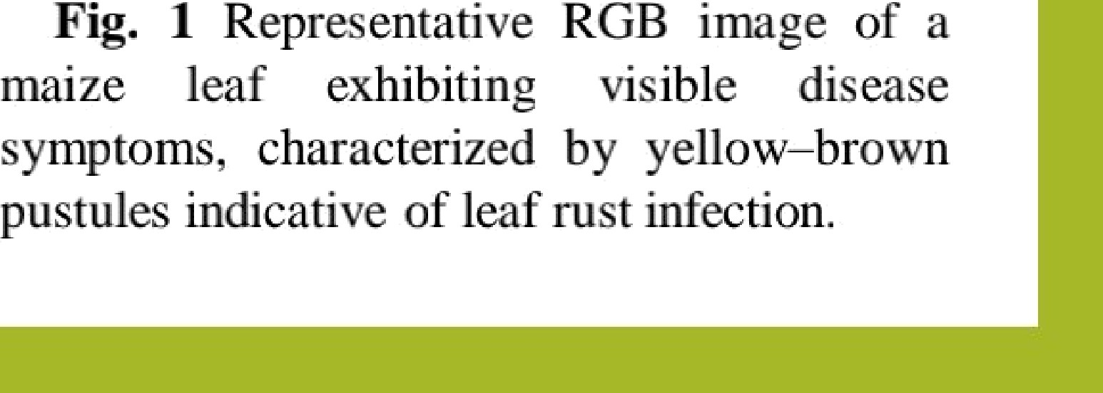
Introduction
Maize (Zea mays L.) -> one of the most widely cultivated cereal crops.
•
Vital role in global food security, serving as:
A staple food for humans
A primary source of animal feed
A raw material for industrial and biofuel production
Also contributes to agricultural economies, in developing countries.
•
Maize production -> highly susceptible to leaf diseases - curvularia
leaf spot, small spot and rust.
I. ,
•
These commonly occUr under -> high humidity and temperature.
If not detected early, they can cause substantial yield losses:
Fig. 1 Representative RGB
image of a
Reduced grain quantity
Degraded grain quality and market value
maize leaf exhibiting visible disease symptoms, characterized by yellow—brown pustules indicative of leaf rust infection.

Slide 4
Why This Work Matters?
Motivation:
Current disease diagnosis methods rely on manual visual inspection:
  Time-consuming and labor-intensive
  Subjective and prone to human error
  Not scalable for large agricultural fields
Deep learning—based approaches, although elective, are often:
  Computationally expensive
  Diflicult to deploy on low-resource devices commonly used by farmers
There is a strong need for an automated, accurate, and resource-eflicient solution for maize disease diagnosis.
Xey Contributions:
Proposed a lightweight MobileNetV2Wonvolutional Block Attention Module (CBAM) architecture for efiicient
feature extraction from maize leaf images.
Trained an independent Support Vector Machine (SVM) classifier on the deep features.
Comprehensive experimental evaluation on two benchmark leaf disease datasets.
Demonstrated superior performance over existing methods in terms of accuracy and effectiveness.
Also, a systematic ablation analysis to access the contribution of each component.

Slide 5
Literature Analysis
Work
mA o ch
WG-MARNet
Fusion model (CNN + VGG16 + Decision Tree)
VGG16 + Explainable AI Deep SqueezeNet
Acc r c o
97.96
96
Li et al. [1] - 2022
Pillai et al. [2] - 2023
Tariq et al. [3] - 2024
Theerthagiri et al. [4] - 2024
94.67
97
Liu et al. [5] - 2024
Multi-Scale Feature Fusion Network
97.45
Hu et al. [6] - 2024
LFMNet
94.12
Bachhal et al. [7] - 2024
Principal Feature Ranking-SVM Integration
CNN, Transfer Learning
96.67
Joyce et al. [8] - 2025
97

Slide 6
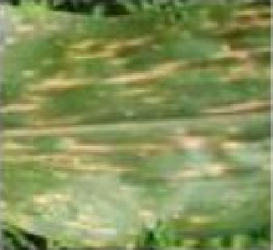
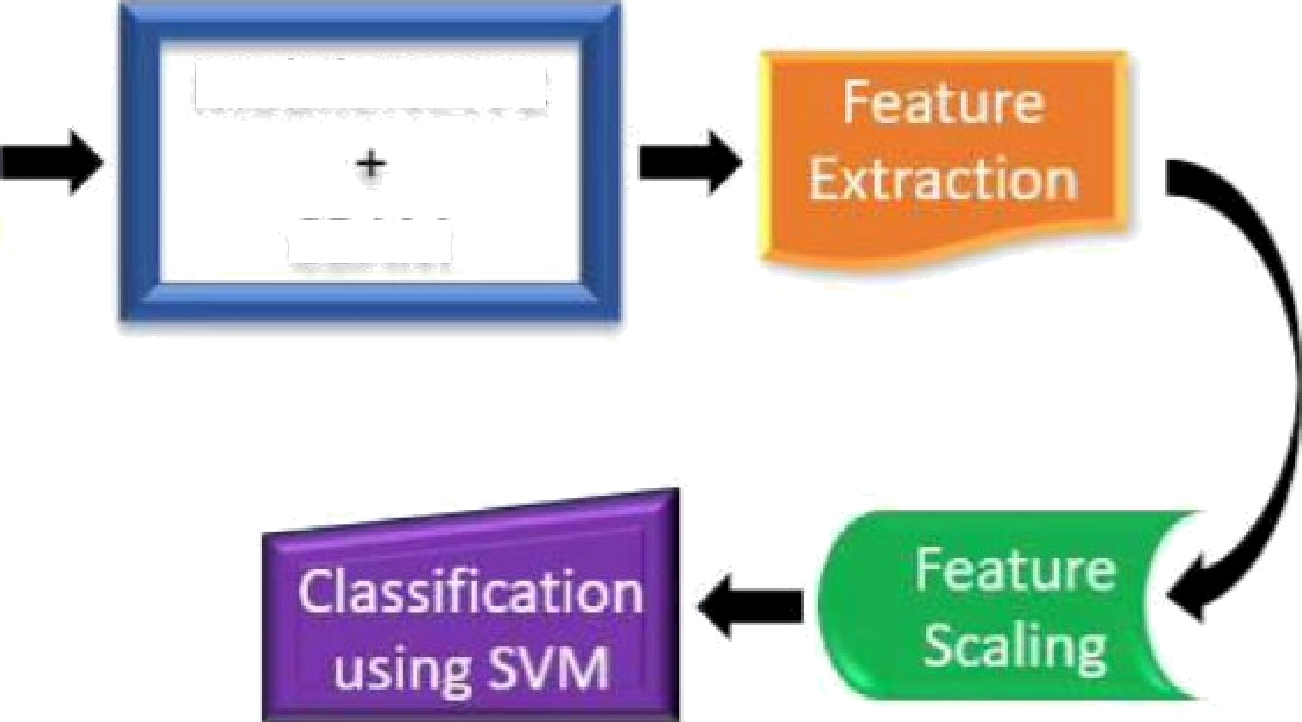

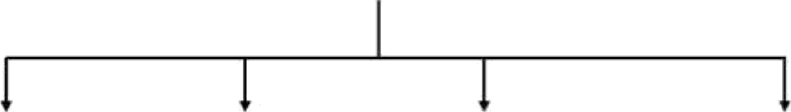




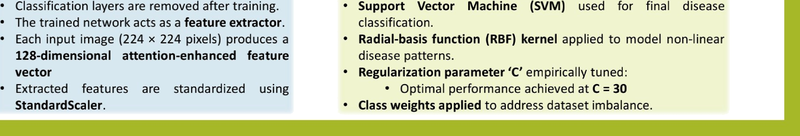
Proposed Methodology
Data
Pre-Processing
MobileNetV2
Phase 1: Feature Extraction MobileNetV2—CBAM
MobileNetV2 backbone augmented with CBAM
for attention-aware learning.
CBAM incorporates:
CBAM
Input
Channel attention — identifies important feature dimensions
Spatial aRention — focuses on disease-
relevant regions in images
The network learns enhanced disease representations from maize leaf images.
Trained end-to-end using -> label smoothing,
weight decay regularization, learning rate
' " scheduling, early stopping to prevent overfitting.
Fig. 2 Illustration of the proposed framework.
Phase 2: Dee Feature Generation Phase 3: Classification Using SVM
Classification layers are removed aker training.
The trained network acts as a feature extractor.
Each input image (224 x 224 pixels) produces a
Support Vector Machine (SVM) used for final disease
classification.
Radial-basis function (RBF) kernel applied to model non-linear
disease patterns.
Regularization parameter ’C’ empirically tuned:
zzg-dimensional attention-enhanced feature
vector
Extracted features are standardized using Standard5caler.
Optimal performance achieved at C = 30
Class weights Bppliizd to address dataset imbalance.

Slide 7
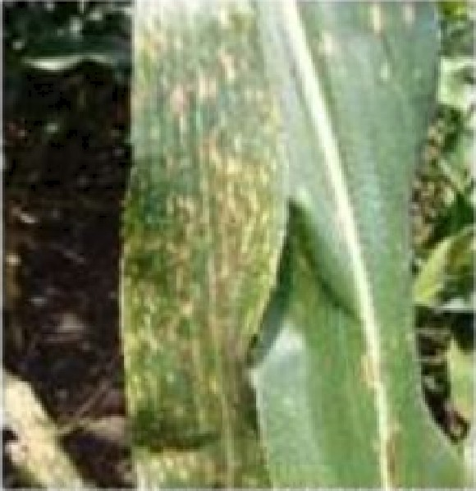
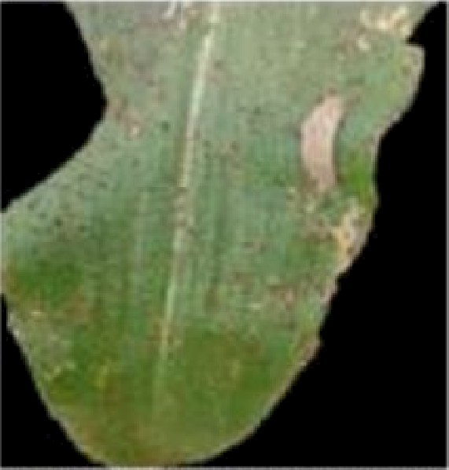
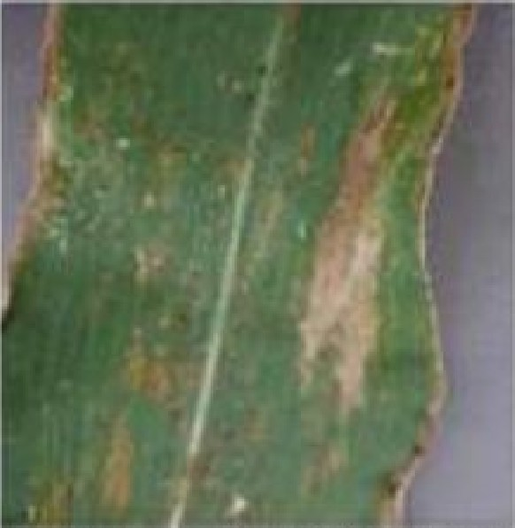
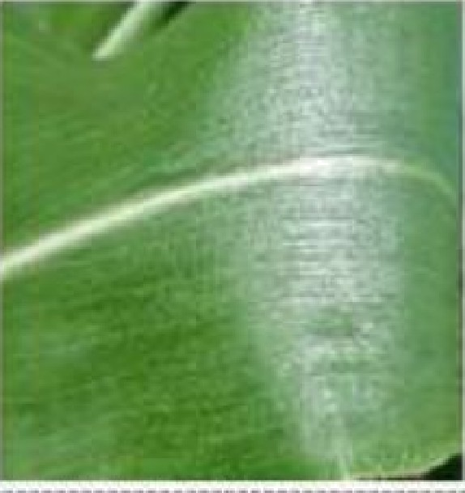
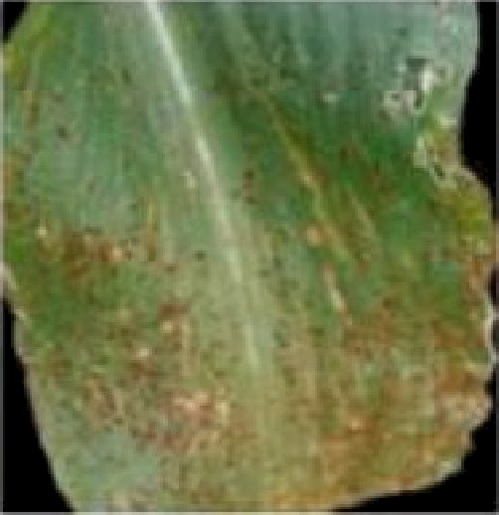
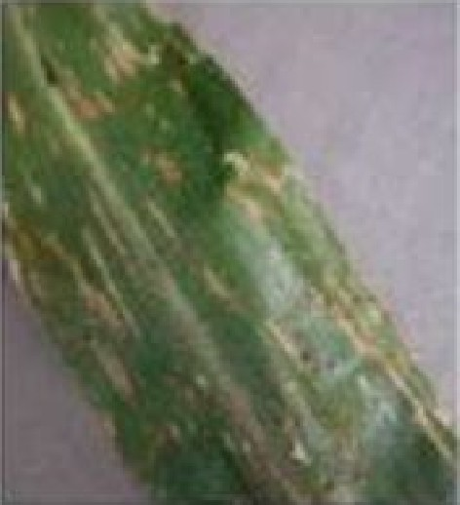
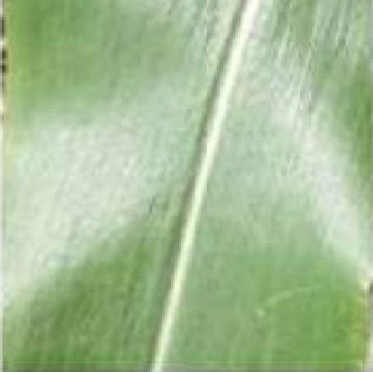
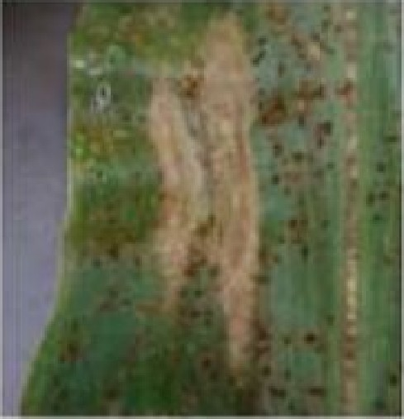
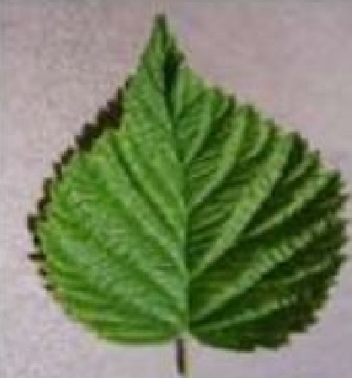
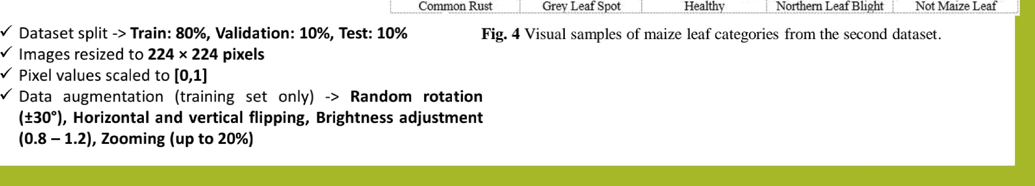
Result Analysis and Discussion
Data Ac uisition and Pre- rocessin
1. Kaggle Leaf Disease Dataset 1 |9]
Total images: 41B8, categorized into 4 classes:
Blight (Class 0): 1146 images
Common Rust (Class 1): 1306 images
Gray Leaf Spot (Class 2): 574 images
Healthy (Class 3): 1162 images
Blight Common Ruz Grey' Leaf Spot Healths
Fig. 3 Visual samples of maize leaf categories from the first dataset.
II. Kaggle Leaf Disease Dataset 2 |10] Total images: B852, categorized into 5 classes:
Common Rust (Class 0): 1907 images
Gray Leaf Spot (Class 1): 1642 images
Healthy (Class 2): 1,859 images
Northern Leaf Blight (Class 3): 1908 images
Non-Maize Leaf (Class 4): 1536 images
Common Rust Grey Leaf Spot Healthy Northern Leaf Blight Not Maize Leaf
Fig. 4 Visual samples of maize leaf categories from the .second dataset.
*” Dataset split -> Train: B0%, Validation: 10%, Test: 10%
*" Images resized to 224 x 224 pixels
'*’ Pixel values scaled to [0,1]
'*’ Data augmentation (training set only) -> Random rotation (13o°), Horizontal and vertical flipping, Brightness adjustment (o.g — z.z), zooming (up to 20%)

Slide 8
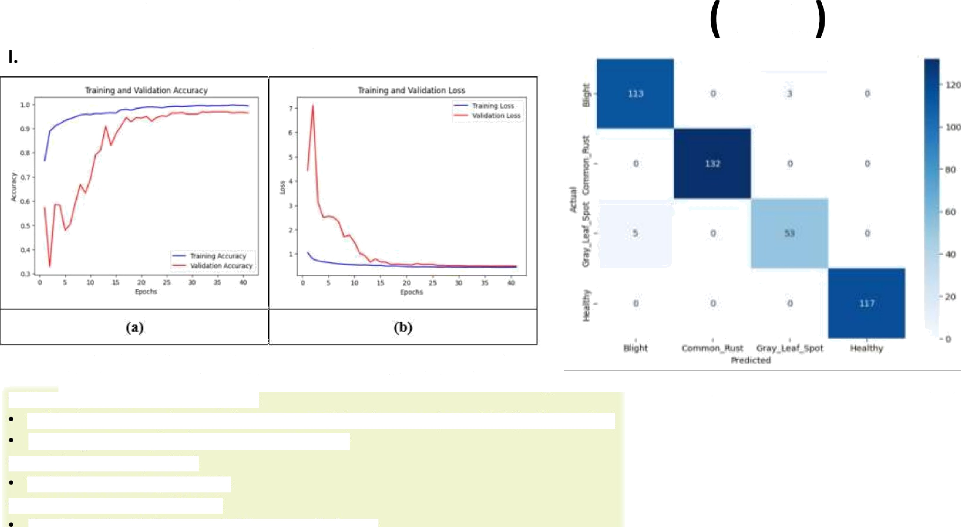
Result Analysis and Discussion cont.
Kaggle Leaf Disease Dataset 1 [9]
Gg. 5 The MobileNetV2-CBAM model's performance during raining and validaãon on the first dataset: (a) Accuracy Cwvæ Q) LosS CurvCS.
Training completed in 41 epochs
Eg. 6 Confusion matrix musœaóng per-class perfonmnce of the proposed
approach on the fi‹st dataset.
Validation accuracy improved-> From -5?B (val loss = 4.4) To >9646 (val loss - 0.5)
Learning rate adaptively reduced to "2 x 10 ^
Training accuracy: >999ś Validation accuracy: 96—97Ø
SVM Test Accuracy: 98.1146
Precision, Recall, F1-score: 0.98 across all classes

Slide 9
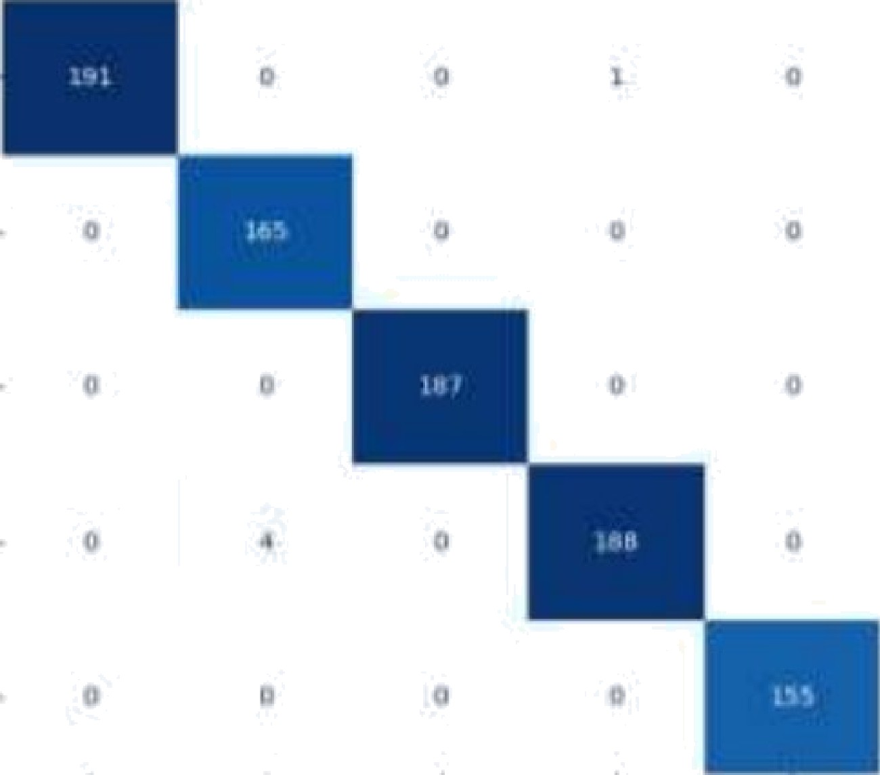

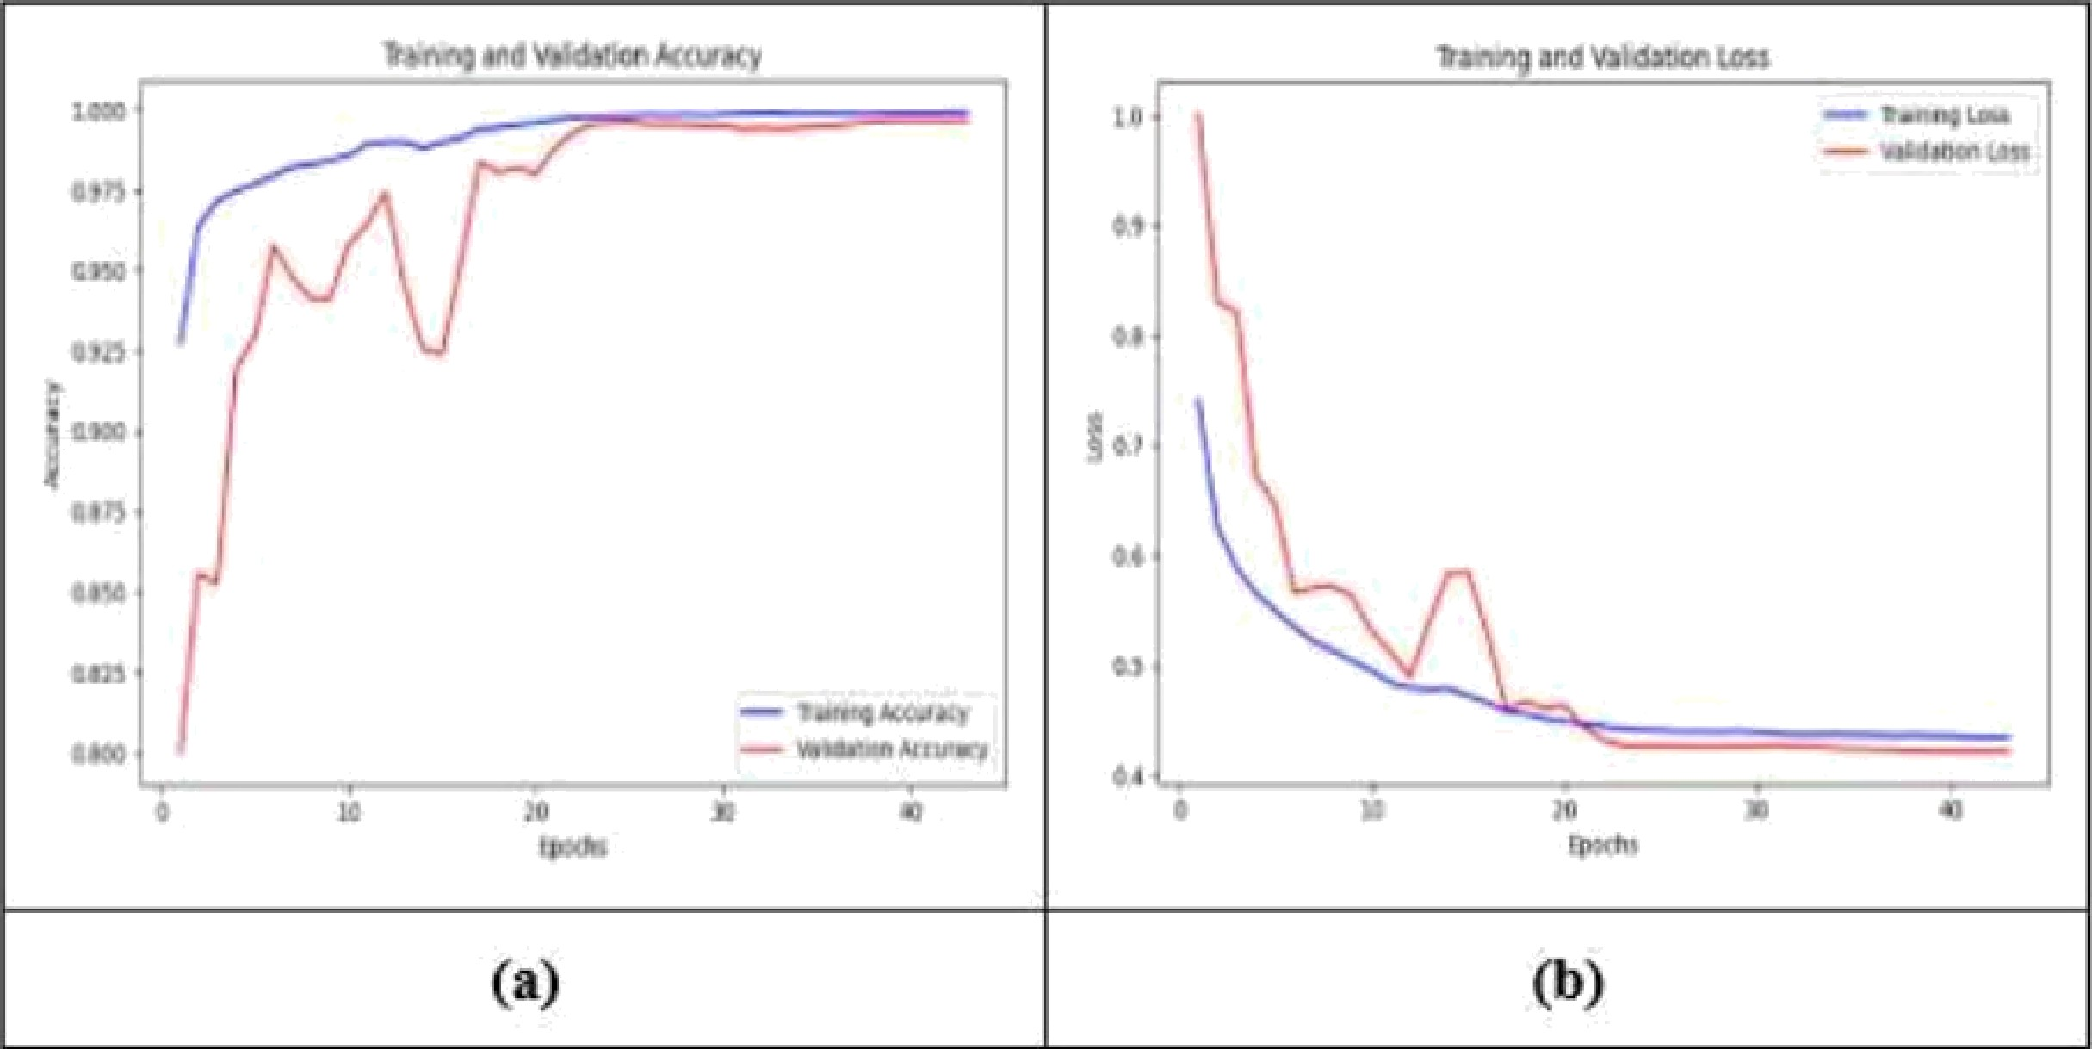

Result Analysis and Discussion cont.
Kaggle Leaf Disease Dataset 2 [10]
II.
f„ T•. ,
. fililiiyi
•
^
‹
-
„
-
. . , ..
. ,
Fig. 7 The MobileNetV2-CBAM model s performance during training and
validation on the second dataset: (a) Accuracy Curves (b) Loss Curves
Training completed in 45 epochs
Training accuracy -> Increased from -zgx to »99e›
Validation accuracy -> Improved from 77°% to *99.7%
Validation loss -> Decreased steadily to *0.42
Learning rate adaptively reduced to 2 x 10-’
SVM classifier trained on deep features -> Achieved 99.44% test accuracy
Precision, Recall, F1-score: > 0.99
-
Fig. 8 CDnfusionmatriX showing the performance of the proposed framework
on the second dataset.

Slide 10
Result Analysis and Discussion cont.
Fusion model (CNN +
VGGz6 + Decision Tree)
VGG:z6 + Explainable AI Deep SqueezeNet Multi-Scale Feature Fusion Network
MobileNetVz-CBAM +
SVM
Pillai et al. [7] - 202a
Tariq et al. [8] - •*^4
Theelhagiri et al. _{[9] -} ^ +k
₉6
₉₄.6/
97
97-h-S
Liu et al. [zo] - ›
*4
Proposed Framework -
zoz6
9#.**
Table 1. Performance comparison of recent methods versus the proposed framework on
the rirst daiaset.
Li et al. [zz] - zozz
WG-MARNet
LFMNet
PRF-SVM Integration CNN, Transfer Learning
MobileNetVz-CBAM
+ SVM
gy.g6
9k-++
g6.6₇
97
Hu et al. [zz] - •
^4
Bachhal et al. [13] - 2024
Joyce et al. _{[+k] - ••›s}
Proposed Framework -
aoa6
99•44
Table 2. Performance comparison of recent approaches and the proposed framework on
the second dataset.
: Scanned with OKEN Scanner

Slide 11

Result Analysis and Discussion cont.
Ablation Analysis of the Proposed Framework
Compared models -> Baseline MobileNetV2, MobileNetV2 + CBAM (attention-enhanced), Proposed Hybrid
Model: MobileNetV2-CBAM + SVM
Xey Insights from Ablation Study:
•*' Attention-weighted deep feature extraction significantly improves performance.
•^ Hybrid learning enhances decision boundary definition.
•^ Combining DL-based attention mechanisms with classical ML (SVM) yields:
  Better generalization
  Higher classification accuracy
95• ^{Z}7
97•¹⁶
g8.xa
97•9⁶
98.9g
99•44
Table 3. Ablation study evaluating the effect of attention mechanism and hybrid DL-ML approach on the model performance.

Slide 12
Conclusion and Future Directions
Proposed an eflicient hybrid framework for maize leaf disease identification.
Framework combines -> MobileNetV2-CBAM for attention-enhanced feature extraction, SVM classifier for robust
disease classification.
Achieved state-of-the-art performance:
•’ 98.11% accuracy on Kaggle Leaf Disease Dataset 1
•’ 99.44% accuracy on Kaggle Leaf Disease Dataset 2
Ablation analysis confirms -> E0ectiveness of attention mechanisms (CBAM), Benefit of hybrid DL-MLIearning.
The lightweight design makes the model suitable for resource-constrained environments.
Future works can extend the framework to -> other crops and plant diseases, diverse agricultural image scenarios.
Incorporate additional imaging modalities -> hyperspectral imaging, thermal (thermography) imaging.
Optimize for edge and mobile deployment -> model quantization, network pruning, lightweight inference
pipelines.

Slide 13
References
Li, Z., Zhou, G., Hu, Y., Chen, A., Lu, C., He, M., ... & Wang, Y. (2022). Maize leaf disease identification based on WG-
MARNet. Plos one, J7(4), e0267650.
Pillai, R., Sharma, N., & Gupta, R. (2023, November). Disease Detection & Classification of Maize Leaves Using Fusion
Model. In 2023 Annual International Conference on Emerging Research Areas.• International Conference on Intelligent S y.stems
{AICERA7ICIS) (pp. 1-5). IEEE.
[S] Tariq, M., Ali, U., Abbas, S., Hassan, S., Naqvi, R. A., Khan, M. A., & Jeong, D. (2024). Corn leaf disease: insightful
diagnosis using VGG16 empowered by explainable AI. Frontiers in plant .srienre, /5, l4028S5.
Theerthagiri, P., Ruby, A. U., Chandran, J. G. C., Sardar, T. H., & Shafeeq BM, A. (2024). Deep SqueezeNet learning model
for diagnosis and prediction of maize leaf diseases. Journal of Big Data, 1111), 112.
Liu, L., Qiao, S., Chang, J., Ding, W., Xu, C., Gu, J., ... & Qiao, H. (2024). A multi-scale feature fusion neural network for
multi-class disease classification on the maize leaf images. Heli yon, /0(7).
Hu, J., Jiang, X., Gao, J., & Yu, X. (2024). LFMNet: a lightweight model for identifying leaf diseases of maize with high similarity. Frontiers in Plant Science, 15, 1368697.
Bachhal, P., Kukreja, V., Ahuja, S., Lilhore, U. K., Simaiya, S., Bijalwan, A., ... & Algarni, S. (2024). Maize leaf disease
recognition using PRF-SVM integration: a breakthrough technique. Scientific Reports, 14;1), 10219.
Nakatumba-Nabende, J., & Murindanyi, S. (2025). Deep learning models for enhanced in-field maize leaf disease diagnosis.
Machine Learning wifh Applications, 100675.
Kaggle Leaf Disease Dataset 1,
Kaggle Leaf Disease Dataset 2,
l›%i .: v› › ›• \ . ' : .ii;‹_._, .‹ i_,t;.i._.ir.@:i ¿;_i.!1_ c«r i, last accessed 2025/07/19.

