Slide 1

Fintech hiring trends
AMI VORA
JUHI PAREEK
ADITYA SONI
HEMIN JOSHI

Slide 2
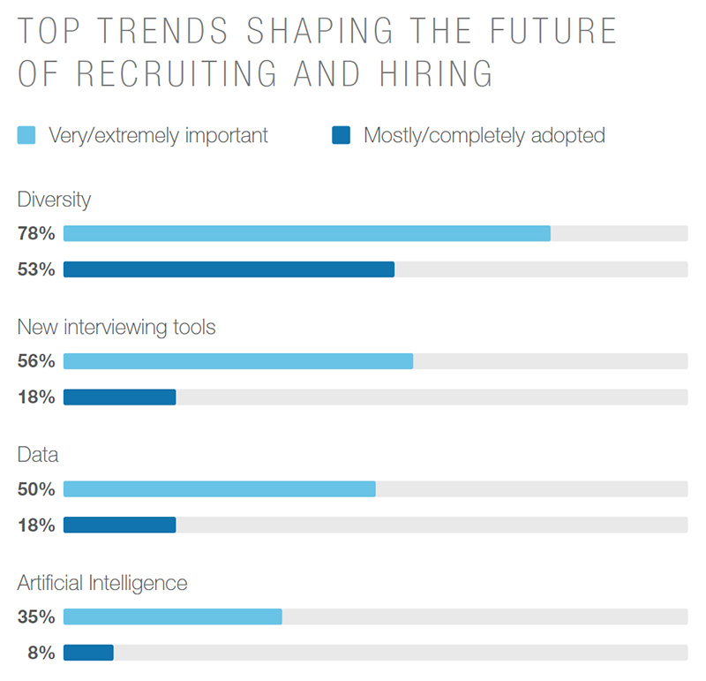
HIRING TRENDS

Slide 3
Essential facts for hiring in FINTECH SECTOR
Compensation is still a key driver for candidates
1
A strong employer brand is a competitive differentiator
2
Diversity remains a top priority
3

Slide 4


Slide 5
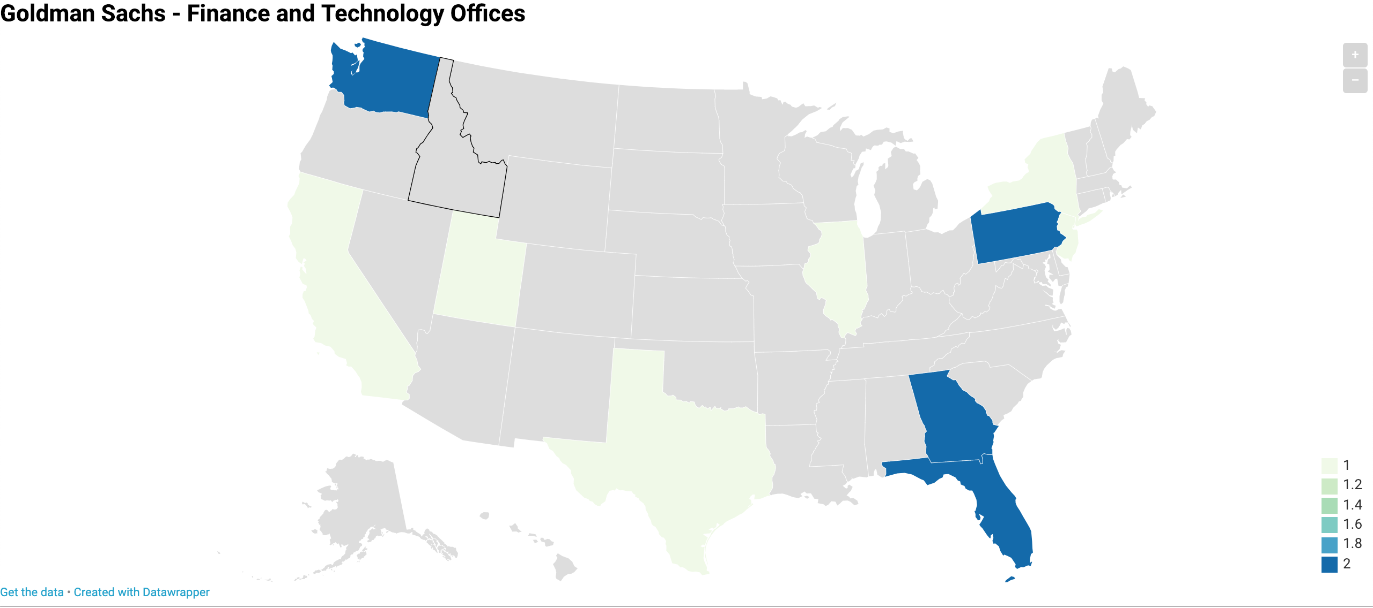
Trends in hiring across 2018-2019

Slide 6


Slide 7
Hiring trends-2019
COMPANIES WILL UTILIZE TECHNOLOGY TO STREAMLINE THE INTERVIEW PROCESS
01
SOCIAL RECRUITING WILL BECOME MORE PREVALENT
02
COMPETITION WILL BE FIERCE but strong job growth
03
CANDIDATES WILL BE HIRED ON POTENTIAL CAREER TRAJECTORY–NOT THEIR DEGREE
04

