Slide 1
I-Blocks
Decentralized Certificate Verification System
Group : TY-60
Guide : Dr. S. T. Patil

Slide 2

Problem Statement
An estimated 9 million students graduate annually.
A student generates a lot of certificates that includes results, diplomas, or transcripts.
Tracking validity and their authenticity manually becomes a tedious job.
The absence of an appropriate anti-forge system leads to a scenario of forged certificates.
To make the data more secure and safe, everything needs to be digitized with the principle of Confidentiality, Reliability, and Availability.

Slide 3
Objective
To make use of the Blockchain + IPFS technology to store, validate and verify any confidential documents

Slide 4
Purpose
Blockchain has numerous features such as Decentralized, Transparency, Confidentiality, Auditing etc.
However it posses some disadvantage in term of gaslimit and expense and time consuming. To solve the problem of data storage we tried replacing storage unit to cloud.
Still we were left with issues like Less Secure and centralized,Encryption Keys stored with Cloud Provider.
Shifted to a more efficient solution of combining Blockchain and IPFS

Slide 5
Literature Review
BB-PKI: Blockchain-Based Public Key Infrastructure Certificate Management | Abba Garba, Qinwen Hu, Zhong Chen, and Muhammad Rizwan Asghar 2020 | They used blockchain to address a different security problem, i.e., Misbehaviour of Certification authorities . Certificate Issuance Request (CIR) should be vouched by many registration authorities. Multiple CAs shall sign and issue the certificate . Any RA that contributes to the verification process of a user’s request can publish the certificate in the blockchain by creating a smart contract certificate transaction.
Certificate validation using blockchain | A.Gayathiri, J.Jayachitra, Dr.S.Matilda 2020 | The paper presents the unmodifiable use case of Blockchain for verification and validation of academic certificates. The certificates are transformed via sampling and quantization into digital certificates. Then the certificates are added with the hash values generated for the digital certificate and are stored into the blockchain. Chaotic algorithm used for generating the hash value of digital certificate.

Slide 6
Content Sharing Network based on IPFS and Blockchain | Haimei Xu , Yan Cheng, Zhengdong Li and Chunyan You | This paper by Haimei Xu proposes Innerlight a IPFS and Blockchain based application called Innerlight to store mental Health information. It puts copies of articles from creators on IPFS to achieve distributed storage of content. In addition to IPFS and Blockchain, ranking algorithms contribute to make Innerlight to be a decentralized autonomous ecosystem. The sorting algorithm is based on upvotes of articles. We in our project have used the IPFS network to record college certificates.
A Comprehensive Blockchain-based solution For Academic Certificates Management Using Smart Contracts | Masoomeh Bahrami, Alireza Movahedian, Arash Deldari. | The proposed system in the paper is efficient and good enough to make it almost impossible to alter the certificates but one of the major drawback of the system is that it is not personalised for any particular organization. So the certificates generated has the same design, arrangement and they rely on same smart contract. There should be a specific smart contract designed for a particular University to maintain its uniqueness.

Slide 7
Limitation in Existing System
Blockchain and Data Storage
1 MB of data $0.73*1024 = $747.52.
Gas Limit for each block 15 million gas
655 million gas per megabyte.
43 blocks to record the whole file
10 minutes to save just 1 MB.
Expensive and time consuming.

Slide 8
Blockchain and Cloud
Simple to store in cloud
But has major drawbacks in terms of decentralization
Data vulnerable to tampering
Encryption Keys stored with Cloud Provider
Less Secure and centralized
.

Slide 9
Blockchain and IPFS
The data is distributed in the IPFS network throughout the world
Decentralizes Storage
No Single Point of failure
1% of the cost of AWS
Less Expensive , Tamper-Proof and Decentralized
IPFS
Decentralise Storage
Using Content addressing to locate data
Chain Storing Metadata
Accessing content through CID

Slide 10
IPFS
Broken down into chunks and stored at different nodes
Uses a Distributed Hash table to map the file
BitTorrent for data exchange protocol
Makes use of Merkle Tree(Hashing) to ensure Tamper-Proof
IPFS
Decentralise Storage
Using Content addressing to locate data
Chain Storing Metadata
Accessing content through CID

Slide 11

Research Findings
This means 2 things.
An identifier can be used to access untampered data online.
You can verify and validate the data by comparing its hash to the one which is stored in blockchain.

Slide 12
Blockchain+IPFS
IPFS
FILE
CID (QR)
HASH + CID
BLOCKCHAIN
OWNER

Slide 13
Blockchain+IPFS
IPFS
CID(QR)
FILE
BLOCKCHAIN
USER

Slide 14
Blockchain+IPFS
IPFS
HASH
BLOCKCHAIN
PRESENT IN CHAIN?
USER

Slide 15
IPFS = HardDrive of Blockchain
A
Public Document Storage and Validation
B
Decentralizing Social Networks
C
Hosting Websites
D
Intellectual Property

Slide 16

Drawbacks
Lack of Strong Economic Incentives
Unreliable with Private Data
Many drawbacks of decentralization also apply to IPFS + Blockchain based technologies

Slide 17
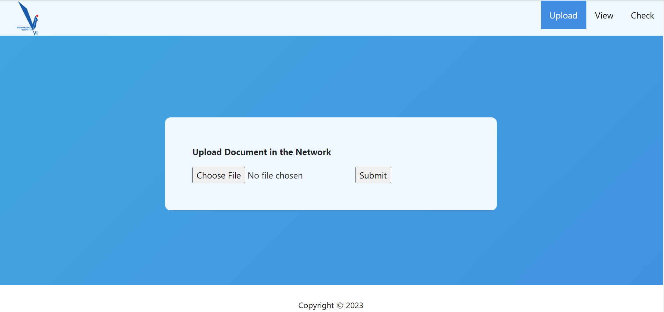

Slide 18
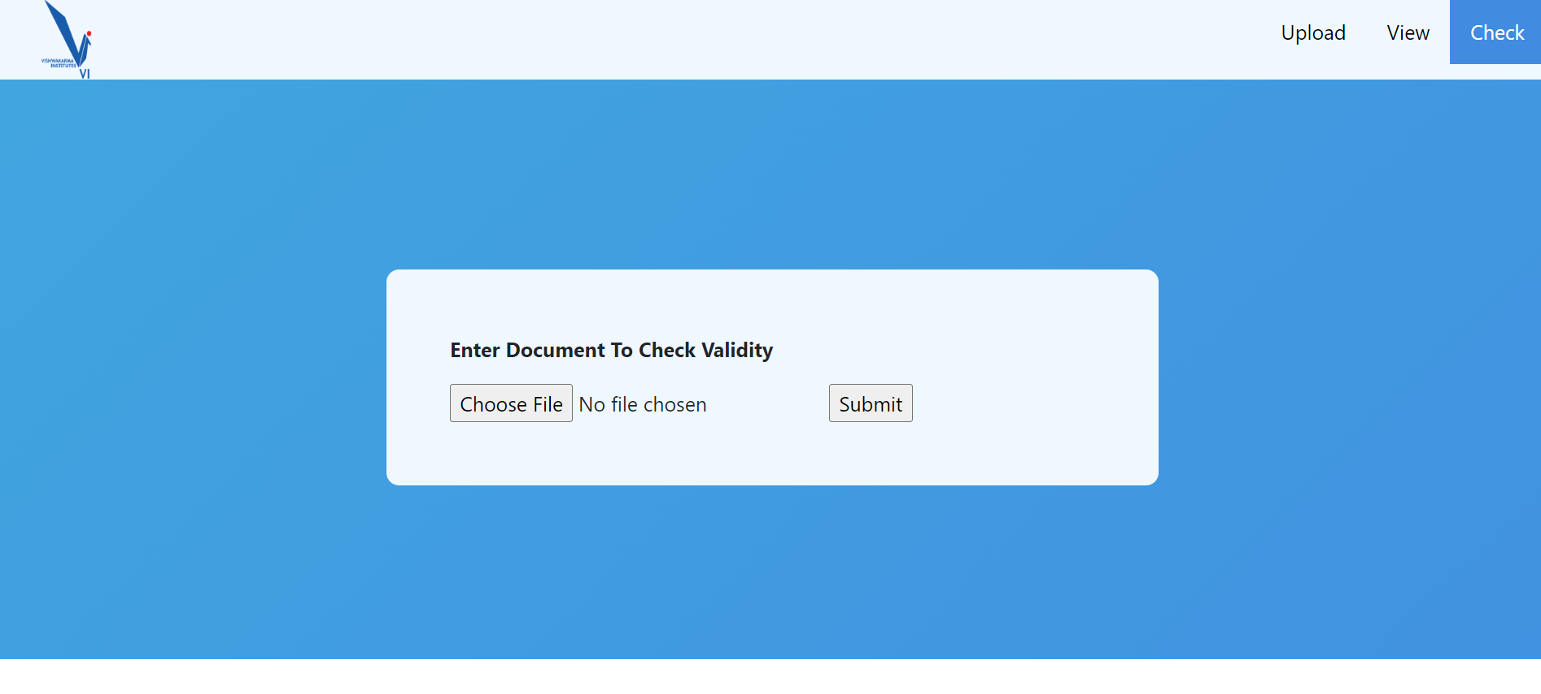

Slide 19
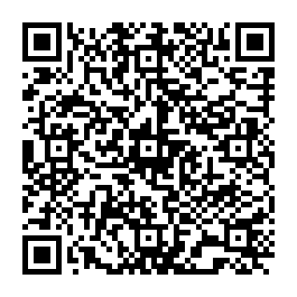


Slide 20
THANK YOU

