Slide 1



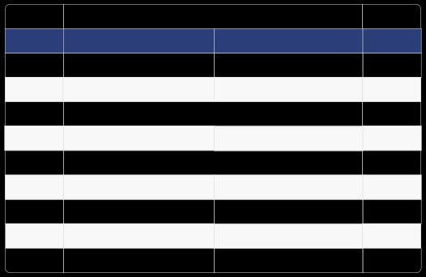
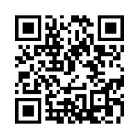

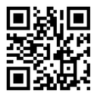


Kingdom of Saudi Arabia
ﺗﻘﺮﻳﺮ إﺟﺎزة ﻣﺮﺿﻴﺔ Sick Leave Report
Leave ID
{{SERVICE_CODE}}
رﻣﺰ اﻹﺟﺎزة
Leave Duration
{{DAYS_COUNT}}
to
الى
)
(
ﻳﻮم
ﻣﺪة اﻹﺟﺎزة
day ( )
{{ENTRY_DATE_HIJRI}}
{{DAYS_COUNT}}
{{ENTRY_DATE_GREGORIAN}}
{{EXIT_DATE_GREGORIAN}}
{{EXIT_DATE_HIJRI}}
Admission Date
{{ENTRY_DATE_GREGORIAN}}
{{ENTRY_DATE_HIJRI}}
ﺗﺎرﻳﺦ اﻟﺪﺧﻮل
Discharge Date
{{EXIT_DATE_GREGORIAN}}
{{EXIT_DATE_HIJRI}}
ﺗﺎرﻳﺦ اﻟﺨﺮوج
Issue Date
{{REPORT_ISSUE_DATE}}
ﺗﺎرﻳﺦ اﺻﺪار اﻟﺘﻘﺮﻳﺮ
Name
{{NAME_EN}}
{{NAME_AR}}
اﻻﺳﻢ
National ID/Iqama
{{ID_NUMBER}}
رﻗﻢ اﻟﻬﻮﻳﺔ/اﻹﻗﺎﻣﺔ
Nationality
{{NATIONALITY_EN}}
{{NATIONALITY_AR}}
اﻟﺠﻨﺴﻴﺔ
Employer
ﺟﻬﺔ اﻟﻌﻤﻞ
Physician Name
{{DOCTOR_NAME_EN}}
{{DOCTOR_NAME_AR}}
اﺳﻢ اﻟﻄﺒﻴﺐ اﻟﻤﻌﺎﻟﺞ
Position
{{JOB_TITLE_EN}}
{{JOB_TITLE_AR}}
اﻟﻤﺴﻤﻰ اﻟﻮﻇﻴﻔﻲ
ﻟﻠﺘﺤﻘﻖ ﻣﻦ ﺑﻴﺎﻧﺎت اﻟﺘﻘﺮﻳﺮ ﻳﺮﺟﻰ اﻟﺘﺄﻛﺪ ﻣﻦ زﻳﺎرة ﻣﻮﻗﻊ ﻣﻨﺼﺔ ﺻﺤﺔ اﻟﺮﺳﻤﻲ
{{HOSPITAL_NAME_AR}}
Tocheckthereportplease visit Seha's offical website
{{HOSPITAL_NAME_EN}}
https://satha.kesug.com
رﻗﻢ اﻟﱰﺧﻴﺺ : 1410101201200270
{{PRINT_TIME}}
{{PRINT_DATE}}

