Slide 1



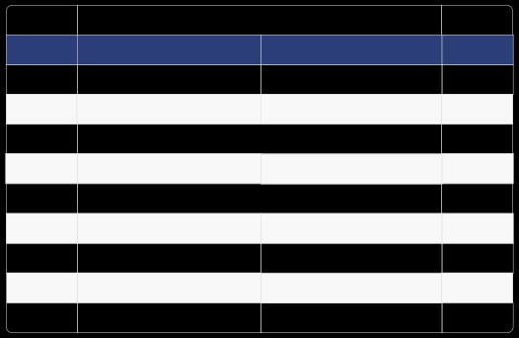
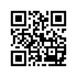
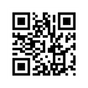
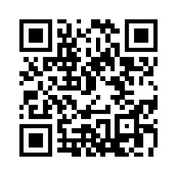


Kingdom of Saudi Arabia
ﺗﻘﺮﻳﺮ إﺟﺎزة ﻣﺮﺿﻴﺔ Sick Leave Report
Leave ID
{SERVICE_CODE}
رﻣﺰ اﻹﺟﺎزة
Leave Duration
{leave_duration_dates}
2 يوم ( 1446-10-22 الى 1446-10-21 )
ﻣﺪة اﻹﺟﺎزة
Admission Date
{ENTRY_DATE_G}
{ENTRY_DATE_H}
ﺗﺎرﻳﺦ اﻟﺪﺧﻮل
Discharge Date
{EXIT_DATE_G}
{EXIT_DATE_H}
ﺗﺎرﻳﺦ اﻟﺨﺮوج
Issue Date
{DAYS_COUNT}
ﺗﺎرﻳﺦ اﺻﺪار اﻟﺘﻘﺮﻳﺮ
Name
{NAME_ENGLISH}
{NAME_ARABIC}
اﻻﺳﻢ
National ID/Iqama
{ID_NUMBER}
رﻗﻢ اﻟﻬﻮﻳﺔ/اﻹﻗﺎﻣﺔ
Nationality
Saudi Arabia
اﻟﺴﻌﻮدﻳﺔ
اﻟﺠﻨﺴﻴﺔ
Employer
ﺟﻬﺔ اﻟﻌﻤﻞ
Physician Name
{DOCTOR_NAME_EN}
{DOCTOR_NAME_AR}
اﺳﻢ اﻟﻄﺒﻴﺐ اﻟﻤﻌﺎﻟﺞ
Position
{DOCTOR_TITLE_EN}
{DOCTOR_TITLE_AR}
اﻟﻤﺴﻤﻰ اﻟﻮﻇﻴﻔﻲ
ﻟﻠﺘﺤﻘﻖ ﻣﻦ ﺑﻴﺎﻧﺎت اﻟﺘﻘﺮﻳﺮ ﻳﺮﺟﻰ اﻟﺘﺄﻛﺪ ﻣﻦ زﻳﺎرة ﻣﻮﻗﻊ ﻣﻨﺼﺔ ﺻﺤﺔ اﻟﺮﺳﻤﻲ To check the report please visit Seha's offical website
{HOSPITAL_NAME_AR}
{HOSPITAL_NAME_EN}
https://www.satha.kesug.com
رﻗﻢ اﻟﱰﺧﻴﺺ : 3810501001210006
10:18 AM
Sunday, 20 April 2025

