Slide 1



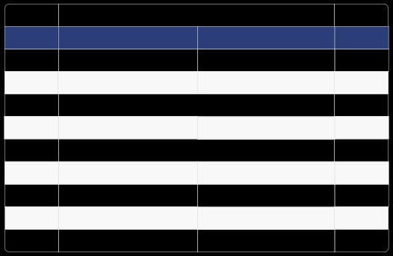
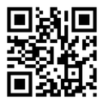


Kingdom of Saudi Arabia
ﺗﻘﺮﻳﺮ إﺟﺎزة ﻣﺮﺿﻴﺔ
Sick Leave Report
Leave ID
PSL98635852494
رﻣﺰ اﻹﺟﺎزة
Leave Duration
1 day ( 26-10-2025 to 26-10-2025 )
1 يوم ( 1447-05-04 الى 1447-05-04 )
ﻣﺪة اﻹﺟﺎزة
Admission Date
26-10-2025
04-05-1447
ﺗﺎرﻳﺦ اﻟﺪﺧﻮل
Discharge Date
26-10-2025
04-05-1447
ﺗﺎرﻳﺦ اﻟﺨﺮوج
Issue Date
26-10-2025
ﺗﺎرﻳﺦ اﺻﺪار اﻟﺘﻘﺮﻳﺮ
Name
{{NAME_EN}}
{{NAME_AR}}
اﻻﺳﻢ
National ID/Iqama
1124875699
رﻗﻢ اﻟﻬﻮﻳﺔ/اﻹﻗﺎﻣﺔ
Nationality
Saudi Arabia
{{NATIONALITY_AR}}
اﻟﺠﻨﺴﻴﺔ
Employer
طالب
ﺟﻬﺔ اﻟﻌﻤﻞ
Physician Name
MUHAMMAD FAROUK
{{DOCTOR_NAME_AR}}
اﺳﻢ اﻟﻄﺒﻴﺐ اﻟﻤﻌﺎﻟﺞ
Position
General
طبيب عام
اﻟﻤﺴﻤﻰ اﻟﻮﻇﻴﻔﻲ
ﻟﻠﺘﺤﻘﻖ ﻣﻦ ﺑﻴﺎﻧﺎت اﻟﺘﻘﺮﻳﺮ ﻳﺮﺟﻰ اﻟﺘﺄﻛﺪ ﻣﻦ زﻳﺎرة ﻣﻮﻗﻊ ﻣﻨﺼﺔ ﺻﺤﺔ اﻟﺮﺳﻤﻲ To check the report please visit Seha's offical website
مستشفى الملك فهد للقوات المسلحة
King Fahd Armed Forces Hospital
https://satha.kesug.com
3810501001210006
رﻗﻢ اﻟﱰﺧﻴﺺ :
11:50 AM
Sunday, 26 October 2025

