Slide 1

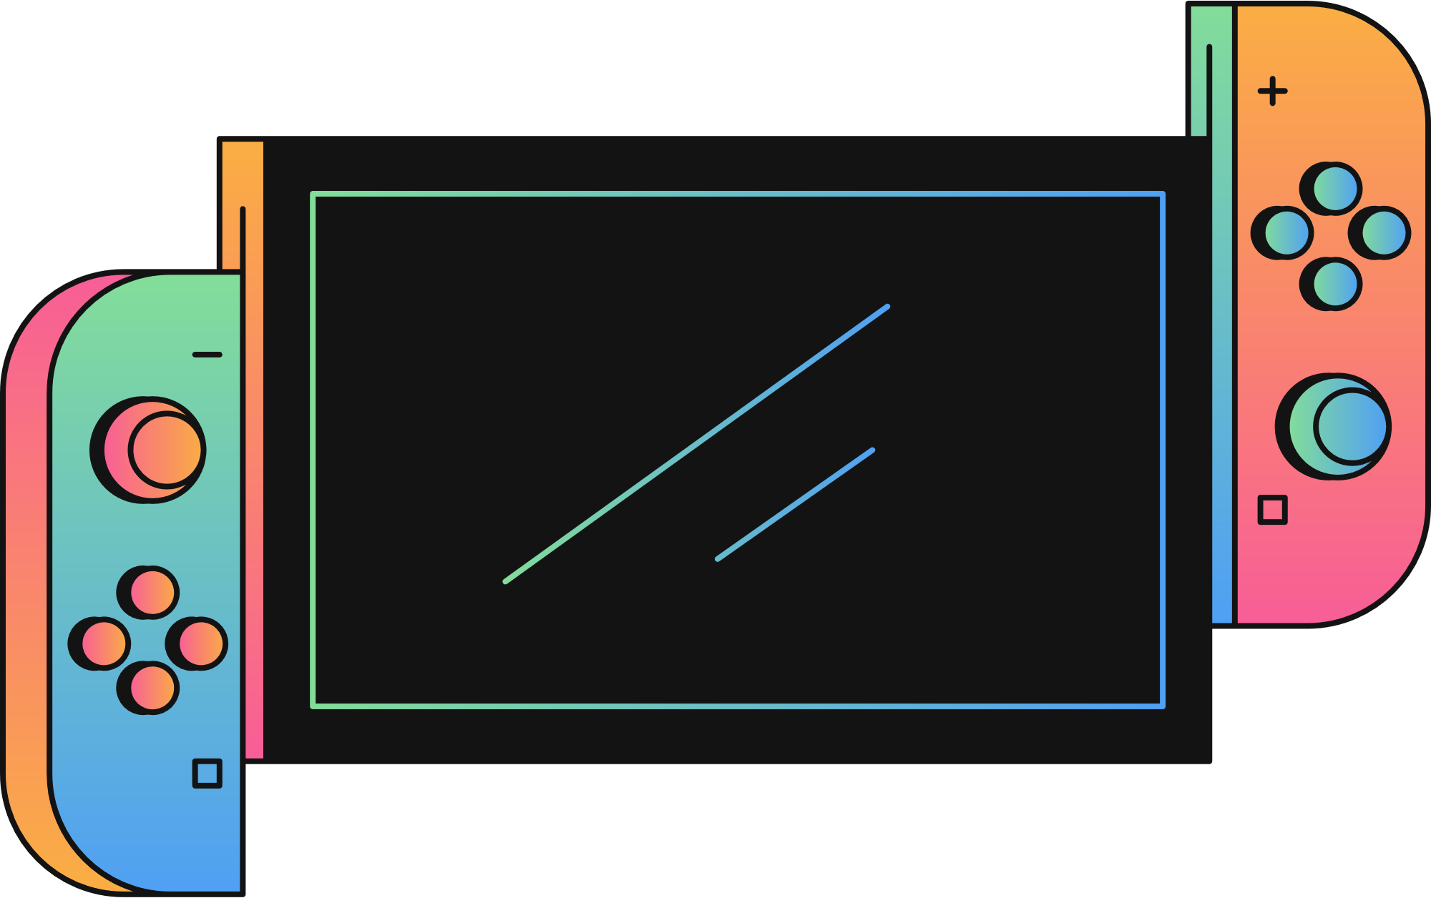
TIC-TAC-TOE GAME
START

Slide 2
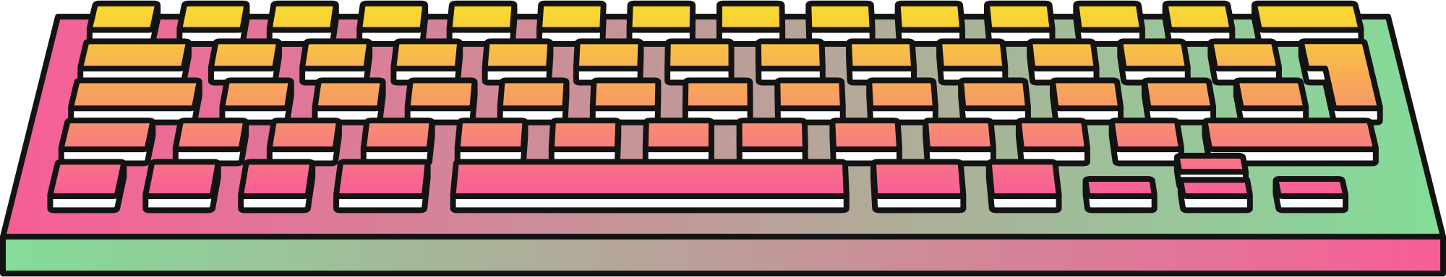
INSTRUCTION
CATEGORIES
PROJECT DESCRIPTION
IMPLEMENTATION METHODOLOGY
USE CASE DIAGRAM

Slide 3

PROJECT DESCRIPTION
Tic-Tac-Toe game written in python programming language.
Tic-Tac-Toe is traditionally played on 3x3 grid.
The Tic-Tac-Toe game we implemented offers users two distinct modes:Playervs. Bot and player vs. player.
The Bot in this Tic-Tac-Toe implementation uses a minimax algorithm for its moves, the minimax algorithm is a decision-making algorithm commonlyusedin two-player games.

Slide 4
INSTRUCTION
CATEGORIES
PROJECT DESCRIPTION
IMPLEMENTATION METHODOLOGY
USE CASE DIAGRAM

Slide 5

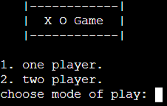

THE PLAYER HAS TO CHOOSE PLAYING WITH ANOTHER PLAYER OR WITH A BOT.
print (' |------------| ')
print (' | X O Game | ')
print (' |------------|\n')
print ('1. one player.')
print ('2. two player.')
try:
mode = int(input('choose mode of play: '))

Slide 6

A HASH SHAPE SQUARE BOARD GRID.
board = { 1 : ' ' , 2 : ' ' , 3 : ' ',
4 : ' ' , 5 : ' ' , 6 : ' ',
7 : ' ' , 8 : ' ' , 9 : ‘ ‘}
def printBoard(board):
print(' ' + board[1] + ' | ' + board[2] + ' | ' + board[3] + ' ')
print('---+---+---')
print(' ' + board[4] + ' | ' + board[5] + ' | ' + board[6] + ' ')
print('---+---+---')
print(' ' + board[7] + ' | ' + board[8] + ' | ' + board[9] + ' ')
print("\n")

Slide 7
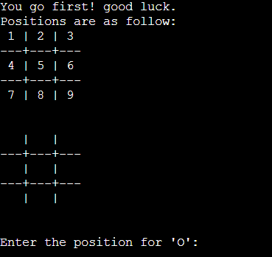
THE PLAYER WILL HAVE TO INPUT A NUMERICAL CHARACTER, FROM 1 TO 9, TO SELECT A POSITION FOR ('O' OR 'X') INTO THE SPACE.
def printStart():
print("Positions are as follow:")
print(' 1 | 2 | 3 ‘)
print('---+---+---’)
print(' 4 | 5 | 6 ‘)
print('---+---+---’)
print(' 7 | 8 | 9 ‘)
print("\n")

Slide 8
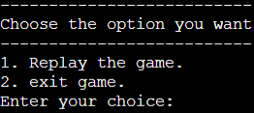
USED A LOOP TO REPLAY THE GAME IF THE PLAYERS WANTED TO.
while er2:
try:
print ("\n--------------------------")
print ("Choose the option you want")
print ("--------------------------")
print ("1. Replay the game.\n2. exit game.")
x =int(input ("Enter your choice: "))
elif x == 1 :
er2 = False
if x == 2 :
EndGame = True
er2 = False
else:
os.system('clear')
except ValueError:
os.system('clear')
os.system('clear')

Slide 9
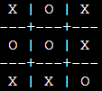
If the blank spaces in the grid are all filled, and there is no winner, then the game is said to be a draw.
def checkDraw():
for key in board.keys():
if (board[key] == ' '):
return False
return True

Slide 10
INSERT
def insertLetter(letter, position):
try:
if (position > 0 and position < 10) and spaceIsFree(position):
board[position] = letter
printBoard(board)
if (checkForWin()):
os.system('cls')
printBoard(board)
if letter == 'X':
if mode == 1:
print("Bot wins!")
else:
print("Player 1 wins!")
return True
else:
if mode == 1:
print("Player wins!")
else:
print("Player 2 wins!")
return True
if (checkDraw()):
os.system('cls')
printBoard(board)
print("Draw!")
return True
else:
print("Can't insert there!")
position = int(input("Please enter new position: "))
insertLetter(letter, position)
except ValueError:
position = int(input("Invalid input. Please enter a valid number:"))
insertLetter(letter, position)
def spaceIsFree(position):
return ( board[position] == ' ‘)
def checkForWin():
if (board[1] == board[2] and board[1] == board[3] and board[1] != ' '):
return True
elif (board[4] == board[5] and board[4] == board[6] and board[4] != ' '):
return True
elif (board[7] == board[8] and board[7] == board[9] and board[7] != ' '):
return True
elif (board[1] == board[4] and board[1] == board[7] and board[1] != ' '):
return True
elif (board[2] == board[5] and board[2] == board[8] and board[2] != ' '):
return True
elif (board[3] == board[6] and board[3] == board[9] and board[3] != ' '):
return True
elif (board[1] == board[5] and board[1] == board[9] and board[1] != ' '):
return True
elif (board[7] == board[5] and board[7] == board[3] and board[7] != ' '):
return True
else:
return False

Slide 11
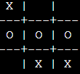

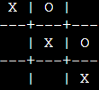
THE GAME ENDS WHEN ONE WHOLE ROW/ COLUMN/ DIAGONAL FILLED WITH HIS/HER RESPECTIVE CHARACTER ('O' OR 'X’).
def checkWhichMarkWon(mark):
winning_combinations = [[1, 2, 3], [4, 5, 6],
[7, 8, 9], [1, 4, 7],
[2, 5, 8], [3, 6, 9],
[1, 5, 9], [7, 5, 3]]
return any(all(board[pos] == mark for pos
in comb) for comb in winning_combinations)

Slide 12
The following Functions show how to move the player and the bot
def playerMove(player):
if player == 'O':
position = int(input("Enter the position for 'O': "))
else:
position = int(input("Enter the position for 'X': "))
flag = insertLetter(player, position)
return flag
def compMove():
bestScore = -800
bestMove = 0
for key in board.keys():
if (board[key] == ' '):
board[key] = bot
score = minimax(board, 0, False)
board[key] = ' '
if (score > bestScore):
bestScore = score
bestMove = key
flag = insertLetter(bot, bestMove)
return flag
def minimax(board, depth, isMaximizing):
if (checkWhichMarkWon(bot)):
return 1
elif (checkWhichMarkWon(player)):
return -1
elif (checkDraw()):
return 0
if (isMaximizing):
bestScore = -800
for key in board.keys():
if (board[key] == ' '):
board[key] = bot
score = minimax(board, depth + 1, False)
board[key] = ' '
if (score > bestScore):
bestScore = score
return bestScore
else:
bestScore = 800
for key in board.keys():
if (board[key] == ' '):
board[key] = player
score = minimax(board, depth + 1, True)
board[key] = ' '
if (score < bestScore):
bestScore = score
return bestScore

Slide 13
Other loops were used to continue the game between the player and the bot/second player
EndGame = False
while not EndGame:
player = 'O'
bot = 'X'
er = True
flag = False
er2 =True
while er:
print (' |------------| ')
print (' | X O Game | ')
print (' |------------|\n')
print ('1. one player.')
print ('2. two player.')
try:
mode = int(input('choose mode of play: '))
os.system('clear')
if mode == 1:
random_number = random.randint(1, 2)
if random_number == 1:
while not flag:
printStart()
flag = compMove()
if flag:
break
flag = playerMove(player)
os.system('clear')
er = False
else:
while not flag:
printStart()
printBoard(board)
flag = playerMove(player)
if flag:
break
os.system('clear')
flag = compMove()
os.system('clear')
er = False
elif mode == 2:
while not flag:
printStart()
printBoard(board)
flag = playerMove('X')
if flag:
break
os.system('clear')
printStart()
printBoard(board)
flag = playerMove('O')
if flag:
break
os.system('clear')
er = False
else:
os.system('clear')
except ValueError:
os.system('clear')
while er2:
try:
print ("\n--------------------------")
print ("Choose the option you want")
print ("--------------------------")
print ("1. Replay the game.\n2. exit game.")
x =int(input ("Enter your choice: "))
if x == 2 :
EndGame = True
er2 = False
elif x == 1 :
er2 = False
else:
os.system('clear')
except ValueError:
os.system('clear')
os.system('clear')

Slide 14
INSTRUCTION
CATEGORIES
PROJECT DESCRIPTION:
IMPLEMENTATION METHODOLOGY
USE CASE DIAGRAM

Slide 15

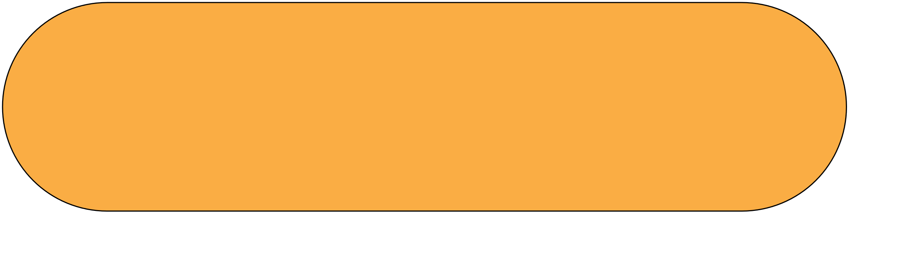


Use Case Diagram
Start playing
Make moves
Player
Player or bot
Replay or end game

Slide 16
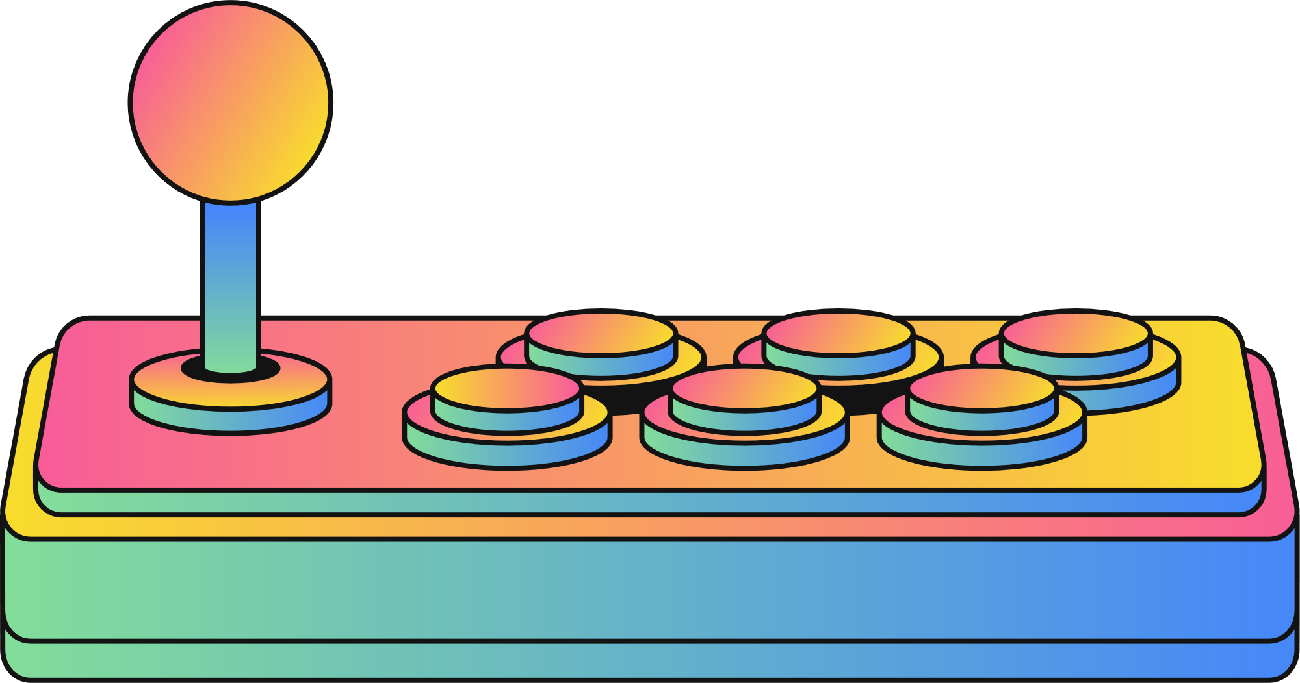
INSTRUCTION
THANKS FOR PLAYING!
END

