Slide 1
Introduction to NLP

Slide 2
What is NLP?
Natural Language Processing(NLP) is a field of Artificial Intelligence that gives machines the ability to read, understand and derive meaning from human language.
With the help of NLP, we can communicate with computers using a natural language such as English.

Slide 3
Advantages of NLP
Today NLP is booming with the advancements in the access to data and increase in the computational power.
This is helping practitioners to achieve meaningful results in areas like
Healthcare
Media
Finance

Slide 4
Problems with Text Data
Today, millions of data is generated through conversations, declarations or tweets and these data are unstructured data.
Unstructured data does not fit into row and column structure which makes it difficult to analyze and manipulate.

Slide 5
Why should we learn NLP?
With the help of NLP, it is possible for the machines to detect figure of speeches like irony and even perform sentiment analysis.
We can not have data in numbers all the time, so to deal with textual data we use NLP which can easily take raw language as input and derive meaningful insights from it.

Slide 6
Applications of NLP
NLP enables the recognition and prediction of diseases based on electronic health records and a patient’s own speech.
Organizations can determine what customers’ are saying about product by identifying and extracting information.
This sentiment analysis can tell a lot about customer’s choices and their decision drivers.

Slide 7
Applications of NLP
Big companies like Google filter and classify emails with NLP by analyzing text in emails and stopping spam emails before they enter your inbox.
Amazon’s Alexa and Apple’s Siri are examples of intelligent voice-driven interfaces that use NLP to respond to vocal prompts and do everything.

Slide 8

Applications of NLP
NLP is used in both search and selection phase of talent recruitment by identifying the skills of potential hires.
NLP is also used in search Autocorrect and Autocomplete.

Slide 9
Steps to solve NLP problems
Gather Data
Gather textual data from emails, posts or tweets.
Clean Data
A clean dataset allows the model to learn meaningful features and not overfit on irrelevant noise.
Remove all irrelevant characters.
Tokenize the word by separating it in different words.

Slide 10
Steps to solve NLP problems
Clean Data
Convert all characters to lowercase. Combine misspelled or alternatively spelled words to single representation.
Reduce words such as “am”, “are” and “is” to a common form.
Finding good representation
Change textual data into numbers form which algorithms can understand and derive insights from it.

Slide 11
Steps to solve NLP problems
Classification
Split the data into training and testing data.
Classify the data using a model by fitting the training data into it and check how well the model generalizes on unseen dataset using the testing dataset.
Inspection
Understand the errors made by model using confusion matrix

Slide 12
What is Text Processing?
Text Processing means analysis, manipulation and generation of text.
It is the automated process which analyzes data for getting structured information.
It includes extracting smaller bits of information from text data and assigning tags depending on its context.

Slide 13
Techniques to analyze text data
Statistical Methods
We use statistical methods such as frequency distribution and TF-IDF to process and analyze text.
Text Classification
Text Classification classifies text into predefined groups based on its content. Popular models include:- Topic Analysis, Sentiment Analysis, intent detection and language classification.

Slide 14
Techniques to analyze text data
Text Extraction
Text extraction is a text processing technique that identifies and obtain valuable pieces of data that are present within the text.
This method helps us to detect and extract the relevant words or expressions from text.

Slide 15
Popular libraries used for NLP
Spacy
Spacy is an open source library which excels at working with incredibly large scale information extraction tasks.
Major takeaways are:-
Part-of-speech tagging, and Tokenization
Dependency parsing
Sentence Segmentation
Entity and sentence recognition
Methods for cleaning and normalizing texts.

Slide 16
Popular libraries used for NLP
NLTK (Natural Language ToolKit)
Its goal is to make learning and working with computational linguistics easier by offering features such as classification, stemming, tagging, parsing, semantic reasoning and wrappers.
Gensim
It is a library for Topic Modelling and similarity retrieval.
It excels at two things: Processing of language and Information Retrieval.

Slide 17
Popular libraries used for NLP
TextBlob
Textblob is used for processing text based data and offers smooth integration with other programming languages.
Part-of-speech tagging
Sentiment Analysis
Classification
Tokenization
N-grams
Parsing, and Spelling correction

Slide 18
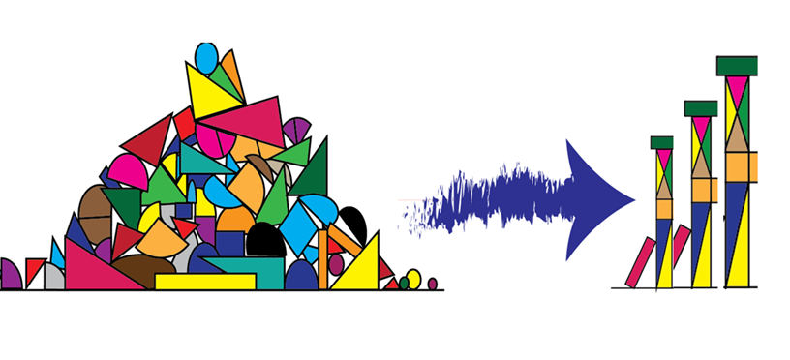
What is Feature Engineering?
Feature engineering is the process of creating new features from the existing ones and removing the unimportant features.
Feature engineering is an art and a skill.
It requires us to have creativity and domain knowledge.

Slide 19

Why do we need Feature Engineering?
Good Features present in the data influence the results of the predictive model in a very positive Way.

Slide 20
Why is it necessary to Clean Data?
Data Cleaning is a very crucial step in NLP because without cleaning, the dataset is just a cluster of words which computer doesn’t understand.
The textual data is unstructured and noisy and can have:-
Typos, Bad grammar, Usage of slangs, URLs.
Stopwords, Expressions, Punctuations etc.

Slide 21
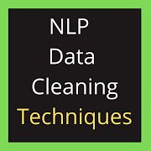
Steps to clean Textual Data
Remove punctuations and numbers
Perform tokenization
Remove special and accented characters
Remove Stopwords
Perform Stemming and Lemmatization

Slide 22
What is Tokenization?
Tokenization is simple as well as the building block of Natural Language.
It is a way of separating a piece of text into smaller units called tokens.
The tokens can be:-
Words, Characters, Sentences

Slide 23
StopWords
Stopwords are the words which do not add much value to sentence.
They are removed from the vocabulary to reduce noise as well as the dimension of the feature set.
The English stop words are:-
The, And, Myself, this, Into, Here etc
And So many more Meaningless words Like this.

Slide 24
Stemming
Stemming is a process of removing a part of a word, or reducing a word to its stem or root word.
Example:-
We have three words: “Ask”, “asking” and “asked”
Stemming converts all the three words into the root word “ask”.

Slide 25
Lemmatization
Lemmatization reduces the word to its dictionary form. The root word in lemmatization is called “lemma”.
We have two words: “good” and “better”.
Lemmatization reduce them to the same root word “good”.

Slide 26
Difference between Stemming & Lemmatization
Algorithms used in stemming process don’t know the meaning behind the words.
Algorithms used in lemmatization process refer to a dictionary to understand the meaning of the word before chopping it off.

Slide 27
Let’s Take an Example
We have three words:- “play”, “playing” and “player”.
According to Stemmer, all three words have same root word “play”.
According to lemmatizer, “play” and “playing” have same root and “player” is a word with different meaning.

Slide 28
Feature Extraction for NLP

Slide 29
What is Feature Extraction?
Feature extraction means to extract and produce feature representations that are appropriate for the NLP task.
Features that can be extracted from the text are:-
Number of words, characters, Stopwords etc.
Length of text.
Number of punctuation.

Slide 30
Feature Extraction Techniques
Major feature extraction techniques for NLP are:-
Bag of words representation
TF-IDF
N-gram analysis

Slide 31
Bag of Words
Bag of words is a way of extracting features from text for use in modelling.
The bag of words approach is very simple and flexible and can be used in a number of ways for extracting features from the documents.

Slide 32
Bag of words representation
Bag of words work in the following way:-
It checks the frequency of distinct words occurring in the text.
All the distinct words make the columns of the matrix and the values are represented as 0 or 1 based on the absence or presence of the word in the text.

Slide 33
Introduction to TF-IDF
TF-IDF short for Term Frequency-Inverse Document Frequency.
It is designed to reflect how important a word is to a document in a collection for corpus.
The TF-IDF value increases proportionally to the number of times word appears in a document.

Slide 34
TF-IDF Score
The value of TF-IDF is calculated by multiplying two metrics:-
How many times a word appears in a document.
Inverse document frequency of the word across a set of documents.
Inverse Document frequency
How common a word is in entire document set
log(Total no. of documents/ no. of documents containing word)

Slide 35
Why TF-IDF?
Information Retrieval
TF-IDF was invented for document search and is used to deliver results that are most relevant to what we are searching for.
Keyword extraction
TF-IDF is also useful for keyword extraction. The highest scoring words for a document are the most relevant keywords.

Slide 36
N-grams
N-grams is a sequence of n-words.
For Example: I love reading books.
1-gram or unigram will be:- “I”, “love”, “reading”, “books”.
2-gram or bigram will be:- “I love”, “love reading”, “reading books”.
3-gram or trigram will be:- “I love reading”, “love reading books”.

Slide 37
Why N-grams?
N-grams of texts are extensively used in text mining and NLP tasks such as Auto completion of sentences and Auto spell check.
Example:-
Using a 3-gram analysis, a bot will understand the difference between “What’s the temperature” and “Set the temperature” which is not possible using 1-gram or 2-grams.

Slide 38
What is Text Classification?
Text classification or Text categorization is the process of analyzing the natural language text and then labelling the text with a predefined set of labels or tags.
Text classifiers have proven to be great alternative to structure textual data in a fast, cost-effective and scalable way.
It allows to easily get insights from data and automate business processes.

Slide 39
Examples
Classifying emails as spam or not spam.
Sentiment analysis:- Understanding if the text has positive, negative or neutral sentiment.
Language detection:- Detecting the language of a given text.
Classifying content into categories to easily search and navigate within a website or application.

Slide 40
Applications of Text Classification
Tagging content or products using categories as a way to improve browsing or to identify related content on the website.
As marketing is becoming more targeted everyday, automated classification of users into cohorts can make marketer’s life simple.
Text classification of content on website help Google crawl website easily which help in SEO.
Email providers use text classification to differentiate between legitimate and spam mails.

Slide 41
Text Classification using ML
Machine learning helps in text classification and classify based on past observations.
By using pre-labelled examples as training data, ML algorithms learn different associations between pieces of texts.

Slide 42
Models for Text Classification
Naive Bayes Family of Algorithms
Support Vector Machines (SVM)
Deep learning

Slide 43
Conditional Probability
Probability of an event occurring based on the occurrence of the previous event.
We have a bag of 5 balls.
2/5
3/5

Slide 44
Example
2/4
2/4
The probability of one event depending on the probability of the previous event.

Slide 45
Bayes Theorem
P(A/B) = P(A and B) / P(B) => P(A and B) = P(A/B) P(B)
P(B/A) = P(B and A) / P(A) => P(B and A) = P(B/A) P(A)
Equating both the terms, we get Bayes Theorem
P(A/B) = [P(B/A) P(A)] / P(B)

Slide 46
Naive Bayes Classifier
Naive Bayes is a family of probabilistics algorithms which uses Bayes theorem to predict the tag of the text.
It is a probabilistic algorithm which means it calculates the probability of each tag for a given text.

Slide 47
Example
We have 4 major words in the categories Sport and not sport.
4 major words are match, game, win and election.
Sport Not Sport
Match 6
Game 5
Win 3
Election 1
Match 1
Game 2
Win 5
Election 7
6/15
5/15
3/15
1/15
1/15
2/15
5/15
7/15

Slide 48
Example
New message comes which has win election in it.
The probability of a message in “sport” or “not sport” category is ½.
P(sport/win election) = 0.006
P(not sport/win election) = 0.07
New message “win election” is in the “Not sport” category.

Slide 49
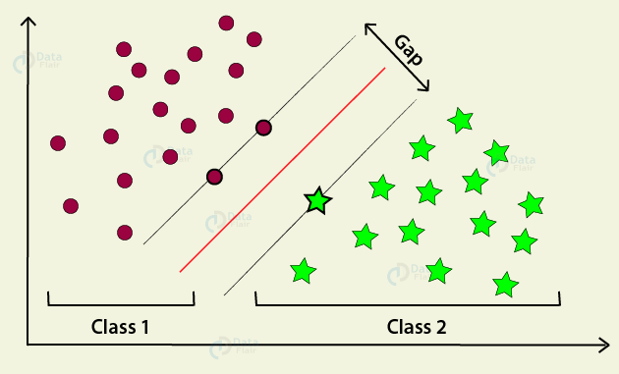
Support Vector Machines(SVM)
SVM is a powerful text classification machine learning algorithm.
SVM divides or separates the two sides by a line.
An optimal line is the one with the largest distance between each label.
It works for both linear and non-linear data.

Slide 50
More Things to Try!
We can try some more classification models such as Logistic Regression and Deep learning.
Instead of using TF-IDF vectorizer, we can use Bag of words to change texts into numbers and check how the model accuracy changes.
In case of Bag of words also we have two choices, either using binary bag of words or frequency bag of words.

