Slide 1
Introduction
to Forecasting

Slide 2

Introduction to Forecasting
Forecasting is the process of making predictions of the future based on the past and present data and most commonly by analysis of trends.

Slide 3
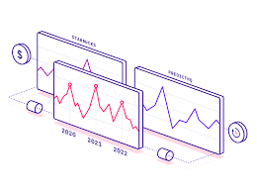
Types of Forecasting
There are two types of forecasting.
Quantitative forecasting
Qualitative forecasting

Slide 4
Qualitative vs Quantitative Forecasting
Quantitative Forecasting
Based on past data which used numerical features.
Data Driven and Lesser bias.
Time series analysis and statistics.
Qualitative Forecasting
Done when we do not have past data to analyse.
It uses Delphi method which involves subject matter experts.

