Slide 1
Applications
of Time Series

Slide 2

Applications of Time Series
Economic Forecasting
Sales Forecasting
Inventory Planning
Workforce Planning

Slide 3
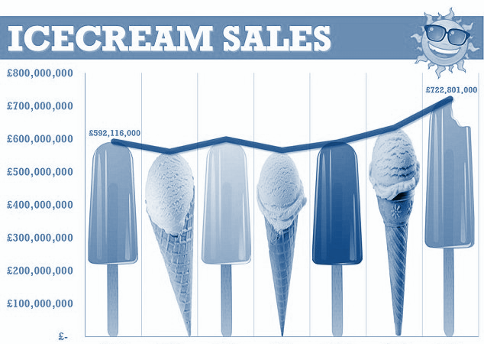
Solution
So, In this scenario we can use the sales of past three months to forecast the sales for the Month of April
This Technique is popularly known as Time Series Forecasting.

