Slide 1
Components
of Time Series

Slide 2
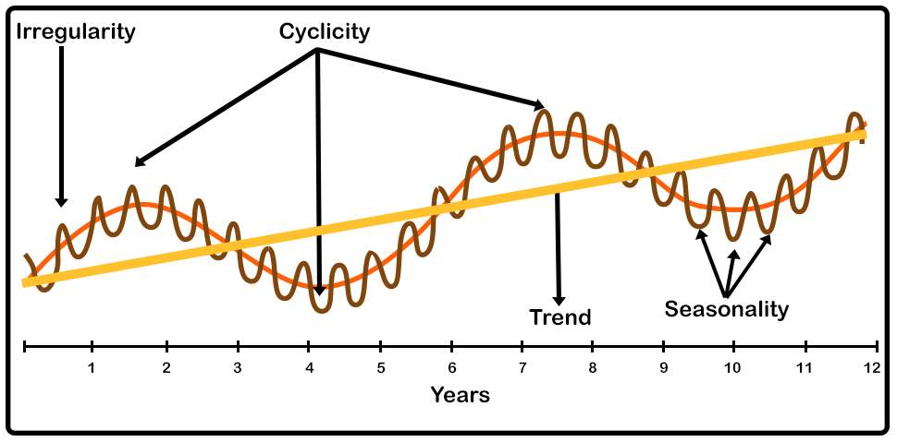
Components of Time Series
The Components of time series are Level, Trend, Seasonality, Cyclicity, Noise

Slide 3

Time series Component: Level
Level is the baseline for the entire time series. It is the average of the time series and the baseline to which we add different other components.

Slide 4

Time series Component: Trend
The Trend is the indication of whether the time series has moved higher or lower over the time period.

Slide 5
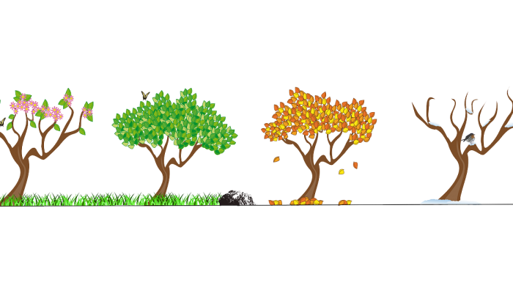
Time series Component: Seasonality
Seasonality is the pattern in time series which repeats after a fixed interval of time.

Slide 6
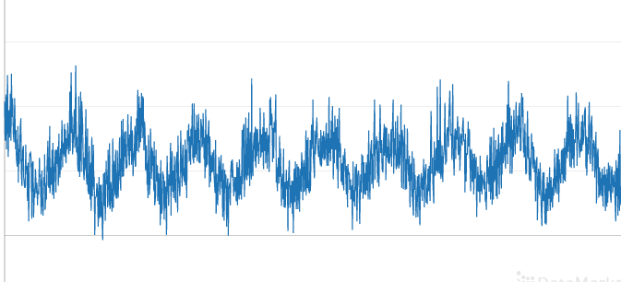
Time series Component: Cyclicity
Cyclicity is the pattern in the time series which repeats itself after some interval of time but the interval of time is not fixed in the case of cyclicity unlike the seasonality.

Slide 7
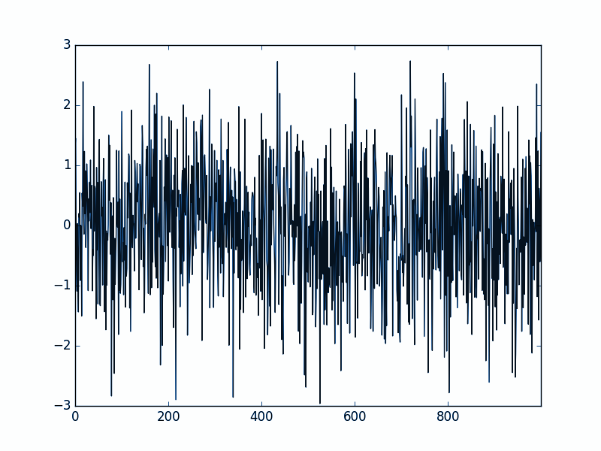
Time series Component: Noise
Noise is the random variation in the time series. We can not use noise to forecast the future.
Noise is just random fluctuations in our data and does not have any Pattern

