Slide 1
Cross Validation in Time Series

Slide 2
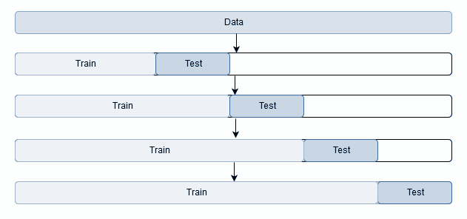
Cross Validation in Time Series
There are Two Types of Cross Validation Techniques commonly used for Time series data.
One-Step Validation
Multi-Step Validation

Slide 3
One-Step Validation
In one-step validation, the test data is exactly after the train data.
Train Data
Test Data

Slide 4
Multi-Step Validation
Multi-step validation is the same as one-step validation with the difference that in multi-step we do not consider the exact next point after train data points.
Train Data
Test Data

