Slide 1
Time Series Decomposition

Slide 2
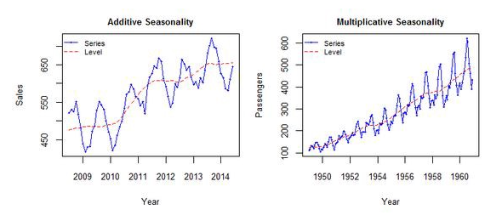
Time Series Decomposition

Slide 3
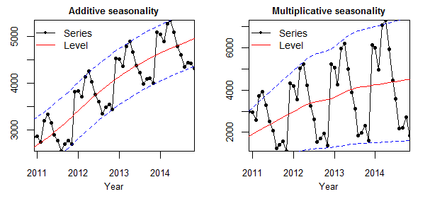
Additive Seasonal Decomposition
Additive Seasonal decomposition is when we add the individual components to get the time series data.
y(t) = Level + Trend + Seasonality + Noise

Slide 4
Multiplicative Seasonal Decomposition
Multiplicative Seasonal decomposition is when we multiply the individual components to get the time series data.
y(t) = Level * Trend * Seasonality * Noise

Slide 5
Additive vs Multiplicative Decomposition
We use additive model, the magnitude of seasonality does not change in relation to time.
On the other hand, we use multiplicative models when the magnitude of the seasonal pattern in the data depends on the magnitude of the data.

