Slide 1
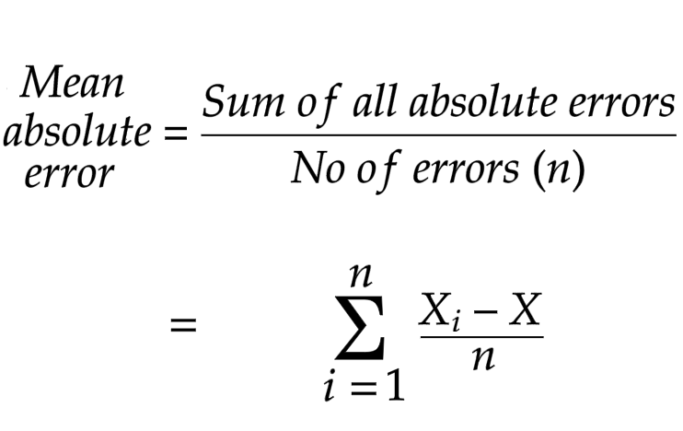
Mean Absolute Error(MAE)
Mean Absolute Error takes the absolute values of the differences between actual values and forecasted values.

