Slide 1
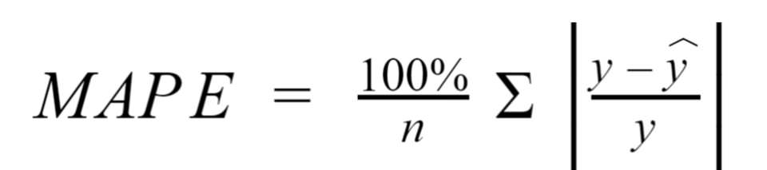
Mean Absolute Percentage Error(MAPE)
Mean Absolute Percentage Error calculates the percentage of mean absolute error to get a clear idea of how much the forecasted values deviates from the actual values.

