Slide 1
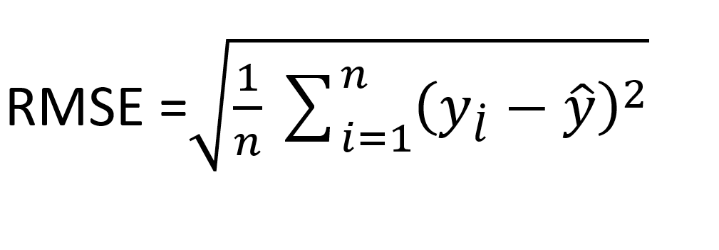
Root Mean Square Error(RMSE)
Root Mean Square Error is equal to the root of the Mean Square error in order to bring error value to the same dimension.

