Slide 1
Qantas Web Automation Test Framework 2.0

Slide 2
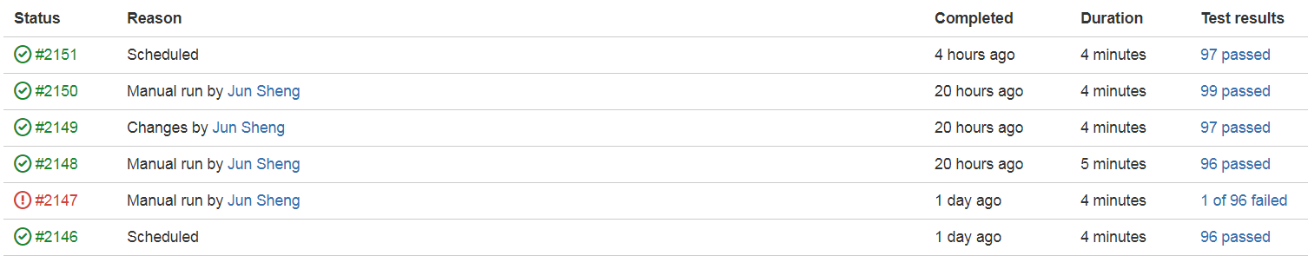
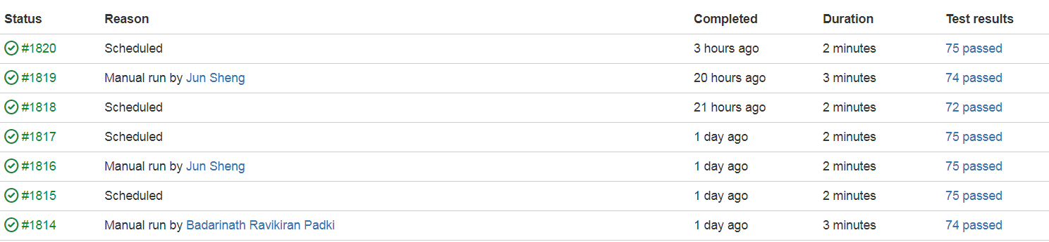
About Q.com Automation Test
Q.Com
Widget Provider
Regression Test Scenarios 170
Test Duration 4-5 mins
Time Efficiency 4 sec / per scenario
Green Build 90%+
Env Coverage Test, Staging, Production

Slide 3
Tool Sets
Programming Language -> Java
Test Framework -> Junit
BDD Framework -> Cucumber-Jvm
Cucumber Test Runner -> ExtendedParallelCucumber
Other Tools: MVN, Selenium, CucumberReport
Test Scripts
Test Runner
CUCUMBER-JVM
JUNIT Test Framework
JAVA Programming Language

Slide 4
Capabilities
CI/CD Integration & Maintenance
Build Scripts – Build scripts embedded in the project
Customised Run – Most configurations can be overwritten from CI/CD
Running Efficiency
Parallel execution – Threads amount relies on the test machine
Reuse browser – Managing browsers in a pool, saving time from close and reopen browser
Cross Browser
Local Browser – Support chrome, firefox and ie so far
Remote Browser – Support all kind of devices and browsers, such as browser stack

Slide 5
Continuous Improvement
API Stub & Monitoring
Mock Proxy – Monitor API call and mock response
Accessibility Testing
AXE – Validate page or element accessibility in one line of code
API Client
Http Client – Interact with backend services
Local Server
Netty – Mock up a local web server to host JavaScript to enable functional testing

Slide 6
Capabilities
Failure Handling
Rerun – Rerun failed scenarios immediately, configurable retry times
Reporting
Report: Html Report, Json Report, Junit Report
Smart: Remove flaky failures from CI Build Result
Useful Helpers
ActionHelper, ElementHelper, CookieHelper, AirportHelper
Others
Centralised Configuration
Easy to integrate with mobile testing

Slide 7
Continuous Improvement
Security Testing
ZAP – Record & Explore any security risks during test
Others
Accessibility Test
Visual Test

Slide 8
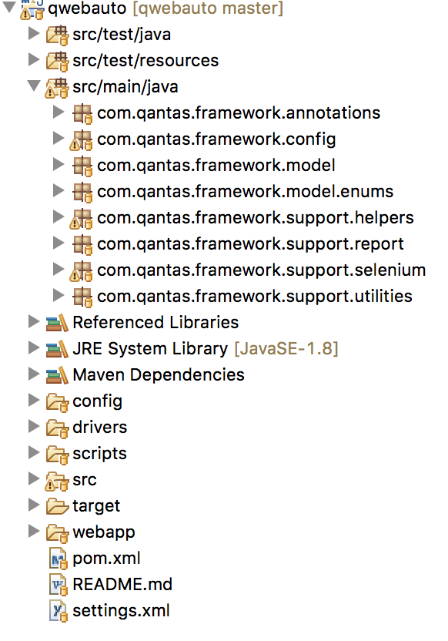
Architecture Overview
Feature
Steps
Scenarios
Configuration
Step Definitions
Local Storages
Cookies
Pages
Elements
Components
Widgets
Report
Model
Helpers
Selenium
Utilities

Slide 9
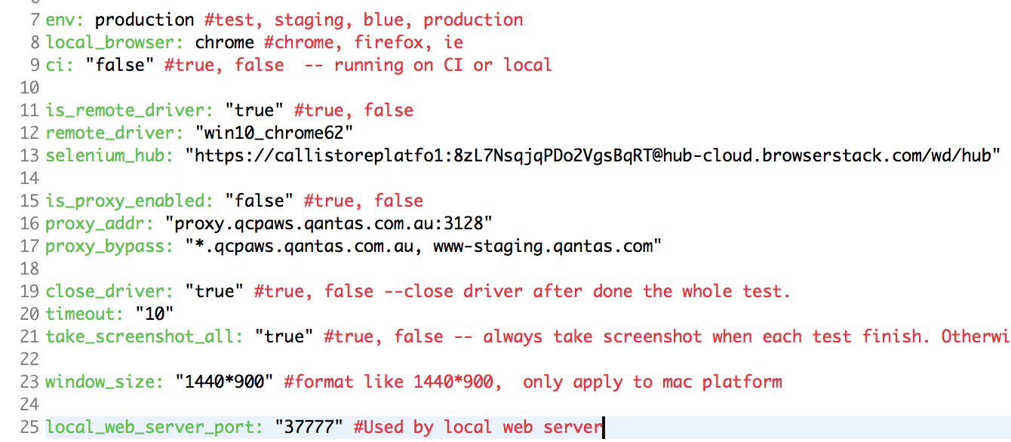
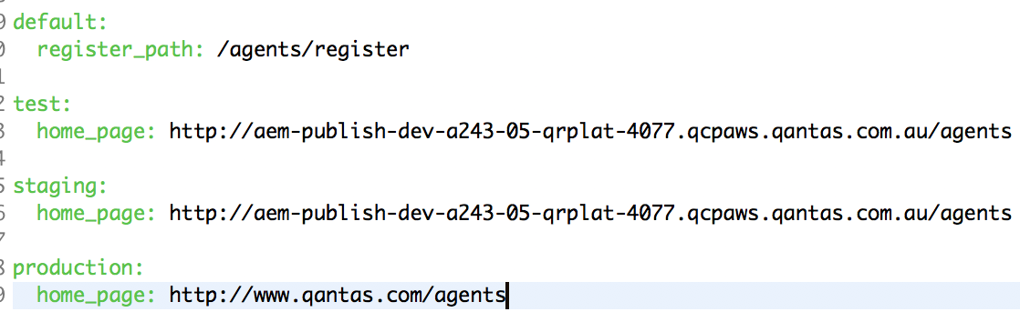
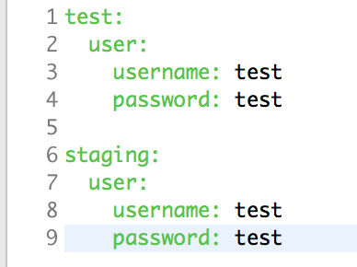
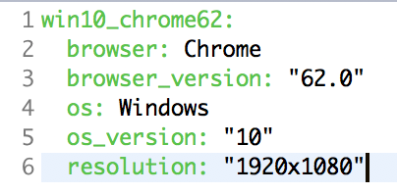
Configuration – What is configurable
GlobalConfig
UrlConfig
TestDataConfig
RemoteDriver

Slide 10
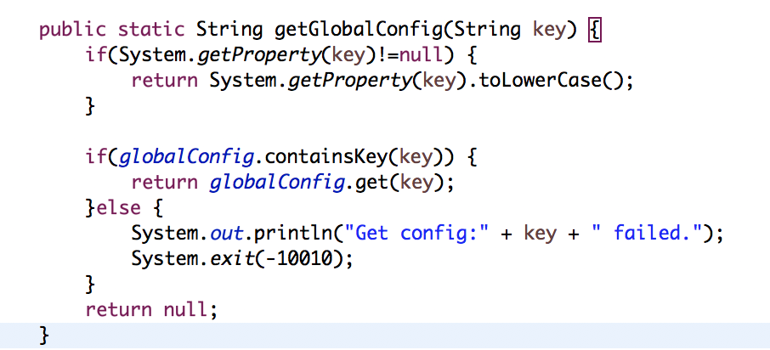
Configuration – CI Customised Run
Most configurations can be overwritten from CI. Loading Priority:
GlobalConfig:
Env Variable -> Yaml File -> Terminate Whole Test
UrlConfig:
Env Variable -> Yaml(Env) ->Yaml(Defaut) -> Fail Current Test

Slide 11
Test Runners
2 test runners available for different test purpose.
RunCukesTest:
The only test class executed by MVN TEST
LocalDebugRunner:
When run test through IDE and debug a test
 | RunCukesTest | LocalDebugRunner
MVN TEST | Yes | No
RunWith | ExtendedParallelCucumber | ExtendedCucumber
Parallel testing | Yes | No
Rerun failed test | Yes | No
Remove flaky failure | Yes | No

Slide 12
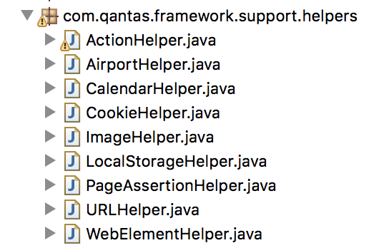
Helpers / Common functions
ActionHelper
Advanced functions in addition to standard selenium action.
WebElementHelper
Advanced functions in addition to standard selenium web element.
PageAssertionHelper
Assert a page with url, title or element presence.
URLHelper
Provide advanced functions to build a url or assert a url.
CalendarHelper
Provide Java-alike calendar functions not based on local machine time but Qantas Server Time.

Slide 13
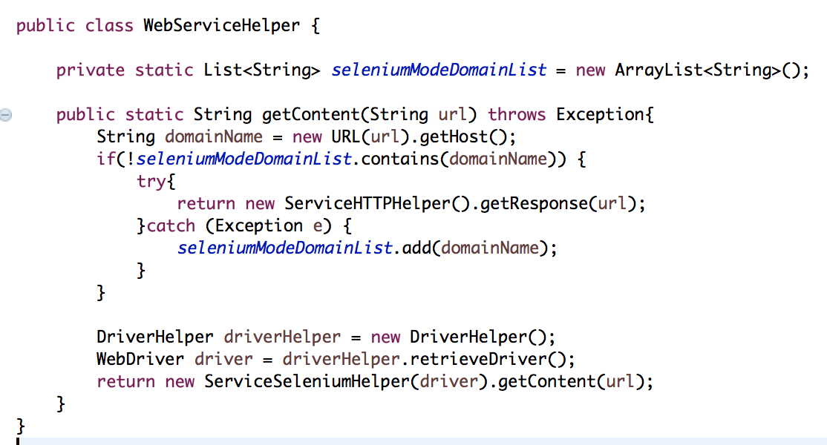
Web Service Helper
Web service helper is used to real-timely fetch some configurations from server side, such as server date, available airports.
HTTP Mode
Selenium Mode

Slide 14
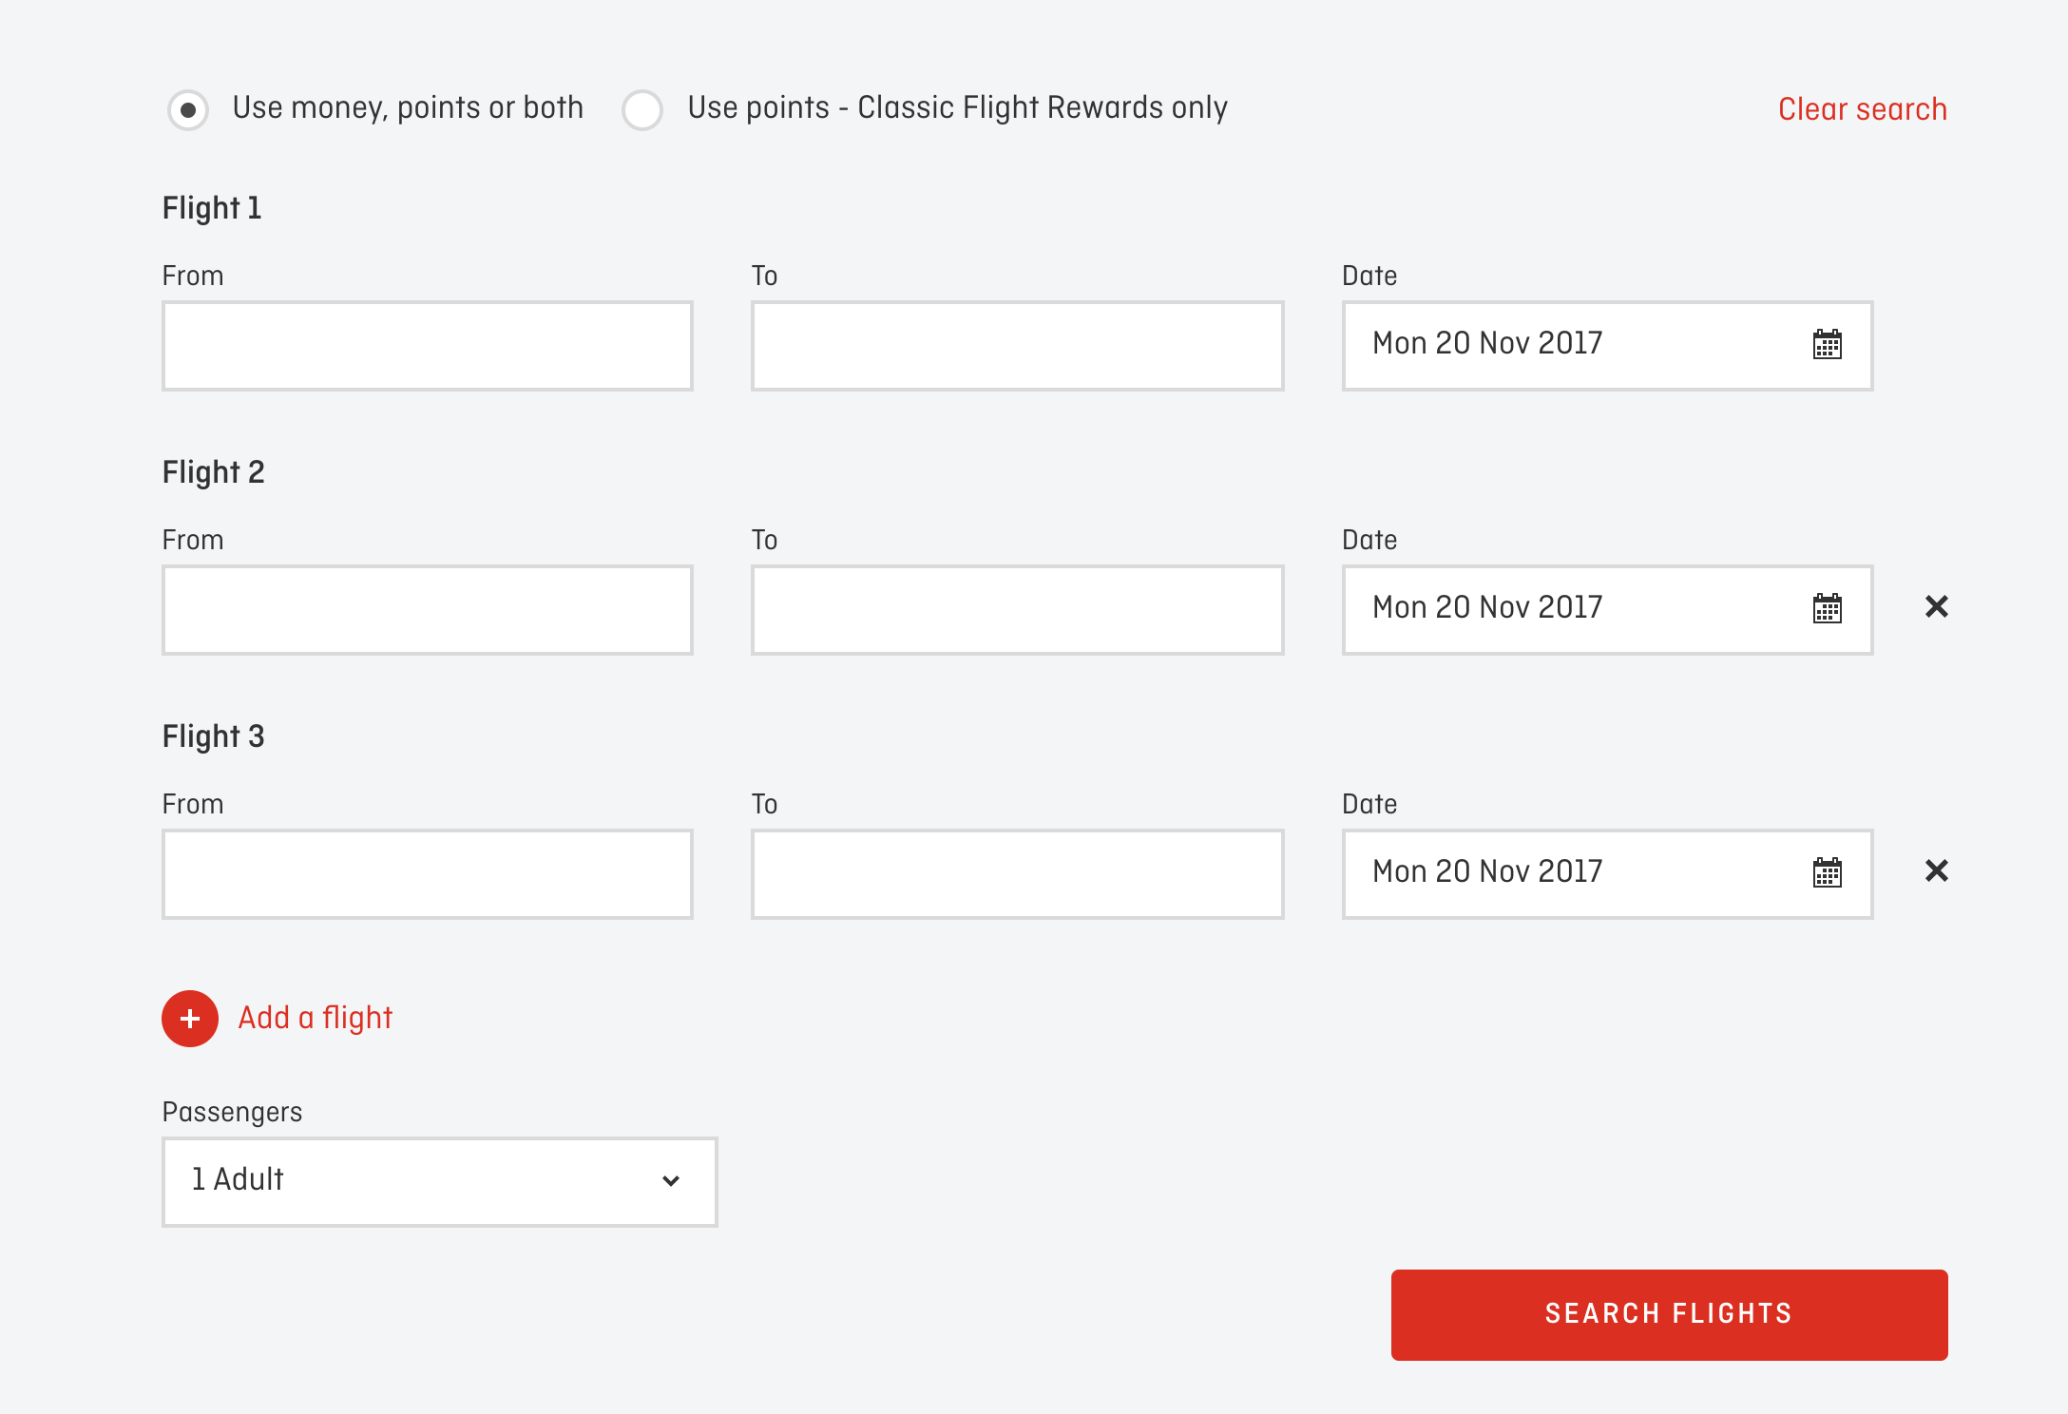
Page Objects -- Terminology
Element
Everything on UI can be element
Component
A common element/component that reused across pages
TypeAheadComponent, CalendarSelectorComponent, PassengerSelectorComponent
Widget
A section/form that reused across pages
BookFlightsWidget, BookCarWidget, ManageBookingWidget

Slide 15
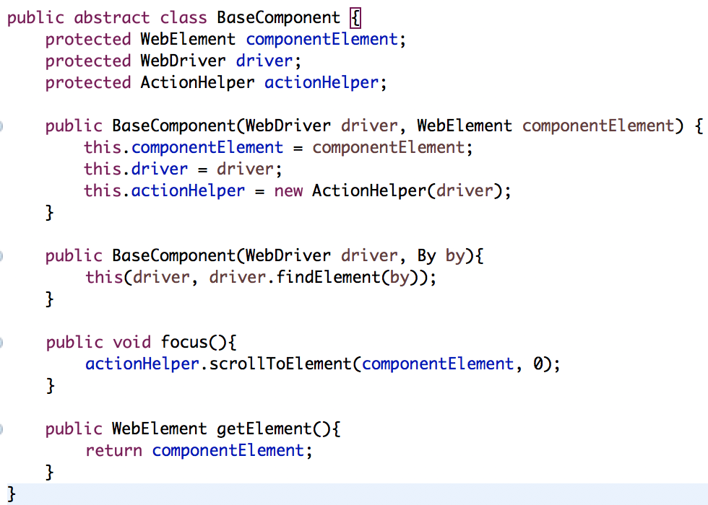
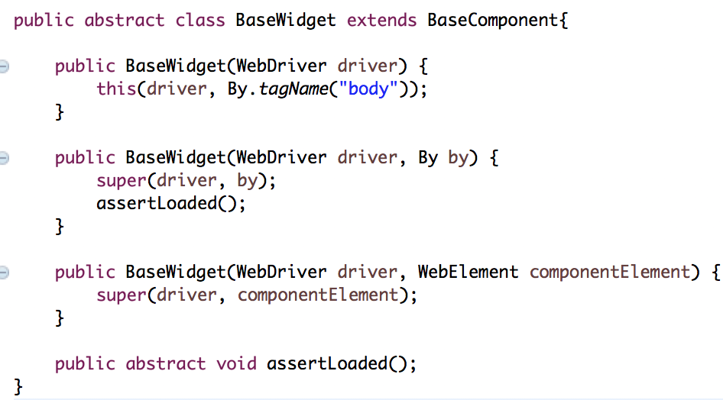
Model – Component/Widget
Widget is a type of component
Whole page is widget if element is not given
Assert widget loaded every time when initiating a new widget instance
Pass Through driver and element
Define helper
Provide some basic common functions

Slide 16
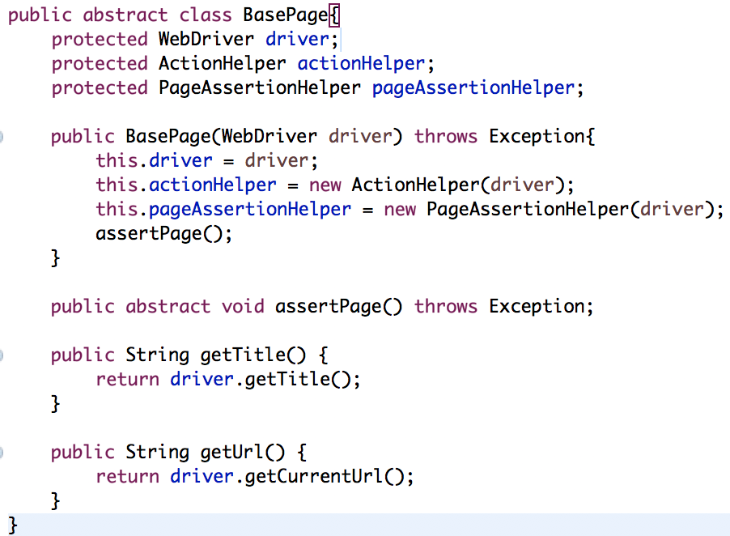
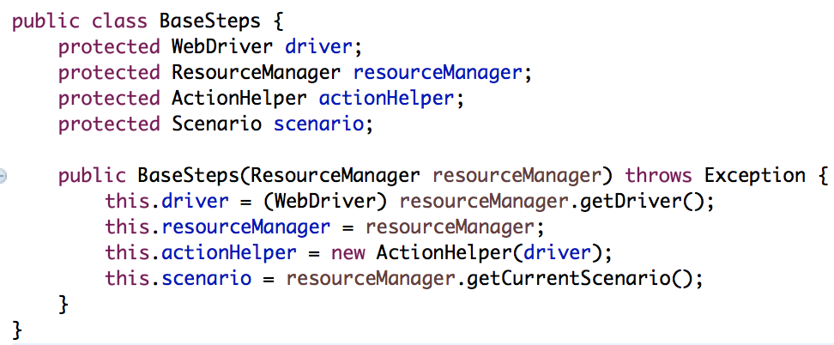
Model – Page/Steps
Pass through resourceManager instance, which is shared across the whole test
Define helpers
Pass Through driver
Define helpers
Provide some basic common functions
Assert Page every time when initiating a new page instance

Slide 17
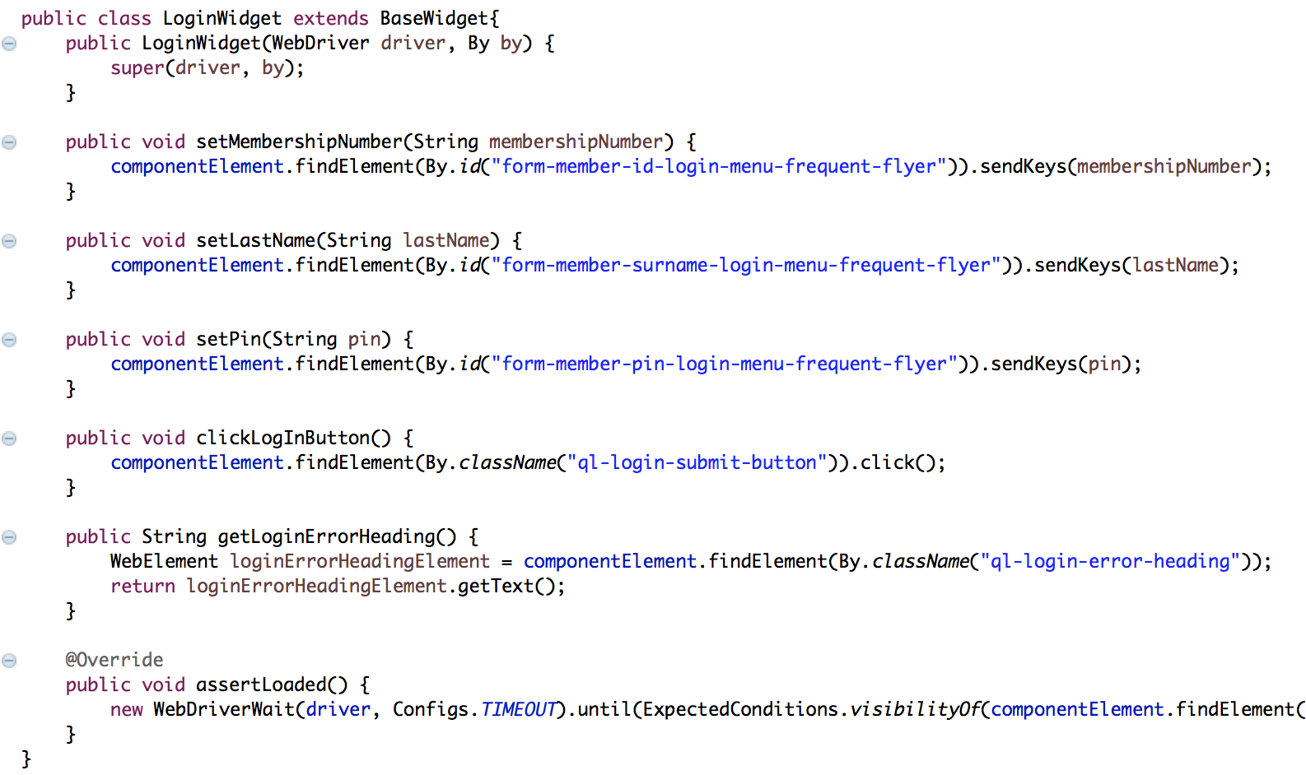
In a page/widget/component
What to do and what not to do
All actions a real user might do
set - InputBox / Dropdown.
get - Text / Visibilitily
is - Visible / Selected / Enabled
Click - Button / Link / Radio
Any technical / test related functions
Junit.Assert
High level function with series of actions – Login(userName, password)

Slide 18
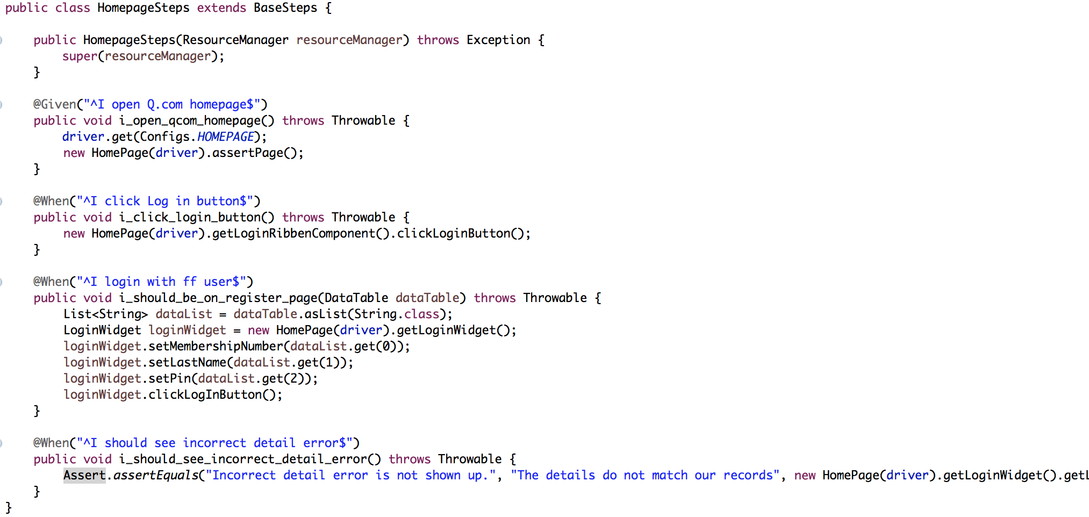
In a test step
What to do and what not to do
Only use actions provided in the page/widget/component
Provide high level common functions
Assert expectation
Re-initiate page/widget/component when necessary
Use resourceManager to share variables across steps
Share page/widget/component definition across methods
Find element / get text directly in a step

Slide 19
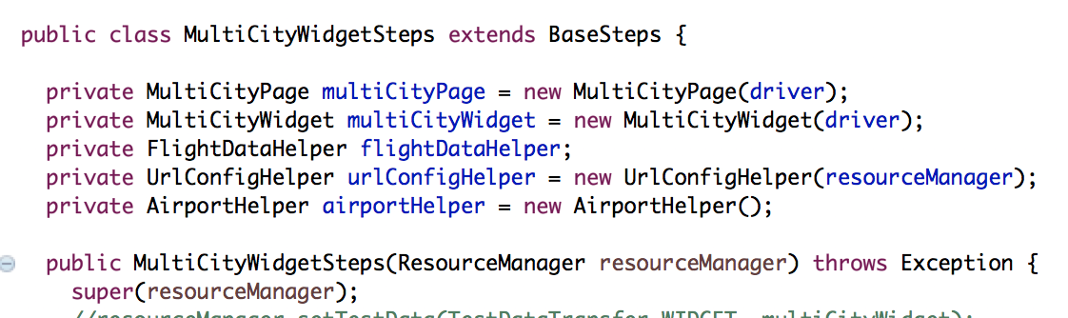
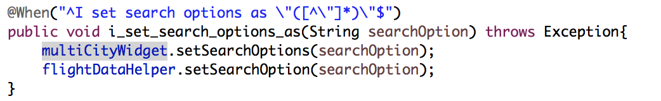
What makes a poor test
Stale Element Reference Exception
Common Causes
A stale element reference exception is thrown in one of two cases, the first being more common than the second:
The element has been deleted entirely.
The element is no longer attached to the DOM.

Slide 20
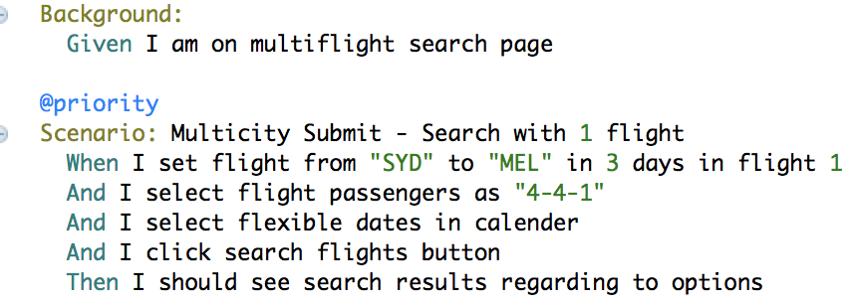
What makes a poor test
Load Page
Render Page, title,header, footer
Load Widget
Load widget from widget provider
Load Data
Fill widget with search history (local storage/cookie)
Why always assert page/widget loading – Avoid intermittent error
Start test without page/widget completely loaded might have timing issue
An element might exist on multiple pages, necessary page assertions will confirm where you are and you are acting on the right element

Slide 21
Where are we
Stash
https://stash.qcpaws.qantas.com.au/projects/AMS02-A974/repos/qwebauto/browse
Bamboo
https://bamboo.qantas.com.au/chain/viewChain.action?planKey=AMS02-A974S17CI
Contacts
Jun Sheng
SYDQCA/6
Email: jun.sheng@qantas.com.au
Slack: junsheng

Slide 22
Demo Time

