Slide 1
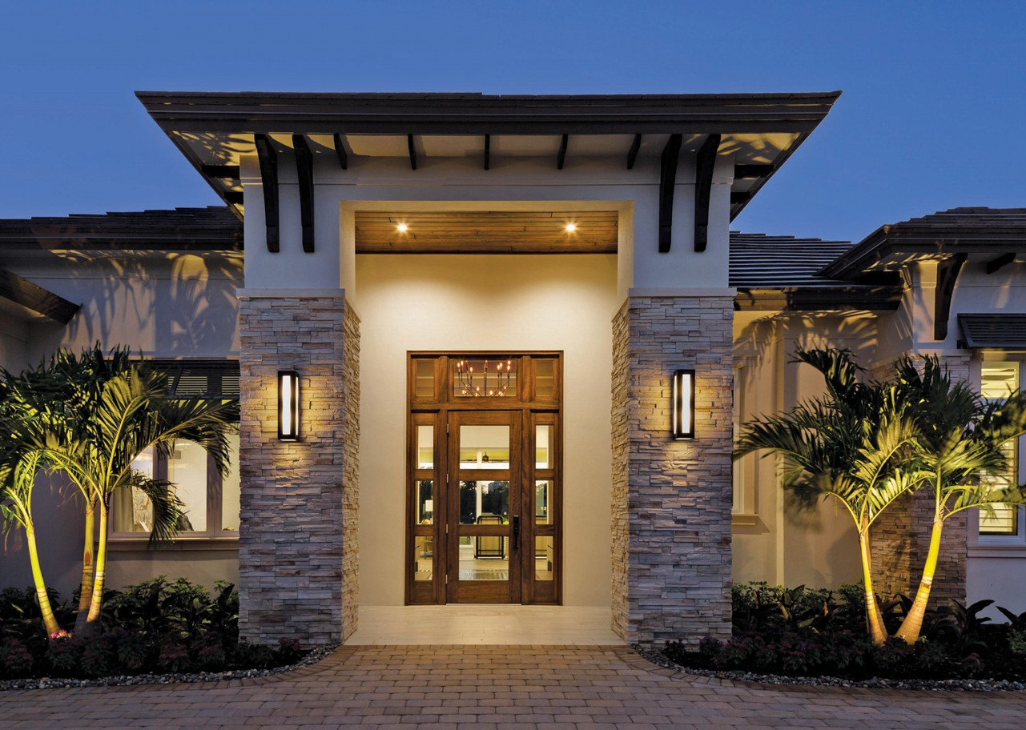
LuxeStay presented By:
Instructor Name:
Dr. Mohammad Dandash
Course: PHP(I3302)
Date: 21-02-2025
Amjad Rifaii
Elio Abdo
Elia Abdel Masih

Slide 2
CONTENTS OF THIS TEMPLATE
LuxeStay is an online reservation platform for guesthouses similar to AirBNB.
1-User Features:
Create Accounts.
Browse properties.
Make reservations.
Manage bookings.
2-Administrator Features:
Oversee reservations.
Manage and insert properties.
Manage users and interact with them.
3-System Benefits:
Efficient and secure reservation system.
Real-time updates.
Dynamic design and functionality.

Slide 3


Importance of Online Reservations in the Hospitality Industry
LuxeStay

Slide 4
Efficiency
Convenience & Accessibility
WHAT WE ARE WORKING ON
Real-time Availability
Competitive Advantage
Guests can book accommodations anytime, anywhere, using different devices.
Reduces manual booking errors and streamlines reservation management
Ensures accurate room availability, preventing overbooking issues.
Digital reservation systems help guesthouses attract more customers and stay ahead in the market.

Slide 5
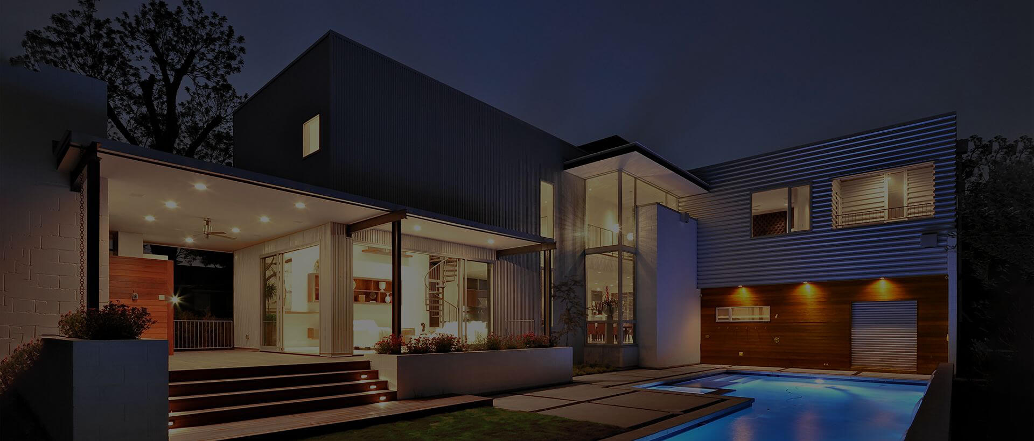


WHAT WE ARE WORKING ON
Ensure secure authentication and data protection for users.
Offer real-time availability updates to prevent overbookings.
Enable efficient management tools for administrators to oversee properties and reservations.
Implement interactive features, such as a dynamic calendar, alerts, and customer support.
Provide a user-friendly interface for seamless reservations.

Slide 6
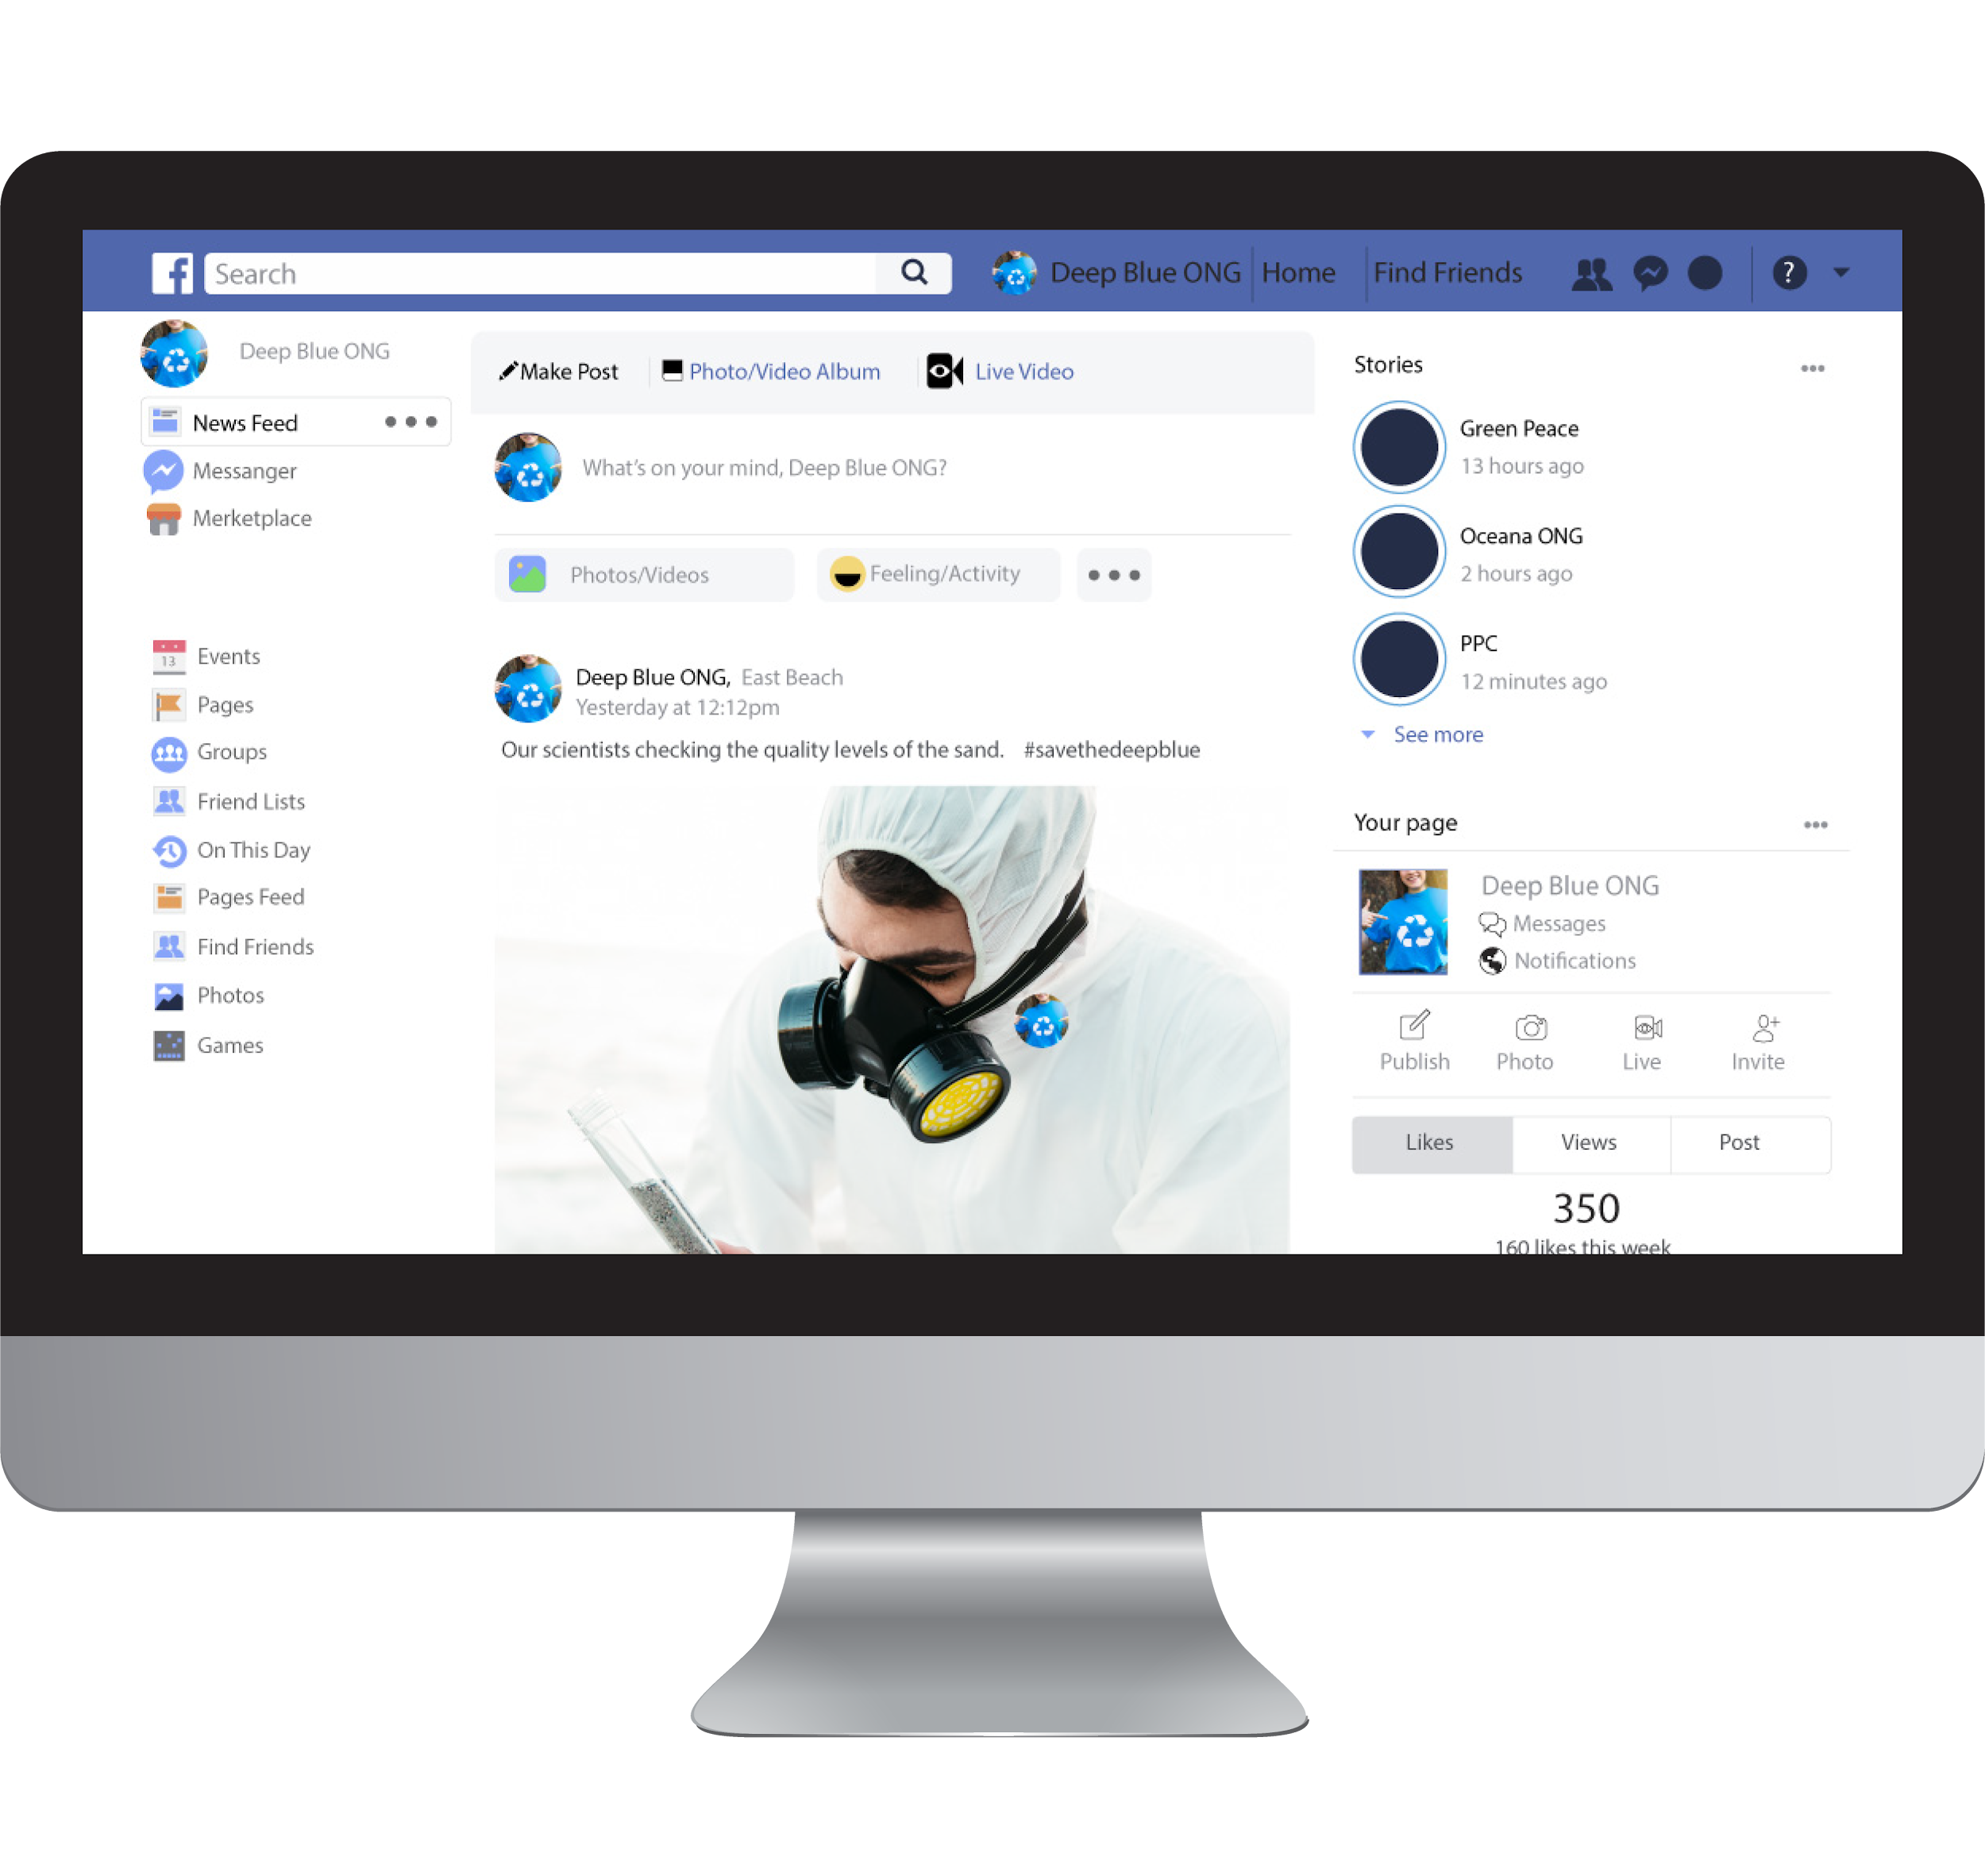
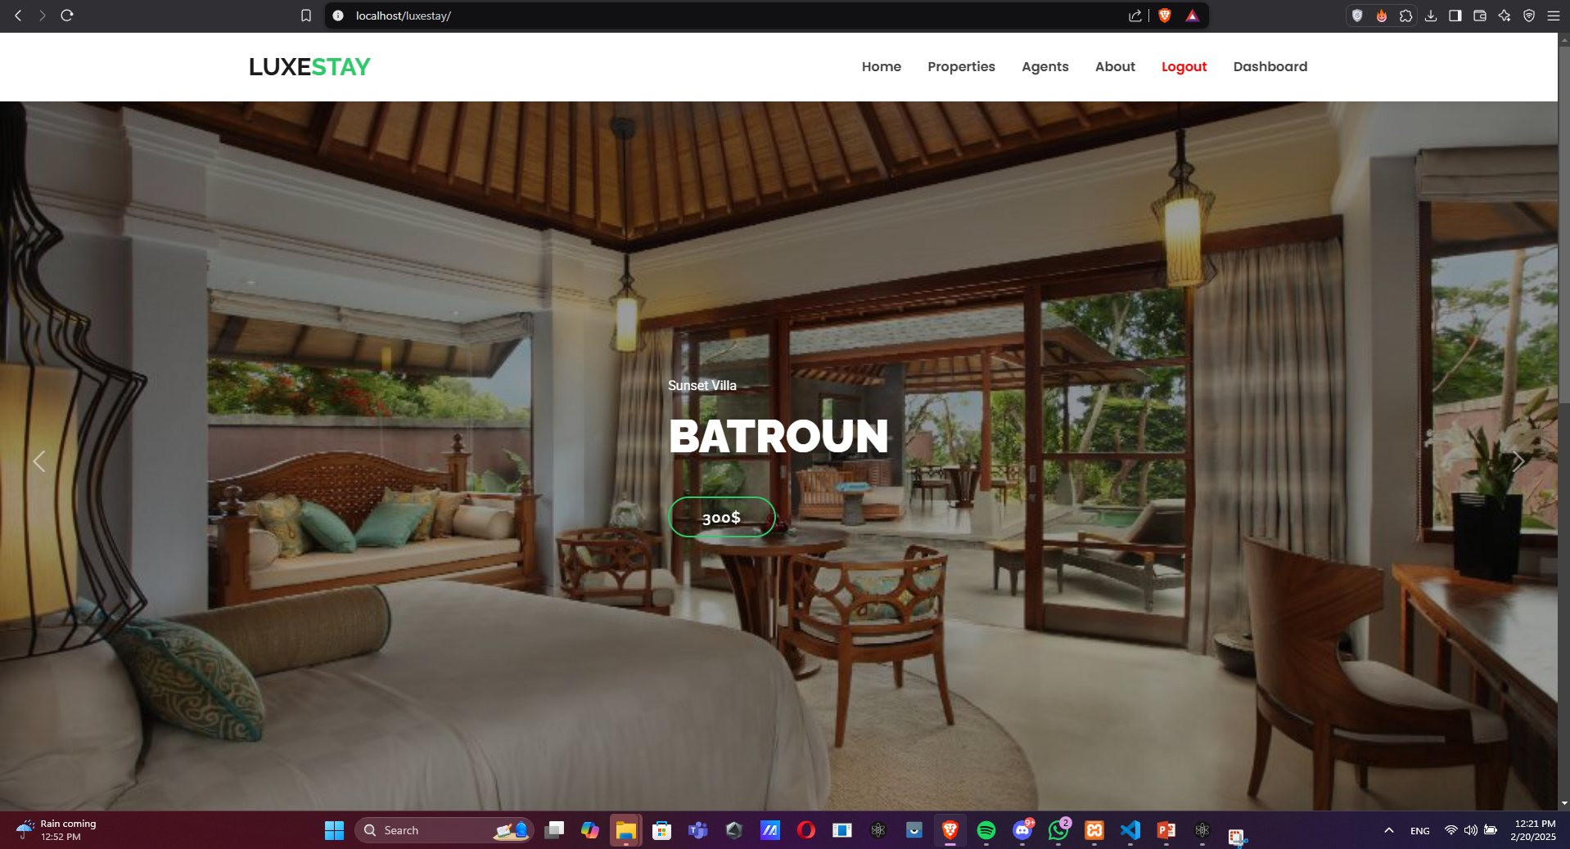
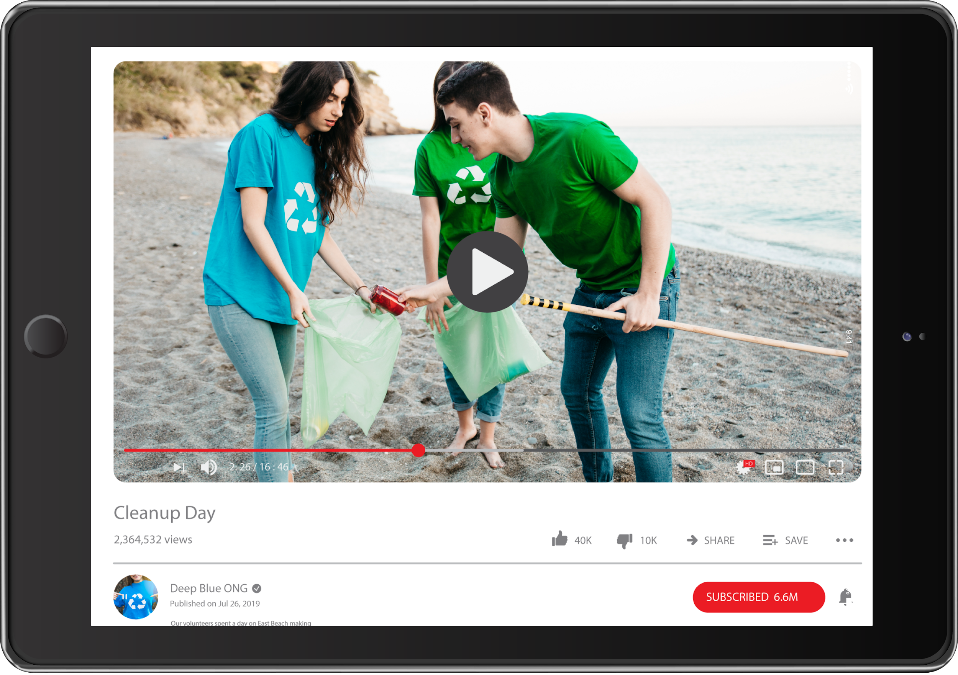
Compatibility
Mobile Friendly

Slide 7


Features for Users
Secure User Authentication (Sign Up, Login, Encryption)
Property Viewing & Details(Users can browse available properties, each includes details and photos)
Reservation Management (Booking, Viewing, Contacting Admin)

Slide 8




Features for Admin
Property Management (Add, Edit, Remove Listings)
Reservation Management
(View, Edit & Cancel Reservations)
User Management (View, Edit & Remove Users)

Slide 9
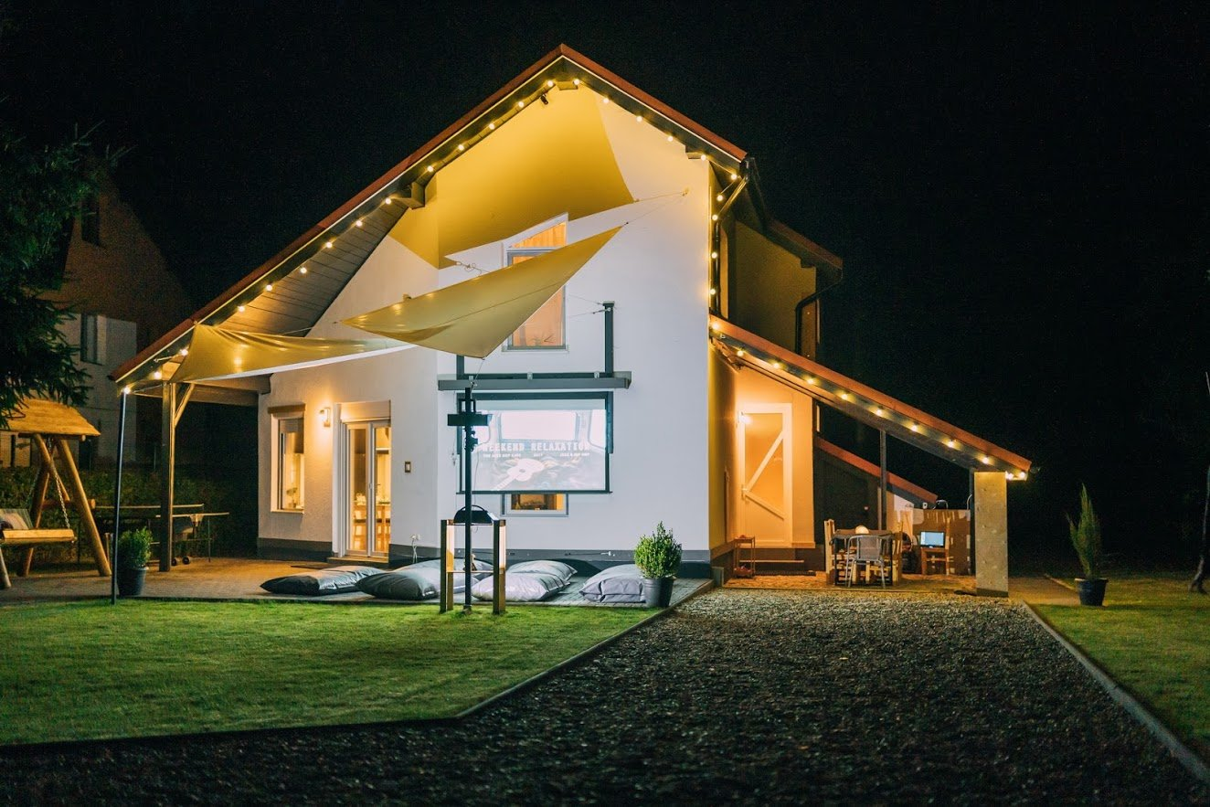
Technologies Used
Front-end: HTML, CSS, Bootstrap, JavaScript
Back-end: PHP, MySQL
Data Handling: JSON, AJAX
Security Measures: Encryption

Slide 10

LuxeStay
Challenges Faced

Slide 11

.
Security concerns
Real-time reservation management
User communication
Dynamic booking system

Slide 12
LuxeStay
Solutions Implemented

Slide 13
.
Password encryption & secure sessions
Real-time database updates
Contact email for user support
Interactive reservation calendar

Slide 14

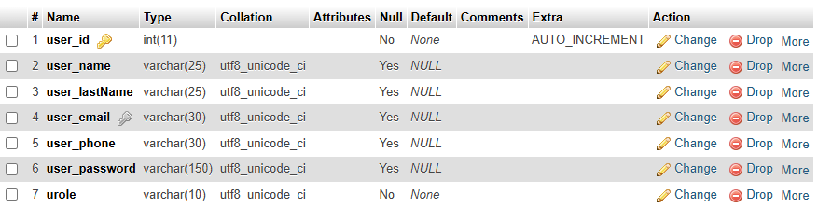
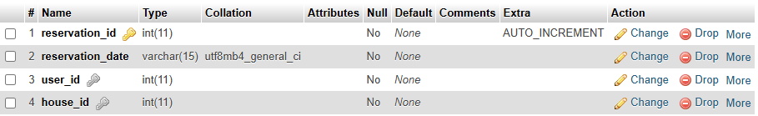
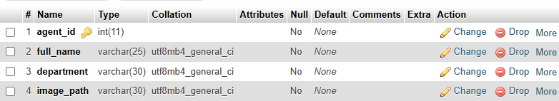
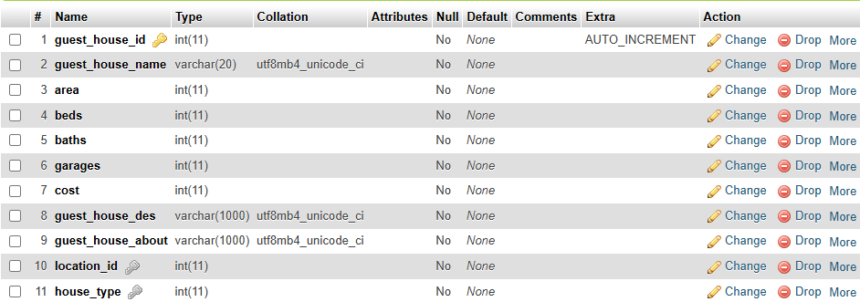
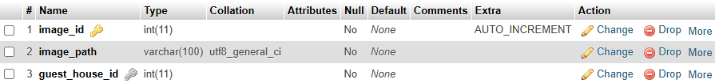

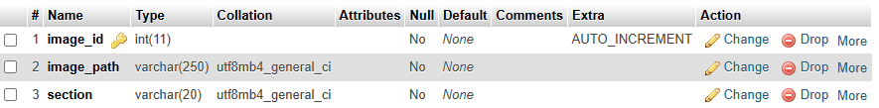
Database Structure
users
reservations
agents
locations
guest_houses
images
house_types
website_images

Slide 15

Advantages of LuxeStay
LuxeStay

Slide 16
Real Time Updates
Efficient booking system
User-friendly interface
Advantages of LuxeStay
Flexibility And Ease Of Use
Dynamic Design
Secure & scalable platform

Slide 17
Future
LuxeStay
Enhancements

Slide 18
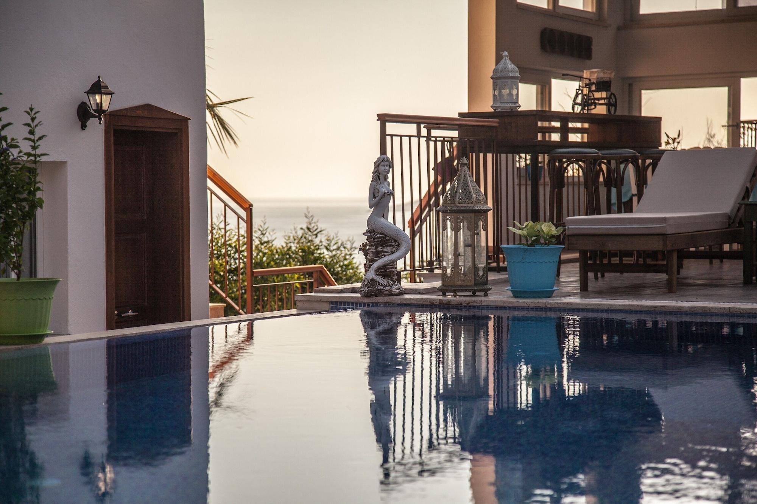
Future Enhancments
Online payment gateway
AI-powered recommendations
An online payment gateway is crucial for a guest house website as it enables secure, fast, and convenient transactions.
AI-powered recommendations enhance a guest house website by personalizing user experiences.

Slide 19
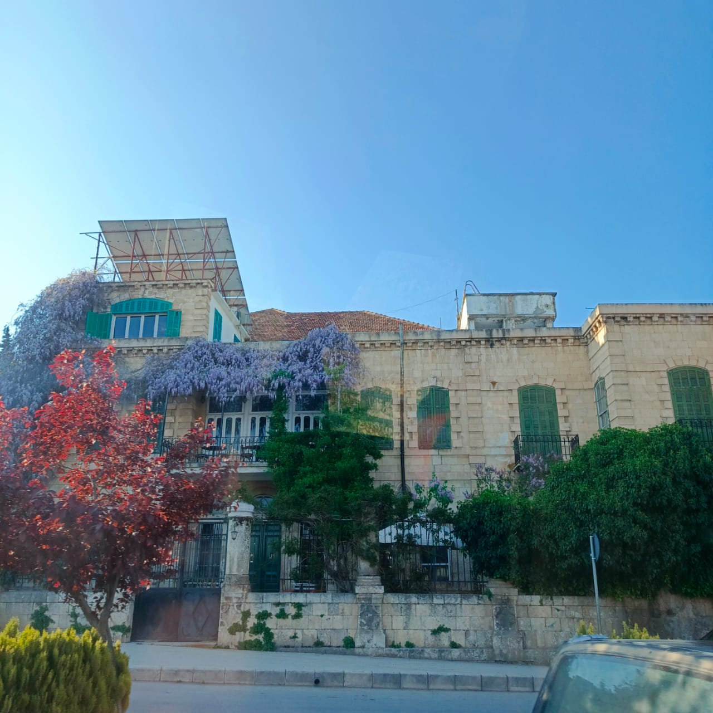
Future Enhancments
Two-factor authentication
Live chat support
Two-factor authentication (2FA) adds an extra layer of security to a guest house website
Live chat support enhances customer experience by providing real-time assistance to users browsing a guest house website

Slide 20

Thank you for your attention
. Now, I'd be happy to answer any questions you may have.

