Slide 1
Grid layout system

Slide 2
Grid layout system
A two-dimensional system that arranges content into rows and columns for structured, flexible, and responsive design.
Grid Container Properties
Grid Item Properties

Slide 3
Grid Container Properties
display: grid; → turns an element into a grid container.
grid-template-rows / grid-template-columns → define rows and columns.
display: grid; → turns an element into a grid container.
grid-template-rows / grid-template-columns → define rows and columns.

Slide 4
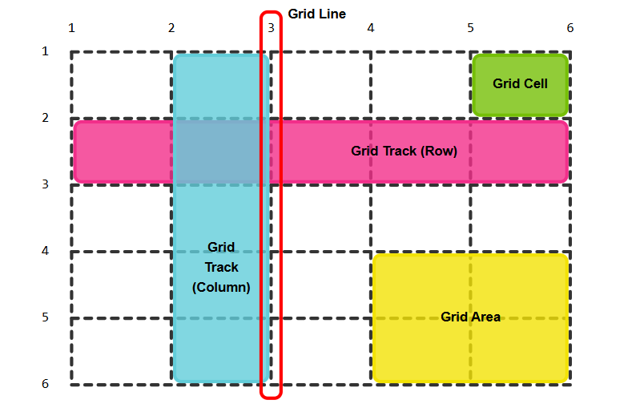
Basic Concepts structure UI
display: grid; → turns an element into a grid container.
grid-template-rows / grid-template-columns → define rows and columns.

Slide 5
Grid Definition
display: grid; → turns an element into a grid container.
grid-template-rows / grid-template-columns → define rows and columns.
display: grid; → turns an element into a grid container.
grid-template-rows / grid-template-columns → define rows and columns.

Slide 6
Grid Item Properties
A two-dimensional system that arranges content into rows and columns for structured, flexible, and responsive design.
grid-column / grid-row → defines position across rows/columns.

Slide 7
Basic Concepts
A two-dimensional system that arranges content into rows and columns for structured, flexible, and responsive design.
grid-column / grid-row → defines position across rows/columns.

Slide 8
Display code
.container {
display: grid;
grid-template-columns: 100px 100px 100px;
grid-template-rows: 100px 100px 100px ;
gap: 15px;
padding: 20px;
}
<div class="container">
<div class="box1">Box 1</div>
<div class="box2">Box 2</div>
<div class="box3">Box 3</div>
<div class="box4">Box 4</div>
<div class="box5">Box 5</div>
<div class="box6">Box 6</div>
</div>

Slide 9
Display code 2
box1 { background-color: lightcoral;
/* grid-row: 1/3; */
}
.box2 { background-color: lightblue;
/* grid-column: 1/4; */
}
.box3 { background-color: lightgreen; }
.box4 { background-color: lightgoldenrodyellow; }
.box5 { background-color: lightpink; }
.box6 { background-color: lightseagreen; }

Slide 10
Thank you

