Slide 1
Flexible Box Layout

Slide 2
Flexible Box Layout
A one-dimensional system that arranges content into a row or a column, providing flexible alignment, spacing, and responsive design.
Container Properties (Parent)

Slide 3
Container Properties
display: grid; → turns an element into a grid container.
grid-template-rows / grid-template-columns → define rows and columns.
display: flex; → activate flexbox
flex-direction: → row | row-reverse | column | column-reverse
justify-content: → flex-start | flex-end | center | space-between | space-around | space-evenly
align-items: → stretch | flex-start | flex-end | center | baseline
flex-wrap: → nowrap | wrap | wrap-reverse
align-content: → controls spacing between wrapped rows

Slide 4
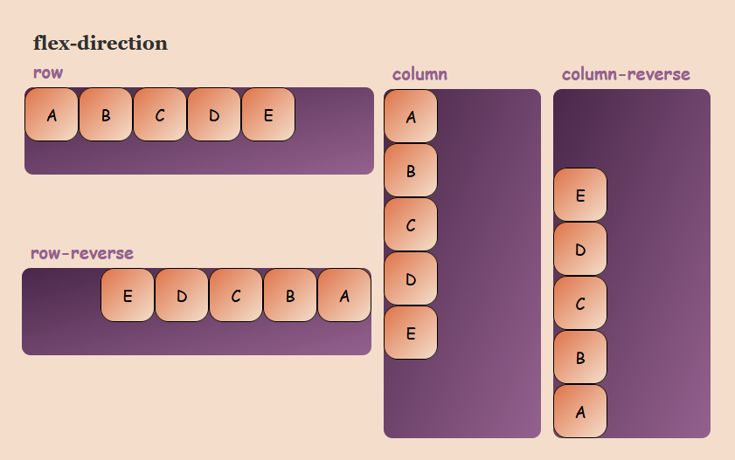
Basic Concepts structure UI
display: grid; → turns an element into a grid container.
grid-template-rows / grid-template-columns → define rows and columns.

Slide 5
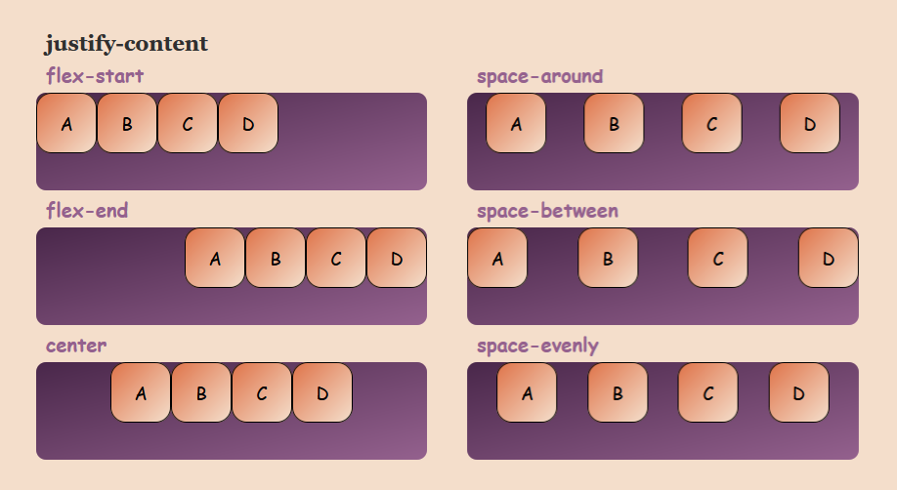
Basic Concepts structure UI
display: grid; → turns an element into a grid container.
grid-template-rows / grid-template-columns → define rows and columns.

Slide 6
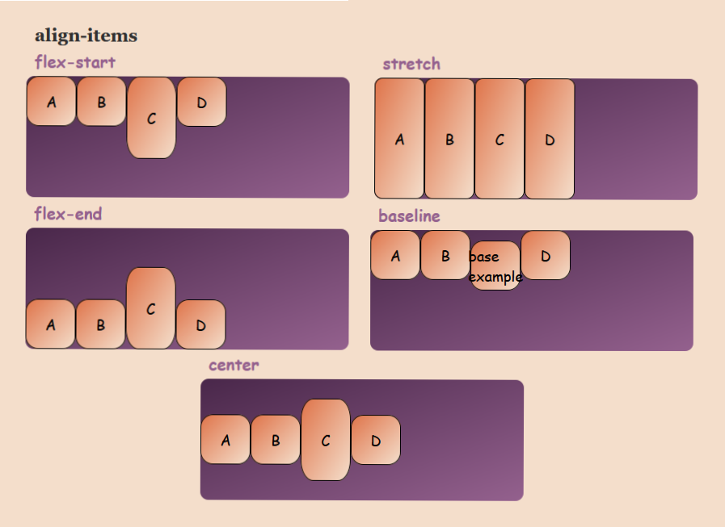
Basic Concepts structure UI
display: grid; → turns an element into a grid container.
grid-template-rows / grid-template-columns → define rows and columns.

Slide 7
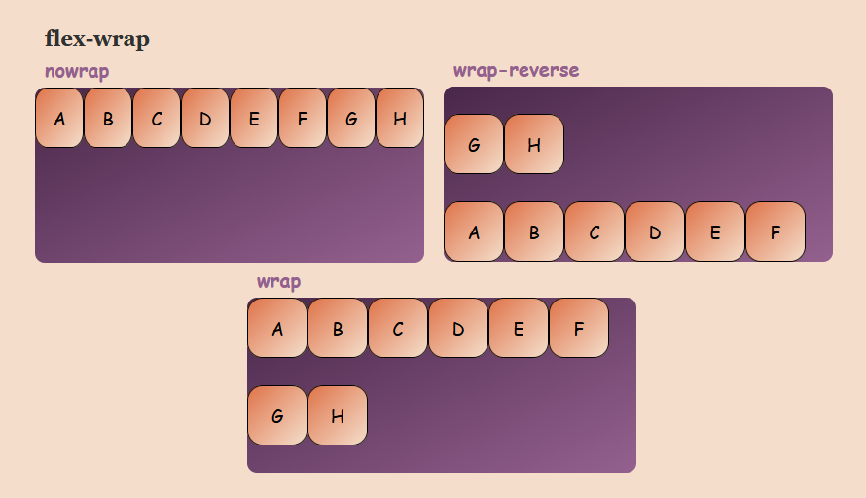
Basic Concepts structure UI
display: grid; → turns an element into a grid container.
grid-template-rows / grid-template-columns → define rows and columns.

Slide 8
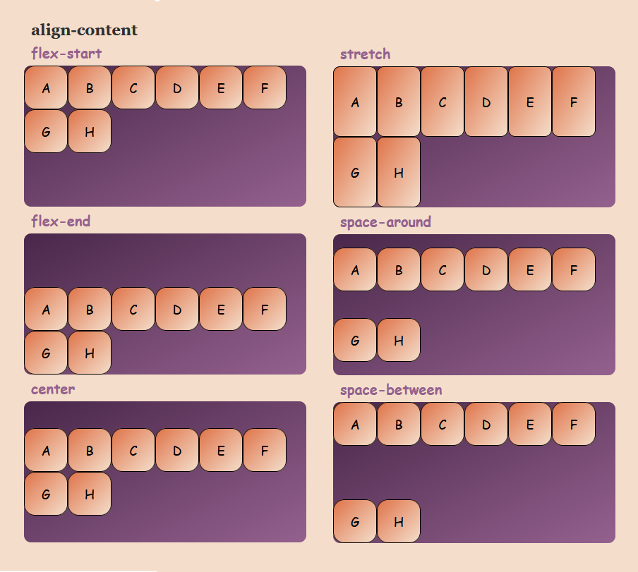
Basic Concepts structure UI
display: grid; → turns an element into a grid container.
grid-template-rows / grid-template-columns → define rows and columns.

Slide 9
Display code
.container {
display: grid;
grid-template-columns: 100px 100px 100px;
grid-template-rows: 100px 100px 100px ;
gap: 15px;
padding: 20px;
}
<div class="container">
<div class="box1">Box 1</div>
<div class="box2">Box 2</div>
<div class="box3">Box 3</div>
<div class="box4">Box 4</div>
<div class="box5">Box 5</div>
<div class="box6">Box 6</div>
</div>

Slide 10
Display code 2
box1 { background-color: lightcoral;
/* grid-row: 1/3; */
}
.box2 { background-color: lightblue;
/* grid-column: 1/4; */
}
.box3 { background-color: lightgreen; }
.box4 { background-color: lightgoldenrodyellow; }
.box5 { background-color: lightpink; }
.box6 { background-color: lightseagreen; }

Slide 11
Thank you

