Slide 1
Smart Meters in the UK
Amulya Jasti, Sitong Guo, Helen Liu

Slide 2
Smart meter rollout in the UK
national program to replace traditional energy meters with smart meters
offering more accurate information on energy usage and costs to both suppliers and households
Our thoughts?
better transparency on energy consumption + live information on energy → more accurate decisions about how much electricity to consume
This can reveal patterns like the price or income demands of elasticity, which can be used for peak pricing.

Slide 3
Data Sources and Methodology
Weave: open access data parquet on UK smart meters
EPN: a specific distributor in the UK (used for case study)
UKPN: UK power networks (geographic network boundaries)

Slide 4
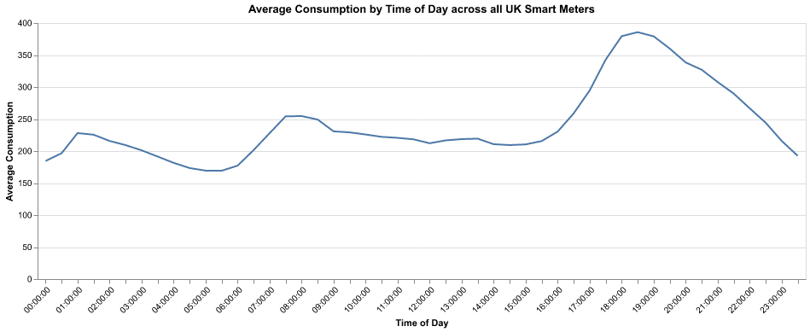
What we found
Trends:

Slide 5
Potential Improvements
Study percentiles of consumption

Slide 6
Policy Recommendation
Peak pricing during:

