Slide 1
Smart Meters in the UK
Amulya Jasti, Sitong Guo, Helen Liu

Slide 2
Smart meter rollout in the UK
national program to replace traditional energy meters with smart meters
offering more accurate information on energy usage and costs to both suppliers and households
Our thoughts?
better transparency on energy consumption + live information on energy → more accurate decisions about how much electricity to consume
This can reveal patterns like the price or income demands of elasticity, which can be used for peak pricing.

Slide 3
Data Sources and Methodology
Weave: open access data parquet on UK smart meters
EPN: a specific distributor in the UK (used for case study)
UKPN: UK power networks (geographic network boundaries)
Aggregate data by time of day
Aggregate data by substation
Observe variations temporally and geographically

Slide 4
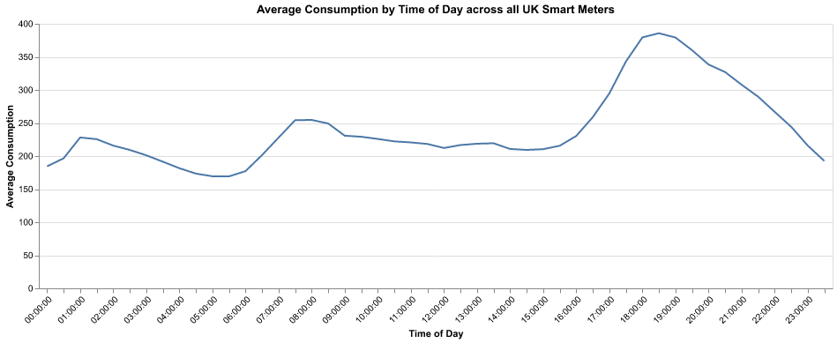
What we found
Trends:

Slide 5
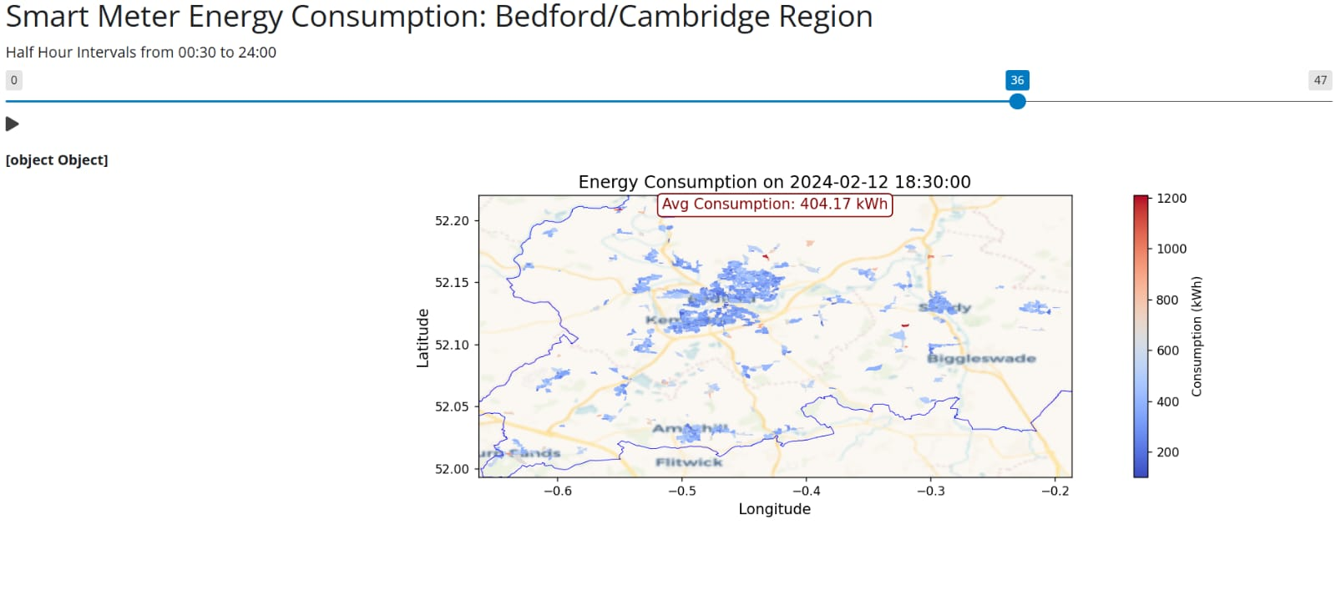
Same trends observed regionally

Slide 6
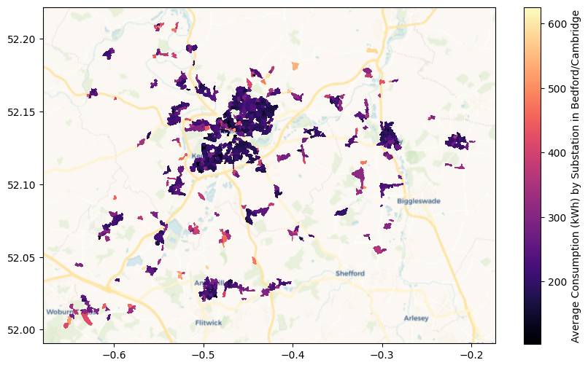
Average consumption by substation

Slide 7
Policy Recommendation
Peak pricing during:
5:00pm-9:00pm
Greater than 275 kwH
Current pricing: 24.50p per kWh
Recommended peak pricing: 30p per kWh (22.45% increase)
Price demand elasticity for electricity: −0.607 (for every 1 percent increase in electricity price, demand decreases by 0.607%) according to studies on Energy and Buildings.
Estimated to reduce demand during peak priced hours by 13.63%

Slide 8
Potential Improvements
Study percentiles of consumption
We can put additional pricing on the top X% of consumers during peak hours
Understand variability by day of the week
Should peak pricing be different on weekdays vs weekends?
Add demographic variability, i.e. income, to study various consumption rates
We can better understand where more people are consuming and do income-based pricing

